Slide 1
Comparitive study of
SAN,NAS,DAS
Sanika Shah -3265
Sumit Sethi-3266
Pratik Shinde-3267
Neeraj Wagh-3276

Slide 2
DAS-Direct Attached Storage
Direct-attached storage (DAS) is digital storage directly attached to the computer accessing it, as opposed to storage accessed over a computer network.
Examples of DAS include hard drives, optical disc drives, and storage on external drives
The main protocols used for DAS connections are ATA, SATA, SCSI, USB, USB 3.0 etc.

Slide 3
In the past, direct-attached storage was often criticized as an inefficient way to manage enterprise storage because DAS storage can't be shared and it does not facilitate failover should the server crash. As virtualization has become mainstream, however, the advantages that DAS offers are once again gaining popularity.
Using DAS is very easy. You simply save files as usual. Your operating system will allow you to view, rename, delete and perform other operations on the files on your DAS.

Slide 4
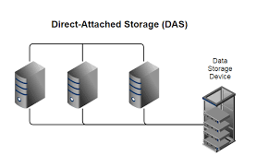

Slide 5
NAS- Network Attached Storage
Network-attached storage (NAS) is a type of dedicated file storage device that provides local-area network local area network (LAN) nodes with file-based shared storage through a standard Ethernet connection.

Slide 6
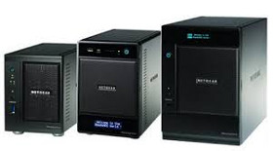
NAS devices, which typically do not have a keyboard or display, are configured and managed with a browser-based utility program. Each NAS resides on the LAN as an independent network node and has its own IP address.

Slide 7
A full-featured operating system is not needed on a NAS device, so often a stripped-down operating system is used. For example, FreeNAS or NAS4Free, both open source NAS solutions designed for commodity PC hardware, are implemented as a stripped-down version of FreeBSD.
NAS uses file-based protocols such as NFS (popular on UNIX systems), SMB/CIFS (Server Message Block/Common Internet File System) (used with MS Windows systems), AFP (used with Apple Macintosh computers). NAS units rarely limit clients to a single protocol.

Slide 8
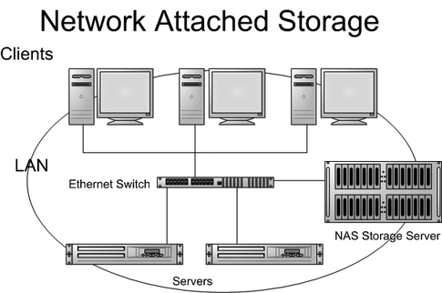

Slide 9
An important benefit of NAS is its ability to provide multiple clients on the network with access to the same files. Prior to NAS, enterprises typically had hundreds or even thousands of discrete file servers that had to be separately configured and maintained.
Many NAS vendors partner with cloud storage providers to provide customers with an extra layer of redundancy for backing up files.

Slide 10
File system Vs Block level Storage

Slide 11
File level storage is seen and deployed in Network Attached Storage (NAS) systems. Block level storage is seen and deployed in Storage Area Network (SAN) storage.
File is typically structured in a file system, which is nothing more than a hierarchical way of organizing files so that an individual file can be located by describing the path to that file. We know that certain attributes -- information that might describe a file and its contents, such as its owner, who can access the file, and its size -- are conveniently stored as metadata in a file system. We also know that network-attached storage (NAS) is the best way to share files securely among users on a network.

Slide 12
In block level storage, raw volumes of storage are created and each block can be controlled as an individual hard drive. These Blocks are controlled by server based operating systems and each block can be individually formatted with the required file system.
Block is a chunk of data It has an address, and the application retrieves a block by making a SCSI call to that address. It is a very microscopic way of controlling storage. How the blocks are combined or accessed is left up to the application. There is no storage-side metadata associated with the block, except for the address.

Slide 13
SAN-Storage Area Network
SAN (storage area network) is a high-speed network of storage devices that also connects those storage devices with servers. It provides block-level storage that can be accessed by the applications running on any networked servers. SAN storage devices can include tape libraries and disk-based devices, like RAID hardware.

Slide 14
A SAN moves storage resources off the common user network and reorganizes them into an independent, high-performance network. This allows each server to access shared storage as if it were a drive directly attached to the server. When a host wants to access a storage device on the SAN, it sends out a block-based access request for the storage device.
A SAN does not provide file abstraction, only block-level operations. However, file systems built on top of SANs do provide file-level access, and are known as shared-disk file systems.

Slide 15
Fiber Channel (FC):
Storage and servers are connected via a high-speed network of interconnected fiber channel switches. This is used for mission-critical applications where uninterrupted data access is required.
Internet Small Computer System Interface (iSCSI) Protocol:
This infrastructure gives the flexibility of a low-cost IP network.

Slide 16
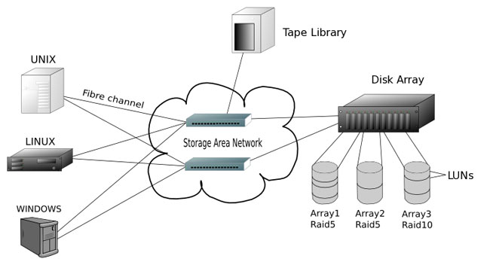

Slide 17
Comparative study of SAN
NAS andDAS

Slide 18
In the early days of computing, DAS was the only type of storage available. In fact, the term direct attached storage didn't come into use until much later when people needed a way to differentiate between traditional storage and SAN and NAS devices.
NAS (network attached storage) offers file-level storage for end users that are connected to a network. The advantage of NAS over DAS is that it simplifies file sharing among multiple users while potentially offering faster performance than a traditional file server.

Slide 19
SAN (storage area network) refers to a network of storage devices that provides block-level storage for servers in a data center. For large organizations with many servers, SAN offers better performance and flexibility than DAS, along with potential cost savings, although SAN hardware can be costly.
Many SAN and NAS devices can also be used as DAS devices. The difference lies in whether they are attached directly to a server or attached to a network via routers and switches.

Slide 20
DAS is a block device from a disk which is physically [directly] attached to the host machine.
You must place a filesystem upon it before it can be used.
Technologies to do this include IDE, SCSI, SATA, etc.
SAN is a block device which is delivered over the network.
Like DAS you must still place a filesystem upon it before it can used.
Technologies to do this include FibreChannel, iSCSI, FoE, etc.
NAS is a filesystem delivered over the network.
It is ready to mount and use.
Technologies to do this include NFS, CIFS, AFS, etc.

Slide 21
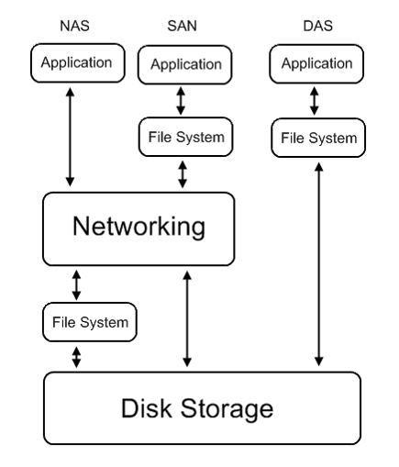

Slide 22
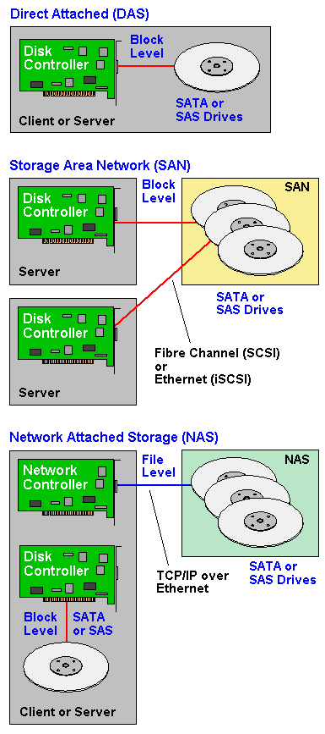

Slide 23
Thank you

