Slide 1

DiGITAL IMAGE PROCESSING
01 COHDSE221F-004 T. A. A. Sudaraka
02 COHDSE221F-015 K. Sanuga Lakdinu Kuruppu
03 COHDSE221F-021 A.D.C. Janaka
04 COHDSE221F-023 (Group Leader) D.D. Thimbiripalage
05 COHDSE221F-034 P.H.M.W. Senevirathna
Assesment -04

Slide 2

Agenda
Introduction
Problems Of early methods
How to overcome
Areas of growth
mathematical concepts
Summary

Slide 3

Introduction
The article presents a new criterion for multilevel thresholding in image processing, which considers two factors.
the discrepancy between the thresholder and original images.
The number of bits required to represent the threshold image.
*provides a review of the conventional maximum entropy criterion and introduces the new maximum correlation criterion for bilevel thresholding.
.

Slide 4

Problems of early methods
Two main approaches to determining threshold values are described
parametric approach→ which is computationally complex and often results in poor performance
the nonparametric approach → which is more accurate but requires supervision and large computational time.

Slide 5
How to overcome
To overcome these problems, the authors propose a new criterion for multilevel thresholding that considers the discrepancy between the thresholder and original images and the number of bits required to represent the thresholder image.
A cost function is proposed that takes both factors into account and can be minimized to automatically determine the classification number and threshold values.

Slide 6
Areas of growth
Image acquisition
Pre-processing
Histogram calculation
Threshold determination
Image segmentation
Post-processing

Slide 7

Now we can move on to the mathematical concepts which are used in our scenario…

Slide 8
The Maximum Entropy Criterion (MEC)
*The MEC is based on the principle of maximizing the information content or entropy of the binary image resulting from thresholding with a given threshold value.
Main scenarios those are used in this core concept…
It computes the probabilities of occurrence of the two classes of pixels, mean intensity values, and variances of the two classes for each possible threshold value.
he threshold value that maximizes the entropy is selected as the optimal threshold value.
The MEC is based on information theory and probability concepts.
*The MEC is the threshold value that maximizes the entropy of the binary image.

Slide 9
The Maximum Correlation Criterion (MCC)
*The MCC is based on the principle of maximizing the correlation between the binary image and the original image.
Main scenarios those are used in this core concept…
This algorithm computes the mean and variance of the pixel intensity values for each possible threshold value.
Uses these values to compute the correlation coefficient between the binary image and the original image.
The threshold value that maximizes the correlation coefficient is selected as the optimal threshold value.
*The MCC is based on statistical concepts such as correlation and probability, and is a widely used technique in digital image processing for threshold selection.

Slide 10
The Automatic Thresholding Criterion (ATC)
*mathematical concept used in digital image processing for automatically selecting an optimal threshold value for thresholding an image.
Uses a histogram-based approach to compute the probabilities of occurrence of the classes of pixels for each possible threshold value.
It then computes a measure of separability, such as the entropy or mutual information, for each threshold value
selects the threshold value that maximizes the measure of separability.
*The ATC is based on statistical measures and concepts such as separability, probability, and entropy, and is a widely used technique in digital image processing for threshold selection.

Slide 11
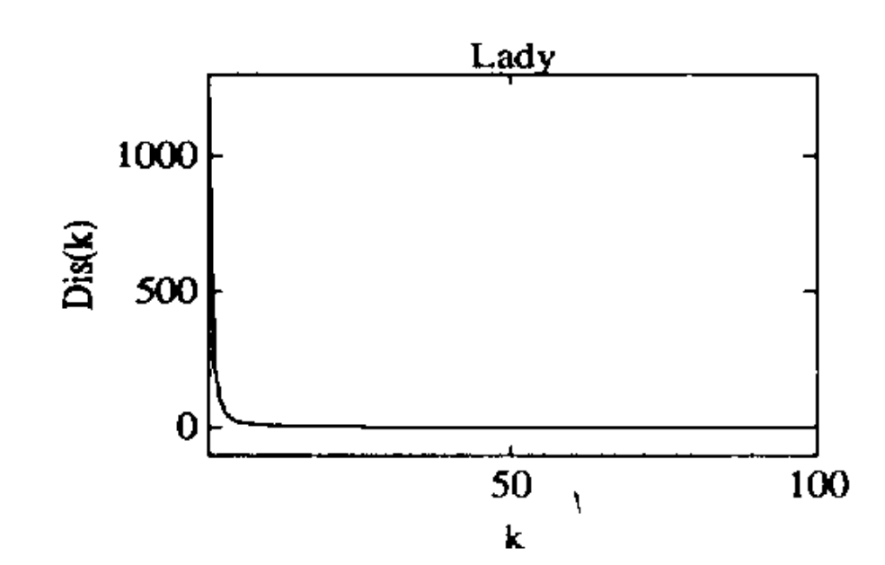
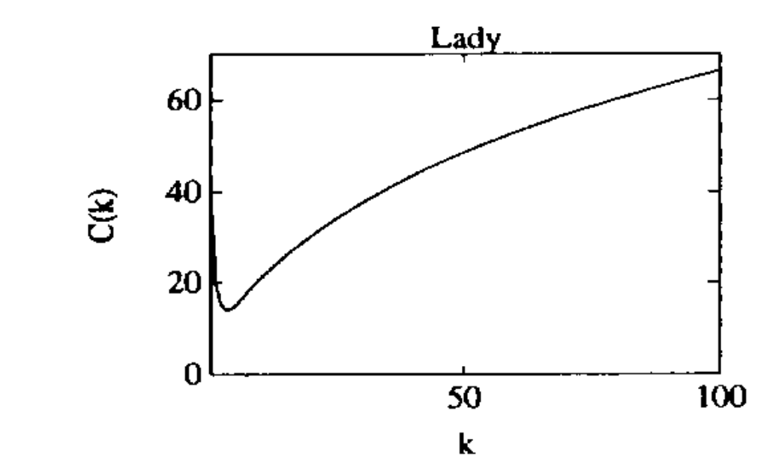
ATC CONT..
Difference between original image and threshold image function behavior against the classification number
Cost Function value behavior against the classification number.

Slide 12
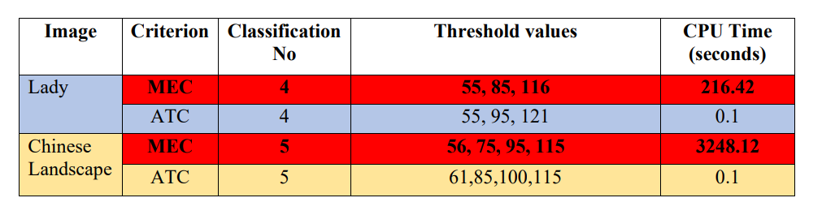
Summary
In summary, MEC, MCC, and ATC are three thresholding techniques in digital image processing that are based on different mathematical principles to select an optimal threshold value. Each technique has its advantages and disadvantages, and the choice of technique depends on the specific application and image characteristics.

Slide 13

Thank you

Slide 14

Task Delegation
Developing algorithms to understand the flow of control of the algorithm.
Software development in MATLAB (Multilevel thresholding in MEC).
COHDSE221F-004
Understanding the research paper and mathematics behind it.
Software development in MATLAB (Bilevel thresholding in MEC).
COHDSE221F-015

Slide 15
Task Delegation Cont..
Understanding the research paper and mathematics behind it.
Software development in MATLAB (Bilevel thresholding in MCC).
COHDSE221F-021
Developing algorithms to understand the flow of control of the algorithm.
Software development in MATLAB (Multilevel thresholding in MCC).
COHDSE221F-023

Slide 16

Task Delegation Cont..
Understanding the research paper and mathematics behind it.
Software development in MATLAB (Multilevel thresholding in MCC).
Preparing final report & presentation.
COHDSE221F-034

