Slide 1
Data Analysis Information retrieval (IR) perspective Lecture - 01
Md Zia Ullah
Post-doc
IRIT, CNRS
October 01, 2020

Slide 2
Outlines
Objectives
Information retrieval (IR) overview
IR system components
Pre-processing
Parsing, Tokenization, Stop-word, Indexing, etc.
Data representation
Linear features (TF, IDF, TF-IDF, etc.)
Non-linear features (Word2vec, BERT, etc.)
Dataset in IR
Practical session

Slide 3
Objectives
Understanding Information Retrieval (IR)
Learning IR Theory
Hands-on experience in data pre-processing and representation

Slide 4





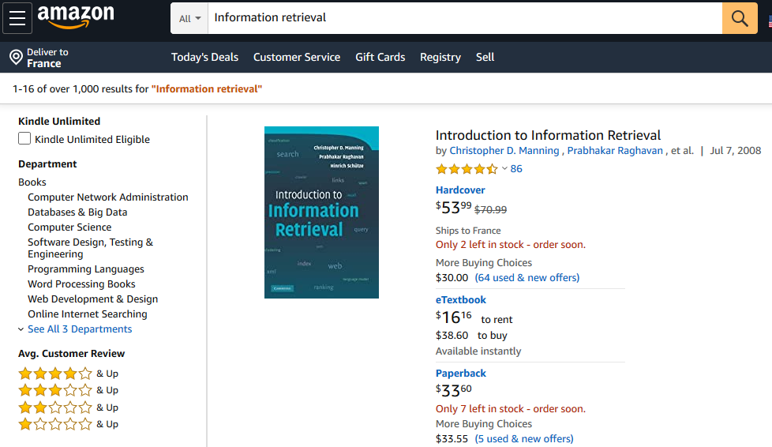
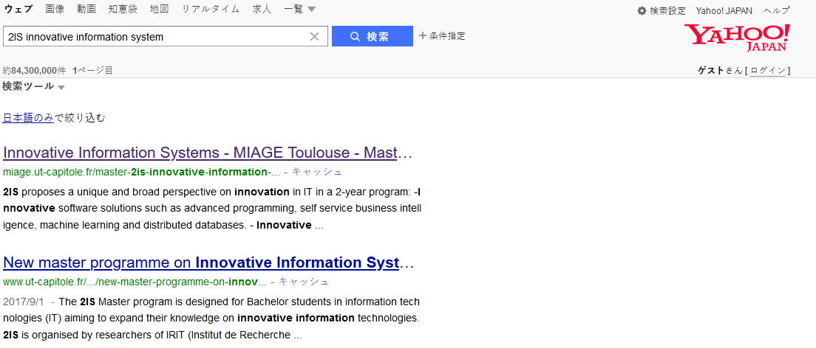
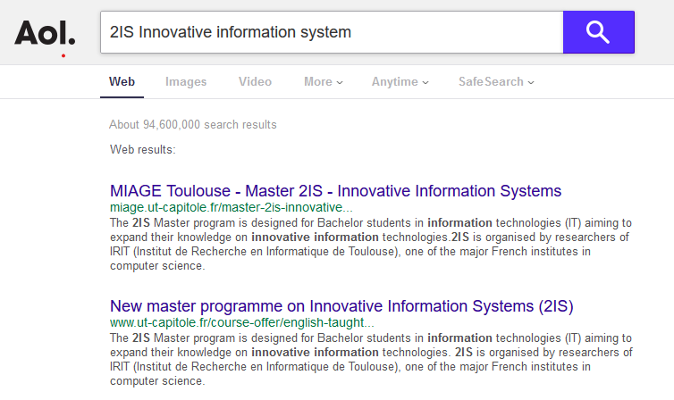
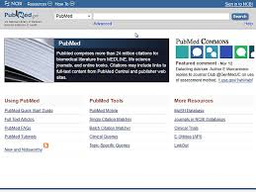
Information retrieval (IR) overview: Search Engine
Notes:
Many search engines on Internet developed by either company or organization
-- Commercial
-- Non-profit

Slide 5


Information retrieval (IR) overview: Search Scenario
Query
(2IS Innovative information system)
Web links
(Web pages)
Want to know about this program
?
Notes:
Submit a search query “2IS Innovative information system” to the search engine “Qwant”
Information needs: I want to know about this program, program duration, prospective, cost, scholarship, etc.

Slide 6
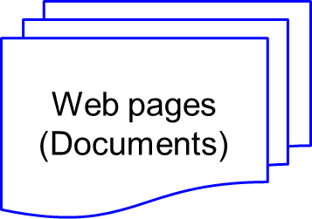

Information retrieval (IR) overview
Indexing
Pre-processing
Pre-processing
Index
Corpus
Matching and ranking models
Search Results
Query
Main-processing
Main-processing
Fig: Schematic diagram of IR system
Notes:
Typical schematic diagram of an IR system

Slide 7
Information retrieval (IR) overview
Indexing
Pre-processing
Index
Corpus
Matching and ranking models
Query
Main-processing
Search Results
Query Logs
Fig: Schematic diagram of IR system
Notes:
How query logs are stored? These logs are later used to extract valuable information for training a machine learning model and keyword research. Ads search

Slide 8
Information retrieval (IR) overview
Corpus
Training Data
(Query Logs)
Machine learning (i.e. Learning to Rank Model)
Index
Matching and ranking models
Search Results
Re-ranking
Query
Re-Ranked Results
Notes:
Machine learning in Search engine is to re-ranked the results.

Slide 9
Information retrieval (IR) overview
Training Data
(Query Logs)
Corpus
What is 2IS?
Index
Query performance prediction
Query understanding
Learning to rank?
Machine learning
Matching and Ranking models
Search Results
Query
Re-ranking
Re-Ranked Results
Data representation
Query suggestion
Query completion
Notes:
Research problems: Extracting efficient and effective features, Query completion, Query difficulty/performance prediction, and Learning to rank for re-ranking search results

Slide 10
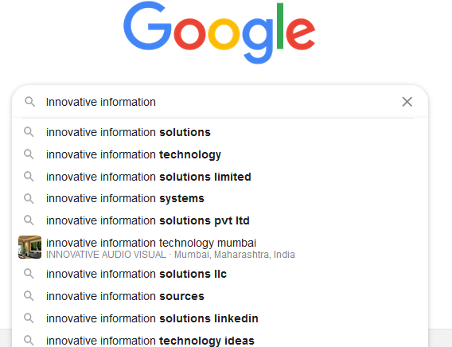
Important Problems
Query performance prediction
Query understanding
Query completion
Query suggestion
Data representation
Learning to rank
Notes:
We will work on these two problems.

Slide 11
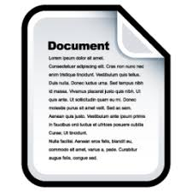
IR system components
Corpus
Documents
Indexing
Pre-processing
Tokenization
Stemming
Stop word Filtering
Inverted Indexing
Inverted Index
Search
User
Ranking Documents
Main-processing
Matching documents
representation
Search Results
Query

Slide 12
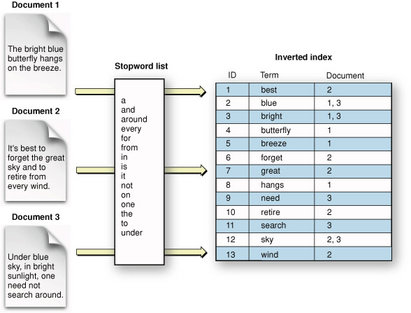
Pre-processing
Tokenization
Stemming
Stopword
Indexing
Notes:
Pre-processing: From corpus/Document, Tokenization, Stemming, Stop word Filtering, Inverted Indexing

Slide 13
Main-processing
Matching
Representation
Ranking
Results
Notes:
Pre-processing: From corpus/Document, Tokenization, Stemming, Stop word Filtering, Inverted Indexing

Slide 14
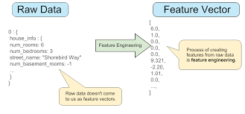
Data representation
Dimension reduction
Feature extraction
Linear features
DF
IDF
TF
TF-IDF
Non-linear features
Word2vec
BERT

Slide 15

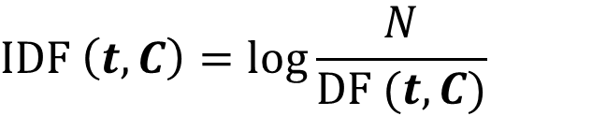
Linear features
DF (Document frequency): The number of documents in the corpus C contains a term t . For example, DF(t, C) = $|\left\{D ε C :t ε D\right\} |$
IDF (Inverse Document frequency):
$$IDF \left(t, C\right)=\log{\frac{N}{DF (t, C)}}$$
Web pages (Documents)
Term
$=$ $\log{ \frac{N}{|\left\{D ε C :t ε D\right\} |}}$
Here, N is the total number of documents in the corpus

Slide 16
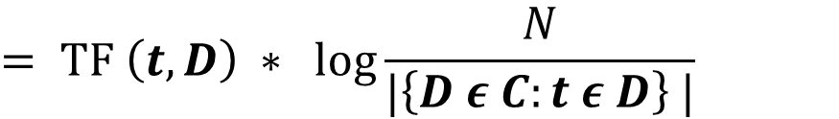
Linear features
TF (Term frequency): The number of times a term t occurs in a document D. For example, TF(t, D)
Term
Web pages (Documents)
TF-IDF (Term frequency-Inverse Document Frequency)
$$TF−IDF \left(t, D\right)=TF \left(t, D\right)∗IDF(t, C)$$
$$= TF \left(t, D\right) ∗ \log{\frac{N}{|\left\{D ε C:t ε D\right\} |}}$$

Slide 17
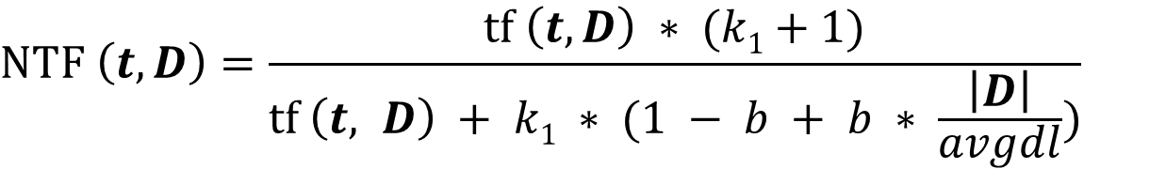
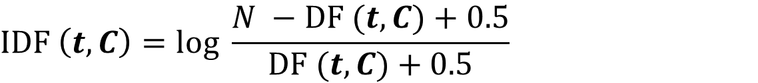
Linear features
BM25 (Best match 25)
$$BM25 \left(t, D\right)=NTF \left(t, D\right)∗IDF (t, C)$$
$$NTF \left(t, D\right)=\frac{tf \left(t, D\right) ∗ (k1+1)}{tf \left(t, D\right) + k1 ∗ (1 − b + b ∗ \frac{\left|D\right|}{avgdl})}$$
$$IDF \left(t, C\right)=\log{\frac{N −DF (t, C)+0.5}{DF (t, C)+0.5}}$$
Here, k₁ 𝝐 [1.2 ~ 2.0] and b = 0.75 are two free parameters

Slide 18

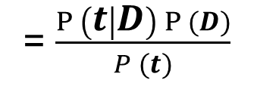
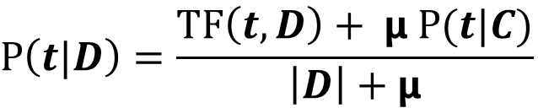
Linear features
LMDIR (Language model with Dirichlet smoothing)
$$LMDIR \left(t, D\right)=P (D|t)$$
= $\frac{P \left(t | D\right) P (D)}{P (t)}$
$$≅P\left(t | D\right) P(D)$$
$$P\left(t|D\right)=\frac{TF\left(t, D\right)+ μ P(t|C)}{\left|D\right|+μ}$$
Term
Web pages (Documents)
Here, $μ$ is the parameter which value ranges from 500 ~ 5000

Slide 19
Dataset in IR
Webpage or Document
TREC Robust
GOV2
WT10G
Clueweb12
MS Marco
Web pages (Documents)
Corpus
Topics
Web track
Terabyte track
Million query track
Robust track
Deep learning track
Queries
Relevance judgments
Notes:
Data collection: Document, collection of document (Corpus), and Queries. How can we search the query in the corpus?

Slide 20
Practical session
Pre-processing pipeline
Document parsing
Document indexing
Feature extraction
Linear features
Non-linear features
Word2Vec
https://www.kaggle.com/c/word2vec-nlp-tutorial
BERT
http://jalammar.github.io/illustrated-bert/

Slide 21
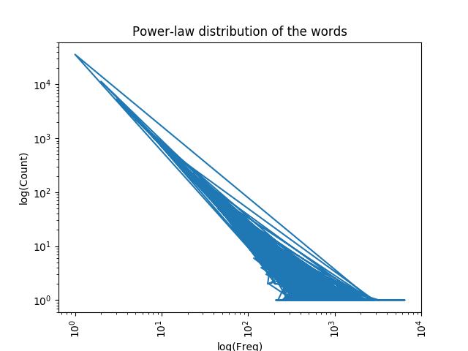
Practical session
Drawing a power law distribution of words for a corpus
Count the word frequency and plot frequency vs count

Slide 22
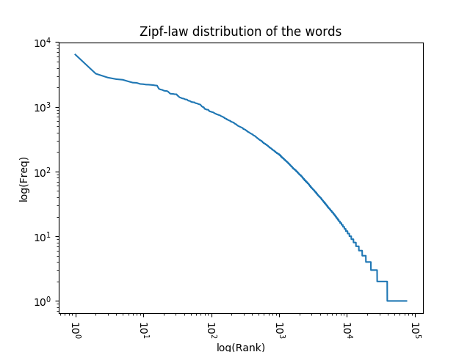
Practical session
Drawing a zipf law distribution of words for a corpus
Rank the words based on frequency and plot rank vs. frequency
Frequency is the reciprocal of the rank

