Slide 1
Data Analysis Lecture – 02 (01)
Md Zia Ullah
Post-doc
IRIT, CNRS
October 21, 2020

Slide 2
Outlines
Objectives
Data Visualization
Correlation analysis
Statistical significance

Slide 3
Objectives
Exploring different data visualization methods
Understanding the strength/degree of relationship between variables
Correlation analysis
Understanding statistical significance

Slide 4
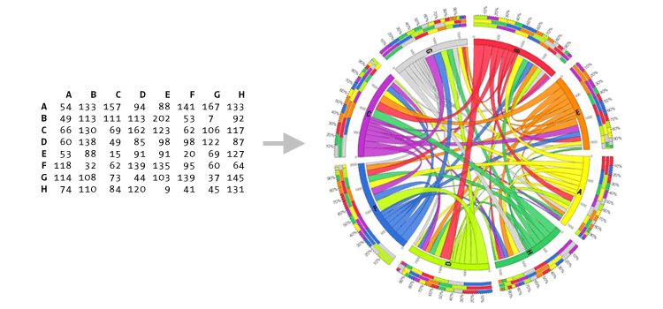
Data Visualization
Data visualization refers to the techniques used to communicate data or information by encoding it as visual objects (e.g., points, lines or bars) contained in graphics.
The goal is to communicate information clearly and efficiently to users. It is one of the steps in data analysis or data science.

Slide 5
Data Visualization
Visualization types
Scatter plot
Bar plot
Boxplot
Heat map
Correlogram plot

Slide 6
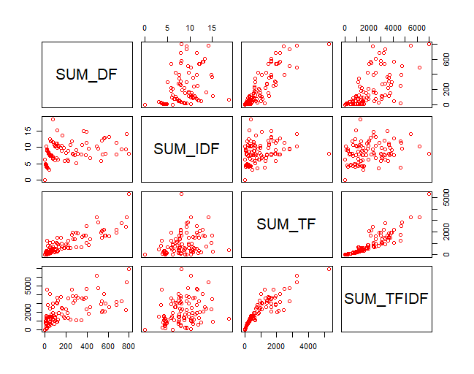
Data Visualization
Scatter plot
Shows how much one variable is affected by another
Visualizing data easily and for simple data inspection

Slide 7
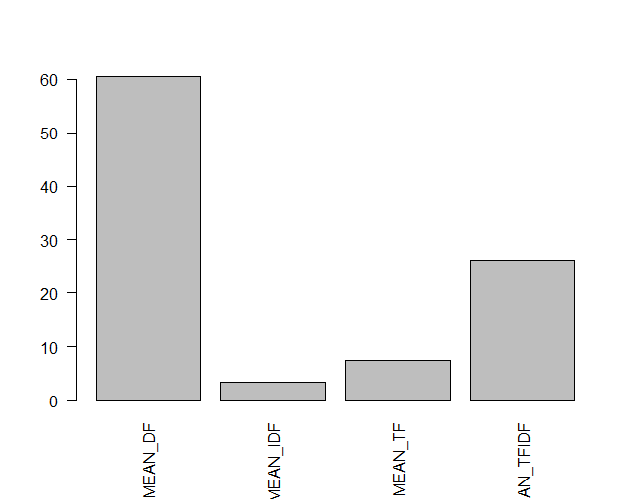
Data Visualization
Bar plot
Bar Plots are suitable for showing comparison between cumulative statistics across several groups.

Slide 8
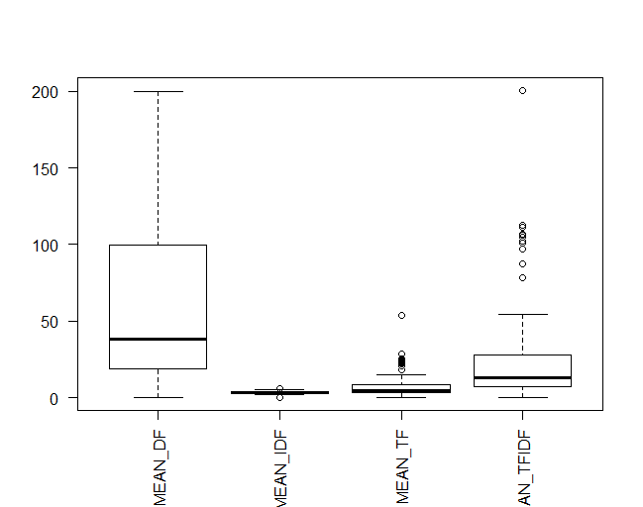
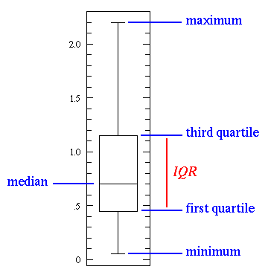
Data Visualization
Box plot
Box plot shows 5 statistically significant numbers-
the minimum, the 25th percentile, the median, the 75th percentile and the maximum.
It is thus useful for visualizing the spread of the data

Slide 9
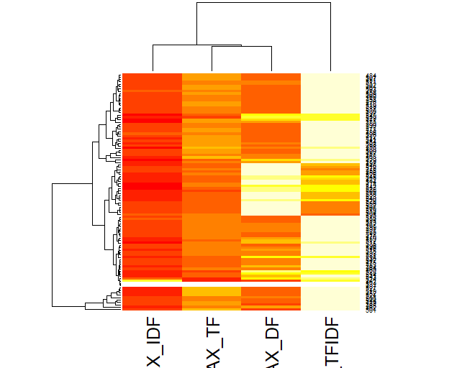
Data Visualization
Heat map
enables to do exploratory data analysis with two dimensions as the axes and the third dimension shown by intensity of color
Notes:
Dendogram

Slide 10
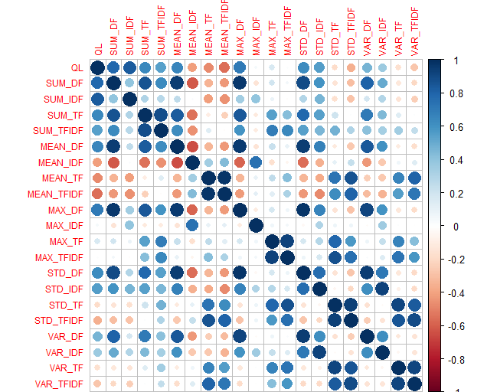
Data Visualization
Correlogram plot
A graph of correlation matrix.
Very useful to highlight the most correlated variables

Slide 11
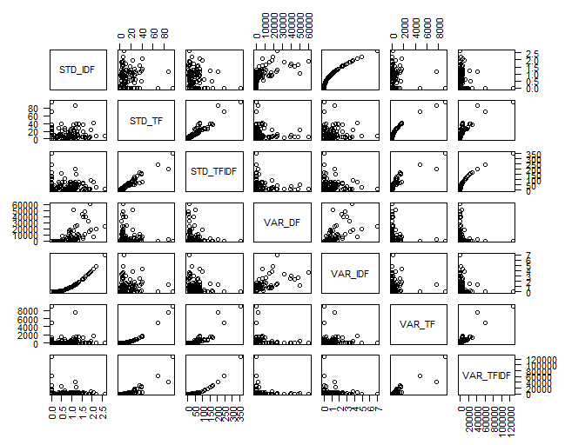
Correlation analysis
Correlation is a statistical technique used to determine the degree/strength of relationship between two variables.

Slide 12
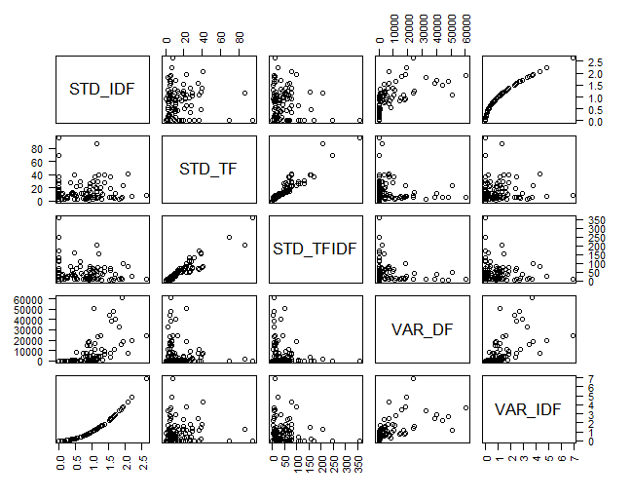
Types of correlation
The pattern of data indicatives the type of relationship.
positive relationship
negative relationship
no relationship

Slide 13
Positive relationship

Slide 14
Negative relationship

Slide 15
No relation

Slide 16
Correlation coefficient
A number which denotes the degree of relationship.
Range of value between -1 and -1
Sign refers to direction
Positive relationship
Negative relationship
strong
intermediate
weak
weak
intermediate
strong
-1
-0.75
-0.25
0
0.25
0.75
1

Slide 17
Types of correlation coefficient
Pearson's correlation
Spearman rank correlation
Kendal Tau-b correlation

Slide 18
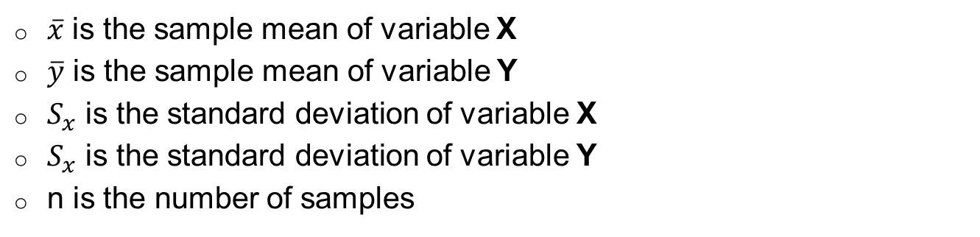
Pearson’s correlation coefficient
Measures the nature and strength between two variables X and Y of the quantitative type
$\overline{x}$ is the sample mean of variable X
$\overline{y}$ is the sample mean of variable Y
$S_{x}$ is the standard deviation of variable X
$S_{x}$ is the standard deviation of variable Y
n is the number of samples
Notes:
Variance
Co-variance
Correlation coefficient

Slide 19
Spearman rank correlation coefficient
Makes use of the two sets of ranks that may be assigned to the sample values of X and Y.
1. Rank the values of X from 1 to n
2. Rank the values of Y from 1 to n
3. Compute the value of d_{i} for each pair of observation
by subtracting the rank of Y_{i} from the rank of X_{i}
4. Square each d_{i} and compute ∑d_{i}²

Slide 20
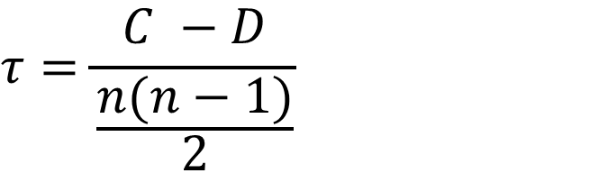
Kendall Tau correlation coefficient
Compares the rank orders between the variables of X and Y.
Kendall rank correlation coefficient:
$$τ=\frac{C −D}{\frac{n(n−1)}{2}}$$
Don’t consider the tired pairs
C is the number of concordant pairs
D is the number of discordant pairs
N is the number of samples
Notes:
Fig: collected

Slide 21
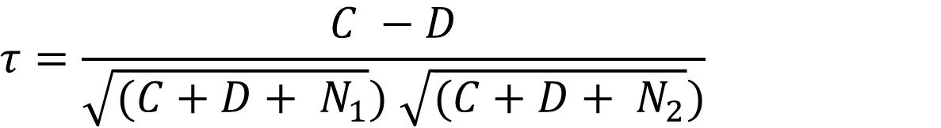
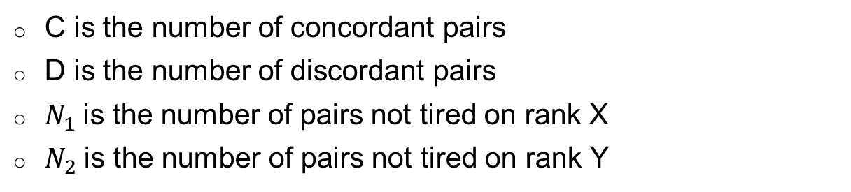
Kendall tau-b correlation coefficient
Kendall tau-b:
$$τ=\frac{C −D}{\sqrt{{(C+D+ N}_{1}}) \sqrt{{(C+D+ N}_{2}})}$$
C is the number of concordant pairs
D is the number of discordant pairs
$N_{1}$is the number of pairs not tired on rank X
$N_{2}$is the number of pairs not tired on rank Y
Notes:
Fig: collected

Slide 22
Testing correlations
So you have a correlation. Now what?
In terms of magnitude, how big is big?
Small correlations in large samples are “big.”
Large correlations in small samples aren’t always “big.”
Depends upon the magnitude of the correlation coefficient
The size of your sample.

Slide 23
Testing correlation
Population parameter = r
Null hypothesis H₀: r = 0
Test of linear independence
What would a true null mean here?
What would a false null mean here?
Alternative hypothesis (H₁) r ≠ 0
Two-tailed

Slide 24
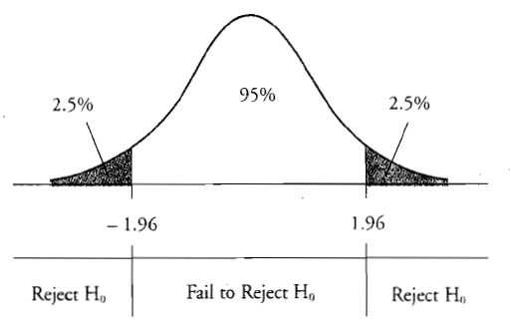
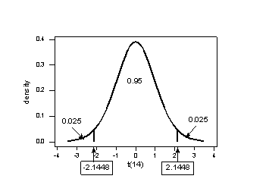
Testing correlation
Population parameter = r
Null hypothesis H₀: r = 0
Alternative hypothesis (H₁) r ≠ 0
Two-tailed
Notes:
STD_IDF has high correlation than VAR_IDF

Slide 25
Significance testing
Converting r to t-value:
where degree of freedom, DF = N-2

Slide 26
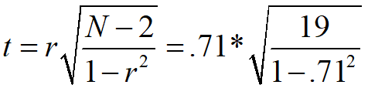
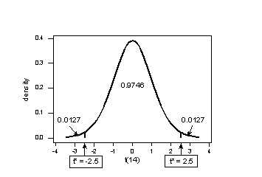
Significance testing
r = 0.71
N = 21
t-value
t-critical value (19)
for significance level 0.01 = 2.528
Since 4.38 is larger than 2.09
reject null hypothesis, r = 0.

Slide 27
Significance testing
From t-value to p-value:
p-value = 2*pt(-abs(t),df=N-1)
pt() is the distribution function

Slide 28
R scripts
Visualization
Correlation analysis
Statistical significance

