Slide 1
Heart Disease Data Analysis
Exploratory Data Analysis (EDA)
-By Sanika Sarang

Slide 2
Introduction:
Objective: Exploring the heart disease dataset to uncover patterns, trends, and relationships between different health conditions and the likelihood of heart disease. The analysis aims to identify key factors influencing heart disease to provide actionable insights for health professionals and policymakers.
Dataset Overview:
The dataset consists of 22 health-related features collected from individuals, including:
BMI (Body Mass Index): Indicator of body fat.
Mental Health Days (MentHlth): Number of days an individual reports poor mental health.
Physical Health Days (PhysHlth): Number of days an individual reports poor physical health.
Lifestyle Factors: Smoking habits, physical activity, alcohol consumption, etc.
Medical Conditions: Presence of High Blood Pressure, High Cholesterol, Diabetes, Stroke, and more.
Demographic Features: Age, Sex, Education, and Income levels

Slide 3
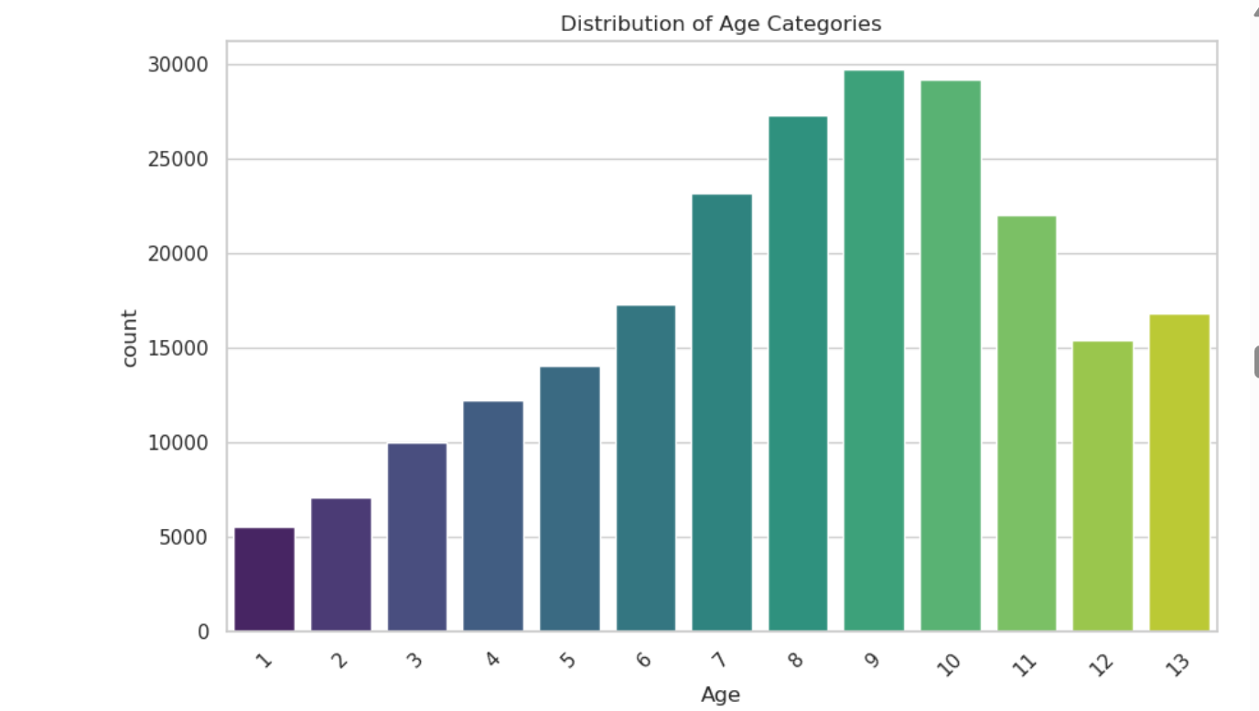
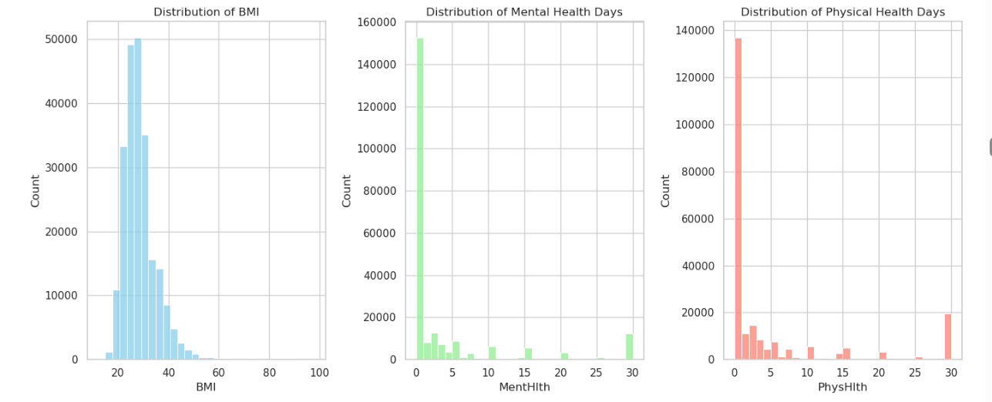
Univariate Analysis:
Examine Distributions of Individual Variables
Univariate Analysis (Numerical)
BMI Distribution: Most BMI values fall within a healthy range.
Mental Health Days (MentHlth): A significant portion of individuals reported few to no poor mental health days.
Physical Health Days (PhysHlth): Similar pattern to mental health, with many reporting good physical health.
Univariate Analysis (Categorical)
Age Distribution: Most data points belong to older age categories. [Age:7-11]
Health Conditions Prevalence: High Blood Pressure (HighBP), High Cholesterol (HighChol), and Smoking are common conditions.

Slide 4
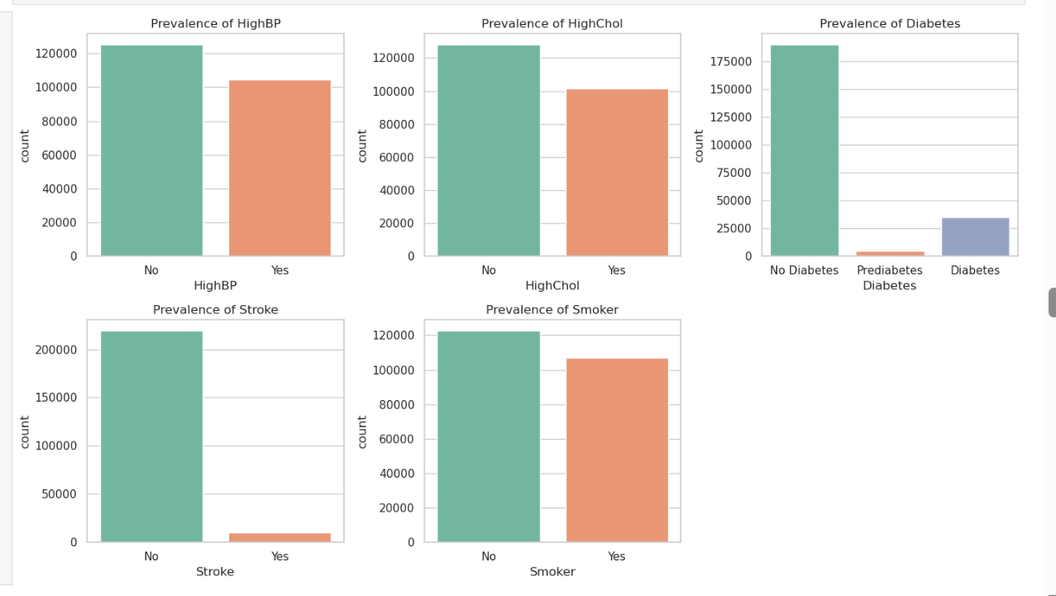
Univariate Analysis:
Investigate Prevalence of Health Conditions
High Blood Pressure (HighBP): A bar chart to show the proportion of individuals with and without high blood pressure. This condition is a key contributor to heart disease.
High Cholesterol (HighChol): A bar chart visualizing the prevalence of high cholesterol among the population. High cholesterol levels can increase the risk of heart disease.
Other Health Conditions:
Diabetes: Categorize individuals as no diabetes, prediabetes, or diabetes.
Stroke: Show the proportion of individuals who have suffered a stroke.
Smoker: Visualize how smoking habits are distributed in the population.

Slide 5
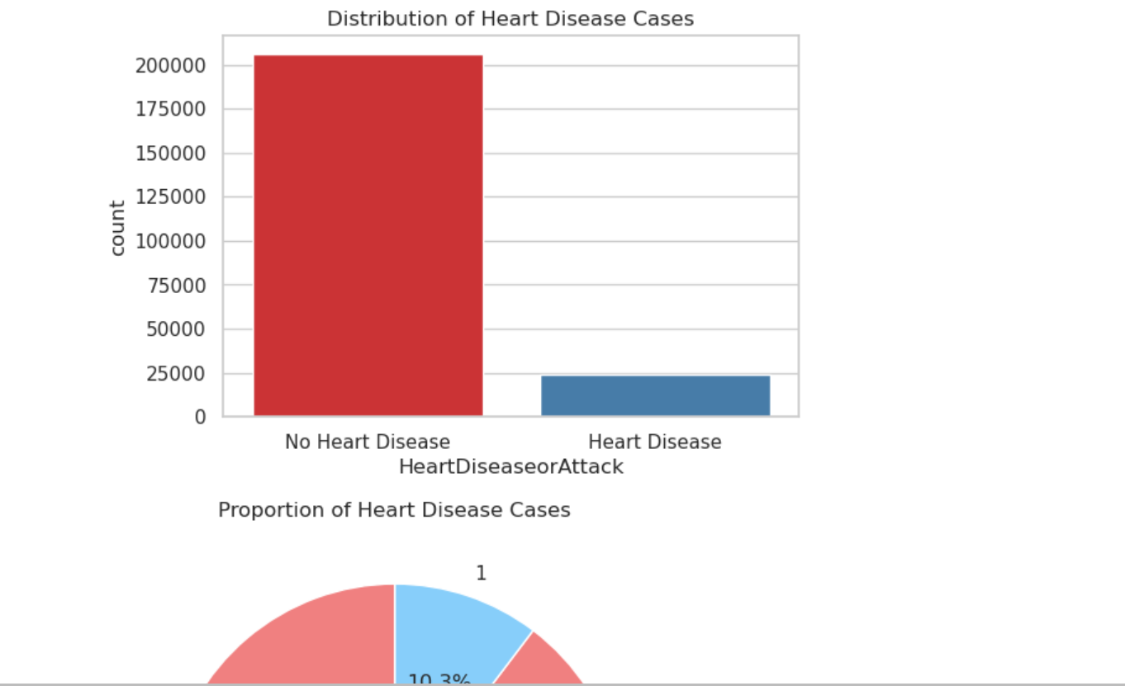
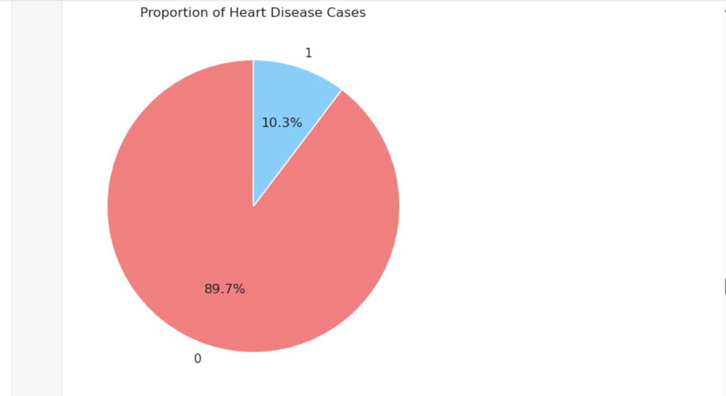
Univariate Analysis:
Analyze Distribution of Heart Disease (Target Variable)
Heart Disease Cases: Visualize the number of individuals who have experienced heart disease or a heart attack vs. those who haven't.
This is crucial to understanding the dataset's imbalance and to observe how prevalent heart disease is in the population.

Slide 6
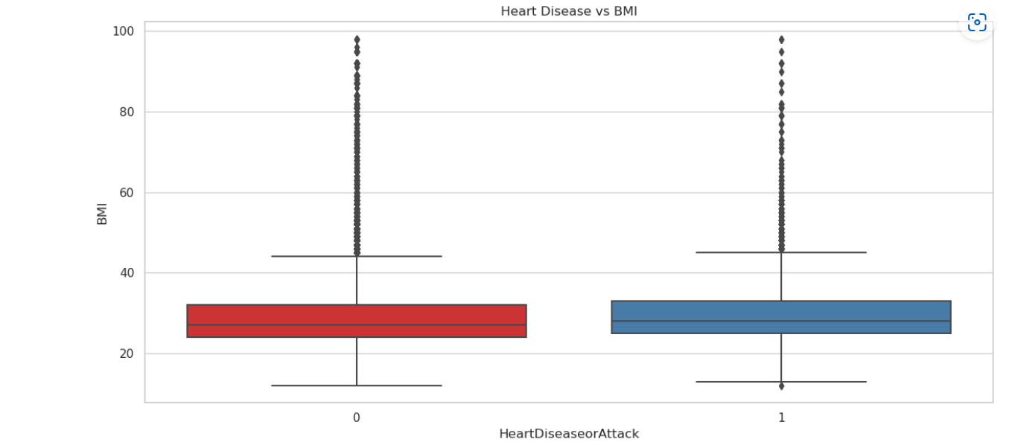
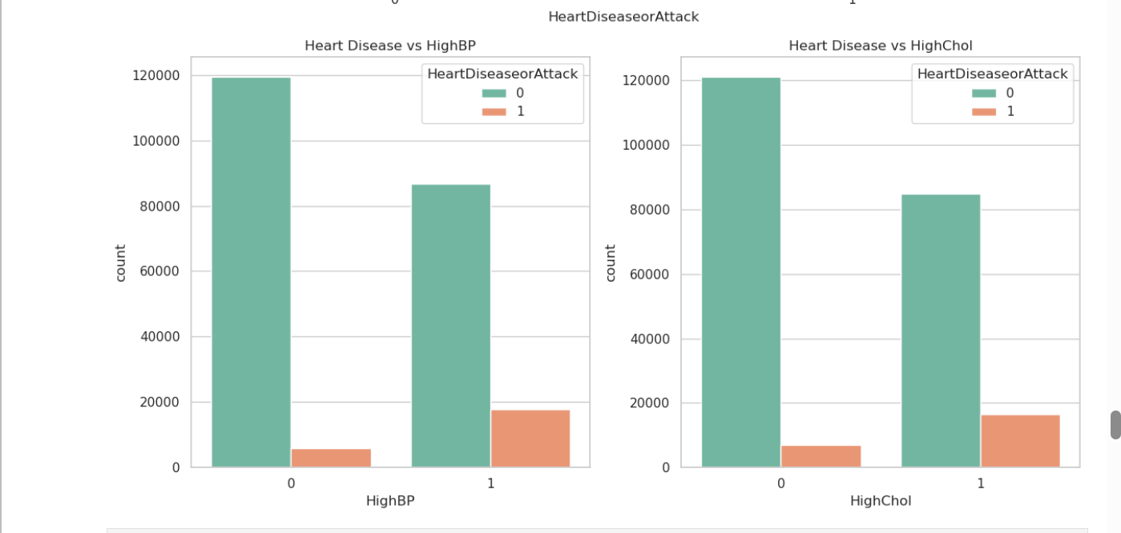
Bivariate Analysis:
Bivariate Analysis - Heart Disease vs BMI
Individuals with higher BMI seem to have a slightly higher risk of heart disease, but the difference is not extremely significant.
Bivariate Analysis - Health Conditions
Stronger association between conditions like HighBP and HighChol with heart disease.
Smokers and diabetic patients also show a higher prevalence of heart disease.

Slide 7
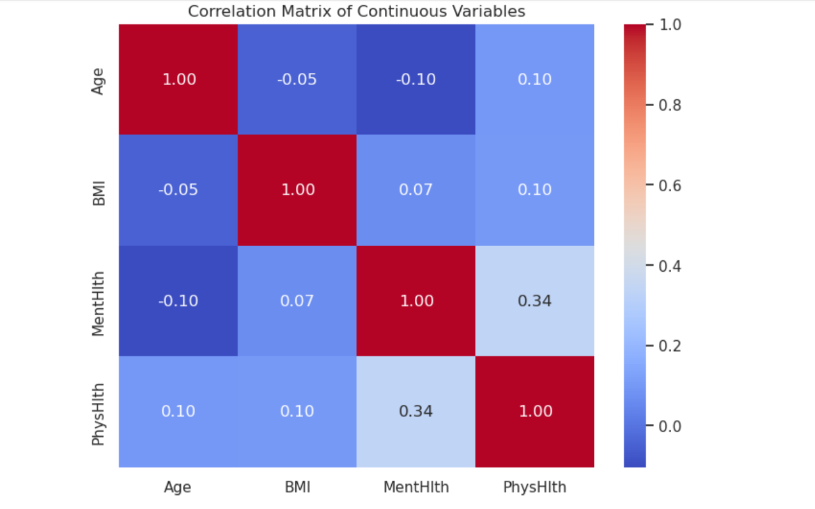
Bivariate Analysis:
Correlation Between Features:
Weak Correlations: The correlation matrix shows weak linear relationships between variables like BMI, MentHlth (mental health days), PhysHlth (physical health days), and Age. This indicates that these variables don't have strong linear dependencies on one another, meaning changes in one feature don't strongly predict changes in another.
No single feature shows a dominant correlation with heart disease, suggesting that heart disease may be influenced by a combination of factors.
Mental and Physical Health Days: A moderate positive correlation between MentHlth and PhysHlth suggests that individuals with more mental health struggles tend to also report poorer physical health, which could be indicative of a holistic impact on well-being.

Slide 8
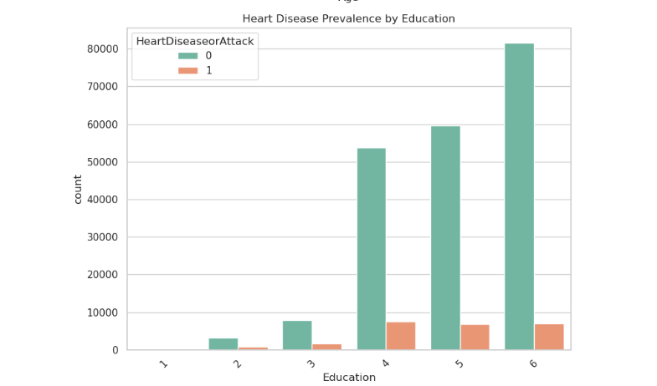
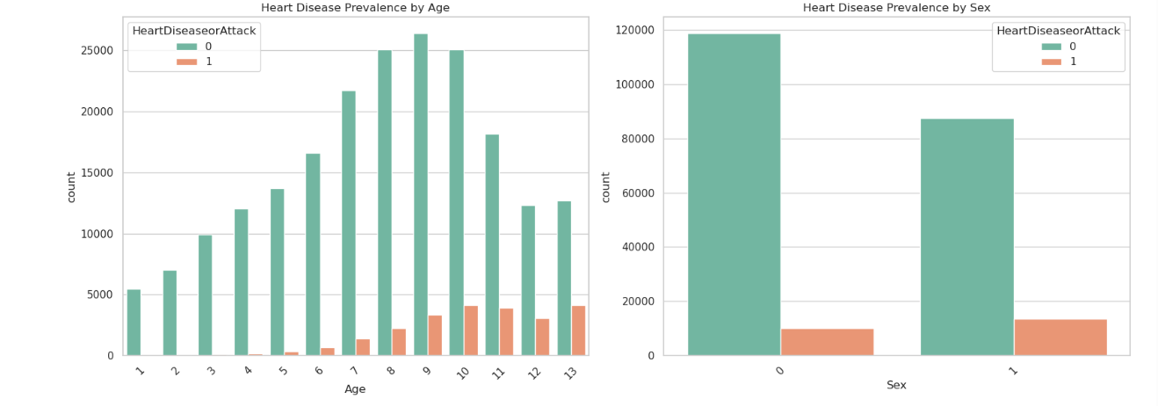
Bivariate Analysis:
Demographic Insights:
Age: The analysis shows a clear trend of increasing heart disease prevalence as age increases. Older individuals, are significantly more likely to suffer from heart disease compared to younger age groups.
Sex: Males appear to have a slightly higher risk of heart disease than females. This is consistent with global health statistics, where men often face higher heart disease risk due to lifestyle factors like smoking and a higher likelihood of having conditions like high cholesterol.
Education: There’s a notable inverse relationship between education levels and heart disease prevalence. Individuals with lower educational attainment (e.g., high school or less) are more likely to have heart disease, compared to those with higher education levels (college or postgraduate degrees). This could be attributed to several factors, including access to healthcare, health literacy, and socio-economic status, all of which are often linked to education.

