Slide 1

Student Management System
Capstone Project
Presented by :
Sharanya Mahajan 590012704 | Sanvi Chawla 590018244 | Prisha Pokra 590013227

Slide 2
Technologies Used
1. Java
Core programming language.
2. Java Swing
Used for graphical interface.
3. ArrayList
Used to store student records dynamically.
4. OOP Concepts
Used for modular design.

Slide 3
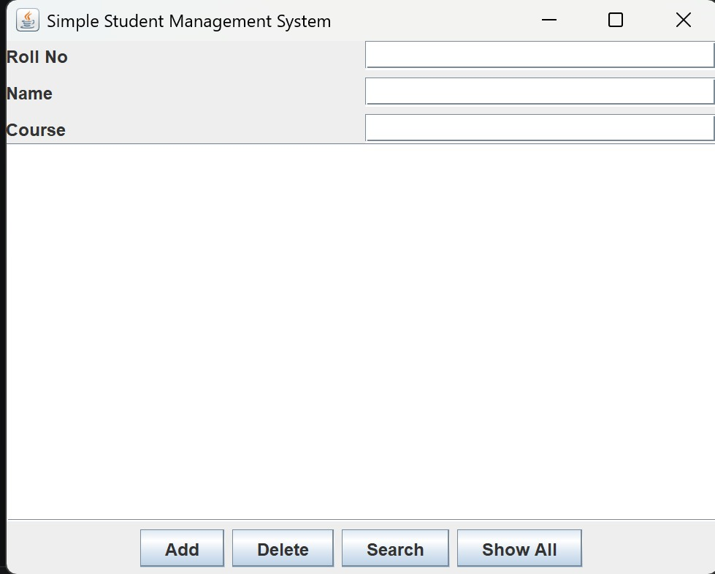
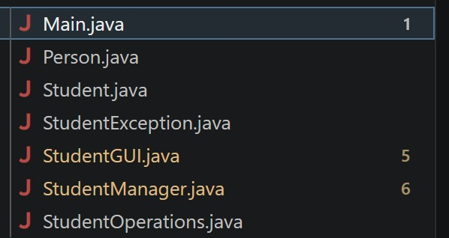
Main Menu(Entry Screen)
Project Folder Structure
Program starts
GUI opens
user clicks button
manager processes
data stored.
Main Menu

Slide 4
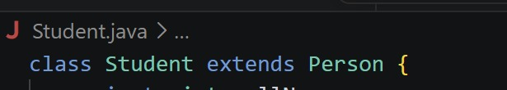
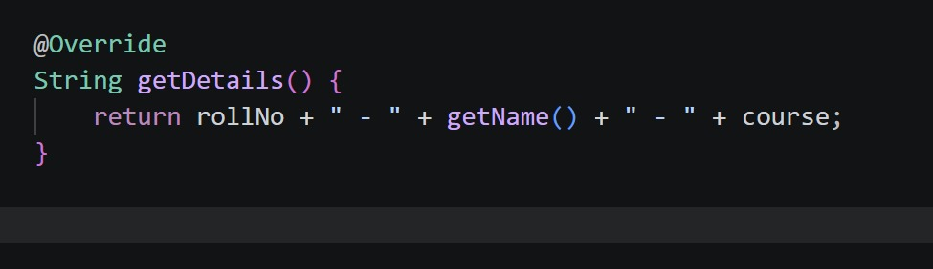

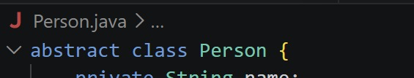
Concepts Used
Inheritance: The Student class inherits properties from the Person class.
Polymorphism: Method getDetails() is overridden to provide specific behaviour.
Encapsulation: Data is hidden using
private variables and accessed through
methods.
Abstraction: The abstract Person class hides implementation details.

Slide 5

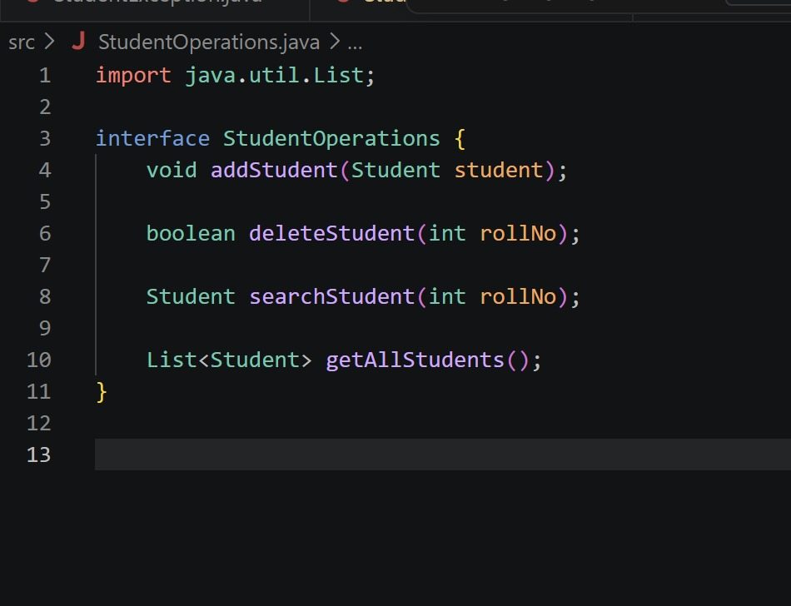
Interface
In Java, an interface is a blueprint that defines what methods a class must implement

Slide 6
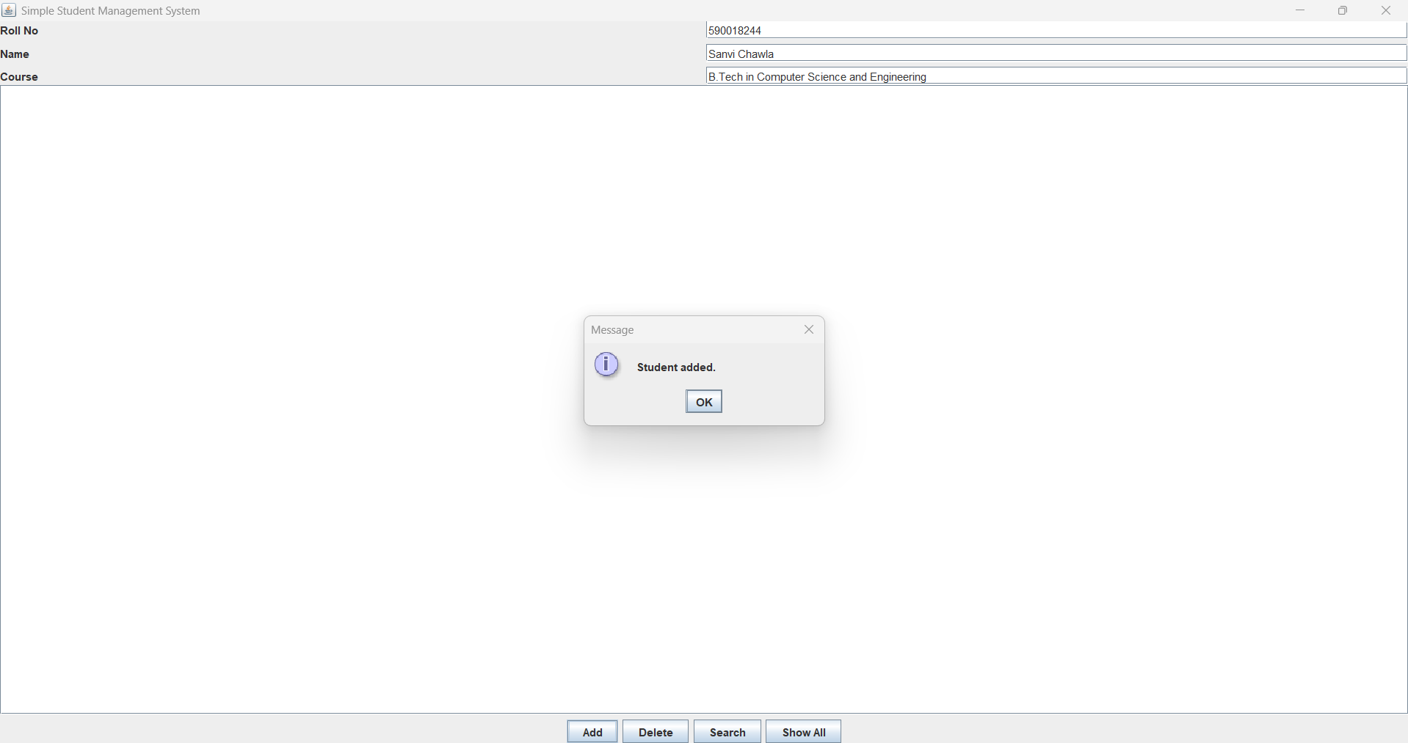
Operations Involved
Add Student: The system first validates the input. If the data is valid, a new Student object is created and stored in the array list.

Slide 7
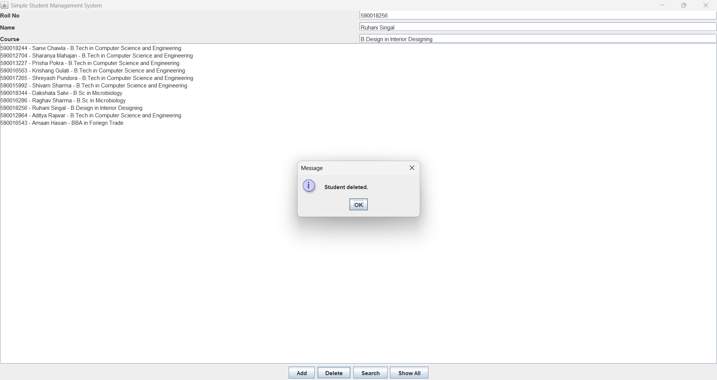
Operations Involved
Delete Student: The system searches for the student in the Array List, and if a match is found, the record is removed.

Slide 8
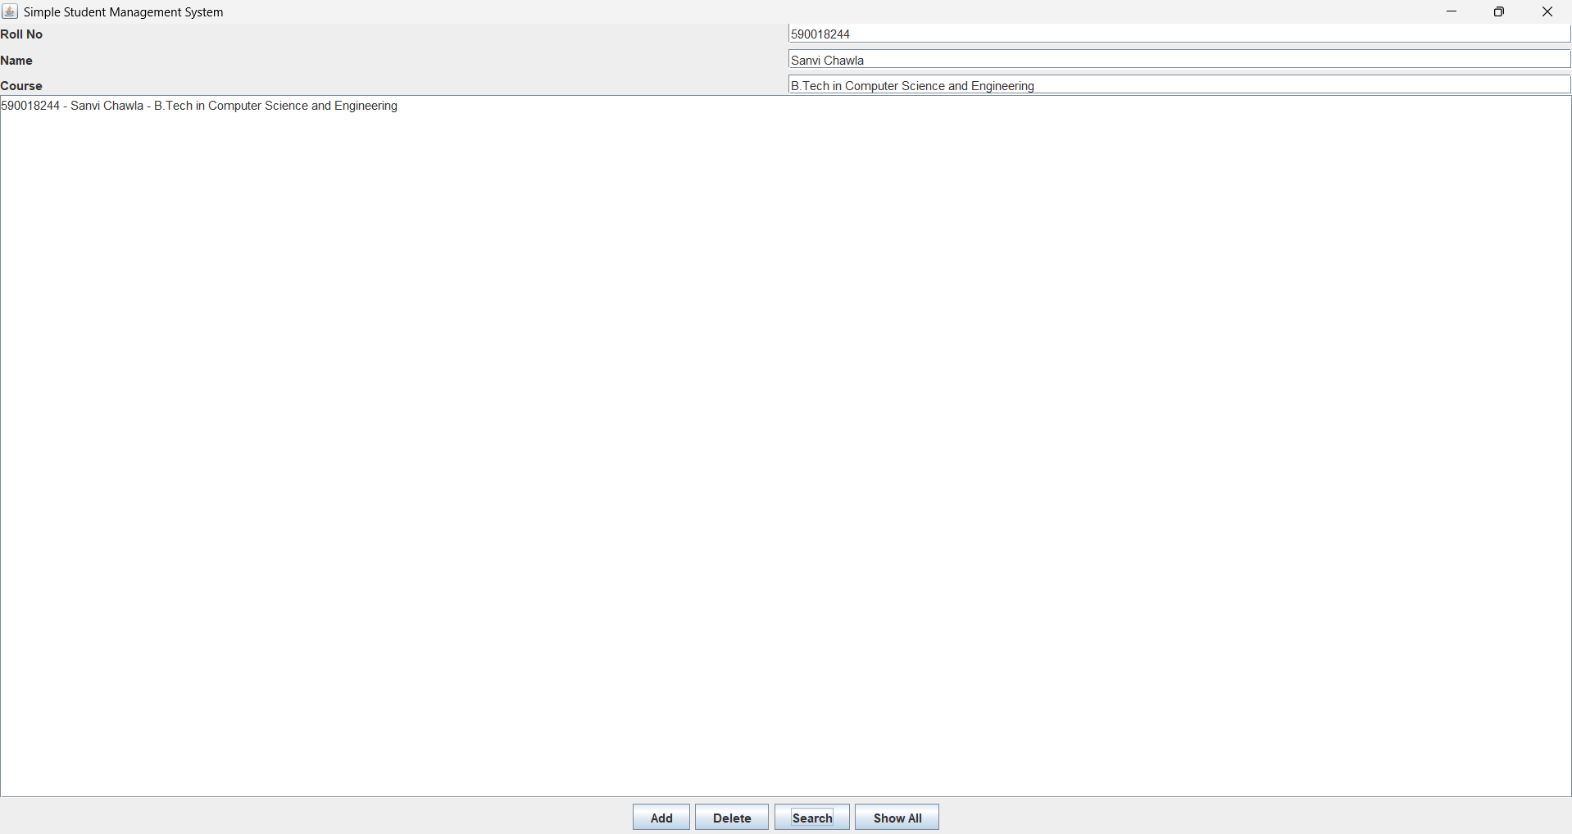
Operations Involved
Search Students: If Student is found ,their details are displayed. Otherwise, a message is shown that the student does not exist.

Slide 9
Operations Involved
Show All Students: It displays all student records stored in the system in a structured format.

Slide 10
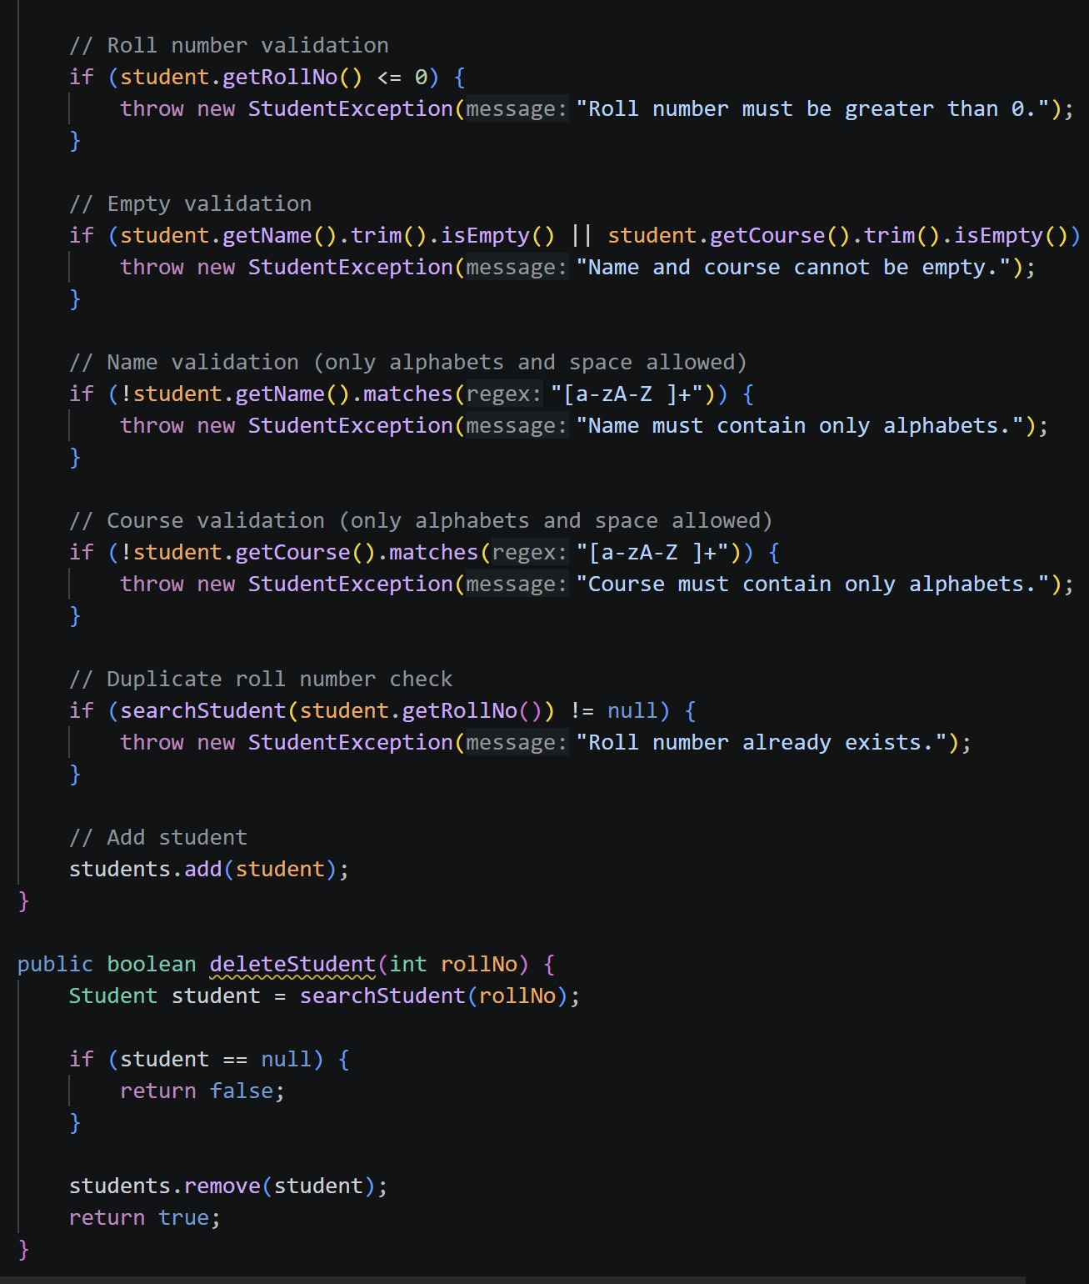
Custom Exception Handling
A custom exception is created to handle all student-related errors in a centralized, clean way — ensuring the application responds gracefully to invalid input.

Slide 11
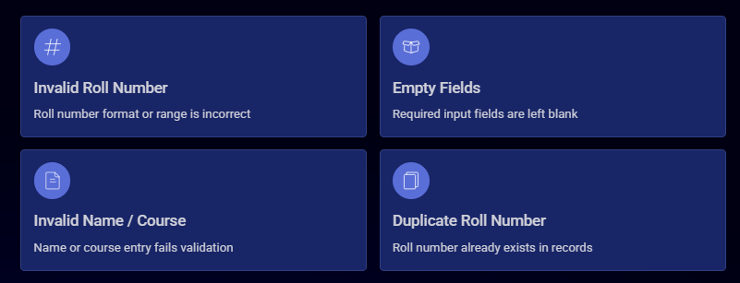
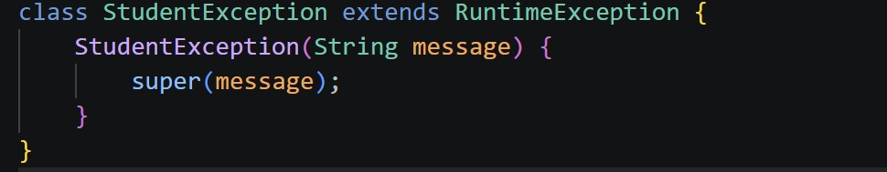
When Exceptions are thrown
The program throws a custom exception under the following conditions:

Slide 12
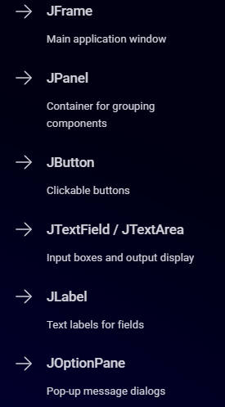
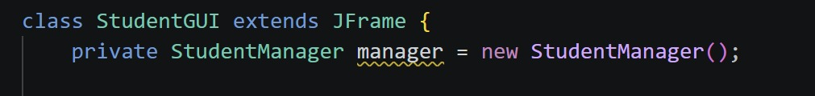
What is java Swing?
Java Swing is a GUI framework in Java used to build desktop applications. It provides a rich set of ready-to-use components for creating interactive windows, forms, and dialogs.
The class behaves like a window in Java Swing.
creation of private object of StudentManager called manager which is responsible for handling all student realated operations.

Slide 13
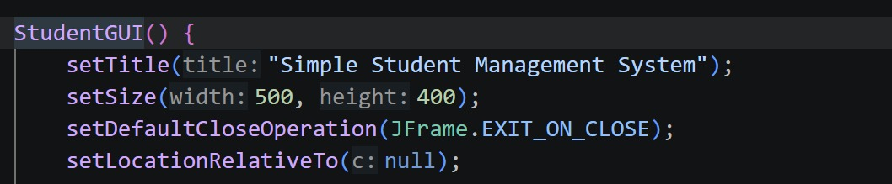
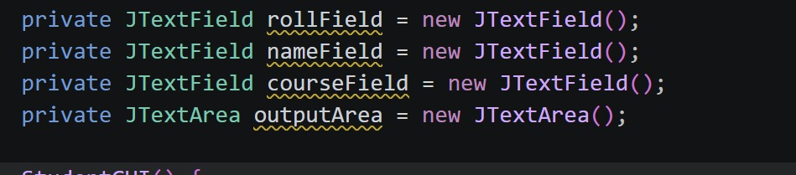
Setting Up the Window
JFrame — First Step
The JFrame is the foundation — it creates the main window that holds all other components.
Window Setup
Properties like title, size, close operation, and visibility are configured to prepare the application window for use.
These are single line input fields using JTextField.
Creation of JTextArea called outputArea, which is used to display output such as student details in multiple lines.

Slide 14
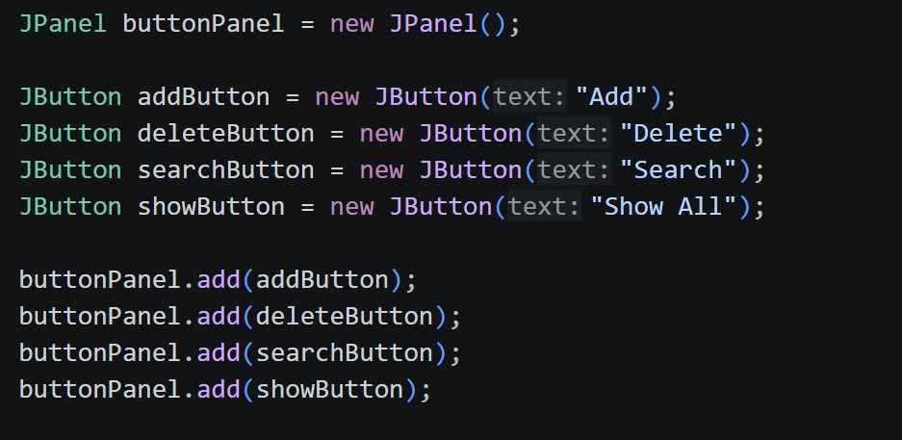
Swing Components in Action
Buttons, text fields, and labels are added to the JFrame to build the student management interface. Each component is configured with properties like size, position, and initial text.

Slide 15
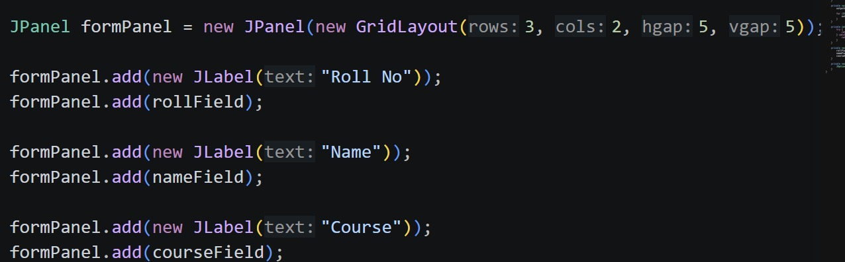

Layout and Screen Placement
Components are arranged using a grid layout — fields are organized in rows and columns for a clean, structured interface.

Slide 16
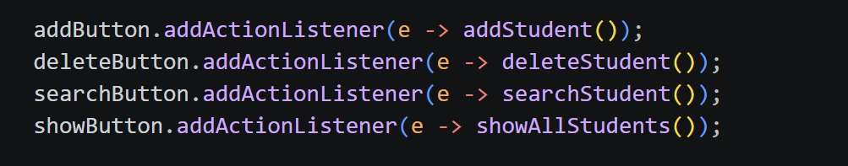
Event Handling
When a user clicks a button, a specific method executes to handle the action.
Example: Click Add → addStudent() runs, validating input and storing the record.
This event-driven model keeps the interface responsive and ties each button to its corresponding logic.

Slide 17
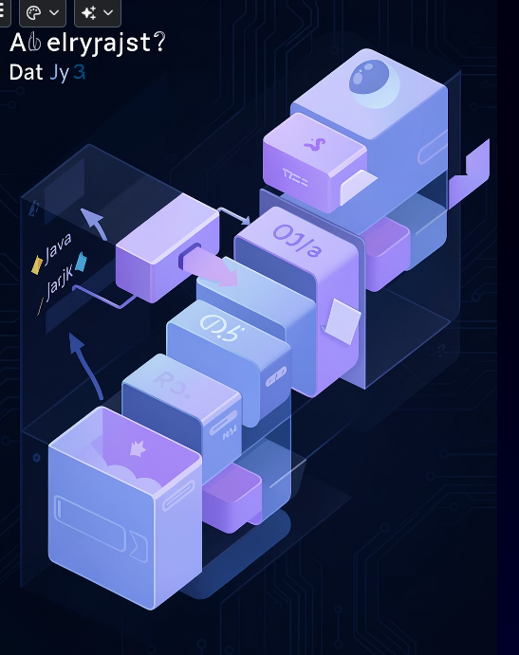
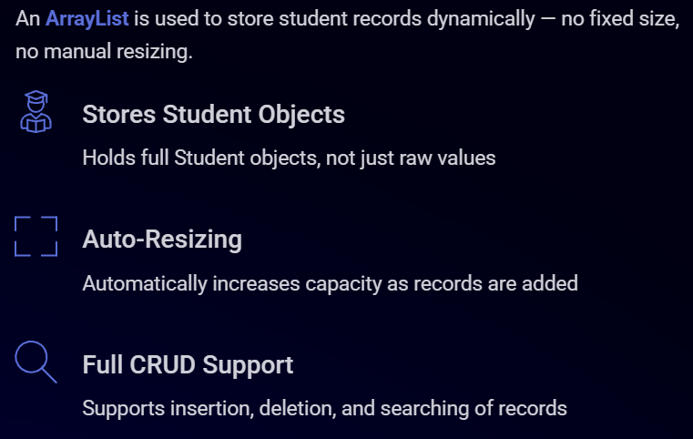
Dynamic Storage with Array List

Slide 18
Advantages
This project successfully implements:
✔️ Object-Oriented Programming concepts
✔️ GUI development using Java Swing
✔️ Exception handling and data validation
✔️ Dynamic student record management using ArrayList.
It provides a simple, efficient, and user-friendly student management system.

Slide 19
Thankyou!

