Slide 1

ONTARIO MLITSD · OCCUPATIONAL HEALTH & SAFETY
Targeting Inspections Where Risk Is Highest
Predictive Risk Identification — a workplace-level risk-scoring engine for proactive inspection planning
All workplaces
Risk-ranked shortlist
Proactive inspections where risk is highest
Inspections today are largely reactive — after a complaint, injury, or fatality — or broad sector campaigns
Inspector capacity is finite; most workplaces are never visited in a given year
The prize: more serious problems caught — and injuries prevented — per inspector-day
Notes:
Open: "Thanks for the time. I chose Option 1 — Predictive Risk Identification. I'll show how the Ministry can use its own enforcement data, plus inspection-report text, to target inspections more proactively — and I'll be upfront about the limits." Then: "Today, most inspections happen reactively — after a complaint, an injury, or a fatality — or through broad sector campaigns. But inspectors are a scarce resource, and in any given year most workplaces are never visited. The opportunity is to get ahead of harm: rank workplaces by safety risk, so our proactive visits go where risk is highest. The goal isn't more inspections — it's more harm prevented per inspector-day." (~1 min)

Slide 2
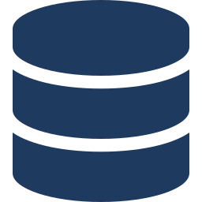




THE SOLUTION AT A GLANCE
A Risk-Scoring Engine for Inspection Planning
Combine enforcement history with inspection-report text to produce a ranked, explainable shortlist.
Structured + text inputs
Feature engineering
Risk model
Score + reason codes
Power BI
FIRE / Ontario open data, report text, WSIB benchmarks
Enforcement history + LLM-extracted hazard features
Interpretable, validated out-of-time
0–100 score, Low/Med/High, top-3 reasons
Monthly prioritized inspection list for planners
Designed for the Ministry's existing stack
Azure · Databricks · Power BI
Notes:
"Here's the solution in one picture. We combine three inputs: our enforcement and visit history, the text in inspection reports, and sector injury benchmarks from WSIB. That feeds a model that outputs, for each workplace, a risk score from 0 to 100, a tier — low, medium, high — and the top three reasons it scored that way. Planners would see this as a prioritized list in Power BI. And it's all designed to run on the stack we already use — Azure, Databricks, Power BI." (~1.5 min)

Slide 3

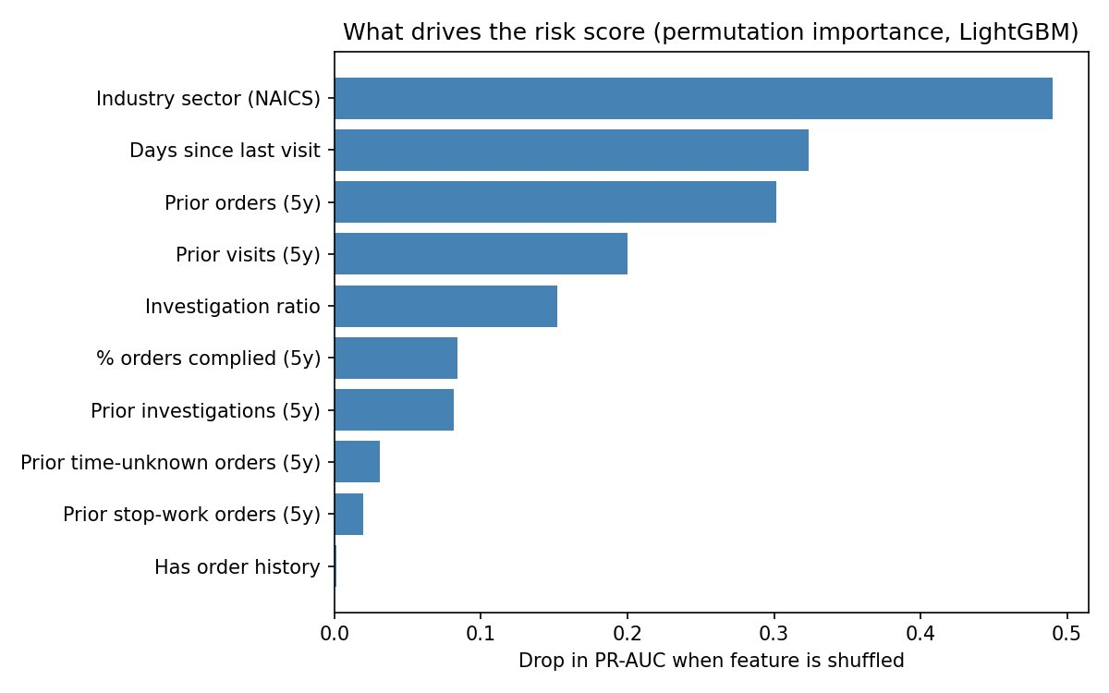
WHAT PREDICTS RISK
What the Data Says Drives Risk
Target (precise): likelihood of a serious enforcement action (stop-work / time-unknown order) on inspection — not individual accidents.
Top structured drivers
Text adds what structured fields miss
BEFORE — de-identified report excerpt
A worker was critically injured when steel tubes fell during unloading. The worker was 21, employed two weeks, working without direct supervision. The employer had no documented training program for the task.
AFTER — LLM extraction (schema-constrained JSON)
"hazard_type": "caught-in / crush"
"injury_severity": "critical"
"vulnerable_worker_flag": true
"supervision_failure_flag": true
"systemic_failure_flag": true
"order_sections": ["OHSA 25(2)(a)", …]
Prior orders & investigations, recency, compliance rate, and industry sector (construction & mining highest).
Narratives become features and dashboard filters: supervision failure, young/new worker, systemic cause.
Notes:
"Let me be precise about what we predict, because it matters. We predict the likelihood a workplace receives a serious enforcement action — a stop-work or time-unknown order, which by definition signal immediate danger — on its next inspection. We validate that against actual serious injuries. We deliberately do not claim to predict individual accidents — that would be overclaiming, and fatalities are too rare to model responsibly. The strongest drivers are intuitive: prior orders and investigations, stop-work history, how recently we've been there, compliance behaviour, and industry sector — construction and mining rank highest. The interesting part is the text. Structured fields don't capture why something happened. So we use an LLM to turn a narrative into structured features. On the right is a real example — a crush incident: the model extracts that it was a critical injury, involved young, new workers, a supervision failure, and a systemic cause — not a worker-compliance issue. Those become features and dashboard filters." (~2–2.5 min)

Slide 4
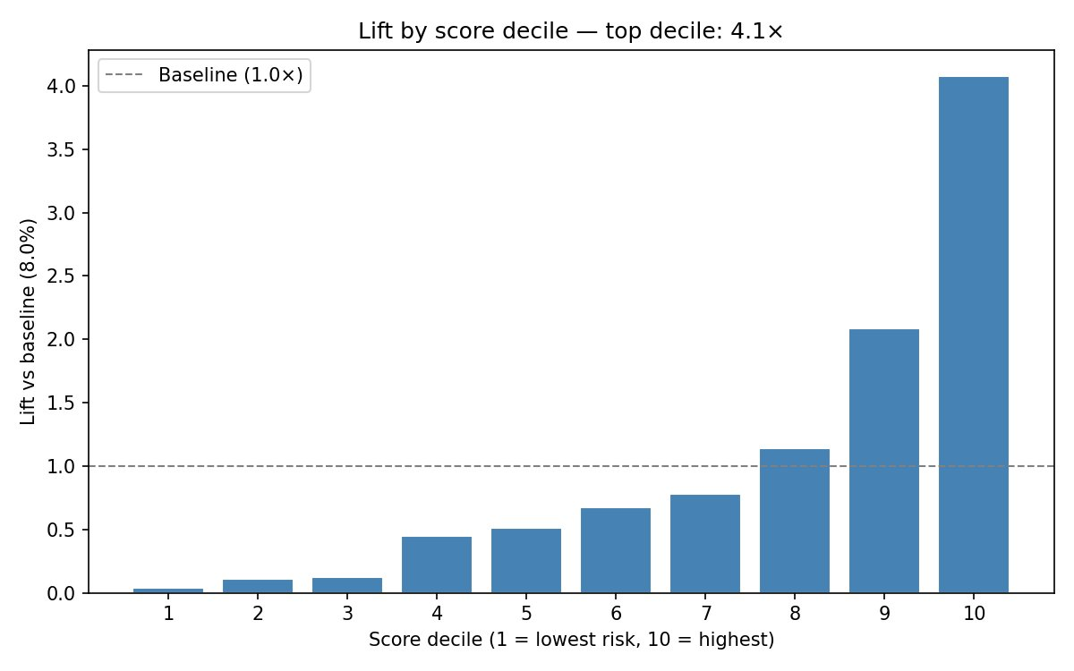

VALIDATION & IMPACT
Validated the Way It Would Be Used
~4×
lift in the top decile — serious problems found per inspection vs untargeted visits
32% vs 8%
serious-order rate: top-scored workplaces vs the 8.0% baseline
Robustness: gradient boosting didn't beat the simple model out-of-fold → signal is real; we keep the fully explainable model with no accuracy penalty.
Business translation: same harm prevented with fewer visits — or more harm prevented with the same budget.
Trained on 2017–2022, tested on 2023; cross-validated, not in-sample. Monotonic lift across deciles.
Notes:
"Does it work? I validated it the way it would actually run: I trained on history through 2022 and tested on 2023 — predicting the future from the past, and cross-validated so the numbers aren't inflated. The headline: about a 4× lift in the top decile. The workplaces the model flags as highest-risk had a 32% serious-order rate, versus an 8% baseline. In plain terms — if we inspected that top group, we'd find serious problems about four times more often than untargeted visits. I also stress-tested it with gradient boosting. Out-of-fold, the complex model didn't beat the simple one — which tells me two things: the signal is real, and we can keep the fully explainable model with no accuracy penalty. That's the right trade for enforcement. One honesty note: this is a prototype on public open data, so these are directional results, not a production guarantee." (~2–2.5 min)

Slide 5




RESPONSIBLE DEPLOYMENT
Built for a Government Environment
Private, fair, explainable, human-in-the-loop, and deployable on our stack.
Privacy (FIPPA / PHIPPA)
Roadmap
De-identify reports before processing; LLM in-tenant on Azure — no data to public APIs.
1
Pilot one sector / region
Fairness
Audit scores for disparate impact by region, sector, and firm size.
Validate
2
Avoid feedback bias
Reserve random / exploratory inspections so the model keeps learning the whole population.
3
Scale on Databricks
Human-in-the-loop
4
Monitor drift & fairness
The model ranks; inspectors decide. Reason codes make every score reviewable.
Notes:
"Finally — and for a government context this is the most important slide — how we do this responsibly. Privacy: reports contain personal and health information, so we de-identify before processing and keep the LLM in-tenant on Azure — no data leaves to public APIs. That's FIPPA and PHIPPA aligned. Fairness: we audit the scores for disparate impact across region, sector, and firm size, so we're not just over-targeting small businesses or one region. Bias: because we only have labels where we chose to inspect, targeting purely on the model could reinforce our blind spots — so I'd reserve some random, exploratory inspections to keep learning. And critically — this is decision support, not automation. The model ranks; inspectors decide. Every score comes with its reasons, so it's reviewable and defensible. The path forward is a pilot in one sector, validate, then scale on Databricks with monitoring for drift and fairness." CLOSING (~15 sec): "So: a credible, explainable way to put inspectors where risk is highest — about 4× more efficient at finding serious problems — built privately and fairly on our existing tools. Happy to go deeper on any part." (~2 min)

Slide 6
APPENDIX — BACKUP FOR Q&A
A1 · Target Definition & Selection Bias
Target variable
Serious order in 2023 = Stop Use / Stop Work Order OR Time Unknown Order. These signal immediate danger.
Evaluation cohort
12,234 workplaces with enforcement history 2017–2022 AND at least one 2023 visit. Baseline serious-order rate: 8.0%.
Why labels are MNAR (missing not at random)
Outcomes only exist where we chose to inspect. Scores for never-visited sites are extrapolations. Mitigation: reserve exploratory inspections; validate against near-random campaign visits.

Slide 7
APPENDIX — BACKUP FOR Q&A
A2 · Model Metrics — Logistic vs LightGBM
Metric | Logistic (kept) | LightGBM
Lift @ top 10% (in-sample) | 4.08× | —
Lift @ top 10% (cross-validated) | 4.00× | 3.73×
Top-decile serious-order rate | ~32% | —
PR-AUC (CV) | 0.31 | —
ROC-AUC (CV) | 0.80 | —
Boosting did not beat logistic out-of-fold → keep the explainable model. Numbers are cross-validated on public open data; directional, not a production guarantee.

Slide 8
APPENDIX — BACKUP FOR Q&A
A3 · Feature Dictionary (top drivers)
Feature | Definition
Industry sector (NAICS) | Sector code; construction & mining carry highest baseline risk
Days since last visit | Recency of last inspection contact
Prior orders (5y) | Count of enforcement orders issued in prior 5 years
Prior visits (5y) | Count of inspection visits in prior 5 years
Investigation ratio | Share of visits that escalated to investigation
% orders complied (5y) | Compliance behaviour on past orders
Prior investigations (5y) | Count of investigations in prior 5 years
Prior stop-work orders (5y) | History of the most serious order type

Slide 9
APPENDIX — BACKUP FOR Q&A
A4 · LLM Extraction — Schema & FIPPA-Safe Prompt
Controls: de-identify before processing · data minimization · in-tenant Azure OpenAI · access controls · schema-constrained JSON only. The LLM structures text — it never assigns enforcement.
SYSTEM: Extract safety attributes from the de-identified inspection
report. Return ONLY valid JSON matching the schema. No personal data.
{
"hazard_type": "<caught-in|struck-by|fall|...>",
"injury_severity": "<none|minor|serious|critical|fatal>",
"vulnerable_worker_flag": <bool>,
"supervision_failure_flag": <bool>,
"systemic_failure_flag": <bool>,
"order_sections": ["<OHSA/Reg citation>", ...]
}

