Slide 1
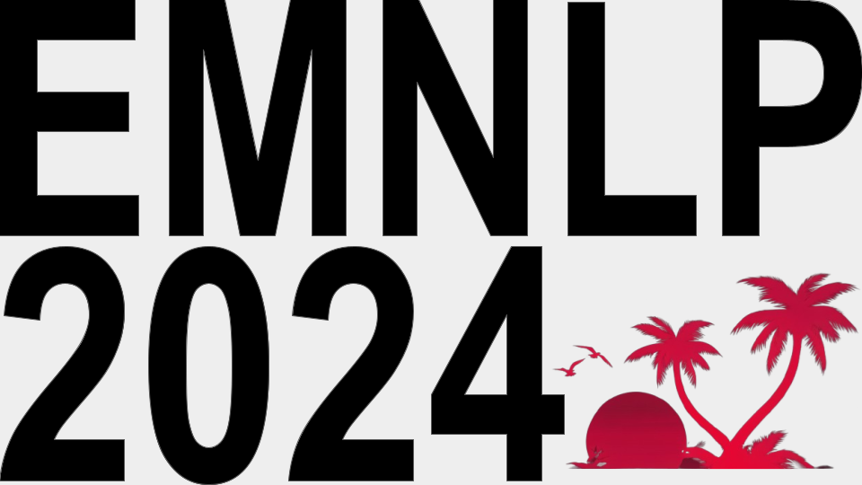
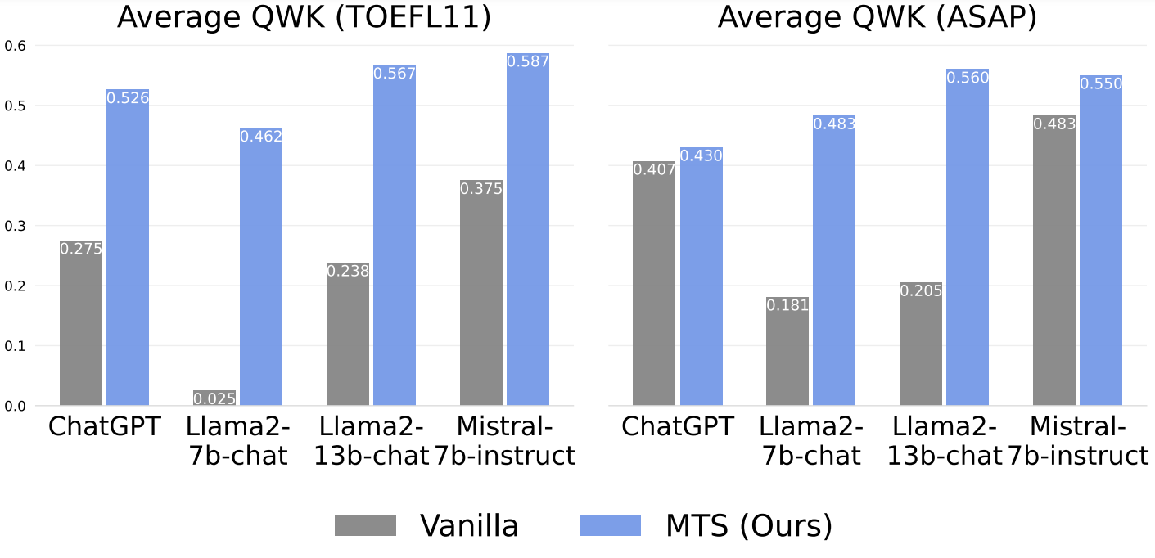
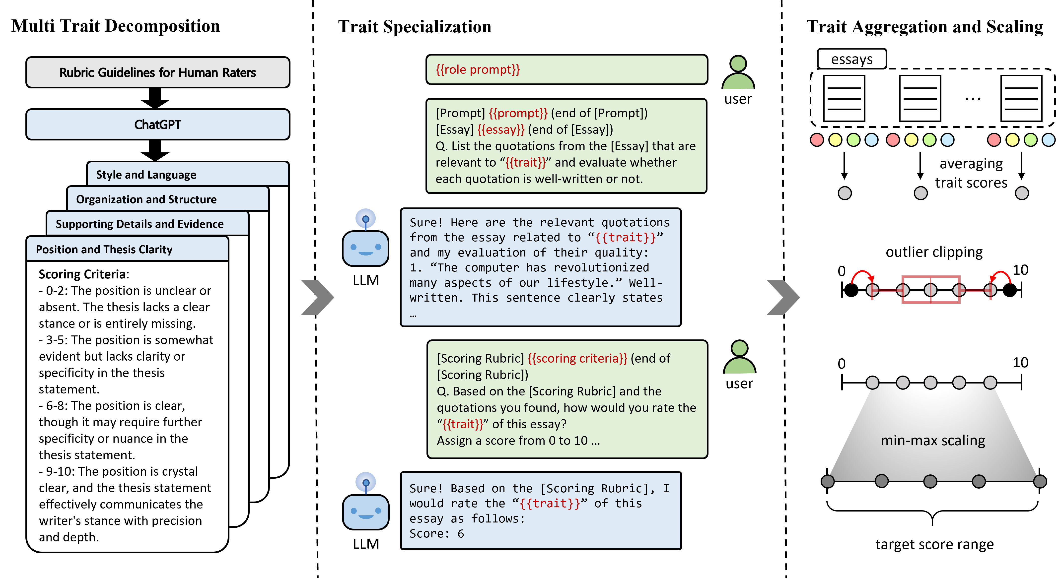
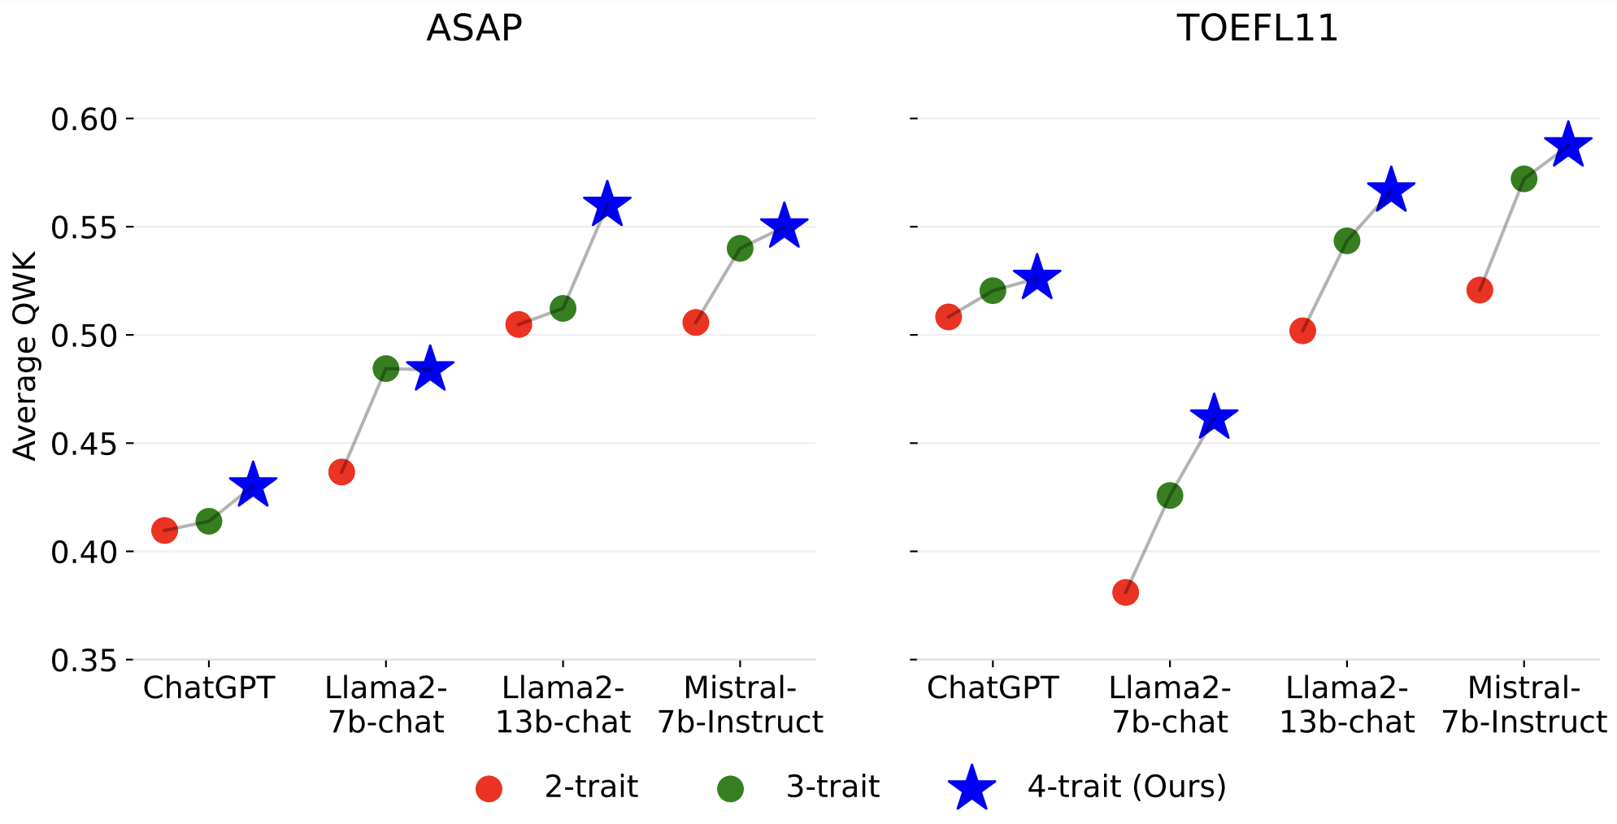
Unleashing Large Language Models’ Proficiency in Zero-shot Essay Scoring
Sanwoo Lee, Yida Cai, Desong Meng, Ziyang Wang, Yunfang Wu
contribution
result
We present MTS (Multi Trait Specialization), a zero-shot prompting framework to elicit essay scoring capabilities in LLMs. MTS is free from training & labeling essays, and readily applicable to any unseen essay topics.
MTS consistently outperforms Vanilla (direct scoring) in
average Quadratic Weighted Kappa (QWK) across all LLMs and datasets.
method
(1) Multi Trait Decomposition: writing proficiency is decomposed to distinct traits; (2) Trait Specialization: an LLM is prompted to extract trait scores from the given essay; (3) Trait Aggregation and Scaling: the overall score is derived via trait averaging and min-max scaling.
Analysis reveals that the key to its success arises from diversified assessment with different traits.

