Slide 1
Customer Behaviour Segmentation
Six kinds of EV charging customer

Slide 2
Approach
20+
Engineering features per customer frequency, energy station reach, charger mix
k = 6
K-Means, chosen by the highest silhouette score (0.65)
0.93
Agreement (ARI) with tight-eps DBSCAN cross-check
Five features drive the clusters: sessions (log), sessions per active month, stations used, average kWh per session, and 300 kW charger share.

Slide 3
Six personas
Personas | Customers | Sessions each | Stations used | Revenue per customer | Revenue share
Power Users | 400 | 258 | 33 | 7,163 | 35.1%
Frequent Chargers | 1,603 | 72 | 28 | 2,102 | 39.5%
Steady Regulars | 3,987 | 18 | 13 | 509 | 24.8%
One-Time Fast-Charge | 497 | 1 | 1 | 39 | 0.2%
One-Time Standard | 713 | 1 | 1 | 26 | 0.2%
One-Time Slow-Charge | 800 | 1 | 1 | 19 | 0.2%

Slide 4
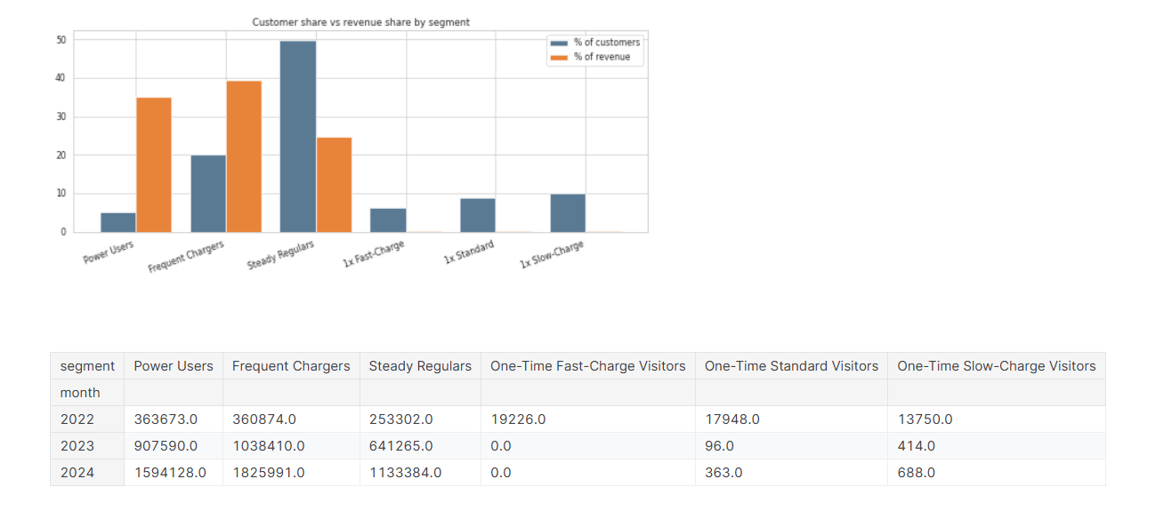
Revenue is concentrated in 25% of customers

Slide 5
What the data does not support
No computer segment.
Weekday share (0.77) and peak-hour share (0.33) are the same in every group, and no customer with more than 5 sessions sends over half their visits to one station.
No “public” segment.
user_type changes from session to session for every repeat customer, so it describes sessions, not people.
Timing and payment carry no signal.
A controlled XGBoost test scored 0.61 against a 0.62 baseline.

Slide 6
Recommendations
Protect the top 25%
Power Users and Frequent Chargers bring 75% of revenue. Prioritise uptime and loyalty perks across all regions.
Upgrade the regulars.
A Frequent Charger earns about 4x a Steady Regular. Target the 3,987 with usage-based incentives.
Test a win-backt
2,010 customers never returned. Test follow-up offers, since they are one retention problem

