Slide 1
EV Charging Demand Forecasting
Predicting future charging demand to plan capacity, staffing, and energy procurement

Slide 2
The Problem
No forward visibility info demand
Historical session data exists, but there’s no forecast to guide staffing, capacity, or energy purchasing decisions.
Network is growing fast
Stations grew from 8 (2024), past demand trends don’t simply extrapolate.
Multiple planning horizons needed
Operational teams need 30-day views. Energy procurement needs 90- and 365-day views.

Slide 3
What We Did
Clean
294,024 sessions checked for nulls, duplicated, and consistency. Identified and documented a systematic install-date data issue.
Explore
Found clear daily and weekly demand patterns, and separated genuine growth from network expansion.
Engineer
Built hour/daily demand series, calendar features, and lag features for modelling.
Model
Built and daily compared Prophet, SARIMA, and XGBoost.
Forecast
Generated 30/90/365-day forecast and built an interactive Power BI dashboard.

Slide 4
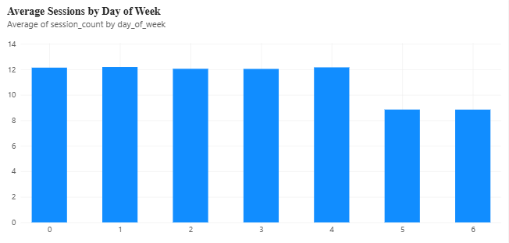
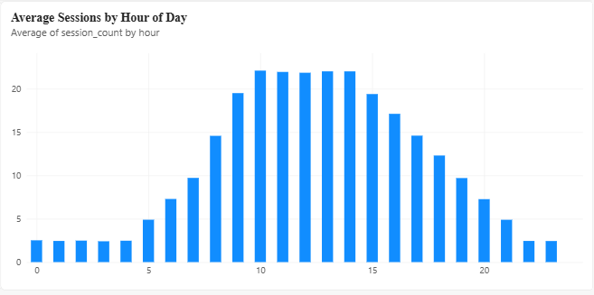
Key Findings: Session Demand Patterns
Demand peaks 10am-2pm and is near-zero overnight, daytime/workplace charging, not overnight home charging.
Weekdays run approximately 27% higher than weekends, showing a clear commuter pattern.
Most historical growth reflects new stations coming online (8 to 17 to 33), not rising demand per station.

Slide 5
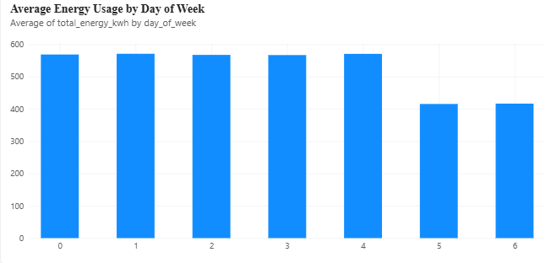

Key Findings: Energy Demand Patterns
Energy usage mirrors the session pattern: near-zero overnight, peaking above 1,000 kWh/hour between 10am-2pm.
Weekday energy usage runs approximately 28% higher than weekends (approx. 575 vs 415 kWh/hour) which is consistent with the session-count pattern.
Confirms energy procurement should be weighted toward the same weekday midday window identified for staffing.

Slide 6
Model Comparison
All three models forecast the same 90-day test window with no access to real values from within it.
Target | Model | RMSE | MAPE
session_count | XGBoost (calendar-only) | 4.98 | 0.350
session_count | Prophet | 5.31 | 0.413
session_count | SARIMA | 5.46 | 0.342
total_energy_kWh | XGBoost (calendar-only) | 233.9 | 0.370
total_energy_kWh | Prophet | 262.1 | 0.449
total_energy_kWh | SARIMA | 264.7 | 0.379

Slide 7
The Forecast: Two Model, Two Assumptions
Both models were refit on the full 2022-2024 history and used to forecast 2025. Checked against the most recent full year of real data:
2024 Actual Average
19.04
session/hour
882.03
kWh/ hour
2025 Forecast Average
XGBoost
19.03 session/hr
881.79 kWh/hour
flat vs. 2024
Prophet
20.28 sessions/hr
930.48 kWh/hr
+6% vs. 2024
XGBoost cannot extrapolate growth beyond the years it was trained on, so it holds flat. Prophet extends the historical trend. Neither is proven correct, both are shown on the dashboard.

Slide 8
Recommendations
Staff for the midday peak
Concentrate staffing/support resources 10am-2pm on weekdays and minimal overnight coverage is needed.
Plan capacity around network growth, not raw trend
Use per-station demand, not fatal demand, when judging whether existing stations are under strain.
Use XGBoost as the working forecast, Prophet as the upside case
Budget energy procurement toward Prophet’s higher estimate as a buffer, treat XGBoost’s flatter estimate as the conservative floor.
Resolve the installation-date date issue upstream
30% of sessions predate their charger’s recorded install date across all 199 chargers, worth at the source for future projects relying on that field.

