Slide 1
Predictive Maintenance for Chargers
Which chargers need attention first?

Slide 2
The data records no failures
0
Faults, status, or maintenance columns in any sheet
64-90%
Of rated power delivered in every session, so no sign of derating
14.6%
Of charger-months are followed by a 3+ day idle spell, the proxy the model predicts
The model therefore predicts inactivity risk, not failure. It cannot tell a fault from a quiet charger.

Slide 3
Chargers differ by type and station size, not one by one
97-100%
Of the differences between chargers are explained by charger type and station size
-0.11 to 0.17
Odd vs even correlation after removing those effects; below 0.14 is noise
5.4%
Average utilisation; delivered power is 77-80% of rated on every charger
No charger is consistently unusual compared with its peers, which limits any maintenance model built on this data.

Slide 4
The model does not beat simple rules
Model (tested on 2024) | AUC | Event rate in riskiest 10%
Full XGBoost model (17 features) | 0.728 | 28.0%
Low recent traffic only | 0.753 | 28.4%
Station size only | 0.753 | 24.8%
XGBoost on station size and traffic | 0.736 | 24.8%
Overall event rate is 15.4%. Among chargers at the same kind of station, the model scores an AUC of 0.41, no better than chance.

Slide 5
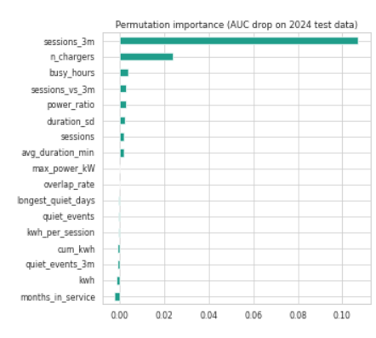
Two features carry the model
9 to 17 features have zero or negative importance. Wear measures (cumulative energy, months in service) add nothing.

Slide 6
Service the busiest chargers first
20
Tier 1 chargers
14 at 8-charger stations, all from 2022-2023 sites
40
Tier 2 chargers
Next service cycle
42%
Of sessions
Handled by Tier 1 and 2, which are 30% of chargers
14
Flagged chargers
3 with long quiet spells:
STN_004_CH_02, STN_004_CH_05, STN_025_CH_02
Priority score is the average of wear rank (sessions, energy) and inactivity-risk rank. Flags are screening rules, not diagnoses

Slide 7
Recommendations
Service by wear, not calendar
2022 chargers average 2,825 sessions each against 836 for 2024. Work through Tier 1 and Tier 2.
Start logging real failures
Record fault codes, downtime and work orders, then retrain the model on real outages.
Inspect the 14 flagged chargers
Start with three long quiet spells and confirm whether the cause is hardware or allocation.
Fix charger allocation
8.3% of sessions start before before the previous one on the same charger has ended.

