Slide 1
Smart EV Charging Network Planning and Management System
EV
ABC Green Energy Solutions Pvt. Ltd. | Java Industry Micro Project
Case study: Shell.ai EV Charging Network Challenge (2022)
Java · OOP · Swing · Collections · Multithreading · JDBC · MySQL · Servlets · JSP
Notes:
Introduce the team and the project: an integrated platform that replaces spreadsheets for ABC Green's EV charging network. It has a Swing desktop console for staff, a Servlet/JSP web portal for customers and a MySQL database.

Slide 2
The problem: a growing network run on spreadsheets
1
Duplicate customers
2
No live availability
3
Manual slot allocation
and inaccurate station records
customers drive to busy or faulty chargers
double bookings, long waiting queues
4
Slow reporting
5
No demand history
6
No central control
no visibility of demand or utilisation
nothing to plan new chargers with
every city works differently
Shell.ai challenge insight: forecasting demand and optimising chargers first requires reliable operational data. This system collects exactly that.
Notes:
These are the pain points from the business case. The Shell.ai challenge is about forecasting demand and placing chargers, which needs data on who charged where, when, and for how long.

Slide 3
Our solution: one platform, two interfaces, one database
Delivered in this version
Designed in for the future
Secure login with roles (Admin, Operator, Customer)
Customers, vehicles, stations, fast and slow chargers
Slot booking with no double booking
Charge now, or a FIFO queue with wait estimate and auto-allocation
Session tracking: duration, kWh, cost, receipt
Billing with GST and simulated online payment
Demand data, dashboards, 9 reports with CSV export
Maintenance, audit log, backup and restore
AI / ML demand forecasting: hourly demand_records per station are already collected as the training data
Charger placement optimisation: utilisation and capacity reports per station
GIS maps and route planning: station latitude and longitude stored, JSON API /api/stations
Real payment gateway: BillingService.pay is the single integration point
Notes:
Left: what we built. Right: the out-of-scope items. The layered design means new modules plug into the service layer, and the data they need is already being collected, as the project brief asks.

Slide 4
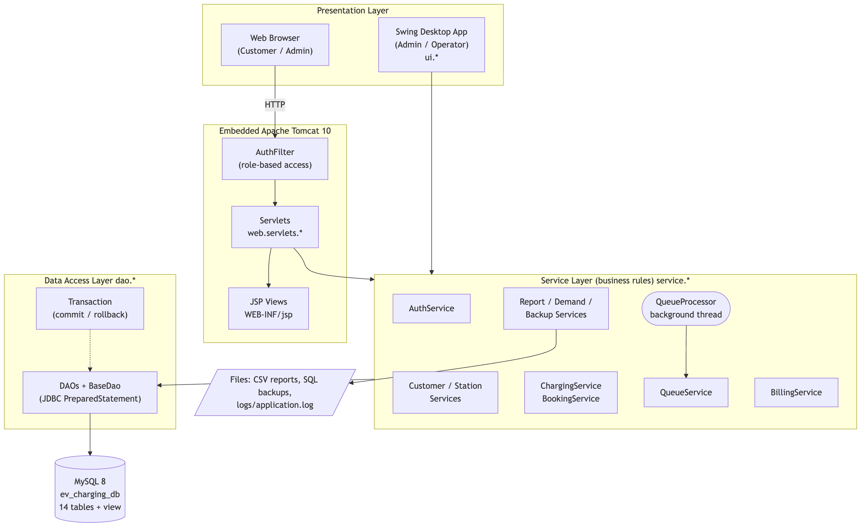
Layered architecture
Presentation: Swing desktop app and Servlet/JSP portal on embedded Tomcat 10
Service layer: all business rules, shared by both front ends
DAO layer: JDBC PreparedStatements and transactions
MySQL: 14 tables + 1 view
Patterns: DAO, MVC, Factory, Template Method, Observer
Notes:
Both user interfaces call the same service classes, so a rule like 'no double booking' is written once. The QueueProcessor background thread lives in the service layer.

Slide 5
Actors and use cases
C
Customer
O
Operator
A
Administrator
Q
Queue Thread
Web portal
Desktop app
Desktop + web
System process
Register and login
Manage vehicles
Find stations
Book a slot
Charge now or join queue
Pay online and download invoice
Manage customers and vehicles
Manage stations and chargers
Start and stop charging
Monitor queue and notifications
Schedule maintenance
Reports and CSV export
Everything an operator does
Manage users and roles
Backup and restore database
Configure system settings
View audit log
Admin web dashboard
Watch for freed chargers
Allocate next charger (FIFO)
Auto-start the session
Update wait estimates
Notify operators
Notes:
Full UML use case diagram: docs/diagrams/02_use_case.png. Four actors: customer (web), operator and administrator (desktop), and the system's queue processor thread that allocates chargers and notifies operators.

Slide 6
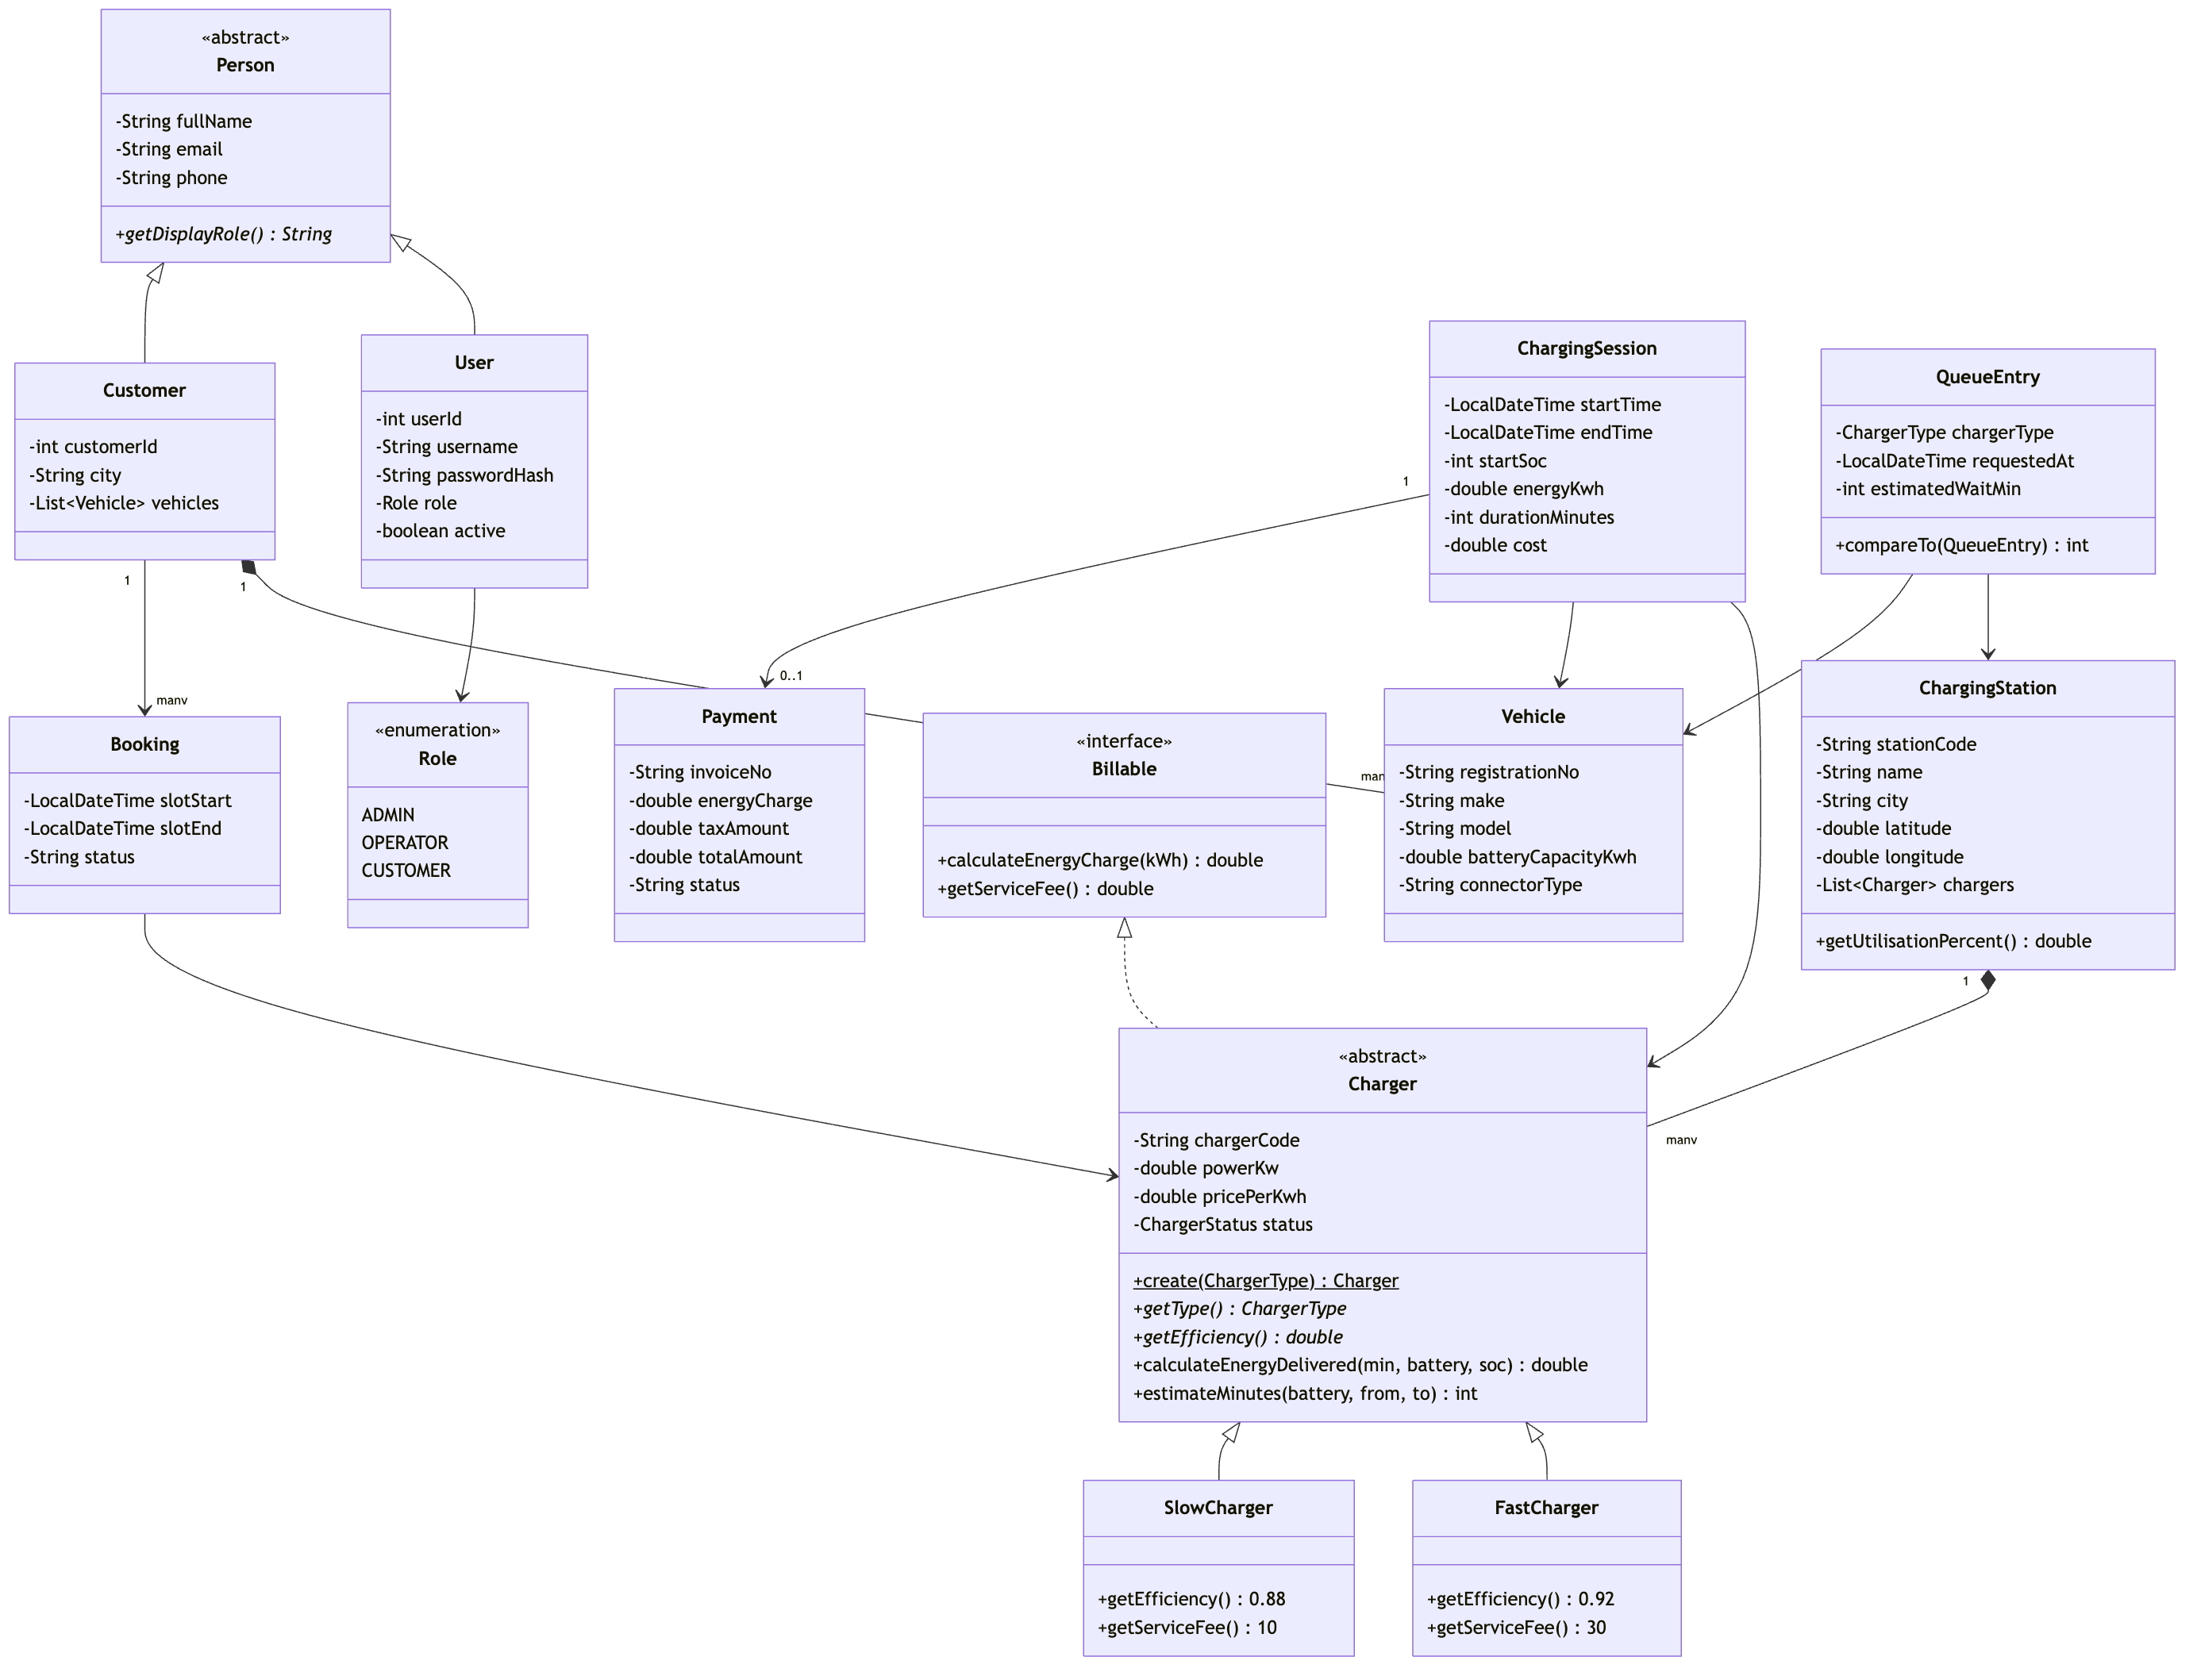
Object-oriented domain model
Inheritance
Person → User, Customer
Charger → FastCharger, SlowCharger
Polymorphism
Efficiency 92% vs 88%, service fee Rs 30 vs Rs 10, created by the Charger.create() factory
Interfaces
Billable, RowMapper, Refreshable
Encapsulation
Private fields and 10 packages
Notes:
Module II. The abstract Charger class implements Billable. Fast and slow chargers override efficiency, service fee and power limits, and the factory method creates the right subclass from each database row.

Slide 7
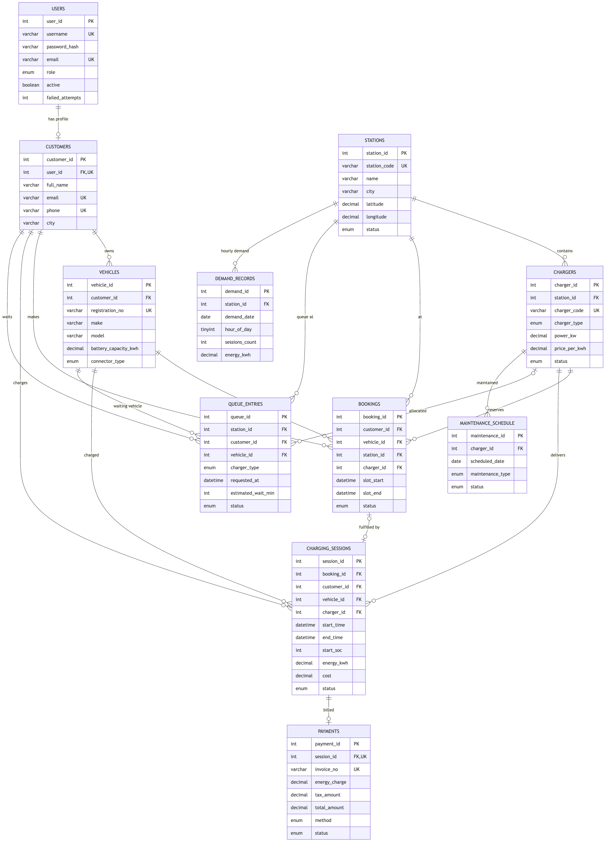
Database design: normalised to 3NF
14
tables + 1 view
10,800+
charging sessions
600
customers, 712 EVs
24 / 138
stations / chargers
Notes:
Primary and foreign keys, UNIQUE constraints for duplicate prevention, CHECK constraints and ENUM statuses. Demo data covers 90 days with realistic peak hours. All dates are relative, so the dashboards always show today.

Slide 8
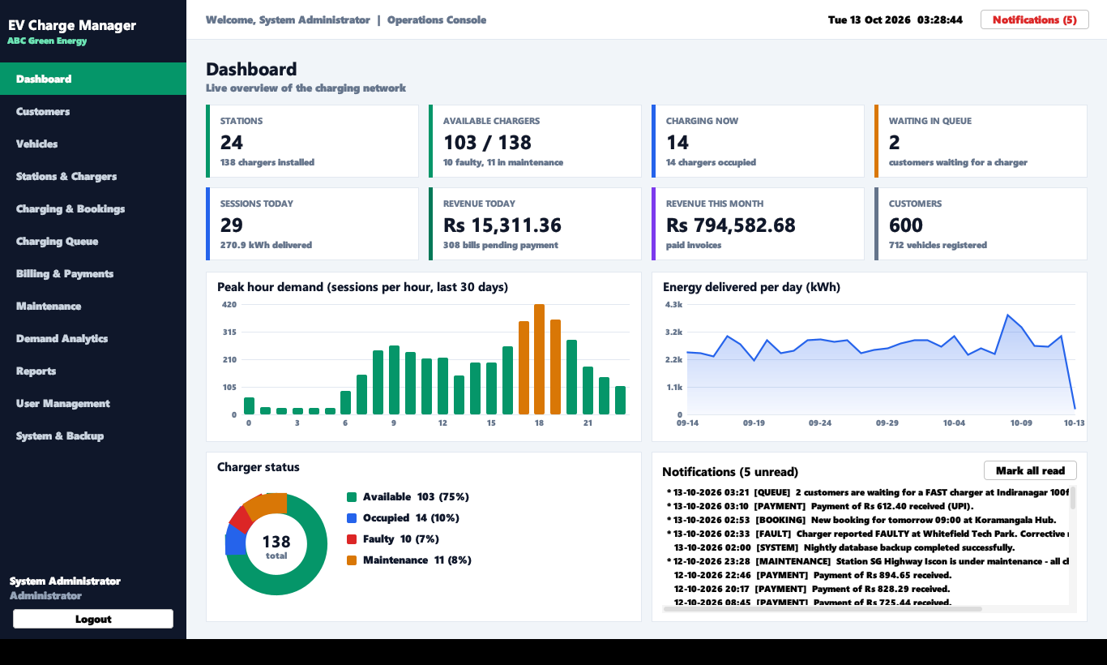
Desktop operations console (Swing)
12 screens with sidebar navigation
Live KPIs, Java 2D charts, notification feed
Reusable generic CrudPanel<T> and BeanTable<T>
Background SwingWorker threads: the UI never freezes
Stack-based undo for charger status changes
Admin-only screens: users, backup, settings
Notes:
Module IV. Show the dashboard live: peak hours in orange, energy per day, charger status donut, notifications. All charts are drawn with Java 2D, with no chart library.

Slide 9
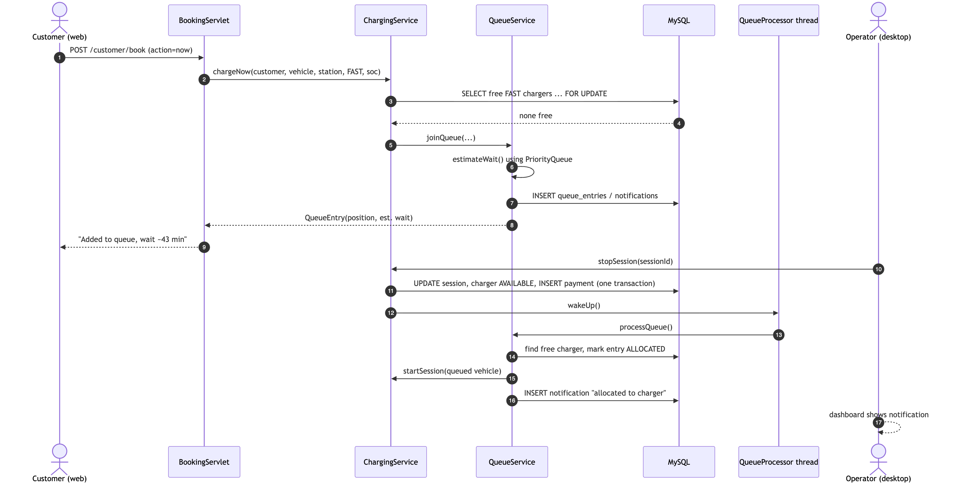
Smart queue: no customer waits blindly
1
All chargers busy
Customer joins a FIFO queue
2
Wait estimated
PriorityQueue of charger free-times
3
Operator notified
In-app notification
4
Charger freed
QueueProcessor thread wakes (wait / notify)
5
Auto-allocated
Session starts in one DB transaction
Notes:
Module III multithreading. Live demo: charge now at Indiranagar, where both fast chargers are busy, so the customer is queued with an estimate. Stop one session and within seconds the freed charger is allocated and a notification appears.

Slide 10
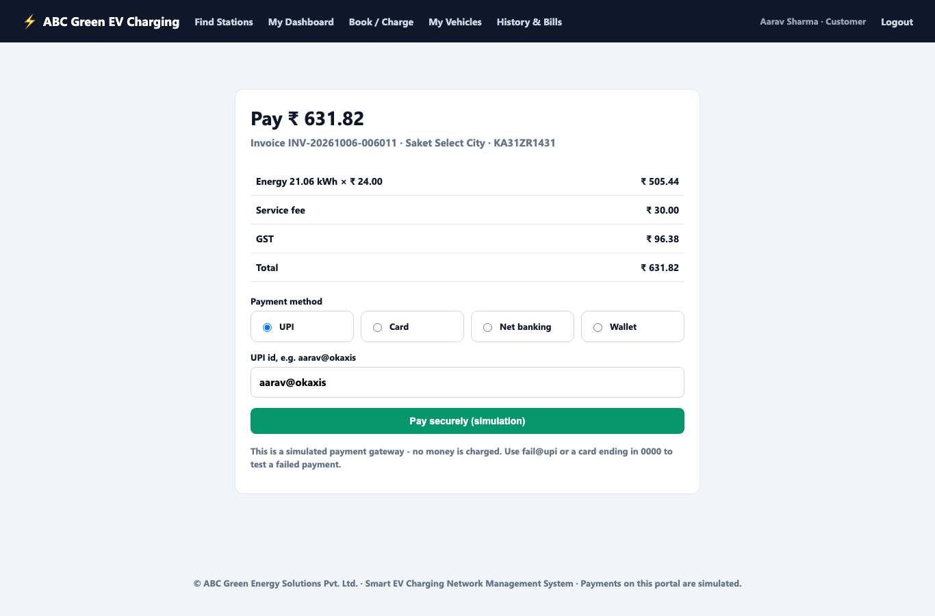
Charging, billing and simulated payment
How a bill is calculated
Energy = power × efficiency × time
capped by battery space (100% − start SOC)
Energy charge = kWh × tariff (Rs 13–24 / kWh)
Service fee = Rs 30 fast | Rs 10 slow
GST = 18% (configurable)
Example: 10 kWh × Rs 20 + Rs 30 + GST = Rs 271.40
UPI, card, net banking, wallet or cash. fail@upi demonstrates a declined payment. Invoices download as printable HTML.
Notes:
The calculation is covered by unit tests TC-BILL-01 to 03. Simulation: 1 real second = 1 minute of charging, so a demo session produces realistic energy.

Slide 11
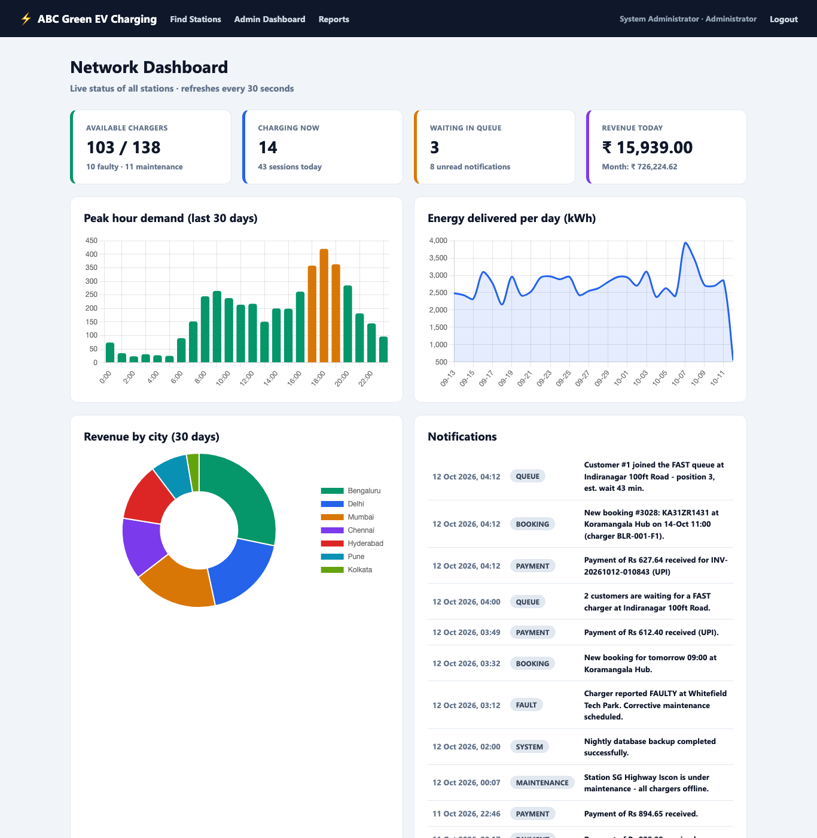
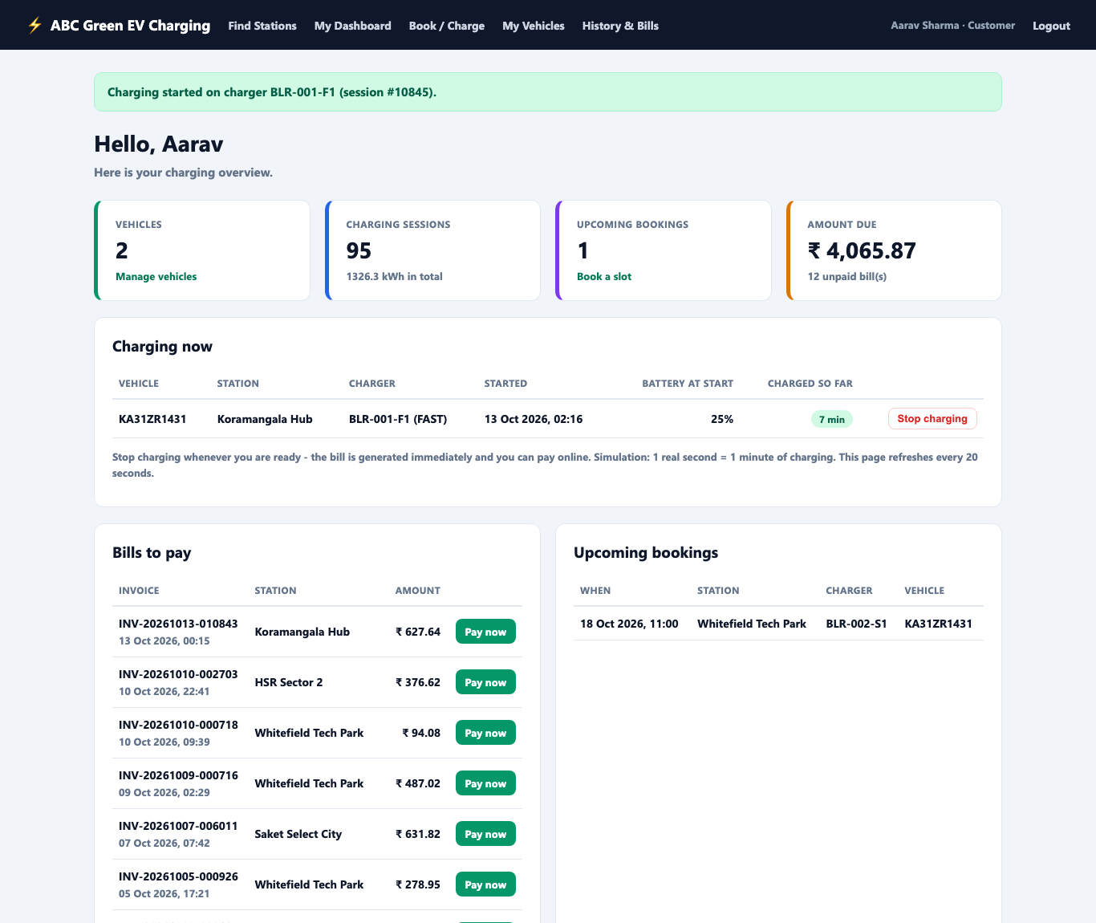
Customer web portal (Servlets + JSP)
Notes:
Module V. 13 servlets mapped in web.xml, an AuthFilter for role-based access, JSP views and a Chart.js admin dashboard. Embedded Tomcat starts from a single main method.

Slide 12
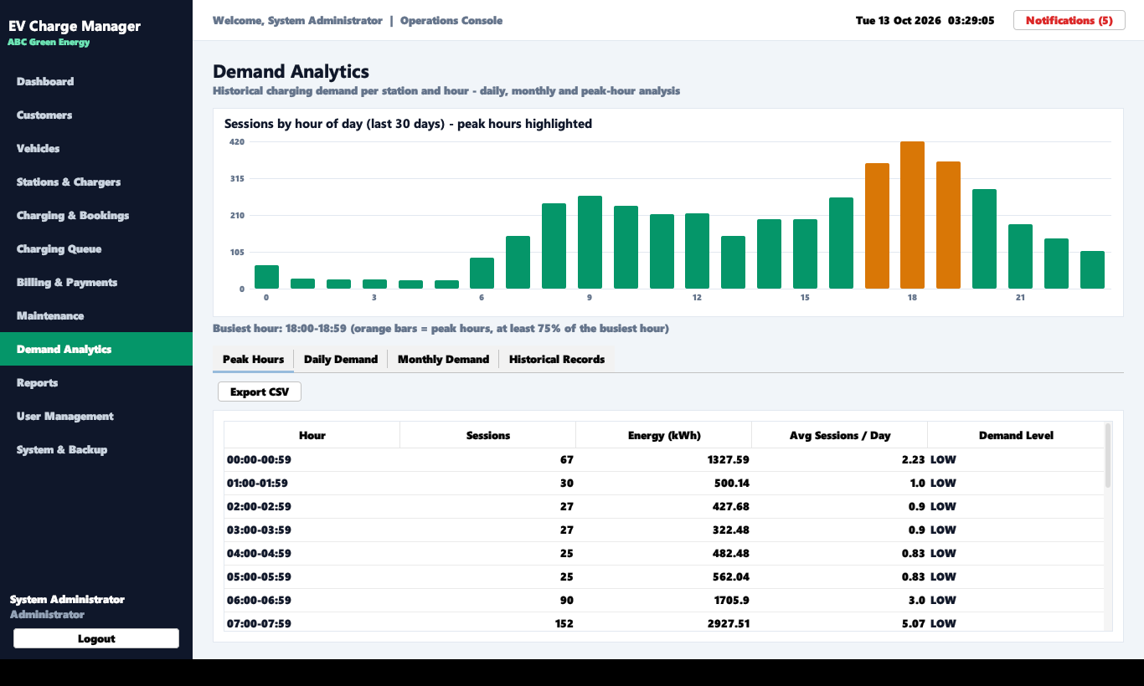
Demand analytics: the data the AI model needs
Peaks 5–8 pm and 8–10 am
Every completed session updates hourly demand_records per station: about 9,300 rows.
Daily, monthly and peak-hour reports, CSV import and export.
This is the training data a future AI forecasting model needs.
Notes:
This is the bridge to the Shell.ai challenge: the hourly demand table per station is exactly the input a forecasting model needs.

Slide 13
Java course modules demonstrated
Module | Concepts | Where in the project
I Fundamentals | Strings, arrays, loops, operators, validation | Validator (regex), PasswordUtil, int[24] hourly demand
II OOP | Classes, inheritance, interfaces, polymorphism, packages | Person / Charger hierarchies, Billable, CrudPanel<T>
III Exceptions, threads, files | Custom exceptions, thread queue processing, CSV, logging | 7 exceptions, QueueProcessor, QueueSimulator, CsvUtil, AppLogger
IV Collections and GUI | ArrayList, Queue, Stack, HashMap, lambdas, Swing events | PriorityQueue wait estimate, undo Stack, 12 Swing screens
V JDBC and web | JDBC CRUD, MySQL, Servlets, HTTP, JSP | BaseDao, Transaction, 13 servlets, AuthFilter, JSP dashboard
Notes:
Every course module maps to concrete classes. The full mapping table is in the README and the design document.

Slide 14
Testing and quality
33
58
< 0.5 s
5
automated JUnit tests, all passing
test cases incl. manual and web
every report (target: 10 s)
bugs found and fixed
Unit: password hashing, validation, energy and bill maths, CSV round trip, multithreaded simulation
Integration (real MySQL): login and lockout, duplicate prevention, start/stop/pay, customer self-stop, queue auto-allocation, double-booking prevention, role checks
Security: PBKDF2 + salt, PreparedStatements (no SQL injection), HTML escaping (no XSS), session-fixation protection, invoice ownership checks
Notes:
Testing caught real bugs: an invoice-number collision, a port conflict on 8080, and test repeatability problems. All are fixed and documented in the test report.

Slide 15
From spreadsheets to a smart, data-ready charging network
Next: AI demand forecasting · charger placement optimisation · GIS maps · real payment gateway · mobile app on /api/stations
Thank you — Questions?
Notes:
Summary: all 12 functional requirements are delivered in desktop and web interfaces on one database, and the demand data needed for Shell.ai-style AI modules is already being collected. Invite questions; keep the desktop and web apps open for live demos.

