Slide 1

PROJECT-BASED LEARNING
PHASE-II EVALUATION
SOUNDSYNC : Smart Music Player
Team ID: DSCPP-III-2026-T201
Department of Computer Science & Engineering
Graphic Era (Deemed to be University), Dehradun
Academic Session 2026–27

Slide 2
Team & Mentor Details
Team Information
Team Members
Team ID: Semester: Section: Domain:
DSCPP-III-2026-T201
3rd
K , E , ML-1
DSA & OOPs with C++
Sanya Goel – 2510010795
Manvi Arora – 2510010232
Eshu Ram – 2510011472
Mentor
Mr. Abhinav Kotnala
Interactions completed: 6
2/10

Slide 3
Phase-I Recap & Feedback Incorporated
Phase-I Status
Phase-I established the basic design of SoundSync, focusing on song library management, playlist organization, C++ OOP concepts, data structures, and file handling.
Feedback Received
Improve the user interface.
Ensure proper module integration.
Perform thorough system testing.
Changes Incorporated
Added login and role-based access.
Planned integration of frontend and backend modules.
Improved patient record management.

Slide 4
Problem Statement & Finalized Objectives
Problem Statement
Our project solves the real-world problem of managing growing personal music libraries by providing an organized system for fast song access, personalized playlist management, and efficient music playback.
Finalized Objective:
Organized the project into Song, MusicLibrary, Playlist, and MusicPlayer modules.
Implemented playlist operations using a Doubly Linked List.
Added song searching and library management features.
Included automated tests for core OOP and DSA functionality.

Slide 5
Updated System Architecture / Workflow
User
/ Web Interface
Input Validation
C++
Songs Modules
Results
/ Records
File Storage
Major Components
Web interface for songs and playlist management.
C++ modules for song library and its functions.
File handling for saving and loading playlist.
Changes Since Phase-I
User interface and songs access.
Playlist Management according to songs, artist are implemented.
Improved coordination between different modules.
5/15

Slide 6
Module Design & Functional Requirements
Major Modules
Login and access control
Songs Management
Music Library Management
Playlist Management
Music Player Control
Functional Requirements
Store and display song details.
Search songs by title, artist or ID.
Add and remove songs from playlists.
Navigate forward and backward through playlists..
Control playback states: play, pause, resume and stop.
Module Dependency
The Song class provides song data to the MusicLibrary and Playlist modules. The MusicPlayer interacts with songs and an optional active playlist to manage track selection, navigation and playback states.

Slide 7
Technology Stack & Development Methodology
Technology Stack
Programming Languages: C/C++
Frontend Technologies: HTML, CSS and JavaScript
Core Concepts: OOPs, Data Structures and Algorithms
Development Tools: Visual Studio Code
Storage: File Handling
Version Control: Git / GitHub
Thnology Stack
Technology Stack
Development Methodology
Requirement Analysis
System Design
Module Development
Integration
Testing & Validation

Slide 8
Implementation of PBL Course Concepts
Course | Concepts Actually Implemented | Project Module
Data Structures in C | Vectors, Linear Searching, Dynamic Array | Music Library Management
Data Structures in C | Doubly Linked List, Node Insertion and Deletion, Pointer Traversal | Playlist Management
OOPs with C++ | Classes, Objects, Encapsulation,Constructors and Getters | Song Management
OOPs with C++ | Composition, Association, Member Function and State Management | Music Player Control

Slide 9
Module | Status | Work Completed
User Authentication | In Progress | Login and registration
Song Management | Completed | Song details, constructors and getters
Music Library | Completed | Song storage, searching and catalog management
Playlist Management | Completed | Doubly Linked List, insertion and deletion
Music Player | In Progress | Play , pause, resume,stop and track navigation logic
File Handling | In Progress | Song loading and playlist saving functionality
Audio Integration | Pending | Actual MP3 playback using an audio backend
Overall Completion: 65 %

Slide 10
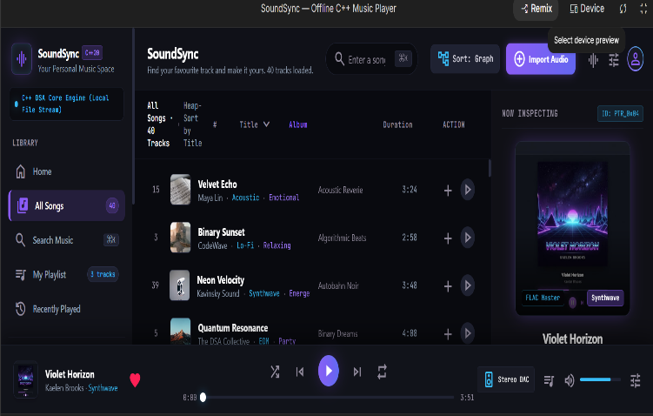
Working Prototype / Demonstration
Implemented Features
Song Library Management and Search
Playlist Management using Doubly Linked List
Add and Remove Songs from Playlist
Next and Previous Track Navigation
Music Player Controls: Play, Pause, Resume and Stop
File Handling and Automated Testing
Prototype / Output
Insert screenshot / output / prototype evidence here

Slide 11
Testing, Results & Validation
Test / Module
Expected Result
Observed Result
Status
Music Library
Song Search
Playlist
Management
Track Navigation
Music Player
40 songs loaded successfully
Song catalog loaded
Pass
Search songs by title and artist
Add and remove songs correctly
Next and previous track work correctly
Play, pause, resume and stop states work correctly
Search results displayed
In Progress
Playlist operations performed
Pass
DLL navigation tested
State transitions tested
In Progress
Pass
Result/Validation
The SoundSync prototype includes music library management, song searching, Doubly Linked List playlist operations, track navigation, and music player state controls. Automated tests are provided to validate core OOP and DSA functionality.

Slide 12
Repository Information
GitHub Link: https://github.com/sanyagoel02/SOUNDSYNC-.github.com
README.md: Updated
Contributors: All team members added as contributors
Repository Status: Updated
Branches: Separate branches used for individual module development.
Development Activity
Regular commits maintained
Meaningful commit messages
Individual contribution visible
Latest implementation uploaded
Documentation maintained
Changes tested before integration into the main branch

Slide 13
Individual Contribution
Member | Role | Technical Contribution | GitHub Commits
Sanya | Team Lead | System coordination and integration | e6e4313
Manvi | Developer | User Interface | 4e88e55
Eshu | Developer | Playlist management | 565c587

Slide 14
Challenges,Remaining Work & Phase-III Roadmap
Challenges Faced
Managing song records across multiple modules.
Keeping playlist navigation and MusicPlayer states consistent.
Synchronizing track selection with playback state transitions.
Ensuring reliable song search and file operations.
Solutions / Learning
Used separate header and implementation files for modular programming.
Used encapsulation and getter methods in the Song class.
Phase-III Roadmap
Improve file handling and error handling.
Improve playlist management and track navigation.
Integrate MP3 decoding and actual audio playback.
Complete project documentation and final demonstration.

Slide 15
Expected Outcomes & References
References
Bjarne Stroustrup, The C++ Programming Language, Addison-Wesley, 2013.
cppreference.com, C++ Language and Standard Library Reference.
GeeksforGeeks, Data Structures and Algorithms.
Miniaudio, Single-File Audio Playback and Capture Library.
Expected Final Outcomes
Song stores private data and provides getters.
MusicLibrary uses std::vector<Song> and linear search.
Playlist supports adding, removing, and navigating songs.
MusicPlayer manages stopped, playing, and paused states.
Thank You
Questions & Suggestions

