Slide 1

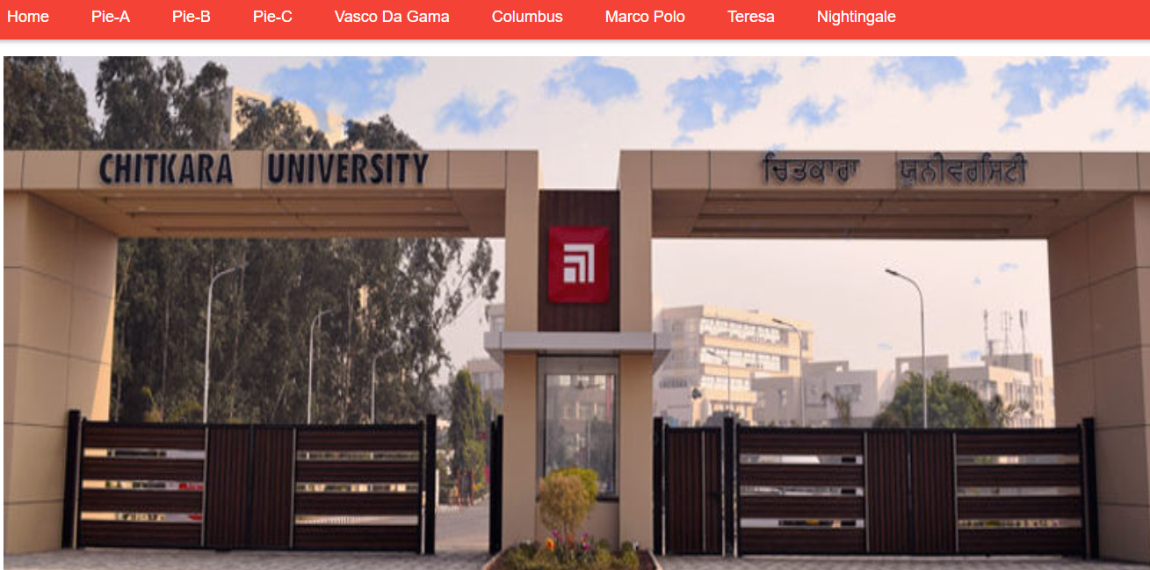
DEVELOPED BY :-
Saksham 1610991756
Sanyam 1610991772
Sarabjit 1610991773
Sarthak 1610991777

Slide 2
Project Statement:
Due to Lack of time and Lack of platform it is not possible for the students as well as staff to share their problems & to brainstorm for the solution.
The aim to develop this website to give the university students where they can share their day-to-day problems/suggestions with the management regarding the hostel stay, food, mess facilities, laundry, etc.

Slide 3

Abstract:
So as to deal with the problem we have developed an online discussion Forum where students could post their grievances and reviews which could be viewed and addressed by the authorities. It is hoped that this project would help providing students a platform to share their views.

Slide 4



Technology Used:
Front-End/Programming Tool: HTML,CSS,Java Script .
Back-End: Firebase.
For Real World Implementation: Firebase console.

Slide 5
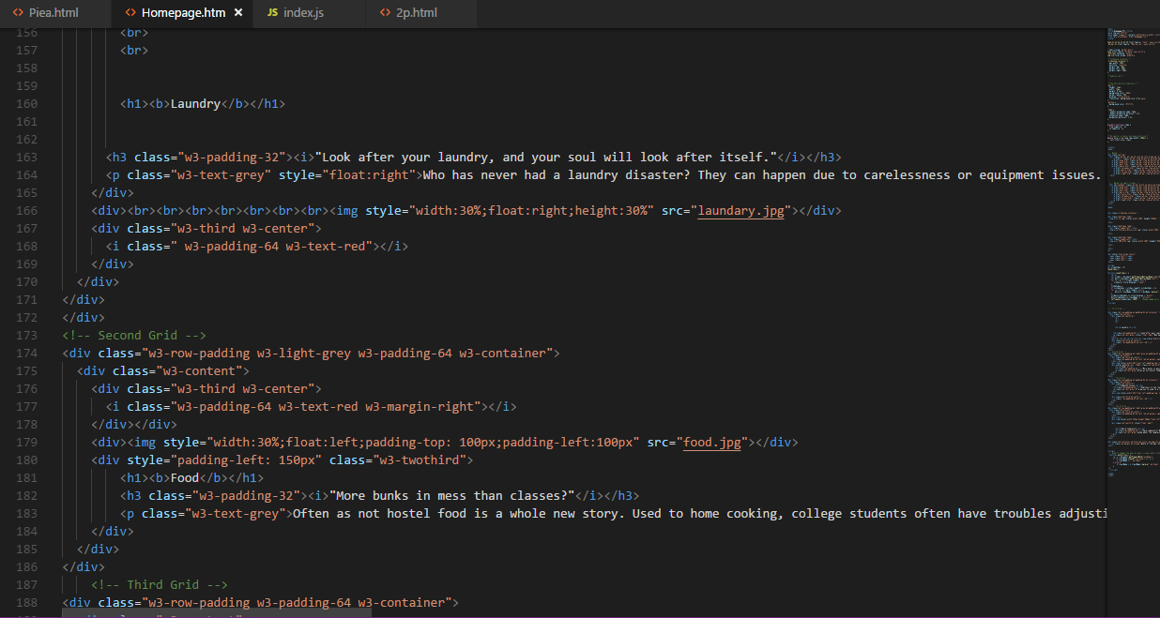
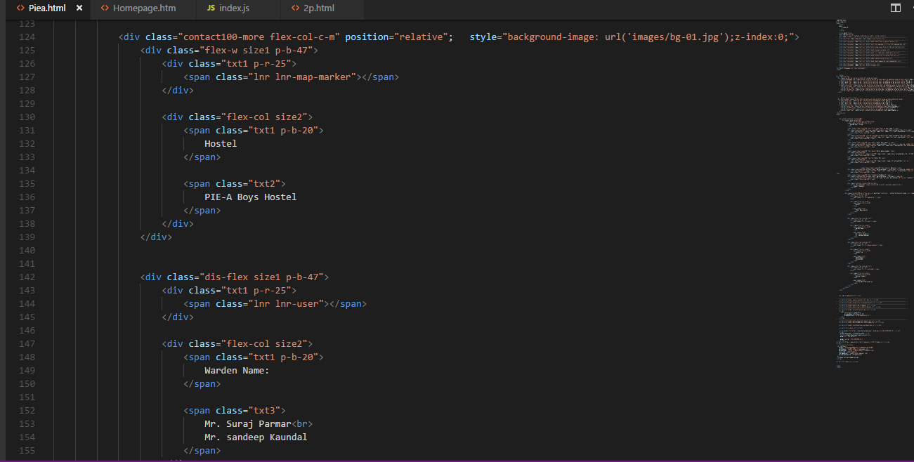
Stages of the project:

Slide 6
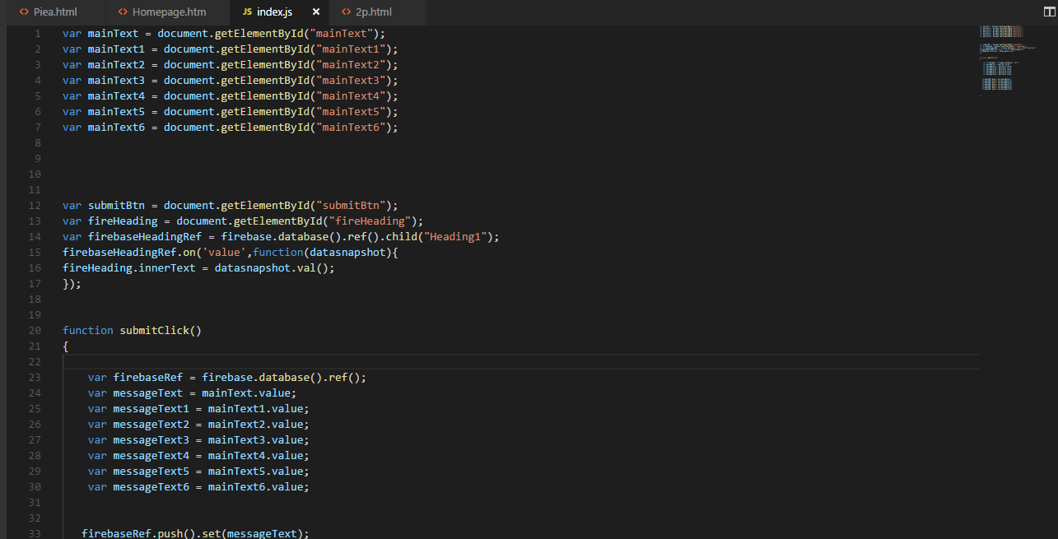
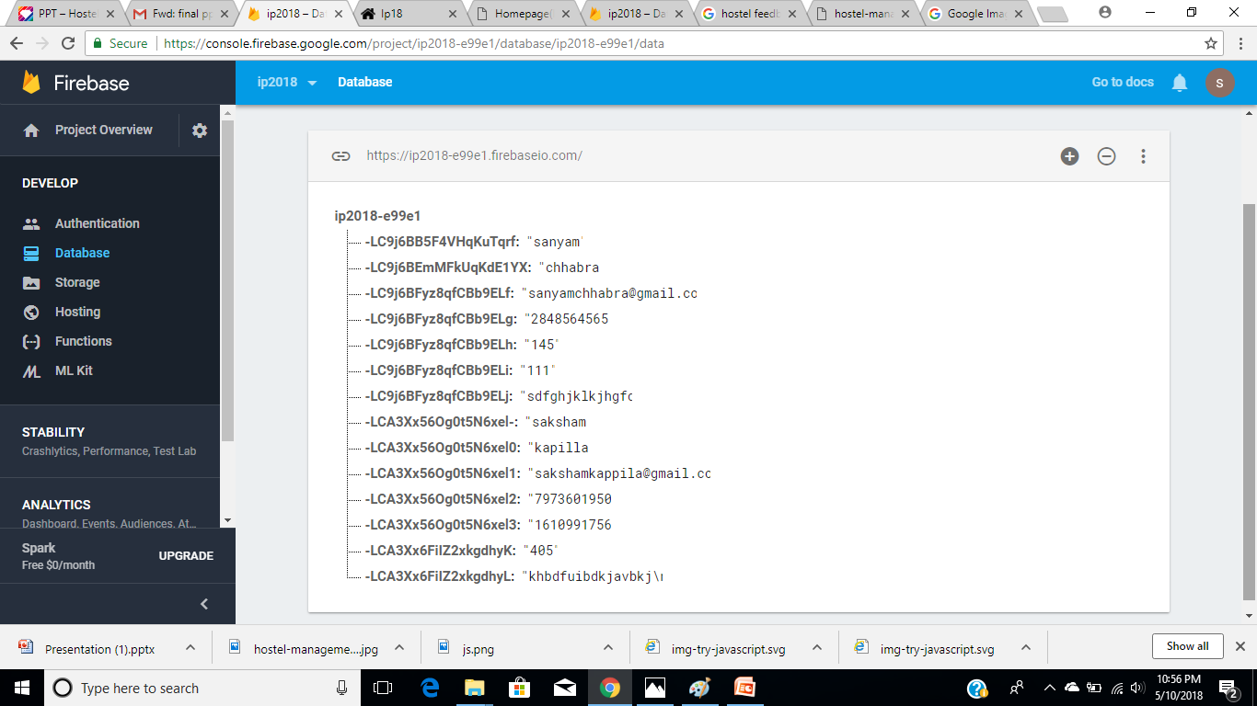
Stages of the project(contd..):
Testing on localhost

Slide 7
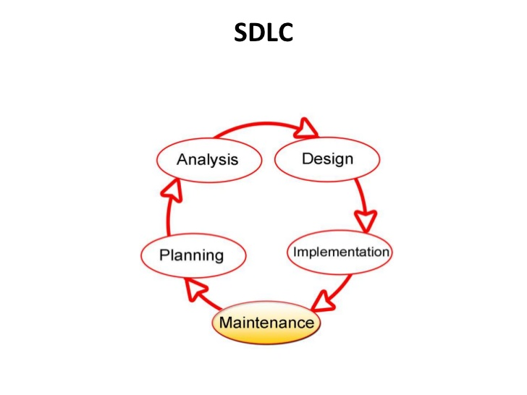
Flow Diagram:
Only Admin could create categories e.g Hostel-1(so all the issues regarding this hostel would be posted under this category)
To submit your feedback you need to review your problems that’s it.

Slide 8
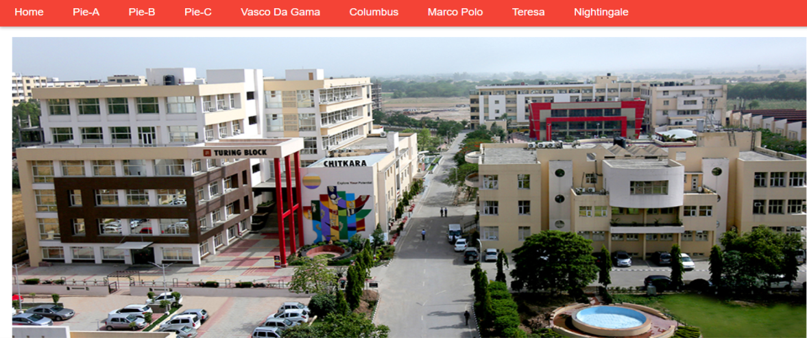
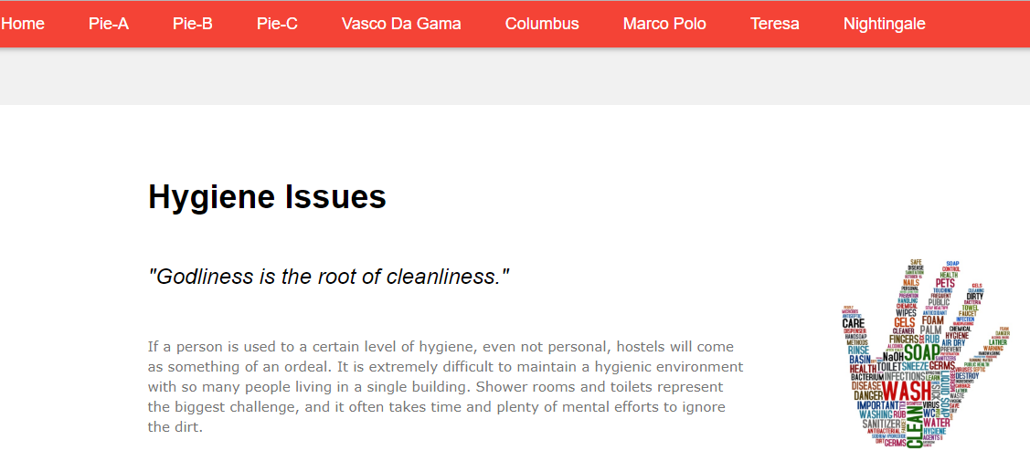
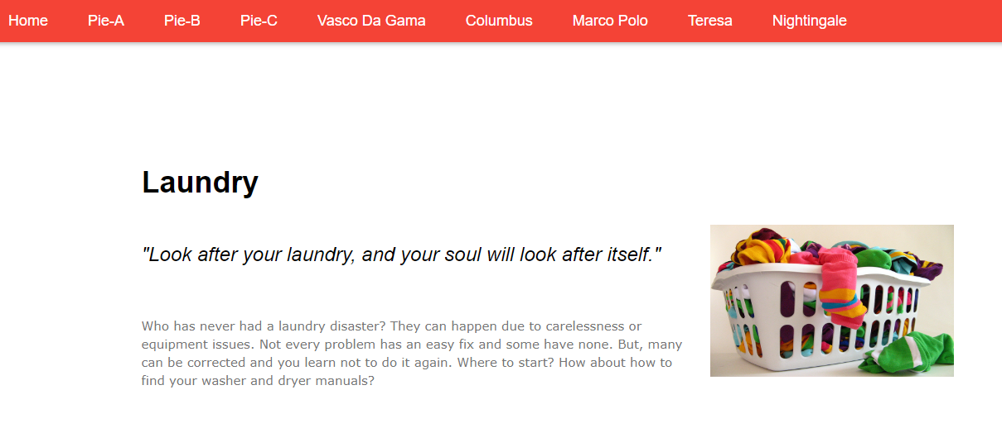
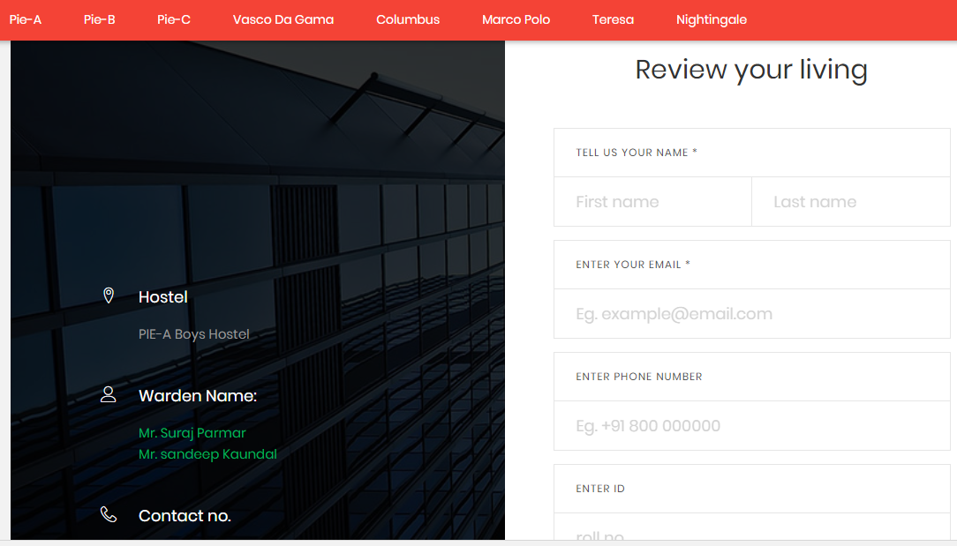
Snapshots:

Slide 9
Future Scope:
In near future we further plan to make this project into an android/ios application.
Improve the user experience based on reviews.
Add a chat window for students to directly talk to the staff in real-time.

