Slide 1
Team Name
Terabyte
Project Name
Registration made Easy

Slide 2
Idea/Problem Statement
In today’s world, where everything is computerizing enormously and time becomes more and more costlier, who has the time to do offline registration.
To do registration of every semester, students have to stand in long queue to get verified their documents and even on the administration side, it is hectic to check all the DU number and their payments manually.

Slide 3
Proposed Solution
What if we can do it just by sitting in our rooms?
So the basic idea of our approach was to automate the whole process. In which a forum has been created for students side to upload their documents and for administrative side, a Desktop app has been created which will verify both the Du number provided by the students and the bank statement

Slide 4
Implementation Details
Forum has been created with the help of Html, Css, Java Script.
GUI of Desktop has been implemented with TKinter and backend has been created with Pymongo, Xlrd,
Xlwt, Node and mongo database.

Slide 5
Future Work
Automating the reading of pdf file using OCR.
Improving the UI/UX of desktop app.
Enhancing the UI/UX of details form.
Using Otp verification for student login.
Sending Emails to the students after successful verification.

Slide 6
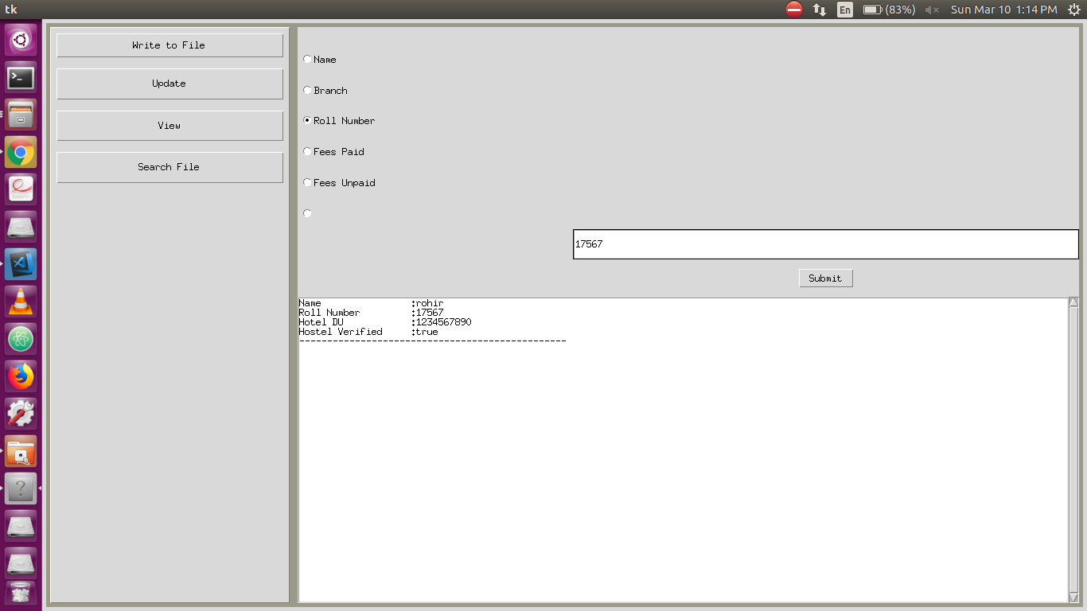
Screenshot of the working of Desktop App and Form

