Slide 1

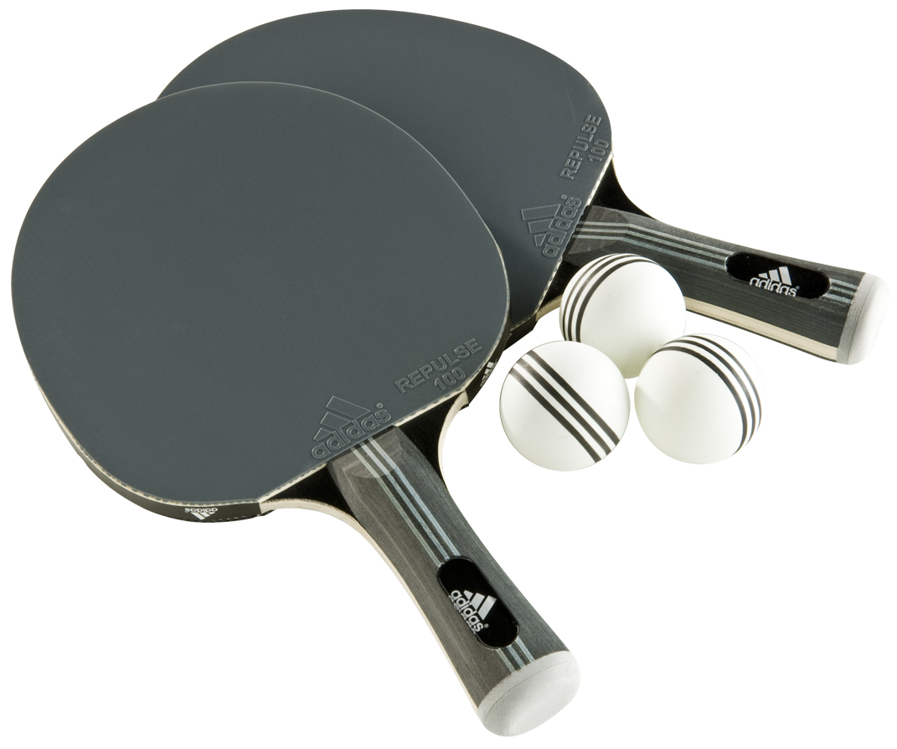
Tournament
Table
Tennis
SCS Pune
Presented By: Sanyam Kamat, Manu Garg
Prepared For: SCS Managers
Date: March 9, 2015

Slide 2

Birds Eye View
TTT - PUNE
PARTICIPANTS
TEAMS
DAYS
WINNERS
MATCHES

Slide 3


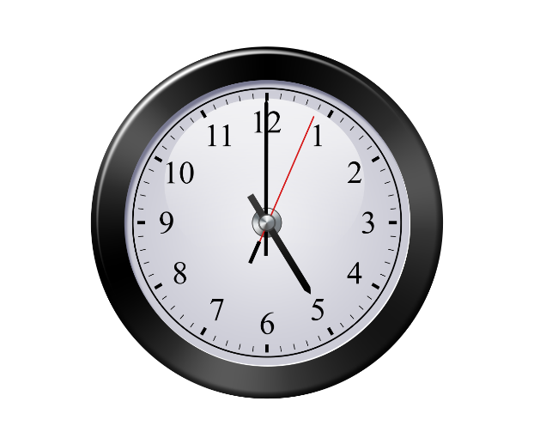
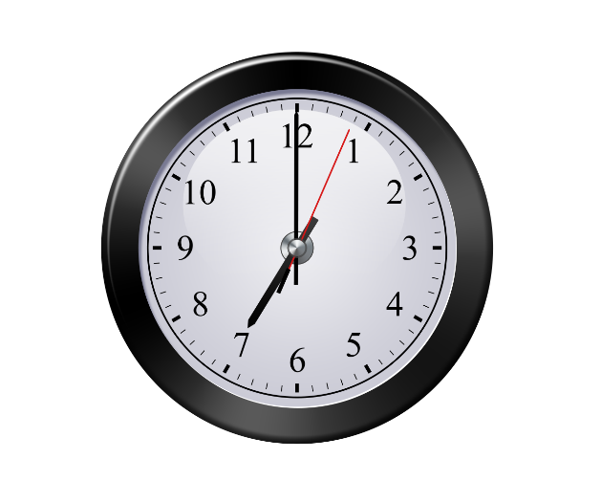

Date, Time, Venue
TTT - PUNE

Slide 4
Categories
TTT - PUNE
Men’s Singles
Doubles (M+W)
Women’s Singles
Note: There are no separate Women’s Doubles and Mixed Doubles matches as such, because of low women headcount and less number of women TT players in SCS Pune.

Slide 5
Players and Referees
TTT - PUNE
Players | Men's Singles | Women's Singles | Doubles
Ajay | ü |  | ü
Akhil | ü |  | ü
Alin | ü |  | ü
Alok | ü |  | ü
Amrit | ü |  | ü
Anil | ü |  | ü
Debajyoti | ü |  | ü
Dhrubajyoti | ü |  | ü
Geetanjali |  | ü | ü
Govind | ü |  | ü
Hemant | ü |  | ü
Henish | ü |  | ü
Jayant | ü |  | ü
Jayendra | ü |  | ü
Kaushal | ü |  | ü
Mahalappa | ü |  | ü
Manguesh | ü |  | ü
Manu | ü |  | ü
Mayukh | ü |  | ü
Players | Men's Singles | Women's Singles | Doubles
Nikhil | ü |  | ü
Pradeep | ü |  | ü
Prakhar | ü |  | ü
Rahul M. | ü |  | ü
Ranjan | ü |  | ü
Ravi | ü |  | ü
Ruptanu | ü |  | ü
Sanyam | ü |  | ü
Shantanu | ü |  | ü
Sharan | ü |  | ü
Shyamali |  | ü
Smita |  | ü | ü
Sri Sai | ü |  | ü
Srikant | ü |  | ü
Srinivas | ü |  | ü
V. Goyal | ü |  | ü
V. Gurumukhi | ü |  | ü
Vebito | ü |  | ü
REFEREES
Vijay Goyal
Manu Garg
Pradeep Singh
Sanyam Kamat

Slide 6
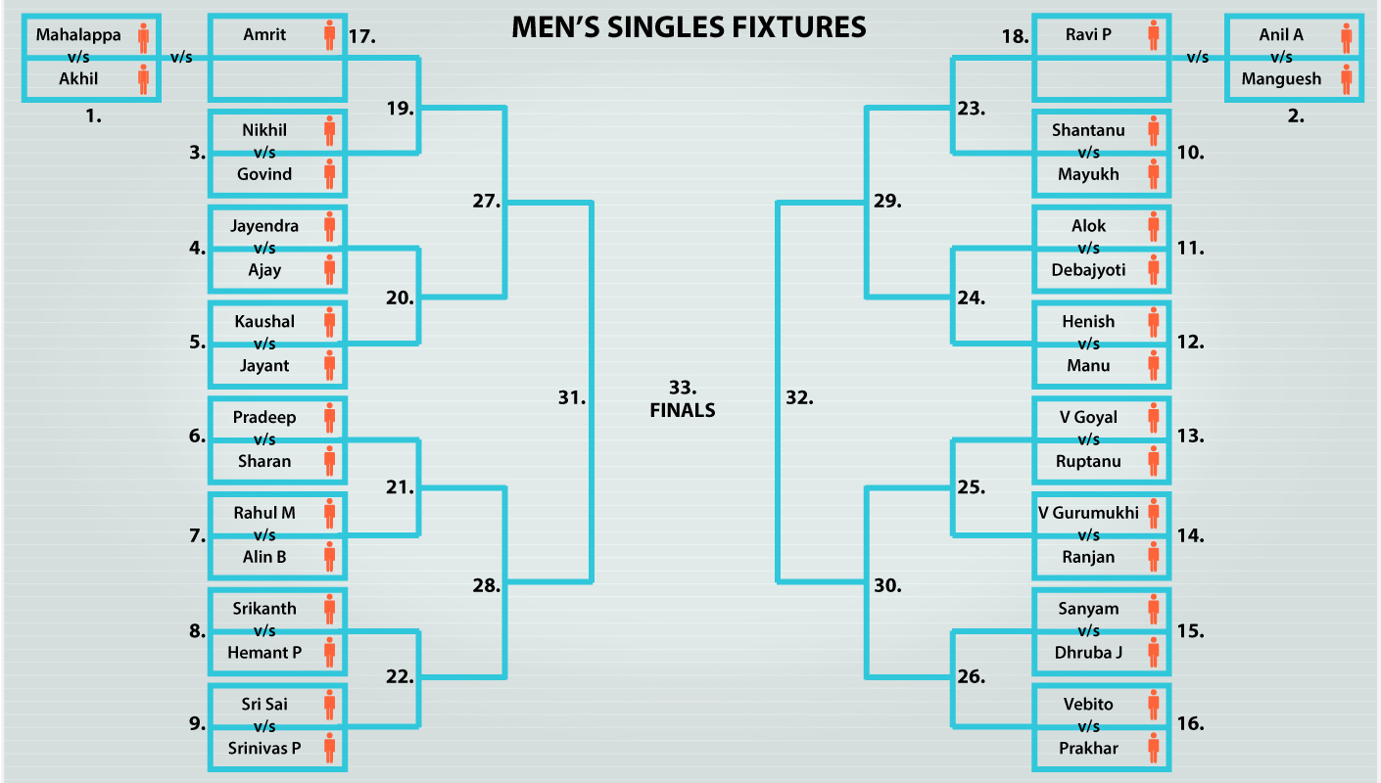
Men’s Singles Fixtures
TTT - PUNE

Slide 7
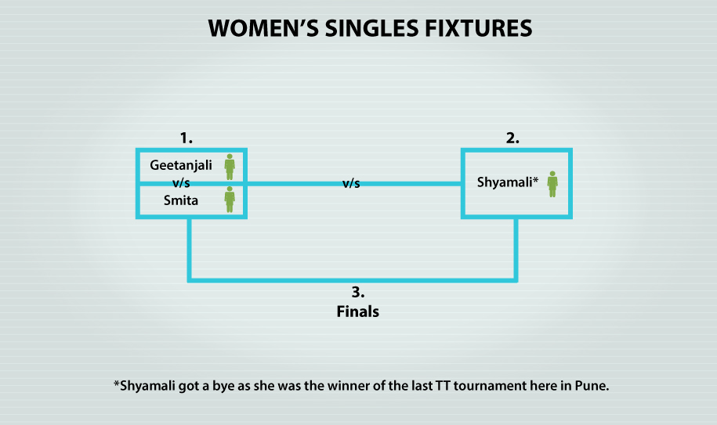
Women’s Singles Fixtures
TTT - PUNE

Slide 8
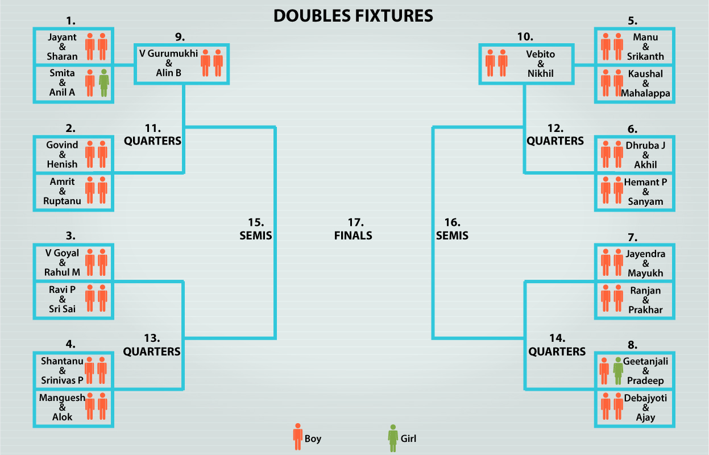
Doubles Fixtures
TTT - PUNE

Slide 9
Trophies and Vouchers
TTT - PUNE
Men’s Singles Winner
1 trophy
INR 750
Men’s Singles Runners Up
1 trophy
INR 500
Women’s Singles Winner
1 trophy
INR 750
Women’s Singles Runners UP
1 trophy
INR 500
Doubles Winners
2 trophies (1 each)
INR 750 (each)
Doubles Runners UPs
2 trophies (1 each)
INR 500 (each)

Slide 10
Notes
TTT - PUNE
Approvals have been obtained by all the managers for the event.
Matches will be held between 5PM to 7PM on weekdays.
Zumba classes for the weeks starting 16-Mar-2015 and 23-Mar-2015 will be preponed/cancelled.
No matches will be played on 20-Mar-2015 as it’s a holiday in Pune.
One player will not play more than a match per day.
One referee will not officiate in more than 4 matches per day.
For more rules and regulations, please refer the Rules and Regulations PDF.
For the detailed match schedule, please refer the schedule spreadsheet.

Slide 11
Thank You!

