Slide 1
Online Medical Management System
Created By:
Sanskar Bhuwania – 18BCP099(Team Leader)
Sanyam Raina – 18BCP100
Shrey Sanghvi - 18BCP107

Slide 2

Abstract
A hospital management system becomes essential for our lives, especially in this situation of a global pandemic. We have developed a GUI wherein the hospital can add entities like patients, doctors, laboratories, etc. A fast and easy to use solution is required for managing hospitals which saves many lives.

Slide 3

Stage 1
We listed the entities involved with the proper functioning of a hospital and listed each of their attributes.

Slide 4
StagStae 2
Stage 2
We created the classes to be implemented and created a basic structure upon which the system would function.

Slide 5
Stage 3
We created a visually appealing GUI for the user to add and view the entries in each entity.
We also added messages wherever required.

Slide 6
Functionalities
Create New Entity: Add new Doctor, Patient, Staff, Medicine etc.
View All Data: View all data at one place.
Close Active Window: Close the current window.
Close All Window: Close all windows.
About the system: About the system(creation and name).
Quit: Quit the system.

Slide 7
Flow Chart
Main
Doctor
Add New Entry
View Existing List
Patient
Add New Entry
View Existing List
Staff
Add New Entry
View Existing List
Medicine
Add New Entry
View Existing List
Facility
Add New Entry
View Existing List
Laboratory
Add New Entry
View Existing List
About
About

Slide 8


Exception Handling
File Not Found Exception: It occurs when data is displayed for the first time and there is no data entries
Number Format Exception: When ID entered is not an integer
IO Exception: When IO operation fails

Slide 9

File Handling
FileWriter (File file, boolean append) – constructs a FileWriter object given a File object
BufferedWriter(Writer out) - Creates a buffered character-output stream that uses a default-sized output buffer.
FileReader(File file) – Creates a FileReader , given the File to read from
BufferedReader(Reader in) : Creates a buffering character-input stream that uses a default-sized input buffer

Slide 10
Implementation Details

Slide 11
Components Of GUI Used
GUI Used: JAVA Swing
JFrame
JMenu Bar
JMenu
JButton
JLabel
JText Box
JCombo Box
JCheck Box
JTable
JOption Pane

Slide 12
Libraries Used
(other than the general ones)
java.awt.event.ActionEvent;
java.awt.event.ActionListener;
java.text.SimpleDateFormat;
java.util.Date;
javax.swing.JFrame;
javax.swing.JOptionPane;
javax.swing.table.DefaultTableModel;

Slide 13
Screenshots Of Project

Slide 14
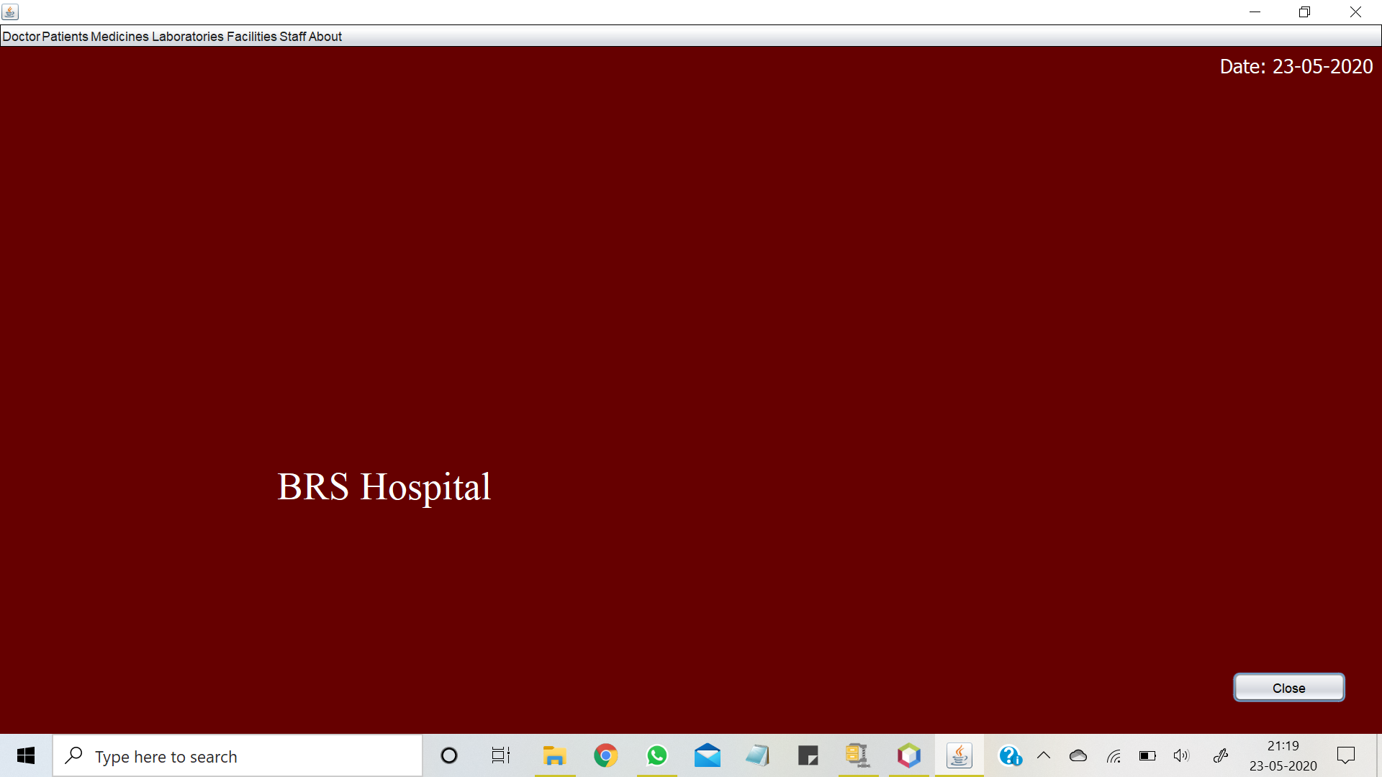
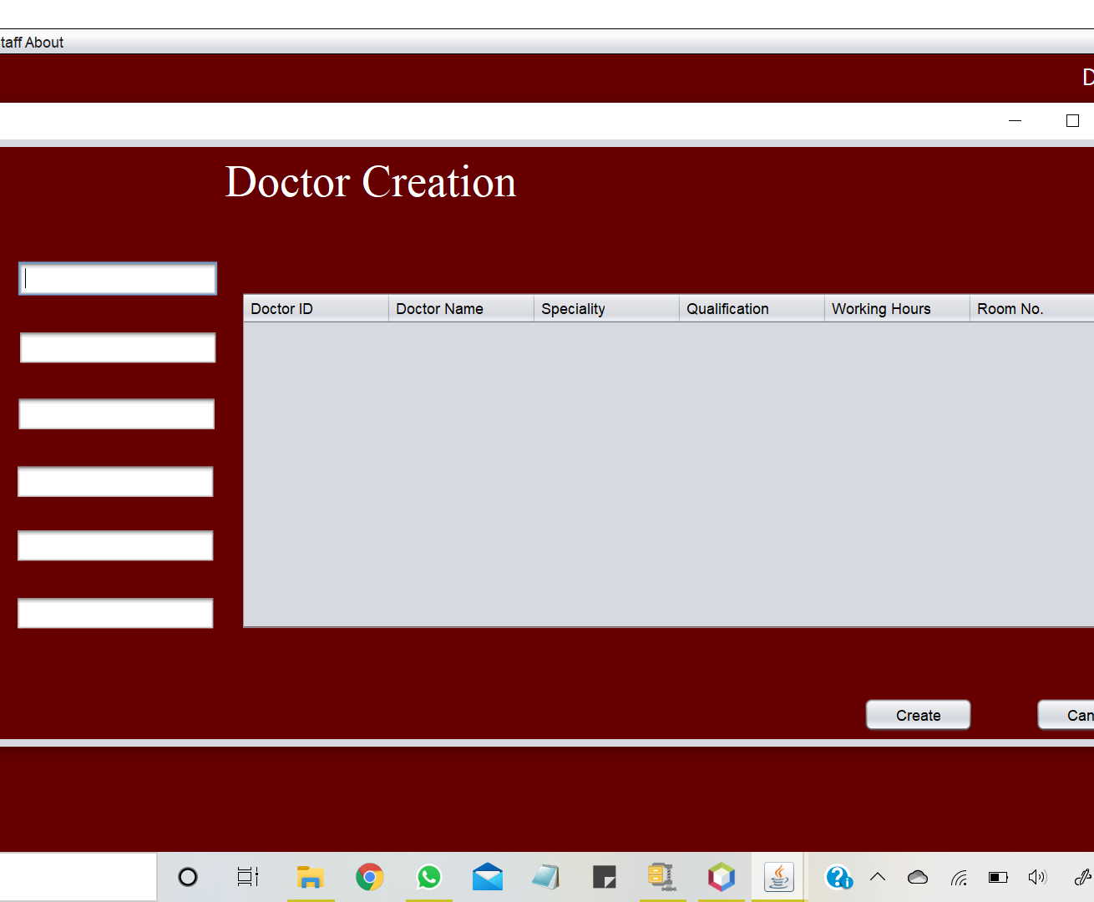
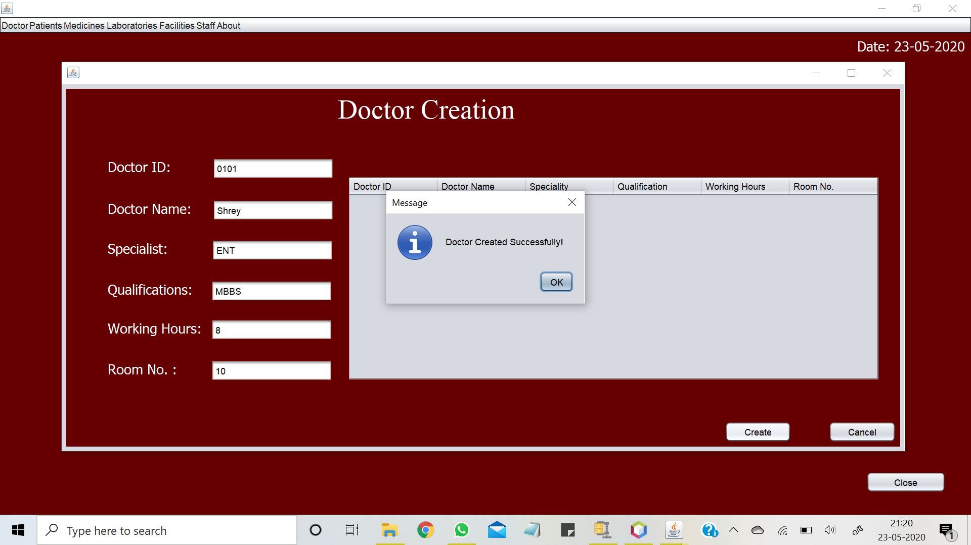
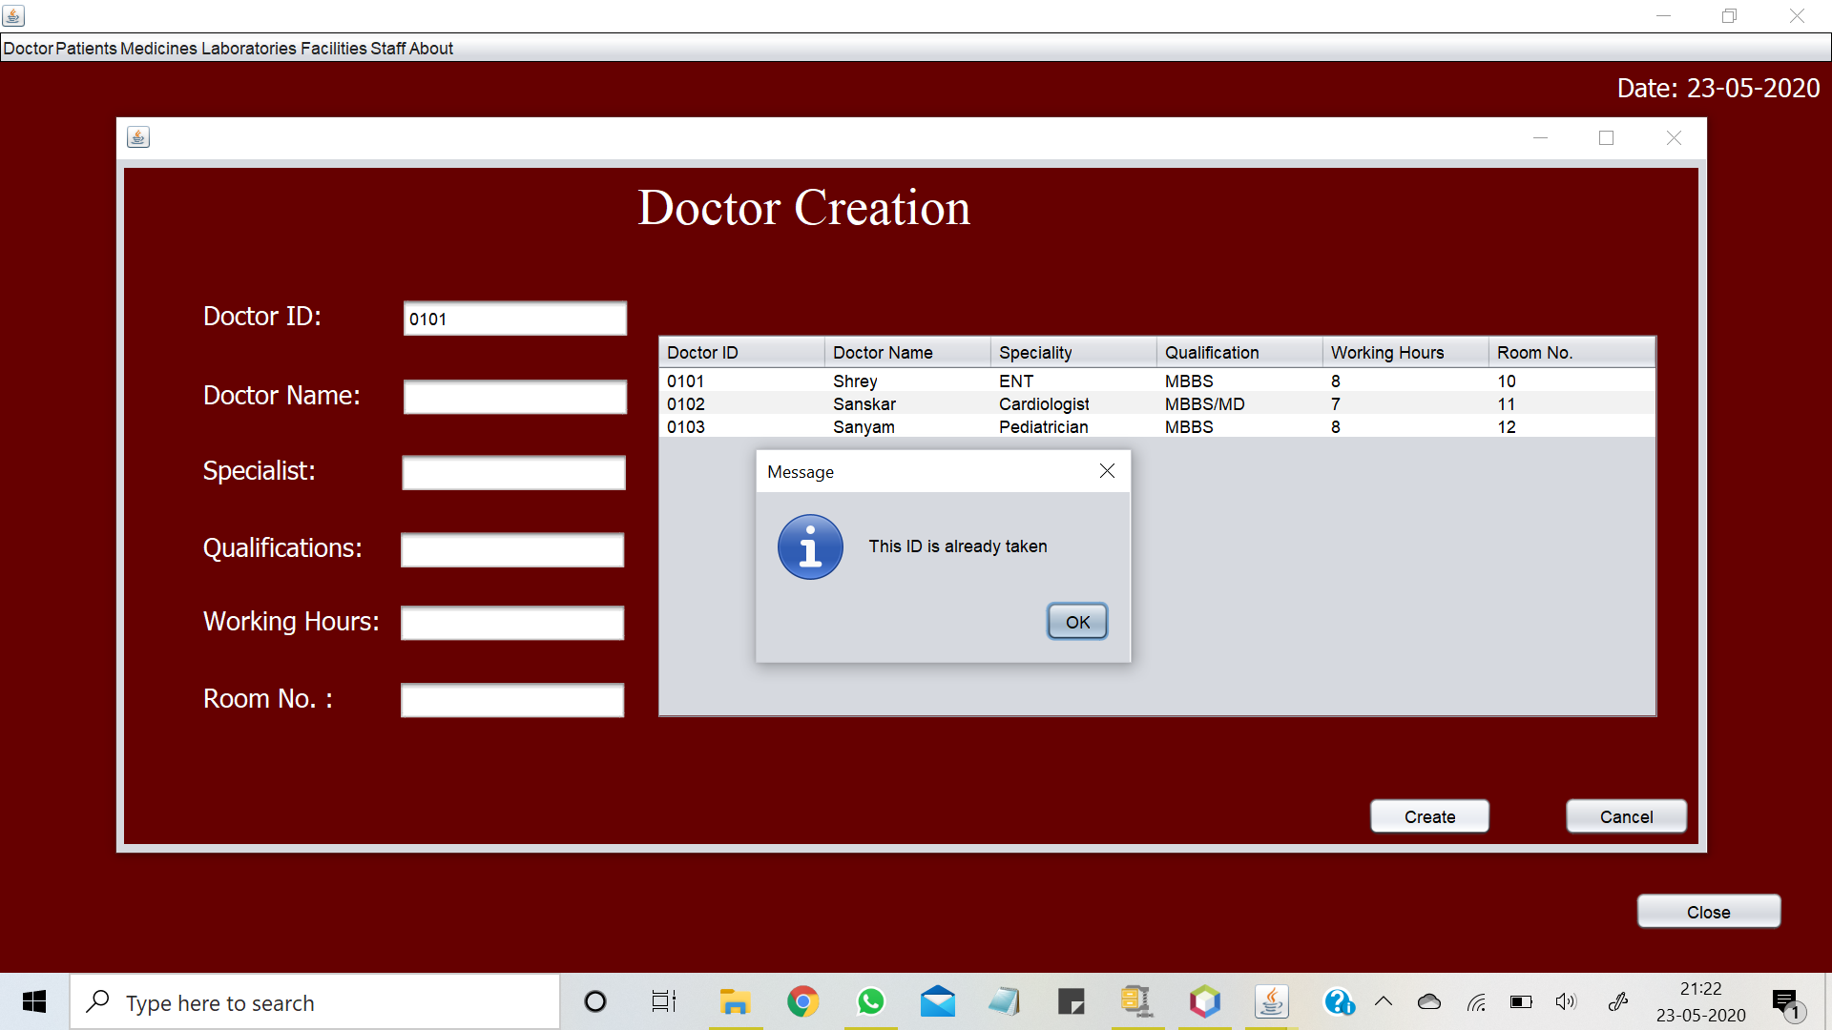

Slide 15
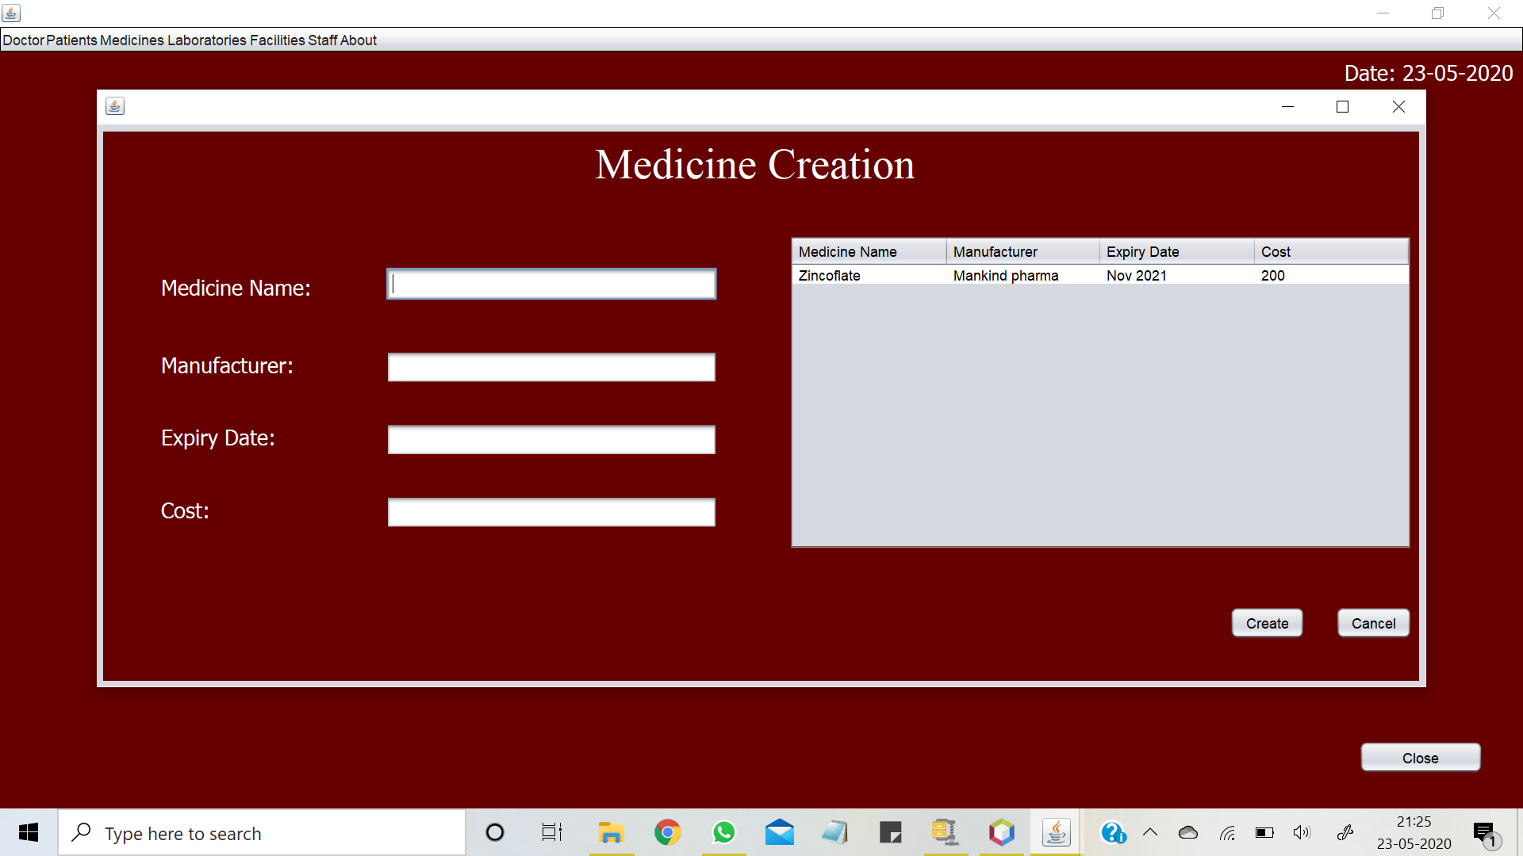
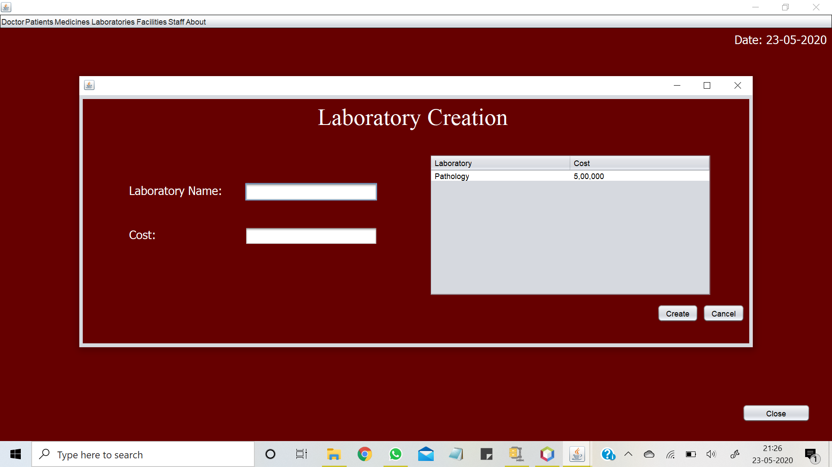
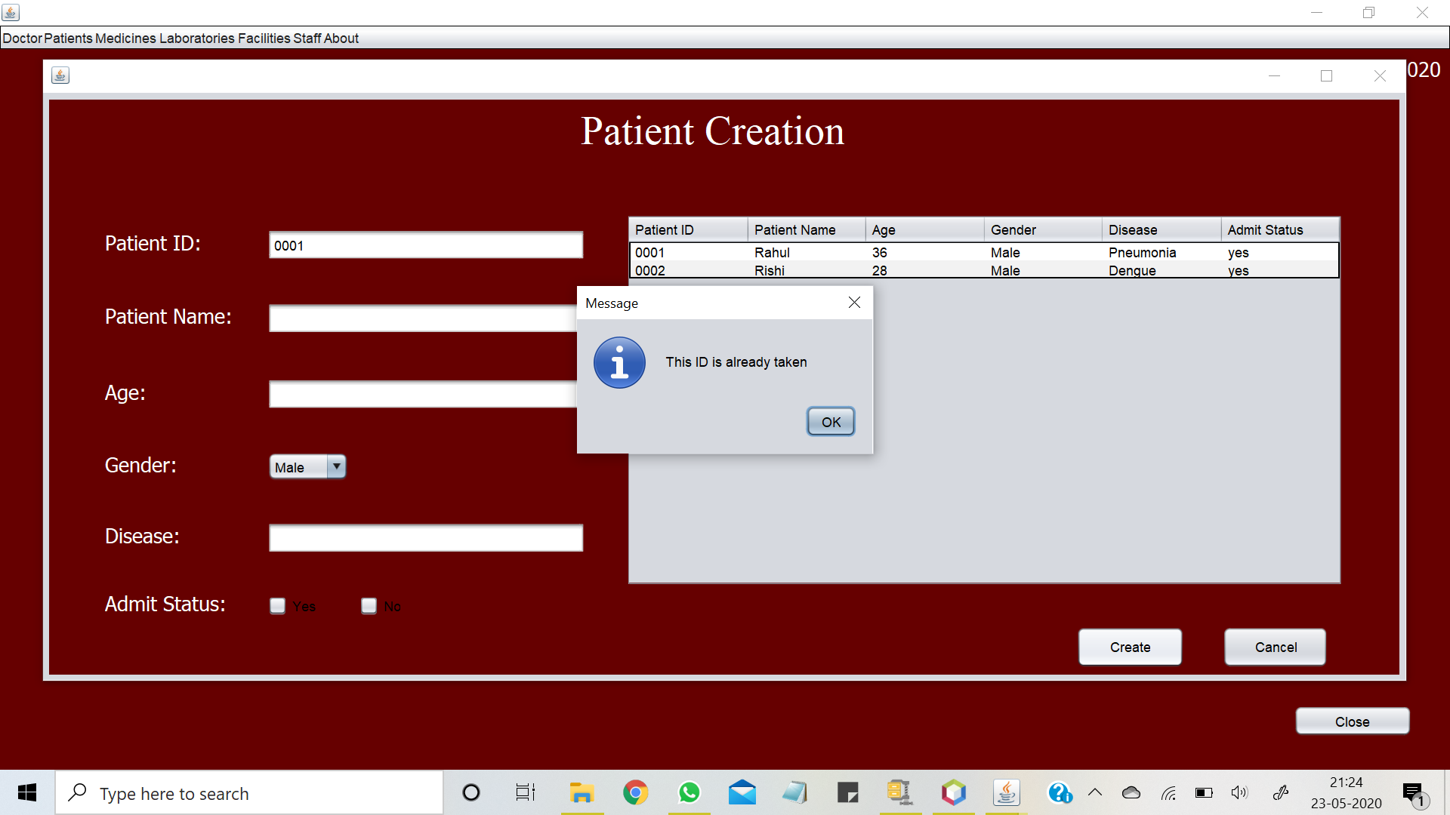

Slide 16
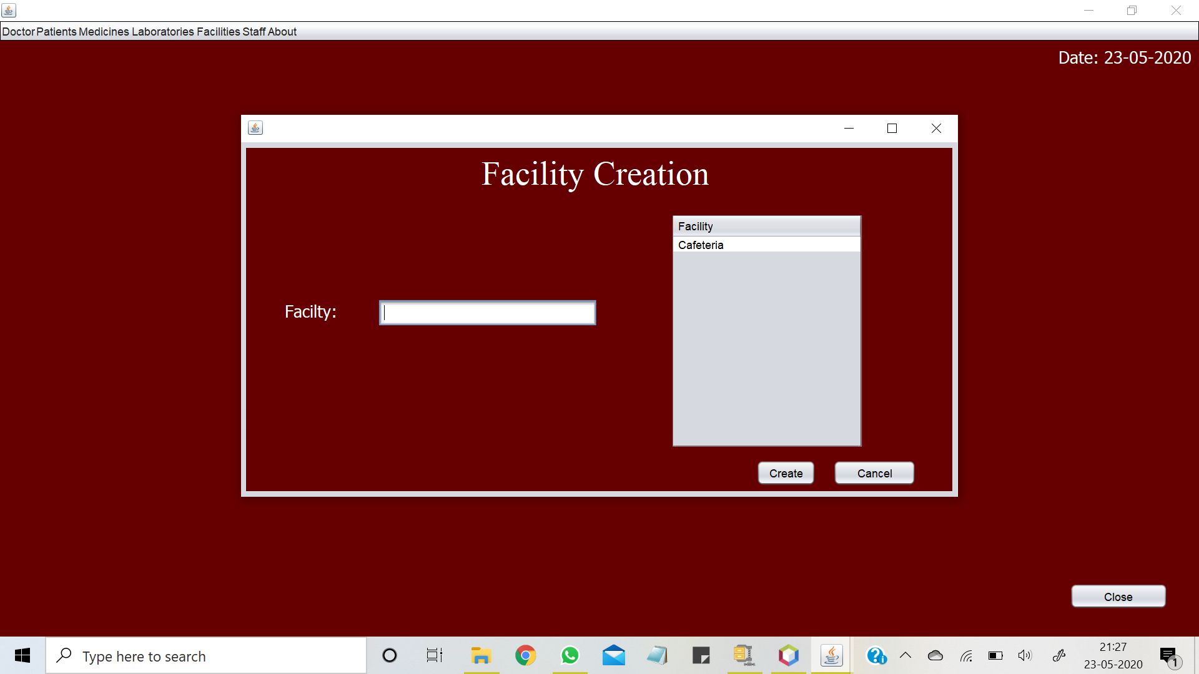
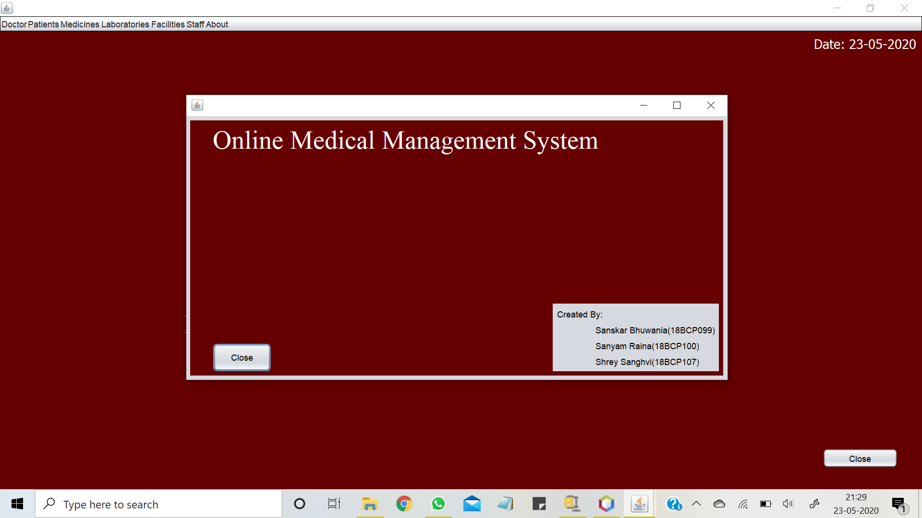
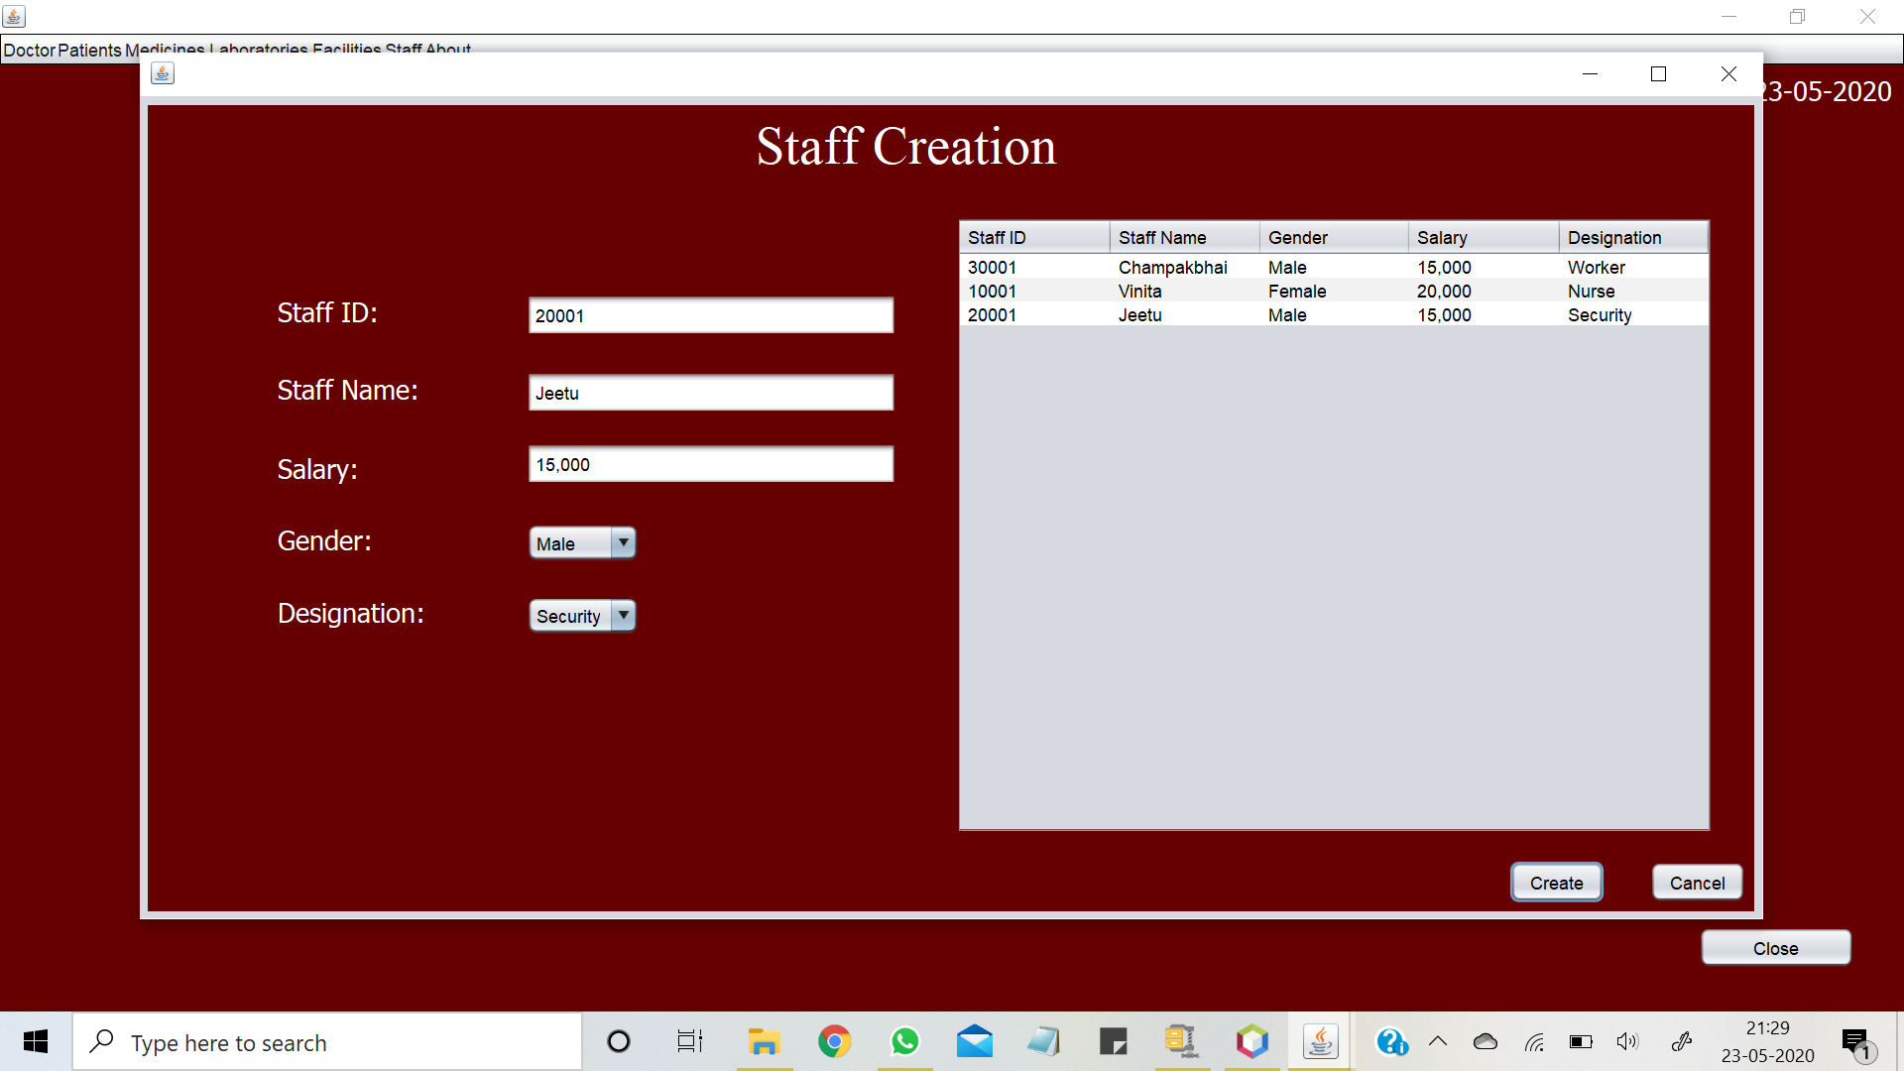

Slide 17
Application
Allows the user to add all the entities involved in a hospital management
User can also view those added entities and each of their attributes.
User can add doctors, patients, staff, medicines, laborataries and facilities.
One can manage these entities altogether while sitting in one spot

