Slide 1
Agri
Intel
A machine learning system to predict farmer income
43,173
105
3
20.24%
Farmer Records
Features
ML Models
Final MAPE

Slide 2
The Problem
The Real-World Challenge
Our Task
Banks need to assess if a farmer can repay a loan. But most small farmers in India have no bank statements, no credit history, and no formal financial records.
So how does a bank decide?
They estimate income from observable signals, land size, location, infrastructure access, soil quality, seasonal crop performance, and more.
Predict
Total annual income for each farmer
Dataset
43,173 records, 105 features per farmer
Metric
MAPE (mean absolute percentage error)
Bonus A
Recommend income-boosting interventions
Bonus B
Model seasonal income volatility as a credit risk signal
02

Slide 3
Pipeline Overview
1
2
3
4
5
6
7
Load Data
Sanitize
Columns
Encode
Feature
Engineering
Log
Transform
Train
Models
Ensemble
& Submit
Read train.xlsx
and test.csv
Fix special
characters in names
Handle text, temps,
location, missing vals
10 composite scores
from 105 columns
Compress skewed
income target
RF, LGB, XGB
+ CV tuning
Weighted blend
→ predictions.csv
How the Data is Split
Training Split (80% - 34,538 rows)
Model learns from this data
Validation (20%)
We test ourselves here
Test Set
Final submission
03

Slide 4
Data Encoding
ML models only understand numbers. Every column must be converted before training.
Temperature Columns
Location Column
"18/34" → col__min = 18, col__max = 34
"28.6, 77.2" → Location__lat, Location__lon
Stored as "min/max" strings. Split into two separate numeric columns so the model can use both independently.
Latitude and longitude combined in one string. Split so the model can learn geographic patterns from each coordinate.
Categorical Text
Missing Values
"Haryana" → 3, "Bihar" → 1 (Label Encoding)
Filled with median — computed on training set only
State names, soil types, crop types converted to numbers. Encoder fitted only on training data to prevent leakage.
Numeric columns with blanks are filled using the training median. No validation or test data influences this value.
04

Slide 5
Feature Engineering
105 raw columns were grouped into 10 composite scores. Each group captures one underlying concept about the farmer.
market_access_score
infra_feature_score
Road density, mandi proximity, railway access, village socioeconomic score
Electricity, pucca house, sanitation, wall material, house size
temp_rf_kharif_score
temp_rf_rabi_score
Temperature and rainfall for the Kharif (summer) growing season
Temperature and rainfall for the Rabi (winter) growing season
geo_kharif_22_score
geo_rabi_22_score
Geographic agricultural indicators for Kharif season 2022
Geographic agricultural indicators for Rabi season 2022
geo_kharif_21_score
geo_rabi_21_score
Geographic agricultural indicators for Kharif season 2021
Geographic agricultural indicators for Rabi season 2021
geo_kharif_20_score
geo_rabi_20_score
Geographic agricultural indicators for Kharif season 2020
Geographic agricultural indicators for Rabi season 2020
05
How: 1. Take raw columns for that group 2. MinMaxScaler → all columns scaled to 0–1 3. Average across columns → one score per farmer

Slide 6
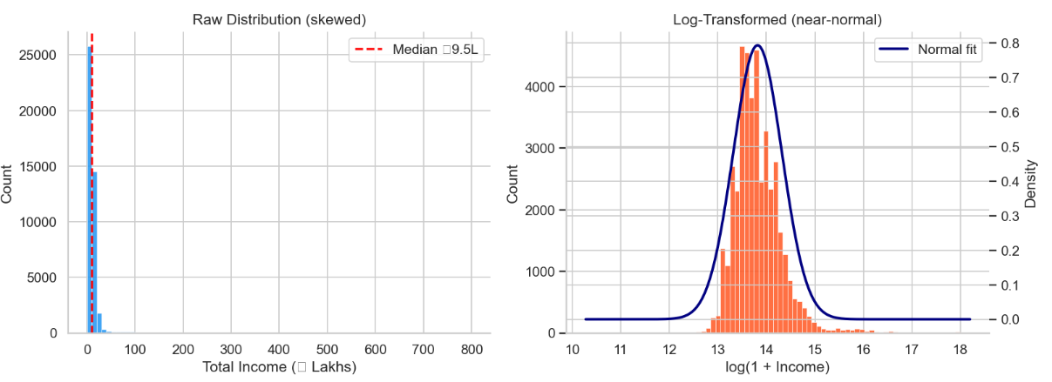
Log Transforming the Target
Why this matters
Raw income is heavily skewed. A few farmers earn 10x the median, which confuses models into chasing outliers. log1p(income) compresses the scale so all farmers are treated fairly.
The model trains in log space, then we reverse with
expm1() to get real rupee predictions.
python
y_tr_log = np.log1p(y_tr) # apply before training
y_val_log = np.log1p(y_val)
preds_raw = np.clip(np.expm1(model.predict(X_val)), 1, None) # reverse after predicting
06

Slide 7
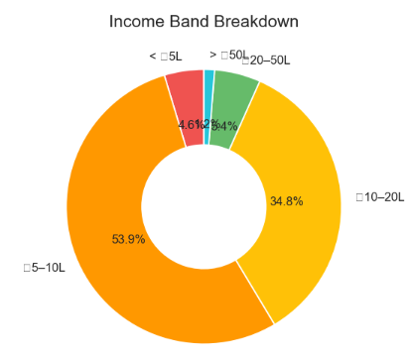
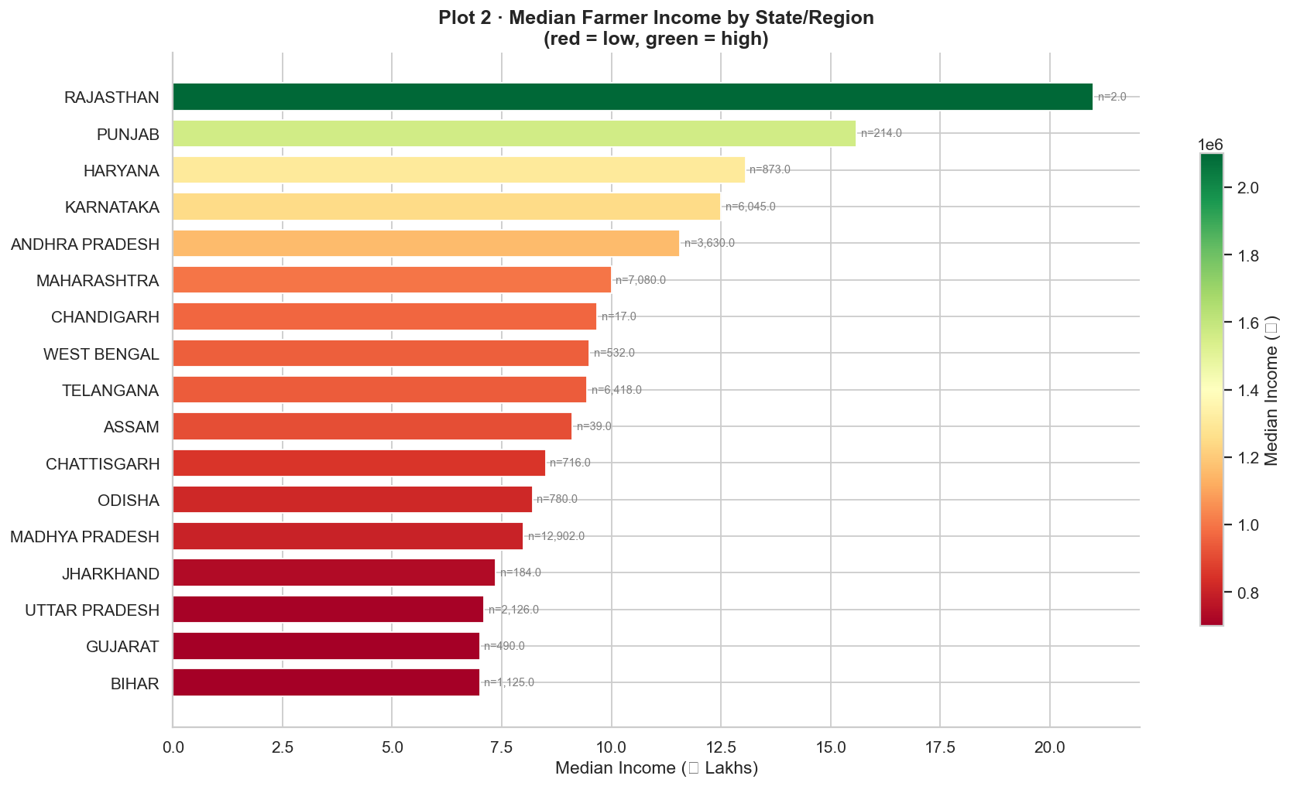
EDA - Income Distribution
88.7% of farmers earn between ₹5L and ₹20L.
State of residence is one of the strongest predictors.
The gap is structural, not climatic.
The bulk of the dataset is concentrated in this band, with the median sitting just under ₹10L.
Rajasthan, Punjab, Haryana farmers earn nearly twice the median compared to Bihar and Gujarat farmers.
High-income states share better irrigation infrastructure and market access, not better weather.
07

Slide 8
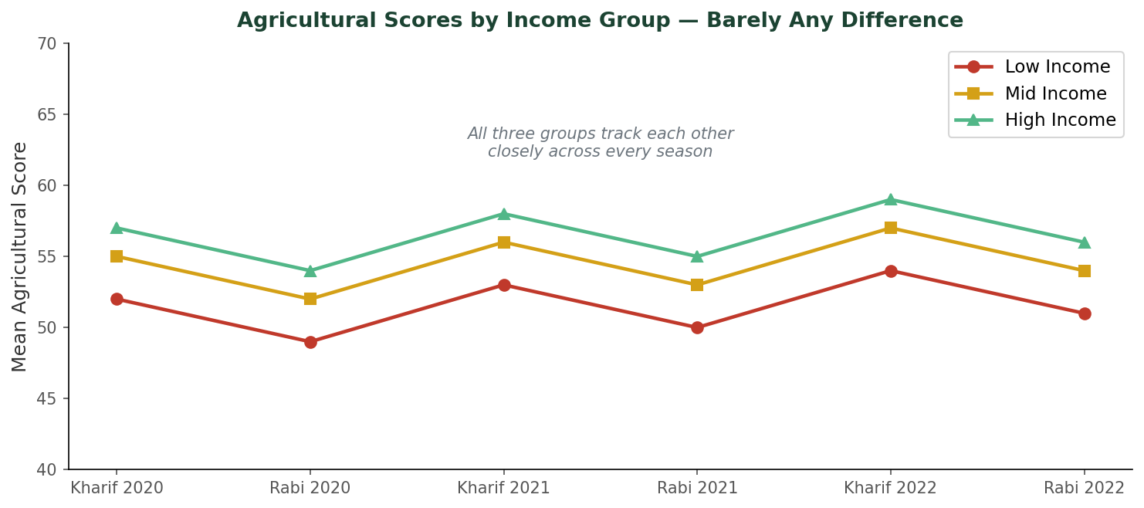
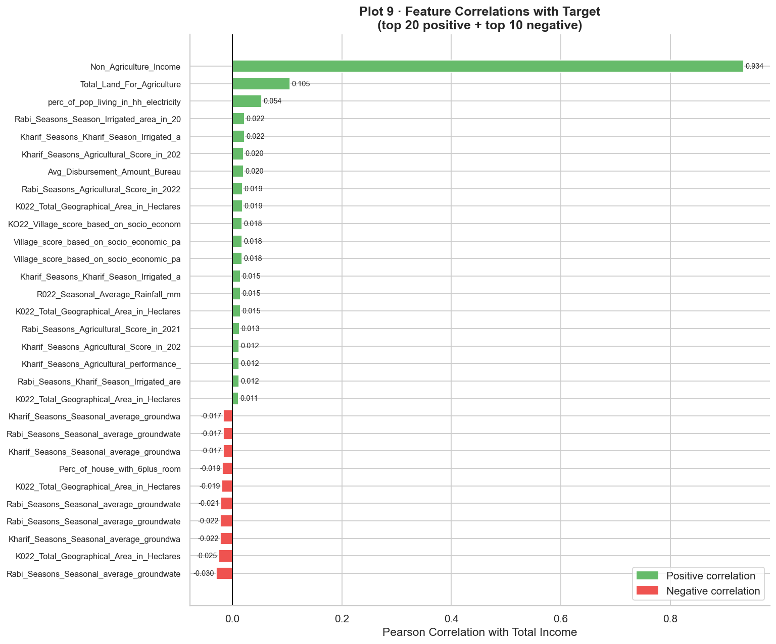
EDA - What Actually Drives Income
Farming quality alone
Non-agricultural income
Rainfall does not matter
Agricultural scores are nearly identical across low, mid, and high income groups. Being a good farmer does not make you a wealthy one.
Dominates all other features by a huge margin (r = 0.91). Farmers with off-farm income sources are structurally wealthier.
Farmers at every income level cluster similarly regardless of rainfall. Infrastructure, not weather, is the dividing factor.
08

Slide 9
Model 1 - Random Forest
What it does
Tuned Hyperparameters
Builds hundreds of independent decision trees, each trained on a random subset of data and features. Averages all their predictions. Randomness gives diversity, averaging diverse predictions beats any single tree.
n_estimators
700
max_depth
15
min_samples_split
5
max_features
sqrt
python
search_rf = RandomizedSearchCV(
rf, param_distributions=param_dist_rf,
n_iter=15, scoring="neg_mean_absolute_percentage_error",
cv=3, n_jobs=-1, random_state=42
)
search_rf.fit(X_tr, y_tr_log)
best_rf = search_rf.best_estimator_
MAPE: 24.34% | R²: 0.373 | Weakest of the three models but contributes unique signal to the ensemble
09

Slide 10
Model 2 - LightGBM
What it does
Key Settings
Gradient boosting, builds trees sequentially. Each tree corrects the errors of the one before it. After thousands of corrections, predictions become highly precise. Uses MAPE as its training objective, so it directly optimises the competition metric.
objective
"mape"
learning_rate
0.05
num_leaves
63
early_stopping
50 rounds
python
lgb_model = lgb.LGBMRegressor(
objective="mape", n_estimators=2000, learning_rate=0.05,
num_leaves=63, subsample=0.8, colsample_bytree=0.8
)
lgb_model.fit(X_tr, y_tr_log,
eval_set=[(X_val, y_val_log)],
callbacks=[lgb.early_stopping(50)])
MAPE: 20.24% | R²: 0.882 | Best single model — directly optimises the target metric
10

Slide 11
Model 3 - XGBoost
What it does
Key Settings
Also a gradient boosting algorithm, similar idea to LightGBM but with a different internal tree-growing strategy. Grows trees level by level rather than leaf by leaf. Often captures different interaction patterns, making it a useful ensemble companion.
objective
reg:squarederror
max_depth
6
learning_rate
0.05
early_stopping
50 rounds
python
xgb_model = xgb.XGBRegressor(
objective="reg:squarederror", n_estimators=2000,
learning_rate=0.05, max_depth=6,
early_stopping_rounds=50, eval_metric="rmse"
)
xgb_model.fit(X_tr, y_tr_log, eval_set=[(X_val, y_val_log)])
MAPE: 22.26% | R²: 0.791 | Contributes diversity to the ensemble through different tree structure
11

Slide 12
Cross Validation + Ensembling
5-Fold Cross Validation
Inverse-MAPE Weighting
Train
Train
Train
Train
Val
Better models get a higher weight in the final blend. Weight = (1 / model MAPE) normalised across all models.
Train
Train
Train
Val
Train
Train
Train
Val
Train
Train
LGB + RF Ensemble
CHOSEN
20.24%
Train
Val
Train
Train
Train
Val
Train
Train
Train
Train
LGB + XGB + RF
20.42%
Average MAPE across 5 folds = reliable, unbiased estimate of true model quality
python
def inverse_mape_weights(*cv_mapes):
inv = [1.0 / m for m in cv_mapes]
return tuple(i / sum(inv) for i in inv)
w_lgb, w_rf = inverse_mape_weights(lgb_cv_mape, rf_cv_mape)
blend = np.clip(w_lgb * lgb_preds + w_rf * rf_preds, 1, None)
12

Slide 13
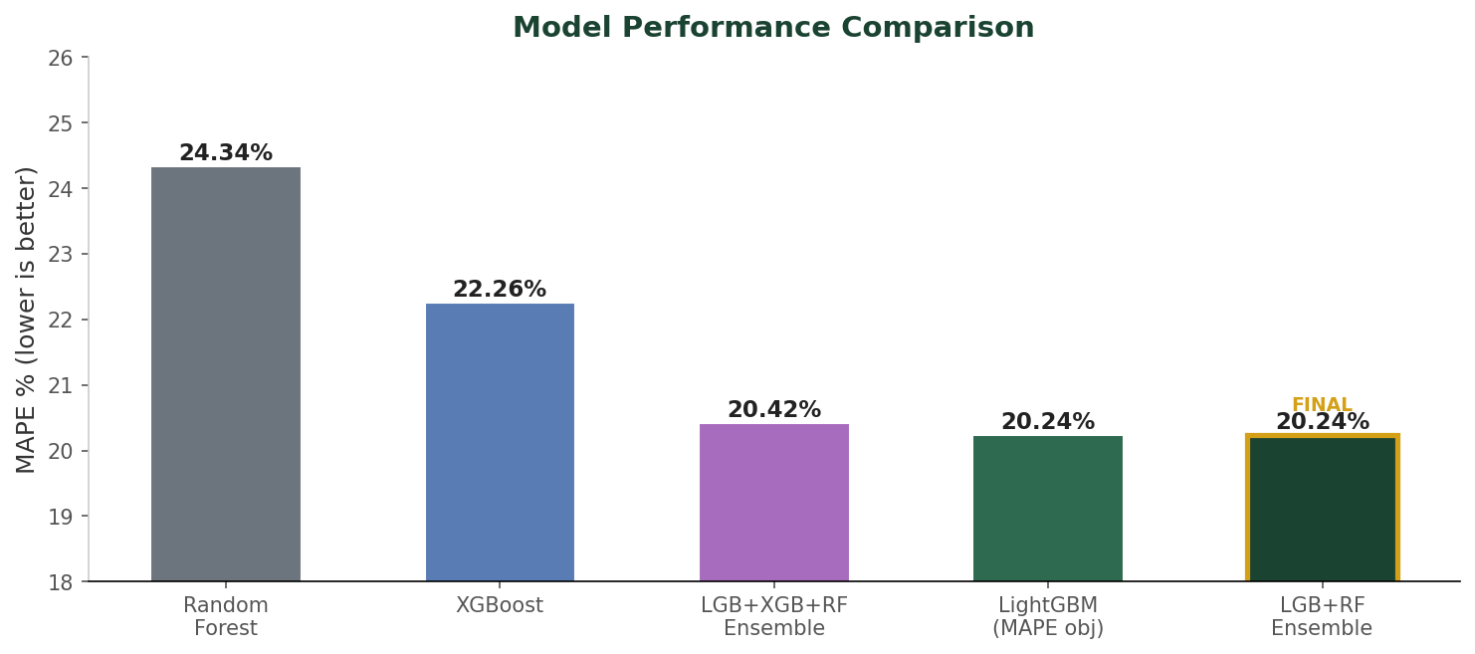
Final Results
Model | MAPE | R²
Random Forest | 24.34% | 0.373
XGBoost | 22.26% | 0.791
LGB + XGB + RF | 20.42% | 0.878
LGB + RF (Final) | 20.24% | 0.882
LGB + RF (Final)
20.24%
0.882
20.24%
0.882
₹7.4L
Final MAPE
R² Score
Avg RMSE
13

Slide 14
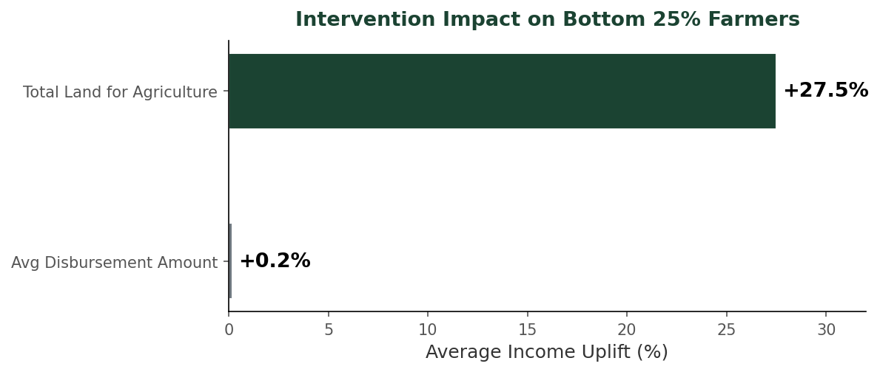
Bonus A (Intervention Recommender)
How it works
1
Predict income for all farmers using the ensemble
2
Identify the bottom 25% , our target population
3
Block income-derived features. e.g. Non-Agri Income cannot be a policy lever
4
Rank remaining features by LightGBM importance
5
Counterfactual simulation: set each feature to the 75th population percentile, rerun the model, measure income change
Key finding: Increasing land access to the 75th percentile lifts bottom-quartile farmer income by 27.5%. Credit alone adds just 0.2%.
14

Slide 15
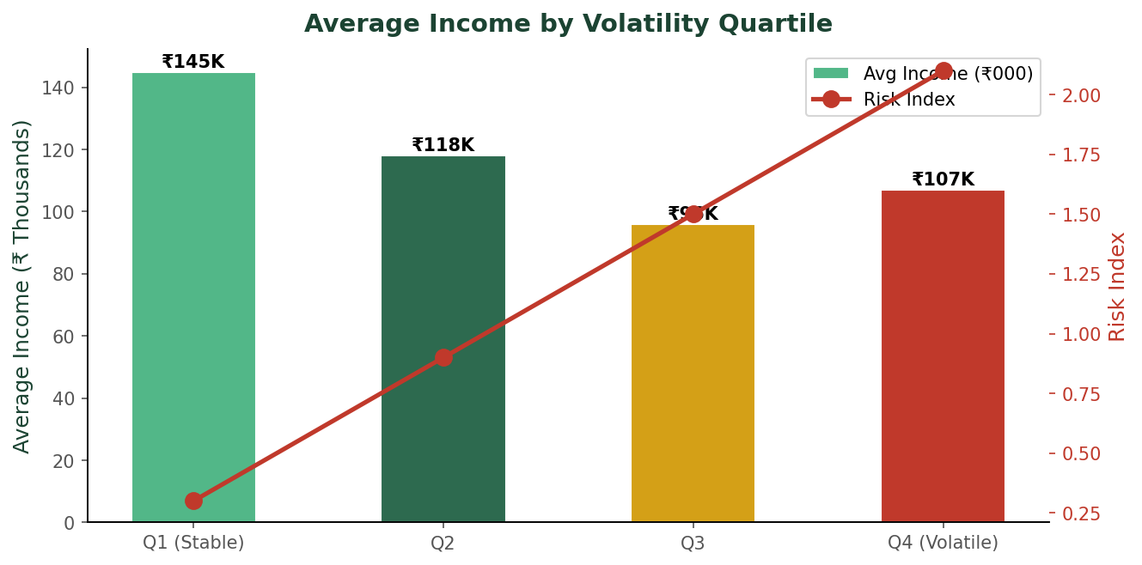
Bonus B (Seasonal Volatility Modelling)
The Insight
A farmer earning ₹12L one year, ₹3L the next, ₹14L the year after is a very different credit risk from one who earns ₹9L consistently every year. Average income alone does not capture this.
We built a volatility score using the Coefficient of Variation (CV = std / mean) across seasonal agricultural scores and performance columns. High CV = unreliable, risky farmer.
python
vol_df['volatility_score'] = StandardScaler().fit_transform(vol_df[['score_cv', 'perf_cv']]).mean(axis=1)
vol_df['high_risk'] = (income < income.quantile(0.40)) & (volatility > volatility.quantile(0.60))
26% lower income
for farmers in the highest volatility quartile compared to the most stable quartile
2.1x more likely
to fall into the low-income group if a farmer shows high seasonal volatility

Slide 16
What We Built
Prediction
An ensemble of LightGBM and Random Forest that predicts farmer income with 20.24% MAPE and R² of 0.882 across 43,173 records.
Key insight
Non-agricultural income dominates all features. Farming quality alone does not separate rich farmers from poor ones.
Intervention
For the bottom 25% of farmers, increasing land access to the 75th percentile lifts income by 27.5%. Credit access alone barely moves the needle.
Risk model
Income stability is a stronger creditworthiness signal than average income. High-volatility farmers are 2.1x more likely to be in the low-income group.

