Slide 1
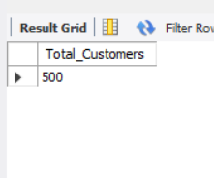
1. Total Customers
Business Question
Count the total number of customers in the database.
SQL CODE
SELECT COUNT(*) AS Total_Customers
FROM Customer_Master;
QUERY OUTPUT
Recommendation: Maintain a single, validated customer master and perform periodic data quality checks

Slide 2
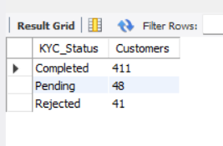
2. KYC Status Summary
Business Question
Summarize customers by KYC status.
SQL CODE
SELECT KYC_Status, COUNT(*)
FROM KYC_Documents
GROUP BY KYC_Status;
QUERY OUTPUT
Recommendation: Prioritize pending and rejected cases to improve compliance rates.

Slide 3
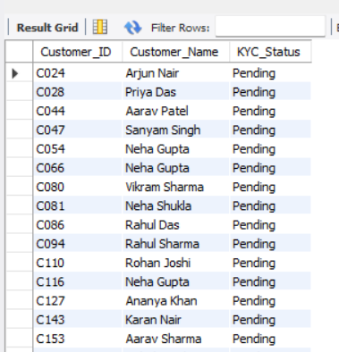
3. Pending KYC
Business Question
List customers with pending KYC.
SQL CODE
SELECT
c.Customer_ID,
c.Customer_Name,
k.KYC_Status
FROM Customer_Master c
JOIN KYC_Documents k
ON c.Customer_ID = k.Customer_ID
WHERE k.KYC_Status = 'Pending’;
QUERY OUTPUT
Recommendation: Contact customers for missing documents and track completion through SLAs.

Slide 4
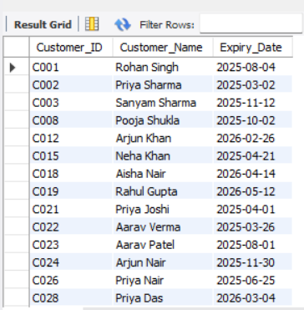
4. Expired Documents
Business Question
Find customers with expired KYC documents.
SQL CODE
SELECT
c.Customer_ID,
c.Customer_Name,
k.Expiry_Date
FROM Customer_Master c
JOIN KYC_Documents k
ON c.Customer_ID = k.Customer_ID
WHERE k.Expiry_Date < CURDATE();
QUERY OUTPUT
Recommendation: Trigger automated renewal reminders before document expiry.

Slide 5
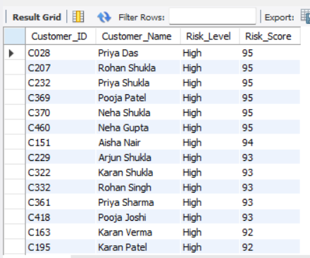
5. High-Risk Customers
Business Question
Identify high-risk customers.
SQL CODE
SELECT
c.Customer_ID,
c.Customer_Name,
a.Risk_Level,
a.Risk_Score
FROM Customer_Master c
JOIN AML_Risk a
ON c.Customer_ID = a.Customer_ID
WHERE a.Risk_Level = 'High'
ORDER BY a.Risk_Score DESC;
QUERY OUTPUT
Recommendation: Apply Enhanced Due Diligence (EDD) and increase monitoring frequency.

Slide 6
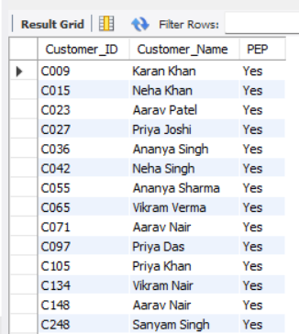
6. PEP Customers
Business Question
Identify Politically Exposed Persons.
SQL CODE
SELECT
c.Customer_ID,
c.Customer_Name,
a.PEP
FROM Customer_Master c
JOIN AML_Risk a
ON c.Customer_ID = a.Customer_ID
WHERE a.PEP = 'Yes’;
QUERY OUTPUT
Recommendation: Conduct periodic reviews and obtain management approval where required.

Slide 7
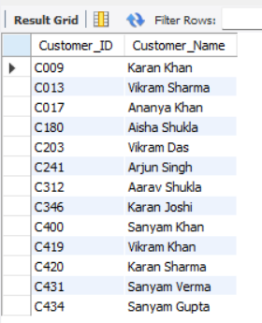
7. Sanction Matches
Business Question
Identify sanction matches.
SQL CODE
SELECT
c.Customer_ID,
c.Customer_Name
FROM Customer_Master c
JOIN AML_Risk a
ON c.Customer_ID = a.Customer_ID
WHERE a.Sanction_Match = 'Yes’;
QUERY OUTPUT
Recommendation: Escalate confirmed matches according to compliance policy.

Slide 8
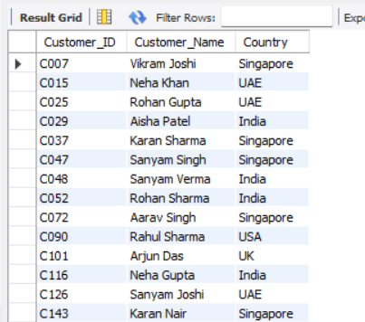
8. High-Risk Country
Business Question
Find customers flagged for high-risk countries.
SQL CODE
SELECT
c.Customer_ID,
c.Customer_Name,
c.Country
FROM Customer_Master c
JOIN AML_Risk a
ON c.Customer_ID = a.Customer_ID
WHERE a.High_Risk_Country = 'Yes’;
QUERY OUTPUT
Recommendation: Apply country-specific controls and periodic reassessment.

Slide 9
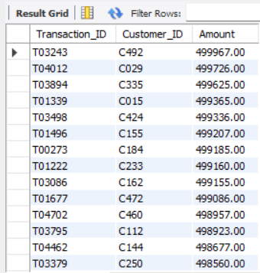
9. High-Value Transactions
Business Question
Transactions above ₹2,00,000.
SQL CODE
SELECT
Transaction_ID,
Customer_ID,
Amount
FROM Transactions
WHERE Amount > 200000
ORDER BY Amount DESC;
QUERY OUTPUT
Recommendation: Review transactions against expected customer behaviour and investigate exceptions.

Slide 10
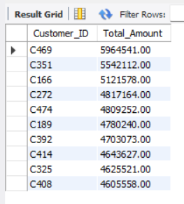
10. Top Customers
Business Question
Top 10 customers by transaction value.
SQL CODE
SELECT
Customer_ID,
SUM(Amount) AS Total_Amount
FROM Transactions
GROUP BY Customer_ID
ORDER BY Total_Amount DESC
LIMIT 10;
QUERY OUTPUT
Recommendation: Monitor these accounts using ongoing transaction surveillance.

Slide 11
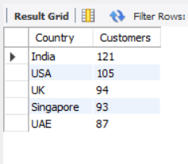
11. Country-wise Customers
Business Question
Count customers by country.
SQL CODE
SELECT
Country,
COUNT(*) AS Customers
FROM Customer_Master
GROUP BY Country
ORDER BY Customers DESC;
QUERY OUTPUT
Recommendation: Allocate compliance resources according to geographic exposure.

Slide 12
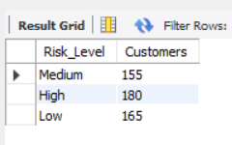
12. Risk Distribution
Business Question
Distribution by risk level.
SQL CODE
SELECT
Risk_Level,
COUNT(*) AS Customers
FROM AML_Risk
GROUP BY Risk_Level;
QUERY OUTPUT
Recommendation: Focus compliance reviews on high-risk customers while maintaining periodic reviews for others.

Slide 13
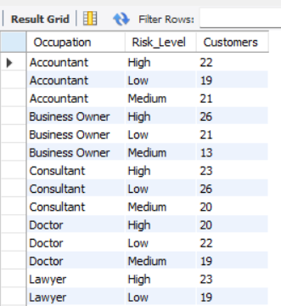
13. Occupation-wise Risk
Business Question
Analyze risk by occupation.
SQL CODE
SELECT
c.Occupation,
a.Risk_Level,
COUNT(*) AS Customers
FROM Customer_Master c
JOIN AML_Risk a
ON c.Customer_ID = a.Customer_ID
GROUP BY c.Occupation, a.Risk_Level
ORDER BY c.Occupation;
QUERY OUTPUT
Recommendation: Include occupation as one factor in the overall customer risk assessment.

Slide 14
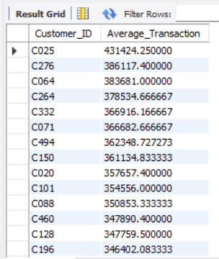
14. Average Transaction
Business Question
Average transaction amount.
SQL CODE
SELECT
Customer_ID,
AVG(Amount) AS Average_Transaction
FROM Transactions
GROUP BY Customer_ID
ORDER BY Average_Transaction DESC;
QUERY OUTPUT
Recommendation: Use threshold alerts to identify deviations from normal behaviour.

Slide 15
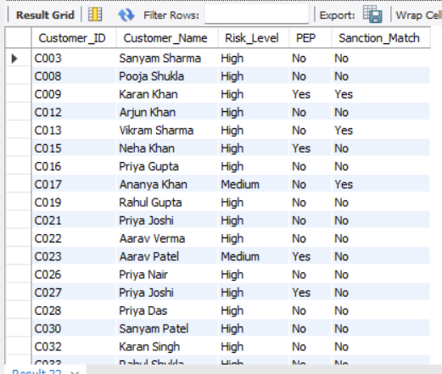
15. Customers Requiring EDD
Business Question
Identify customers requiring Enhanced Due Diligence.
SQL CODE
SELECT
c.Customer_ID,
c.Customer_Name,
a.Risk_Level,
a.PEP,
a.Sanction_Match
FROM Customer_Master c
JOIN AML_Risk a
ON c.Customer_ID = a.Customer_ID
WHERE a.Risk_Level = 'High'
OR a.PEP = 'Yes'
OR a.Sanction_Match = 'Yes’;
QUERY OUTPUT
Recommendation: Complete EDD before onboarding or continuing the business relationship.

Slide 16
Overall Business Recommendations
Improve KYC completion rates through proactive document collection.
Automate alerts for expiring KYC documents.
Perform regular PEP and sanctions screening.
Implement a risk-based review schedule for high-risk customers.
Monitor high-value transactions using automated AML rules.
Use interactive Power BI dashboards for continuous compliance reporting.
Conclusion
The project demonstrates practical application of SQL, Excel, and Power BI in a KYC/AML context. It highlights data validation, compliance monitoring, customer risk assessment, and business reporting skills relevant to entry-level KYC/AML Analyst roles.

