Slide 1
Project Planning
Presented by -
Sanya Syed

Slide 2
Project Plan Overview:
Aim: What You Want to Do?
Simple Project: Basic data analysis to find insights.
Intermediate Project: In-depth data analysis for actionable insights.

Slide 3
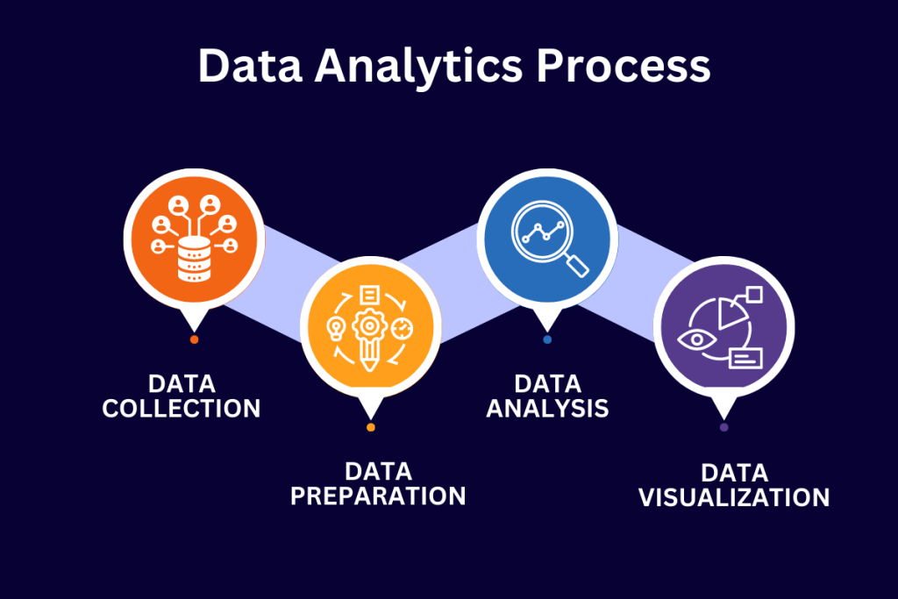
Project Plan Overview:
Objective: Analyze a dataset to find basic insights.
Stage 1: Data collection or access existing dataset Tools: Excel, Google Sheets, CSV files, Kaggle Datasets
Stage 2: Data cleaning, preparation, and integration Tools: Python (Pandas), SQL (Postgres), Talend, Power Query (Power BI)
Stage 3: Basic visualizations and summary statistics Tools: Excel (charts), Python (Matplotlib, Seaborn)

Slide 4
Advance Project:
Objective: Perform a deeper analysis and derive actionable insights.
Stage 1: Define the business problem and analytical goals Tools: Google Docs, Microsoft Word, Jira (for task planning)
Stage 2: Data acquisition (gathering multiple data sources if needed) Tools: SQL (Postgres, MySQL), Python (for API calls, web scraping)
Stage 3: Data cleaning, preparation, and integration Tools: Python (Pandas), SQL (Postgres), Talend, Power Query (Power BI)
Stage 4: Feature engineering and transformation Tools: Python (Scikit-learn, Pandas), SQL
Cont.…

Slide 5
Advance Project:
Stage 5: Exploratory data analysis (EDA) with advanced techniques Tools: Python (Matplotlib, Seaborn), Jupyter Notebook
Stage 6: Statistical analysis or model building (if relevant) Tools: Python (Scikit-learn, Statsmodels), R, Excel (for simpler models)
Stage 7: Advanced visualizations and storytelling with data Tools: Power BI, Tableau, Python (Plotly, Seaborn)
Stage 8: Draw conclusions, derive insights, and provide recommendations Tools: PowerPoint, Google Slides, Word for reporting
Stage 9: Final report and presentation Tools: Power BI (dashboards), Tableau, PowerPoint

Slide 6
Replication as a Learning Method:
Key to reinforcing knowledge.
Helps to understand processes by repeating and refining tasks.
Use for improving problem-solving skills in projects.

Slide 7
Resources for Learning & Development:
Online Platforms:
Kaggle: For datasets, competitions, and community discussions.
Git: For version control and collaboration on projects.
Additional Learning Resources:
Zoomcamp: Free online bootcamp.
Unpaid/Paid Courses: For structured, in-depth learning

Slide 8
Potential Blockers in Data Projects:
Common Challenges:
Environment Issues: Unable to open files.
Error Messages: Needing to read and search for fixes.
Version Conflicts: Mismatches in Python or package versions.
Expertise Levels: Varying levels of understanding can cause delays.
Solution:
Use official documentation (e.g., Python docs, Postgres docs) to resolve syntax or functionality questions.

Slide 9
Key Takeaways for Success:
Effort: Consistent work leads to progress.
Use Cases: Aim for real-world applicability, particularly in corporate environments.
Focus on Outcomes: Provide insights and actionable recommendations through your analysis.

Slide 10
Q & A

