Slide 1



Sales_Report_Of_A_Renouned_Company
View in Power BI
Last data refresh:
1/27/2022 10:37:50 AM UTC
Downloaded at:
1/27/2022 10:43:49 AM UTC

Slide 2
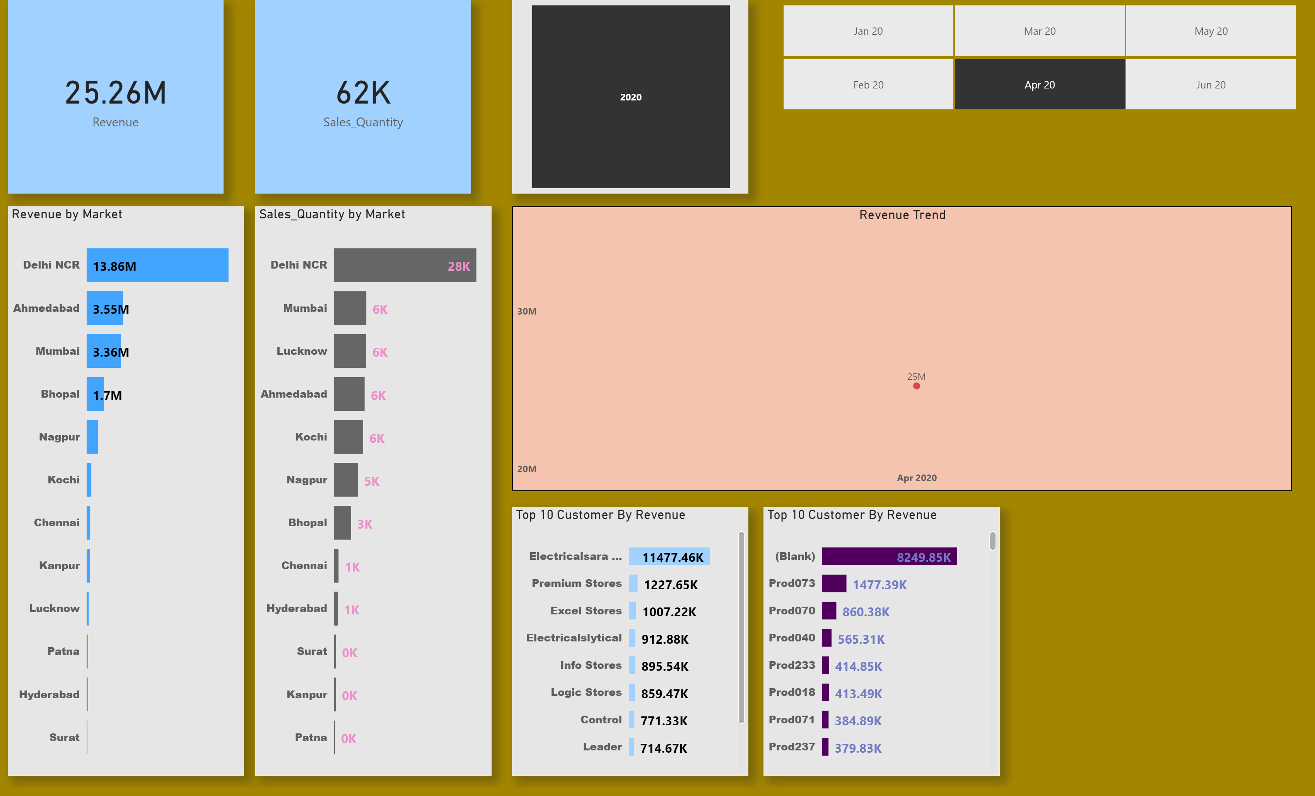
Page 1
Notes:
card
No alt text provided
card
No alt text provided
Revenue by Market
No alt text provided
Sales_Quantity by Market
No alt text provided
slicer
No alt text provided
Sales_Quantity by Market
No alt text provided
Top 10 Customer By Revenue
No alt text provided
Top 10 Customer By Revenue
No alt text provided
Revenue Trend
No alt text provided

