Slide 1
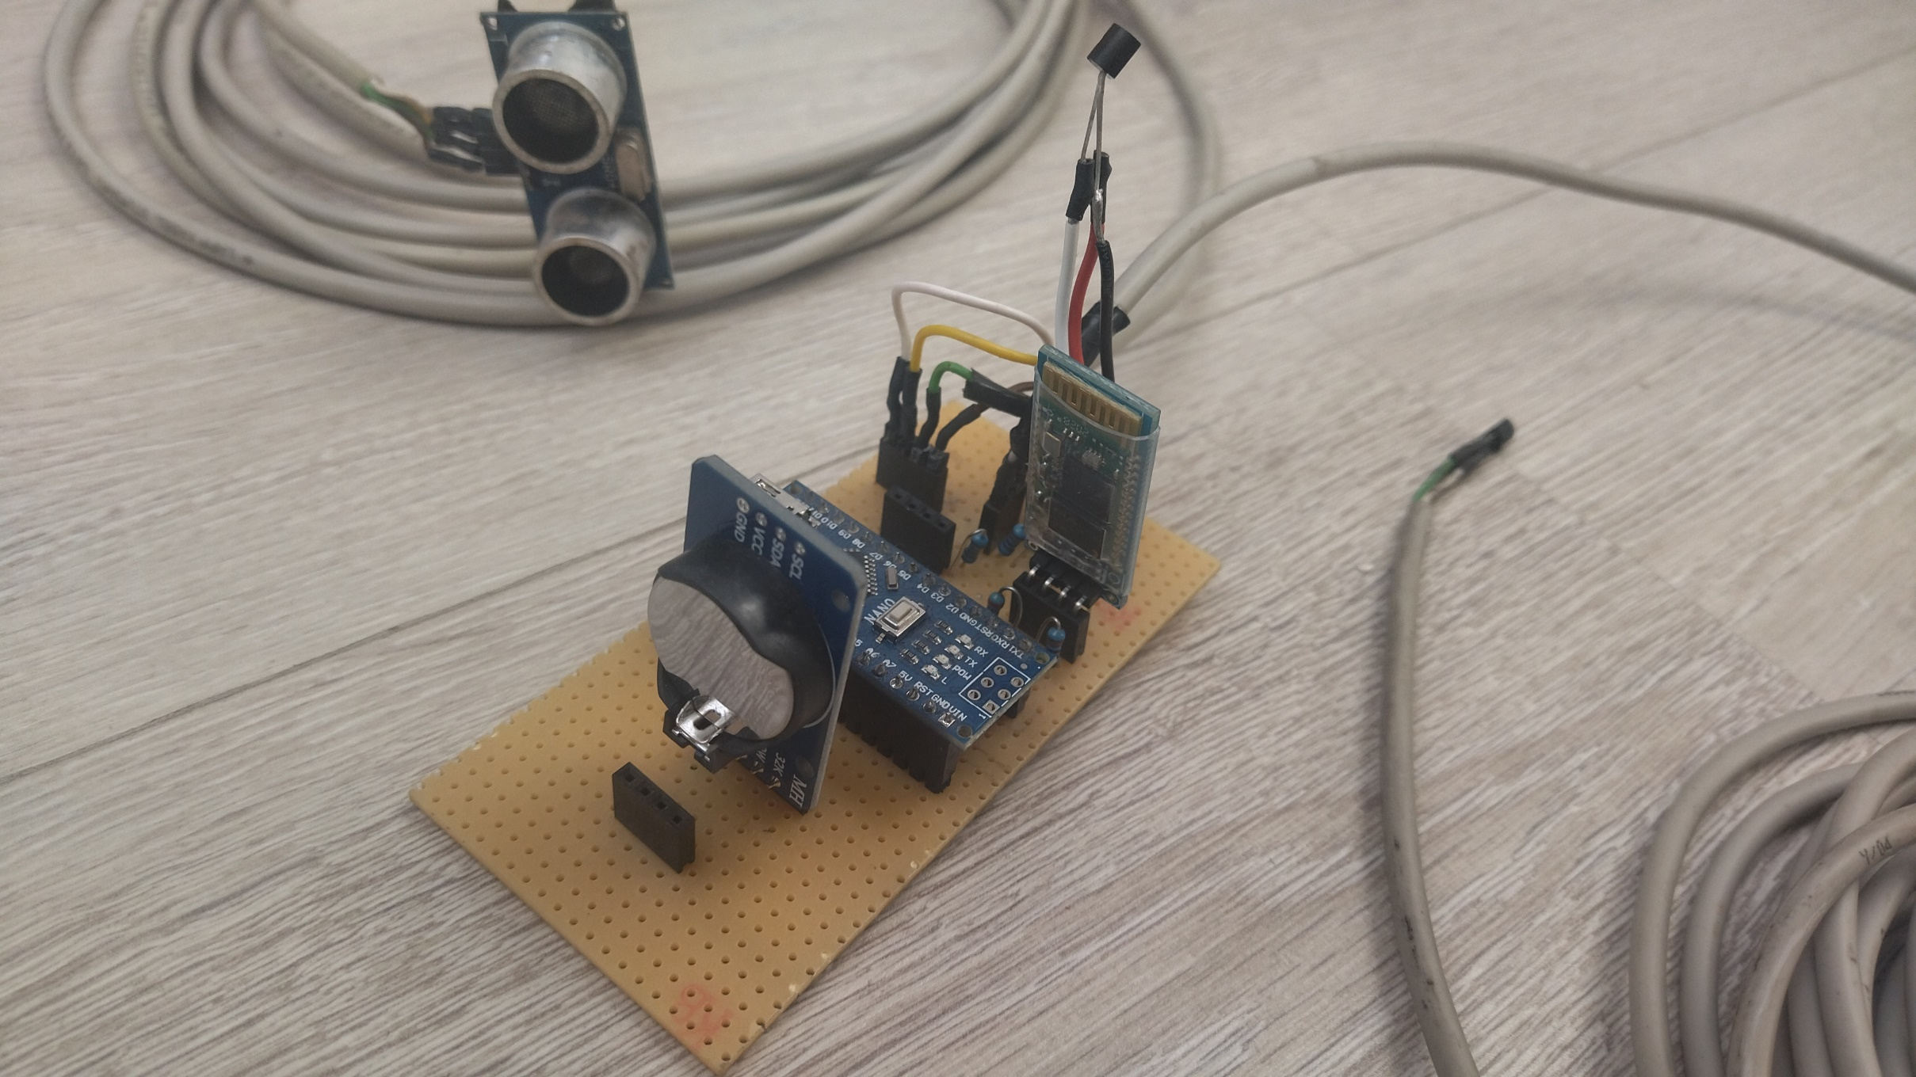
Inner temperature sensor
Ultrasonic distance sensor
Connector for humidity sensor
Buzzer
Outer temperature sensor
Blutetooth module
RTC module
Connector for an I2C LCD display
Ardunio Nano

