Slide 1
Capstone Project
By Shreesanyog rath
Organization - Coforge
e.code- 85000058

Slide 2
Capstone Project 1
Enterprise Loan Default Prediction System
End-to-End Machine Learning, FastAPI Deployment, and Azure MLOps

Slide 3

Business Problem & Objective Mitigating Financial Risk with Predictive AI
The Challenge: Incorrect loan approvals carry immense financial consequences for institutions, while rejecting creditworthy applicants results in missed revenue.
The Goal: Build an automated classification model to predict default risk (0 = Safe, 1 = Default) based on historical borrower data.
The Solution: A full MLOps lifecycle from Scikit-Learn model development to a scalable REST API on Azure.

Slide 4
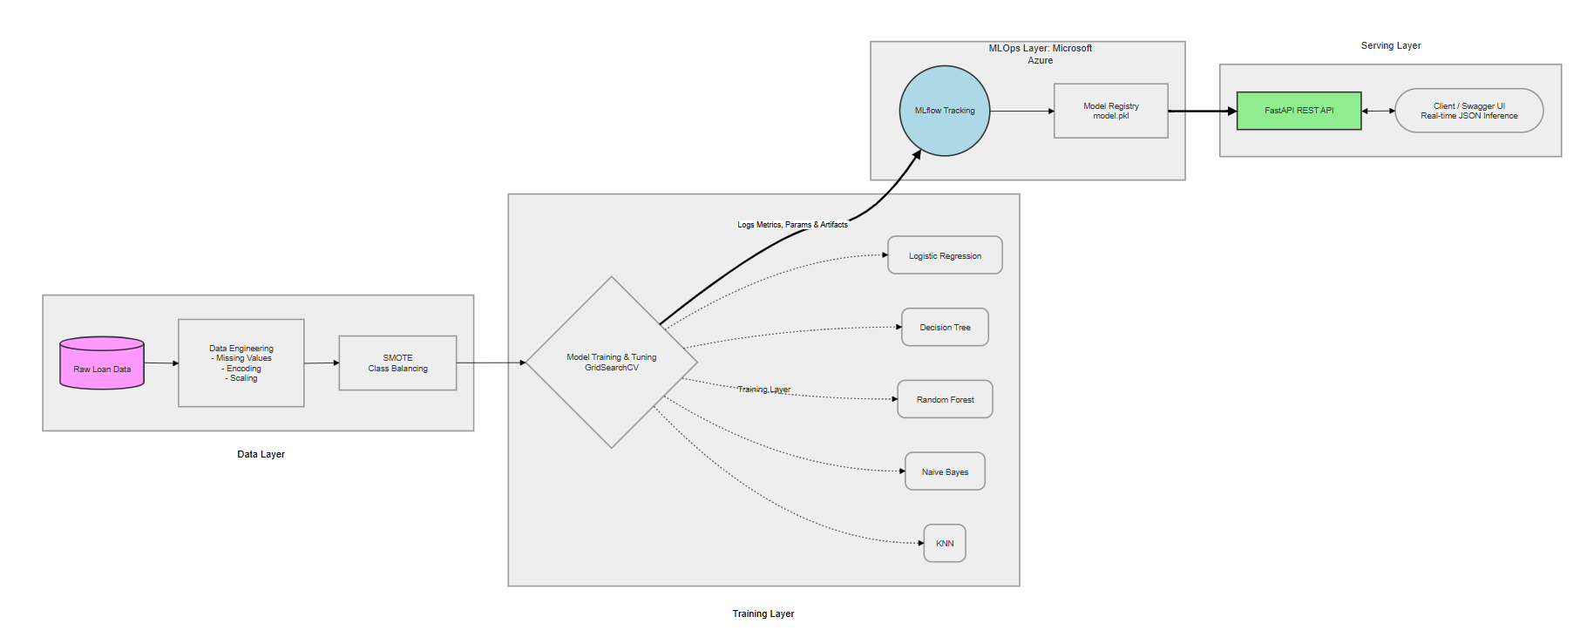
Figure 1: End-to-end data flow from raw ingestion to model deployment via FastAPI and Azure MLflow.

Slide 5
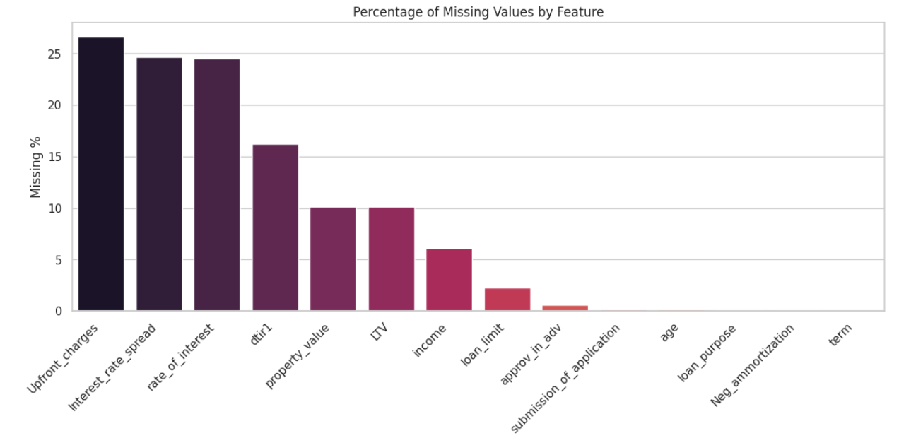
Data Engineering & Preprocessing
Imputation: Systematically handled missing values (median for skewed numericals, mode for categorical data).
Outlier Treatment: Applied Interquartile Range (IQR) clipping to prevent extreme values from distorting the model.
Feature Scaling & Encoding: Standardized numerical features and applied Label Encoding for categorical text.

Slide 6
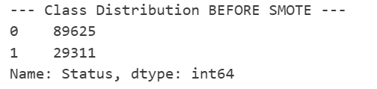
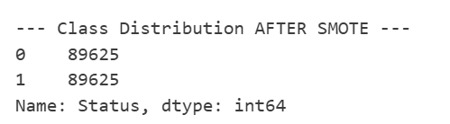
Solving the Imbalance Problem (SMOTE)
The Issue: Non-defaults heavily outnumbered defaults in the dataset. A standard model would just guess "Safe" every time and appear accurate.
The Fix: Applied SMOTE (Synthetic Minority Over-sampling Technique) to artificially balance the target variable representation.

Slide 7
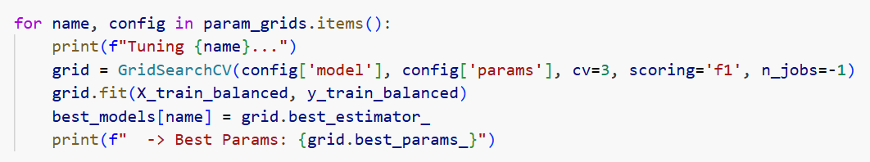
Model Selection & Hyperparameter Tuning
Implemented five distinct classification algorithms to establish a competitive baseline: Logistic Regression, Decision Tree, Random Forest, Naive Bayes, and KNN.
Utilized GridSearchCV to exhaustively test parameter combinations (e.g., tree depths, n_estimators) through rigorous cross-validation.

Slide 8
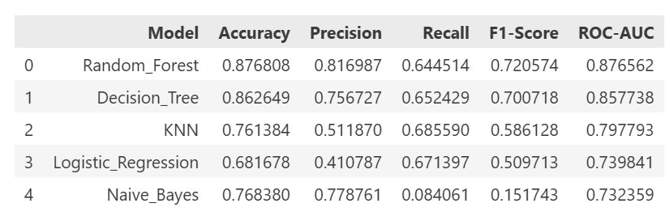
Model Evaluation Results
Metric Philosophy: We prioritized the F1-Score over raw Accuracy because the business cost of a False Negative (missing a true defaulter) is extremely high.
The Winner: Random Forest emerged as the superior model, achieving the best balance of Precision and Recall.

Slide 9
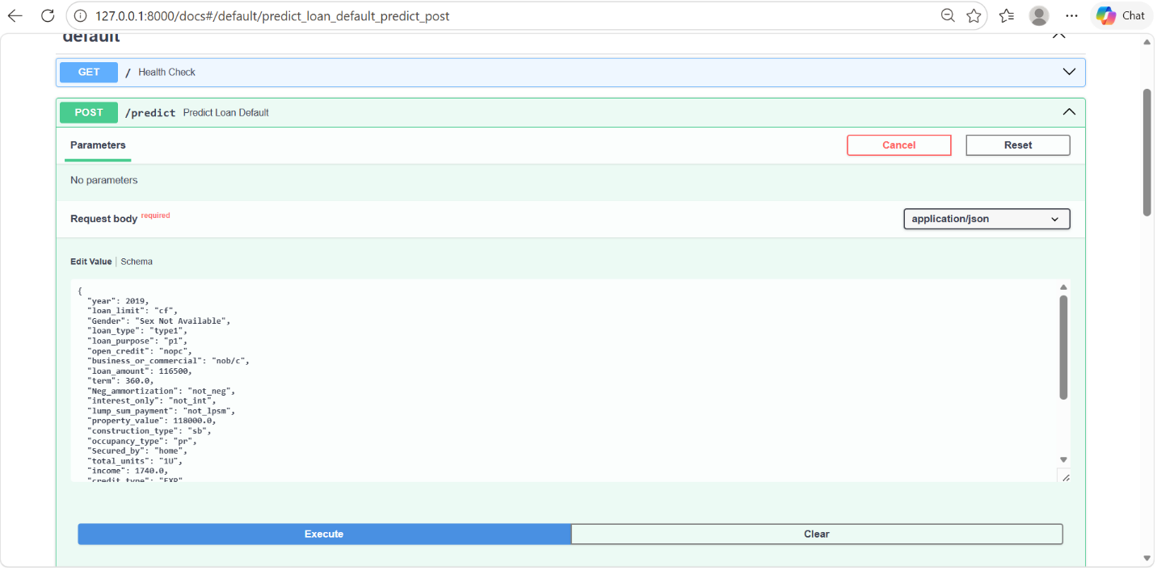
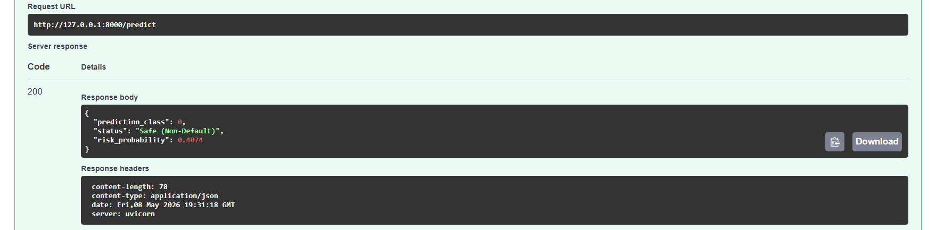
Real-Time API Deployment (FastAPI)
The Backend: Developed a high-performance ASGI web server using FastAPI to handle real-time inference requests.
Strict Validation: Implemented Pydantic schemas (LoanInputSchema) to enforce strict input validation, preventing server crashes from malformed data.
Cloud Infrastructure: Deployed as a Managed Online Endpoint on Azure, routing 100% of live traffic to the secure scoring script.

Slide 10
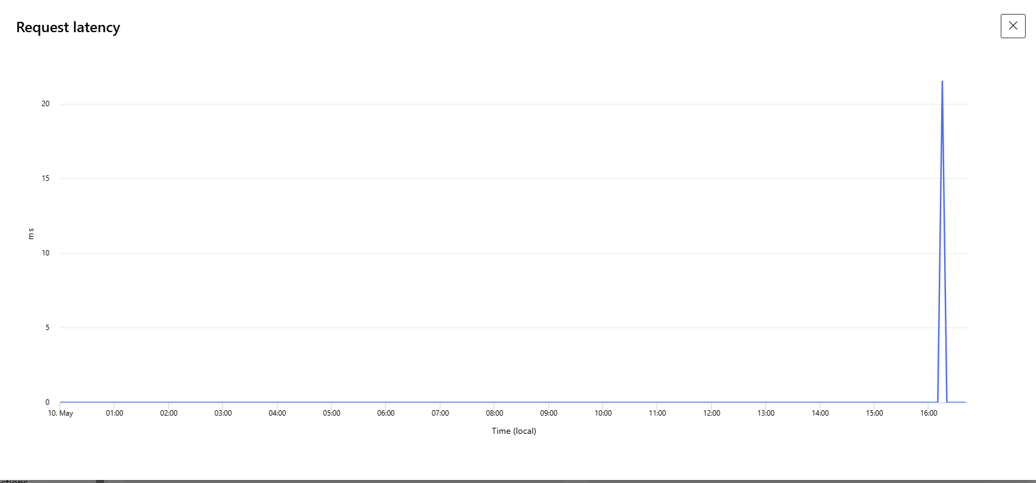
Production Monitoring & Live Inference
Load Testing: Simulated heavy user traffic (100 parallel requests) to validate the endpoint's stability.
Telemetry & Logs: Tracked system health using Azure's online deployment logs (gunicorn.access). The container successfully processes requests with continuous HTTP 200 OK statuses.
Latency: API resolves predictions in milliseconds, providing a seamless user experience.

Slide 11
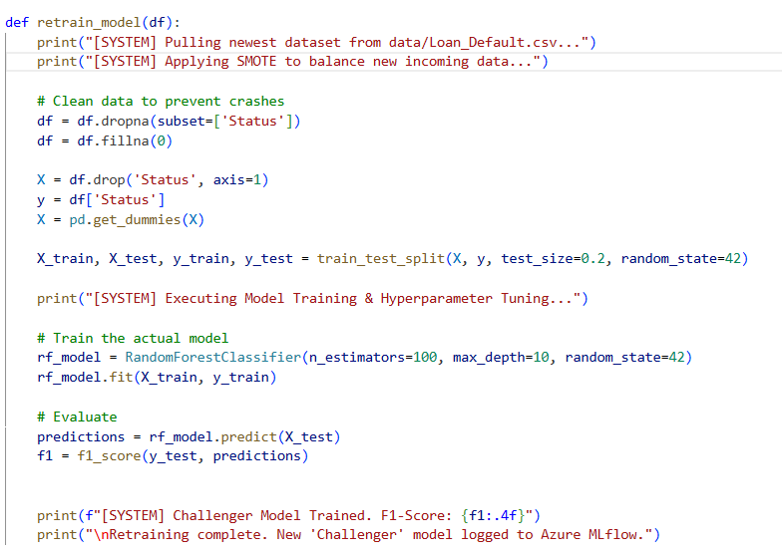
Automated Retraining Strategy
The Threat: Models degrade over time as economic conditions and borrower profiles change.
Event-Driven Triggers: The system continuously monitors live predictions. If the F1-Score drops below a threshold (e.g., < 0.75), an automated alert triggers the retraining pipeline.
Autonomous Resolution: The script fetches new data, re-applies SMOTE, trains a new "Challenger" model, and automatically registers it to Azure for a zero-downtime rollout.

Slide 12
Capstone Project 2
Enterprise Customer Support Automation
Next-Generation RAG Pipeline with Multi-AI-Agentic Workflow & CI/CD Deployment

Slide 13
The Problem: "Naive RAG" vs. "Agentic RAG"
The Industry Challenge: Traditional chatbots and "Naive RAG" (Retrieval-Augmented Generation) systems take a user's question, blindly fetch a document, and generate a response. They lack diagnostic reasoning, emotional intelligence, and quality control.
The Agentic Solution: Instead of a single, monolithic LLM prompt, this architecture introduces a Multi-Agent Workflow.
The Result: Five highly specialized AI "Personas" collaborate sequentially. They triage the issue, analyze customer sentiment, retrieve strict data, draft a response, and independently QA the result before sending it to the user.

Slide 14
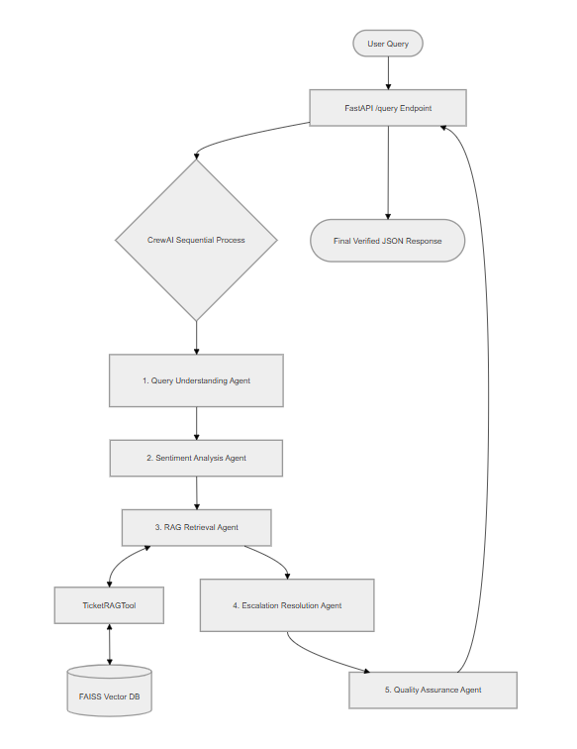

Slide 15
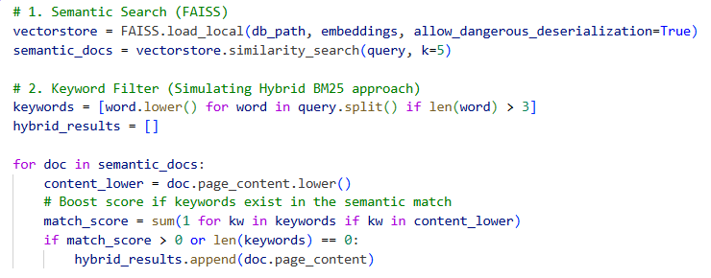
Building the Brain (Hybrid RAG)
Vectorization: Historical support tickets are chunked and converted into dense vector embeddings using HuggingFace's all-MiniLM-L6-v2. They are stored in a FAISS index for ultra-fast, local similarity search.
Hybrid Search Strategy: Semantic search alone can hallucinate. Our custom TicketRAGTool combines Semantic Search with Keyword Filtering (simulating BM25). It only returns documents if the user's core keywords physically exist in the retrieved semantic matches.

Slide 16
The Multi-Agent Assembly Line
Agent 1 (Query Understanding): The first point of contact. Its sole responsibility is to strip away conversational noise and identify the core technical entity (e.g., "Router").
Agent 2 (Sentiment Analysis): Receives the parsed intent and evaluates the emotional weight, appending an "Urgency Score".
Agent 3 (RAG Retrieval Agent): The only agent permitted to access external data via the TicketRAGTool. It queries the local FAISS Vector DB using Hybrid Search. If no relevant historical ticket is found, this agent strictly returns "NO_SOLUTION_FOUND" rather than hallucinating.
Agent 4 (Escalation Resolution Agent): The drafter. It consumes the technical steps and applies the emotional parameters to draft a human-readable email response.
Agent 5 (Quality Assurance Agent): The final firewall. It reviews the drafted response against the original query. If the draft fails any criteria, it forces a localized rewrite.

Slide 17
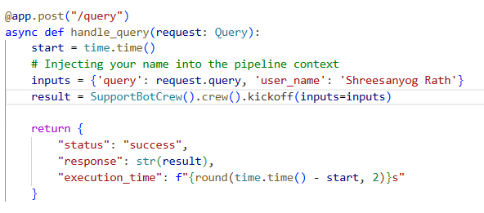
API Serving & Integration
The Interface: The CrewAI pipeline is wrapped in a high-performance FastAPI ASGI web server.
Data Validation: Uses Pydantic schemas (BaseModel) to validate incoming user requests.
Execution Time Tracking: Monitors exactly how long the multi-agent reasoning process takes to complete.

Slide 18
Automated Deployment (CI/CD Pipeline)
Continuous Integration: Triggers on pushes to the main branch. Automates Python setup, dependency installation, and Docker image builds.
Deployment Validation: Spins up the container on the GitHub runner and executes a live Health Check (curl -f http://localhost:8000/docs).
Self-Healing Rollback Strategy: If the FastAPI server crashes due to a bad commit or missing API key, the pipeline automatically catches the failure, deletes the broken container, and aborts the deployment to protect production.

Slide 19
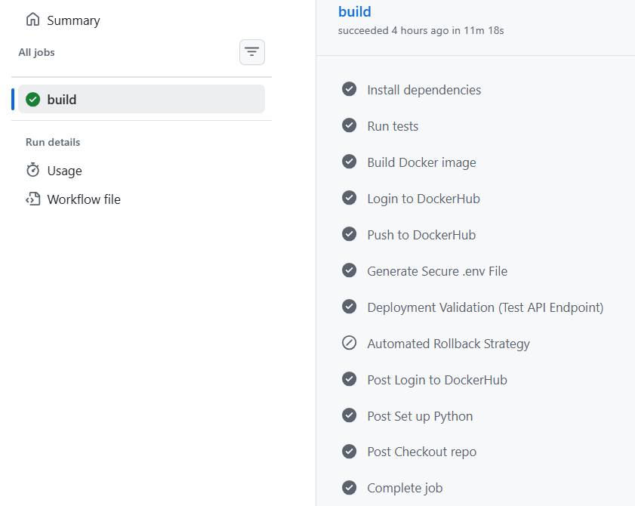
Event-Driven Continuous Improvement
Static vector databases become outdated as new products release.
The Implementation: Configured a repository_dispatch webhook in GitHub actions listening for the feedback-threshold-reached event.
Business Value: If the customer support team flags too many answers as "unhelpful," this webhook automatically triggers the pipeline to pull the newest CSV ticket data, rebuild the FAISS database natively in Docker, and redeploy the updated intelligence with zero human intervention.

Slide 20
Capstone Project 3
RAG Pipeline with Azure Prompt Flow & Azure AI Services
Objective

Slide 21
The Enterprise AI Dilemma The Problem with "Black Box" Generative AI
The Industry Challenge: Large Language Models (LLMs) are powerful, but they suffer from hallucinations and lack domain-specific knowledge (e.g., proprietary Tesla financial filings or internal support policies).
The Naive Approach: Basic RAG implementations are written in raw code, making them difficult to debug, scale, and evaluate at an enterprise level.
The Prompt Flow Solution: Microsoft Azure Prompt Flow provides a visual, modular Directed Acyclic Graph (DAG). It allows engineering teams to physically see the data flow, inject strict context, and automatically grade the AI's accuracy before deploying it to users.

Slide 22
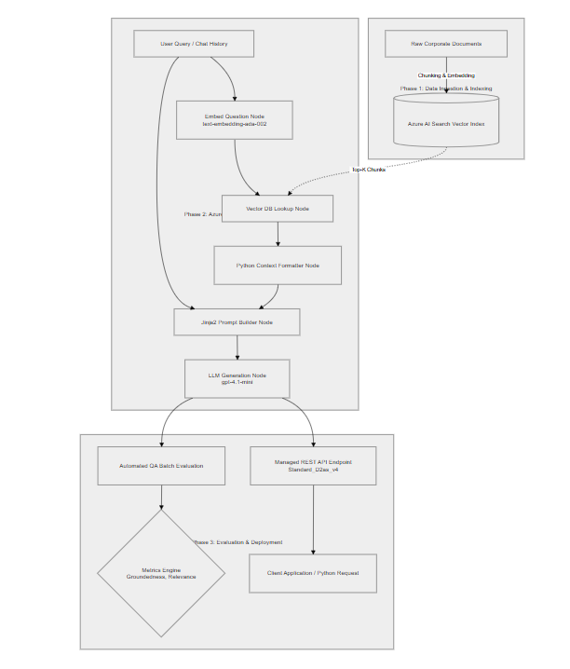

Slide 23
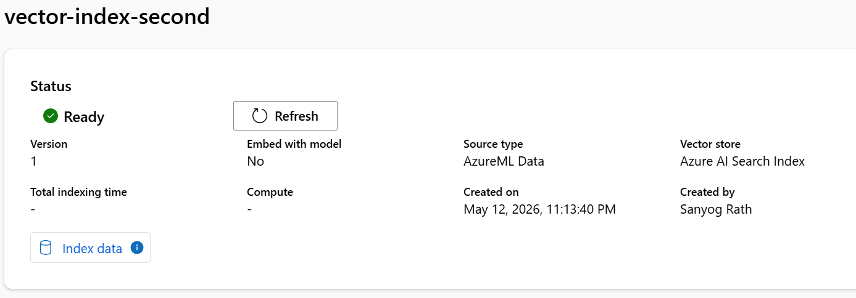
Knowledge Base Indexing
The Dataset: Domain-specific corporate documentation uploaded to Azure ML Data Assets.
Vector Indexing: Utilizing the Azure Prompt Flow Vector Index wizard, the raw PDFs/text files are chunked into logical segments.
Embedding: Each chunk is converted into a mathematical vector array using text-embedding-ada-002 and pushed to an active Azure AI Search index.
The Result: The system can now perform "Hybrid Search“ - combining keyword matching with deep semantic understanding to retrieve exact policy paragraphs.

Slide 24
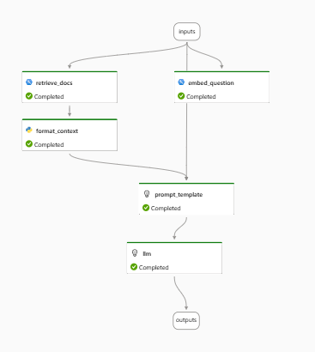
Orchestrating the Prompt Flow
embed_question: Converts the user's live natural language query into a vector.
retrieve_docs: Executes a Vector DB Lookup against Azure AI Search, fetching the top 5 most relevant document chunks.
format_context: A custom Python node that safely parses the retrieved JSON objects and concatenates them into a clean string to prevent LLM confusion.
build_prompt: A Jinja2 node that constructs the final prompt, injecting the formatted context and the user's chat history.

Slide 25
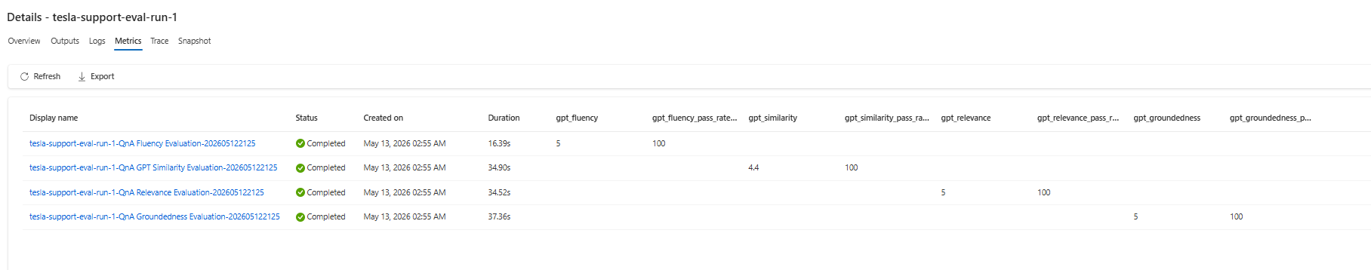
Automated Batch Evaluation
The Evaluation Strategy: You cannot use standard unit tests for Generative AI. Instead, we use Microsoft's Built-in QA Evaluation flow.
The Dataset: A custom .json file containing 10 complex question-and-answer pairs representing "Ground Truth".
The Judge: An external GPT-4.1-mini model is tasked with reading the RAG pipeline's generated answers, comparing them to the retrieved context and the ground truth, and scoring them from 1 to 5.

Slide 26
Evaluation Metrics & Business Validation
Groundedness: 5.0 (100%) – Zero Hallucinations. The AI strictly used the retrieved documents.
Relevance: 5.0 (100%) – Perfect Retrieval. Azure AI Search successfully found the exact policy paragraphs.
Fluency: 5.0 (100%) – The model generated perfectly readable, grammatically correct English.
Similarity: 4.4 (100%) – The model successfully maintained factual integrity while intelligently adapting rigid ground-truth text into conversational support responses.

Slide 27
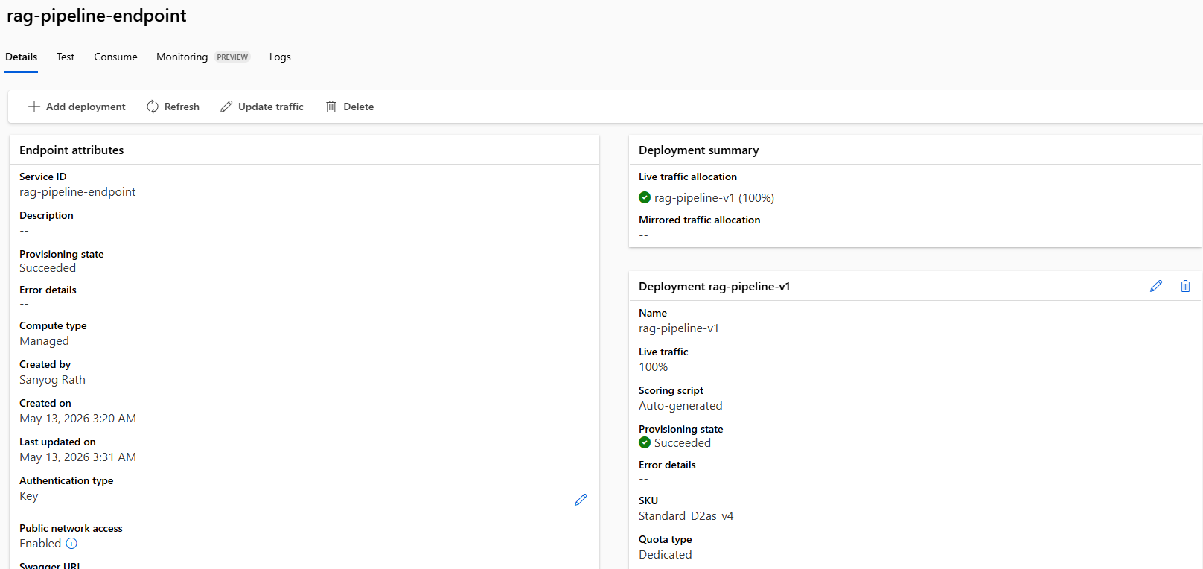
Cloud Deployment
Compute: Deployed to a Standard_D2as_v4 virtual machine to balance cost-efficiency with the memory requirements for a stable Python ASGI server.
Routing: Deployed as a managed online endpoint (rag-pipeline-endpoint). Azure handles load balancing and SSL encryption automatically.
Security: Secured via key-based authentication (auth_mode="key"), ensuring only authorized client applications can consume the RAG pipeline.

Slide 28
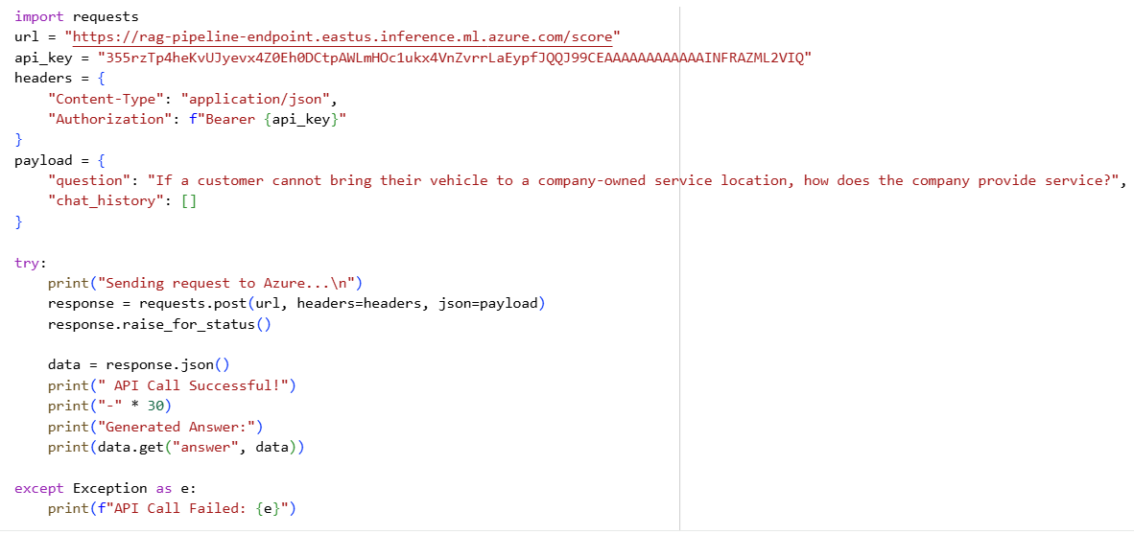
Endpoint Consumption

Slide 29
Thank You

