Slide 1
Schuster project

Slide 2
Problem statement
Schuster is a multinational retail company would like to know more about customers payment behavior from their past payment data
Schuster would also like to predict the likelihood of delayed payment using historical data.
This should help the collection department to prioritize their work on customers accordingly and save time and money and also brand value by following up only with the right customers.

Slide 3
What we could find out about customers
Customers are segmented in 6 different clusters with
RFM
Recency of transaction
Frequency of invoices
Monetary value carried for those customers

Slide 4
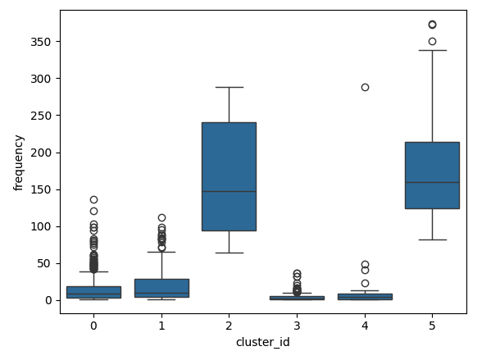
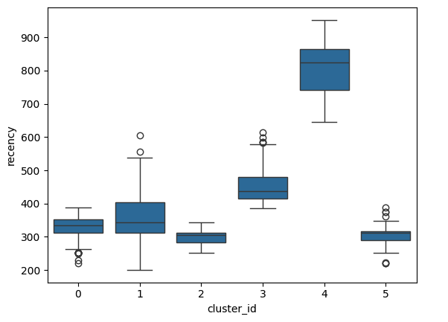
Patterns for frequncy and recency in segments

Slide 5
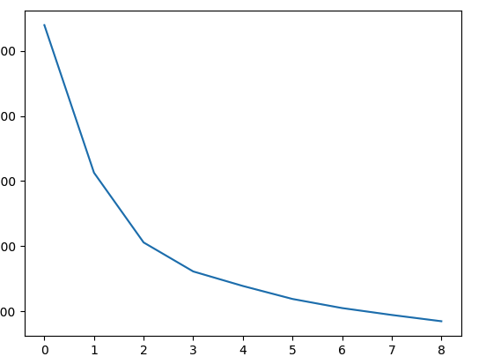
Elbow curve defined by silhoute score

Slide 6
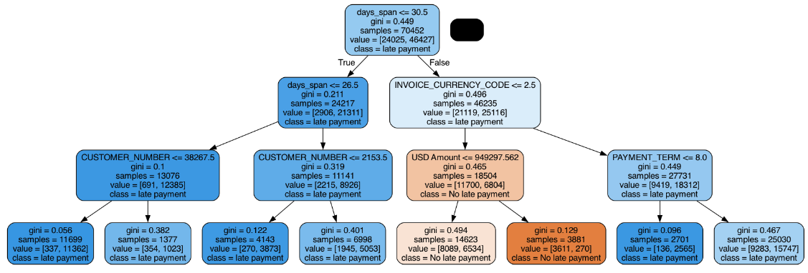
Decision tree model with depth 3: first model

Slide 7
Insights
Our first model itself predicts few really good points
Having less than 30 days of difference between due date and invoice date really affects the customer toward timely payments
Few customers stand by their value and do timely payments irrespective of other parameters few customer numbers stand out that way.
High invoice amount customers needs to be followed closely
Uncommon payment terms and currency code that is transactional currency yields a risky customers.

Slide 8
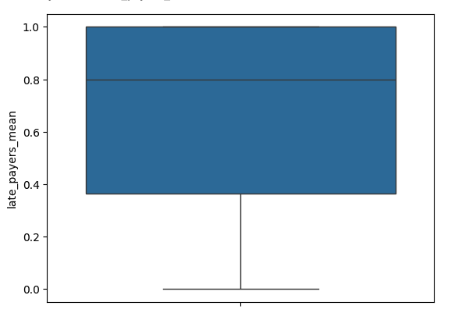
More than 50 % of customers have 80% invoices delayed

Slide 9
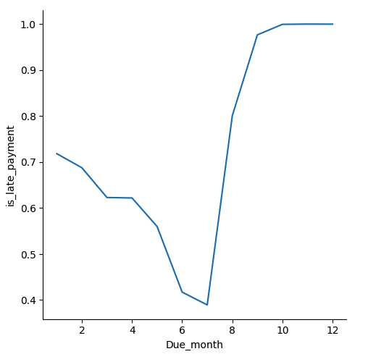
June and july are best months and we should not keep due dates at the end of the year

Slide 10
Final randome forest model
MODEL SPECIFICATION:
Random forest model with
Max depth 10
Max features 4
Min sample leaf 10
Model score:
Train Accuracy: 86.25%
Test Accuracy: 85.45%
Train Recall: 94.96%
Test Recall: 94.50%

