Slide 1


Slide 2


Project Title
Second Year Project Synopsis
Submitted by
ROLL NO. | NAME
2301730014 | Sanyogita Sharma
2301730028 | Prachi Lamba
2301730063 | Jagdish Barik
2301730041 | Aditya Pandey
Industry Mentor: Mr. Sachin Kaushik
Faculty Mentor: Mr. Harsh Vardhan
Notes:
New Courses replaced with New Programmes

Slide 3


Resume Builder: A Personal Portfolio
Website
The website is created to showcase your skills, projects, experience, and achievements in a professional and visually appealing manner.
Notes:
New Courses replaced with New Programmes

Slide 4
Introduction
This project is a web application developed using Flask framework in python. It is designed to demonstrate backend logic, user authentication, and secure data handling.
Notes:
New Courses replaced with New Programmes

Slide 5
Objective
The goal of this project is to create a simple, clean, and responsive personal portfolio website to showcase your skills, projects, and experience. It serves as a digital identity, allowing individuals to highlight their expertise, past work, and accomplishments in a structured and accessible way. It acts as an online resume, offering a dynamic alternative to traditional PDFs.
Notes:
New Courses replaced with New Programmes

Slide 6
Tech Stack
Languages: Python
Framework: Flask
Database: (Assumed) SQLite or MySQL
Others: bcrypt, virtual environment
Notes:
New Courses replaced with New Programmes

Slide 7
System Architecture
The application follows a typical MVC structure:
- Model: Data handling and database integration
- View: HTML templates
- Controller: Flask routes and logic
Notes:
New Courses replaced with New Programmes

Slide 8
Features
• - User Registration and Login
• - Password Encryption using bcrypt
• - Modular Code Structure
• - Virtual Environment for Dependency Management
Notes:
New Courses replaced with New Programmes

Slide 9
Code Structure
Main Files:
• - app.py: Core application logic
• - env/: Virtual environment
• - templates/: HTML files (not visible yet)
• - static/: CSS/IS (if included)
Notes:
New Courses replaced with New Programmes

Slide 10
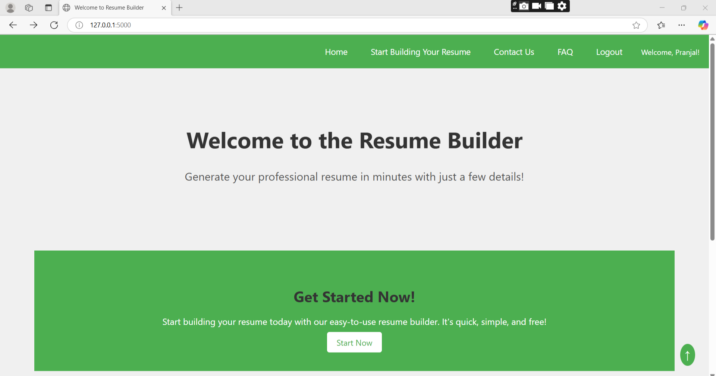
Demo Screenshot
Notes:
New Courses replaced with New Programmes

Slide 11
Challenges and Solutions
• -Setting up environment: Solved using virtualenv
• - Password security: Used bcrypt
•- Routing and templates: Handled with Flask
Notes:
New Courses replaced with New Programmes

Slide 12
Challenges and Solutions
This project demonstrates a robust Flask app.Future improvements:
• - Add database integration
• - Enhance Ul
• - Implement Apls
• - Deploy on cloud
Notes:
New Courses replaced with New Programmes

Slide 13
THANK YOU

