Slide 1
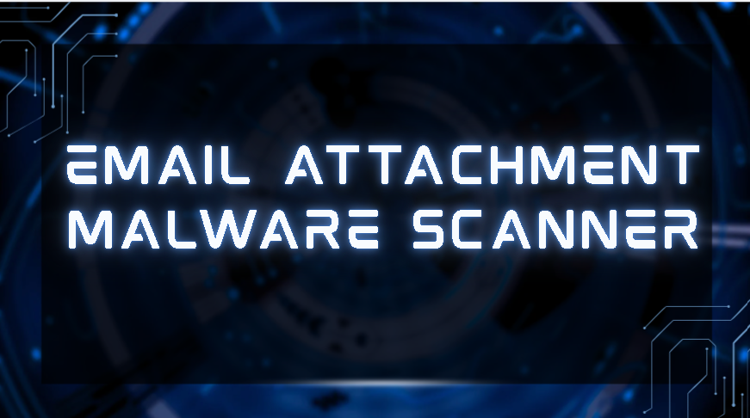
⌑
ATTAHMENT
MALWARE
SCANNER
AI-ASSISTED DFIR • PHISHING • MALWARE • RISK
SECURITY ANALYSIS PLATFORM

Slide 2
PROPOSED SOLUTION
MALWARE SCANNER
EMAIL SCANNER
REPORT GENERATION + IOC
• Securely transfer suspicious attachments to an isolated analysis environment
• Perform static malware analysis using hashes, magic bytes, entropy, strings, PE/Office analysis and YARA
• Classify malware and calculate a threat score using analysis results and threat-intelligence data.
• Securely ingest emails through read-only Gmail integration and extract forensic evidence
• Perform SPF, DKIM, DMARC, header, URL, sender and social-engineering checks
• Generate an explainable phishing risk score and verdict from combined evidence.
• Correlate email and malware findings into a unified security assessment
• Generate a DFIR-style report containing verdict, evidence, threat score and recommended actions
• Extract IOCs such as malicious IPs, domains, URLs, hashes and suspicious artifacts.
02

Slide 3
TECHNICAL APPROACH FOR EMAIL SCANNER
Structured forensic analysis rather than a single black-box verdict
EMAIL ANALYSIS ENGINE
Technical workflow
Gmail API
→
Email Parser
→
Evidence Extraction
→
Security Checks
→
Risk Scoring
→
Explainable Result
EVIDENCE EXTRACTION
KEY PRINCIPLE
• Email headers & sender information
• Authentication results
• Domains & IP addresses
• URLs & email body / HTML
• Attachments
• Metadata
Each security check returns an individual result:
✓ PASS ⚠ SUSPICIOUS ✕ FAIL
Every finding carries technical evidence, risk contribution, explanation and a recommended action.
03

Slide 4
EMAIL SECURITY CHECKLIST
Multiple layers are evaluated before the final trust score is produced
LAYER
TECHNICAL CHECKS
Sender & Authentication
SPF • DKIM • DMARC • From / Reply-To • Return-Path • Message-ID • Received chain
Domain & Identity
Domain reputation • lookalike domains • typosquatting • impersonation • sender IP
URL & Content
URL extraction • redirects • suspicious destinations • urgency • credential requests • social engineering
Metadata & Forensics
Timestamp consistency • embedded metadata • author information • suspicious artifacts
Attachment Indicators
Attachment presence • file type • filename tricks • suspicious extensions • handoff to malware analysis
Output: PASS / SUSPICIOUS / FAIL + evidence + risk contribution
04

Slide 5
EMAIL SCANNER — ATTACK / ANALYSIS FLOW
SUSPICIOUS EMAIL
Gmail API
(Read-only ingestion)
Email Parsing &
Evidence Extraction
Security Checks
Risk / Trust Score
Verdict +
Explainable Findings
Attachment
Detected?
YES
NO → continue with email-only assessment
Malware Analyzer
(next module)
Unified Risk Engine
The email scanner produces the evidence and score; suspicious attachments are handed to the malware-analysis pipeline.
05

Slide 6
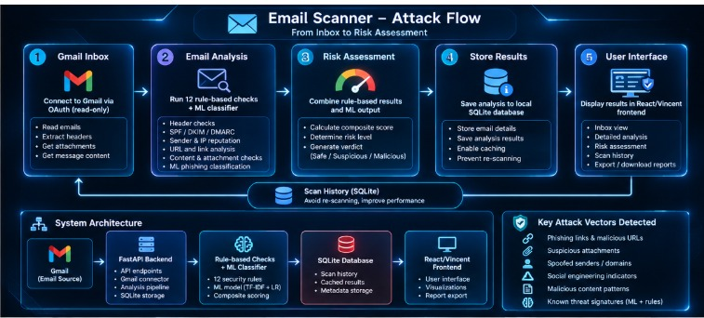

Slide 7
MALWARE SCANNER — WORKFLOW
Planned next module: isolate first, analyse second
01
Attachment Handoff
Create Case ID and securely retrieve the attachment from Gmail.
02
Isolated Workspace
Place the sample in a temporary analysis environment — never execute it on the web host.
03
Static Analysis
Inspect hashes, type, entropy, strings, PE/Office structure, archives and YARA.
04
Threat Intelligence
Check hashes and discovered indicators against approved intelligence sources.
05
Classification
Combine evidence into a malware classification and threat score.
Dynamic sandboxing is reserved as a later phase if development time permits.
06

Slide 8
MALWARE SCANNER — STATIC ANALYSIS
FILE IDENTITY
HASHING
Magic bytes • MIME/file type • extension mismatch
MD5 • SHA-1 • SHA-256 • fuzzy hash
BINARY ANALYSIS
DOCUMENT ANALYSIS
Entropy • strings • PE headers • sections • imports
PDF • Office • OLE • VBA/macros • embedded objects
ARCHIVE ANALYSIS
SIGNATURE DETECTION
ZIP/7z • nested files • encrypted archives • suspicious contents
YARA rules mapped to suspicious patterns and malware families
07

Slide 9
MALWARE SCANNER — THREAT CLASSIFICATION
EVIDENCE → CLASSIFICATION → THREAT SCORE
Static Evidence
YARA / Hash
Reputation
Correlation
Engine
Classification
POSSIBLE CLASSIFICATIONS
SCORE INPUTS
EXPLAINABLE OUTPUT
Trojan • RAT • Ransomware
Worm • Downloader • Botnet
Generic / Unknown
Known-bad hash • YARA severity
File anomalies • entropy
Threat-intelligence evidence
Verdict • confidence
Evidence behind classification
Recommended analyst actions
08

Slide 10
MALWARE SCANNER — DYNAMIC ANALYSIS (FUTURE)
Only if time permits: execute the sample inside a disposable, isolated VM
DISPOSABLE ANALYSIS VM
Process Tree
File Changes
Network / DNS
Controlled execution
PROCESS
FILES
SYSTEM
NETWORK
Spawned processes
process relationships
Created / modified
/dropped artifacts
Registry changes
persistence indicators
DNS • IPs • domains
connections / C2 indicators
After analysis: collect telemetry → extract behavioral IOCs → revert/destroy VM → correlate results.
09

Slide 11
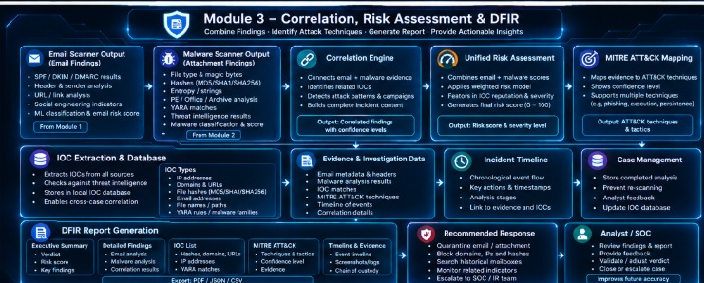

Slide 12
REPORT GENERATION — EVIDENCE TO DFIR ASSESSMENT
Content placeholder — replace with the report material you will provide
1. INCIDENT / CASE SUMMARY
2. TECHNICAL FINDINGS
• Case ID and investigation timestamp
• Email and attachment under investigation
• Executive summary
• Overall severity / verdict
• Evidence sources and analysis status
This slide can later include the final Composite Risk Score and incident narrative.
• Email security findings
• Malware analysis findings
• Threat-intelligence matches
• IOCs and supporting evidence
• Risk assessment
• Recommended containment / remediation
Report structure will be updated from the content you send.
10

Slide 13
REPORT GENERATION — RESPONSE & IOC OUTPUT
Content placeholder — final report/response content to be inserted
INDICATORS OF COMPROMISE
SHA-256 / file hash
Malicious domains
IP addresses
URLs
Suspicious files / artifacts
RECOMMENDED RESPONSE
FUTURE THREAT SHARING
• Quarantine / contain confirmed malicious content
• Search for matching IOCs across the organization
• Block confirmed malicious infrastructure
• Preserve evidence and document actions
• Normalize discovered IOCs
• Correlate repeated samples / campaigns
• Share authorized intelligence with relevant security teams
• Maintain privacy and access controls
11

Slide 14
END-TO-END FRAMEWORK
EMAIL
MALWARE
CORRELATION
REPORT
→
→
→
Gmail API
Email forensics
Static analysis
Dynamic analysis*
Trust + threat
Composite risk
DFIR assessment
IOCs + response
* Dynamic analysis is an optional advanced phase after the static malware-analysis MVP.
DETECT • ANALYZE • CORRELATE • EXPLAIN • RESPOND
12

Slide 15
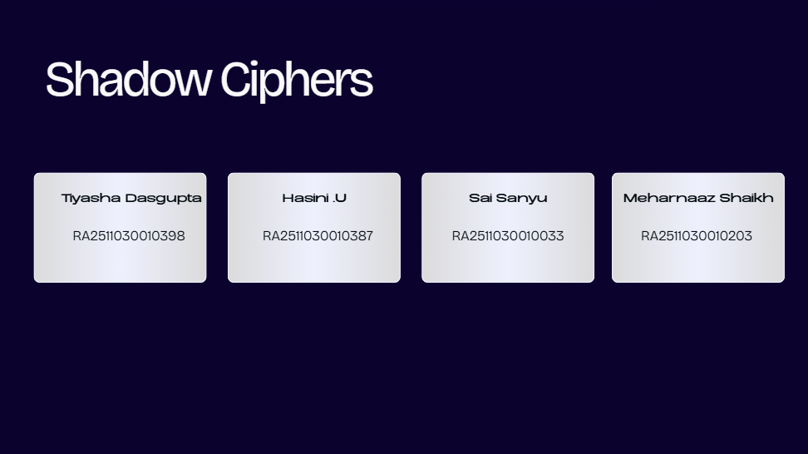

Slide 16
THANK YOU
Email → Malware → Correlation → DFIR
Questions / Demo
13

