Slide 1

L.Y B Major Project Presentation
“InsightDesk - Intelligent complaint triage system”
Guide:Prof.Ganesh Wadmare
Group No:10
Team Members –
Krisha Sinnarkar(Roll No.-61)
Sanyogita Shinde(Roll No.-60)
Krushnam Sadrani(Roll No.- 40)
Department of AI-DS, K.J. Somaiya Institute of Technology, Sion, Mumbai 400022
26/6/2023

Slide 2
TABLE OF CONTENTS
Sr.No. | Content
1. | Problem Statement
2. | Literature Survey
3. | Objective of Project
4. | Implementation
5. | Flow diagram
6. | Applications
7. | Future Scope
8. | References
9. | Conclusion
26/6/2023

Slide 3
PROBLEM STATEMENT
Vision Helpdesk handles a large volume of customer complaints generated from support tickets, emails, and feedback systems. These complaints are unstructured textual data, making manual analysis time-consuming and inefficient.
Existing systems mainly rely on keyword-based filtering or manual categorization, which fail to capture hidden patterns, sentiment intensity, and sudden spikes in complaints. As a result, when complaint volume increases rapidly, it becomes difficult to identify the root cause in time, leading to delayed responses and reduced customer satisfaction.
Therefore, there is a need to develop an intelligent system for Vision Helpdesk that can automatically detect complaint spikes, group similar issues, analyze sentiment, and generate root-cause diagnostics to improve response efficiency and service quality.
26/6/2023

Slide 4
LITERATURE SURVEY (1/3)
Paper (venue, year) | Method | Parameters / thresholds | Limitation | Our improvement
“Release Planning of Mobile Apps Based on User Reviews” (CLAP) [1], ICSE 2016 | Review features + DBSCAN clustering | eps 0.6 published; 0.75 tuned on our data | Batch only; groups by shared words (F1 0.24 on our data) | Online cases; LLM judge separates look-alike problems
“Towards More Accurate Retrieval of Duplicate Bug Reports” (REP) [2], ASE 2011 | BM25F keyword retrieval + metadata | k1 = 1.2, b = 0.75; top-k candidates | Misses paraphrases; top-5 hit 0.43–0.44 vs our 0.46–0.56 | Semantic retrieval + LLM verification
“Sentence-BERT: Sentence Embeddings using Siamese BERT-Networks” [3], EMNLP 2019 | Bi-encoder cosine similarity | One cosine threshold per task | One cut cannot be safe and inclusive (F1 ≈ 0.10) | Two calibrated cuts: 0.26 and 0.8306
“BERTopic: Neural Topic Modeling with a Class-Based TF-IDF Procedure” [4], 2022 | Embeddings + UMAP + HDBSCAN topics | Library defaults (minimum topic size) | Topics are themes, not problems (precision 0.16) | Problem-level cases; topics only for routing
26/6/2023

Slide 5
LITERATURE SURVEY (2/3)
Paper (venue, year) | Method | Parameters / thresholds | Limitation | Our improvement
“Cupid: Leveraging ChatGPT for More Accurate Duplicate Bug Report Detection” [5], 2023 | ChatGPT extracts essentials, then REP retrieval | LLM on 40–60% of reports; Recall-Rate@10 0.60–0.65 | Ranking only; no cases, spikes or escalation | Online cases with spike alerts and RCA
“Entity Matching using Large Language Models” [6], EDBT 2025 | Zero-shot GPT-4 pair judge | Prompt only; F1 89.6–98.4 on record pairs | Judges every pair: cost grows with pairs | Judge only in the calibrated band, at most 5 candidates
“GPTrace: Effective Crash Deduplication Using LLM Embeddings” [7], ICSE 2026 | LLM embeddings + HDBSCAN clustering | Density clustering over 300K crash reports | Batch; stack traces only | Online grouping of free-text complaints
“Dial-In LLM: Human-Aligned LLM-in-the-loop Intent Clustering for Customer Service Dialogues” [8], EMNLP 2025 | LLM-in-the-loop intent clustering | 100k calls, 1,507 clusters; >95% agreement with humans | Intents, not problems; batch | Problem cases decided as complaints arrive
26/6/2023

Slide 6
LITERATURE SURVEY (3/3)
Paper (venue, year) | Method | Parameters / thresholds | Limitation | Our improvement
“LLM-Guided Lifecycle-Aware Clustering of Multi-Turn Customer Support Conversations” [9], AACL 2025 | Incremental clustering; LLM splits degraded clusters | Silhouette / Davies-Bouldin quality triggers | No spike detection, RCA or escalation | Full pipeline: spikes, RCA, approval
“TickIt: Leveraging Large Language Models for Automated Ticket Escalation” [10], FSE 2025 (ByteDance) | LLM escalation with category fine-tuning | Predefined ticket categories | Fixed category set; no spike detection | Open-ended cases + CUSUM + vague alarm
“Incident-aware Duplicate Ticket Aggregation for Cloud Systems” (iPACK) [11], ICSE 2023 (Microsoft) | Links tickets to cloud incident alerts | Requires monitoring alerts; F1 0.87–0.94 | Depends on telemetry | Works from complaint text alone
SentiSum anomaly detection [12], commercial, 2025 | Anomaly detection per tag | z-score > 2 per tag | Fails at 0–2 complaints per window (0% detected) | Poisson CUSUM, h = 2 (76–91% detected)
Research finding: several systems group duplicate reports (CLAP, TickIt, iPACK, Dial-In LLM), but none we found in academic papers, industry blogs, products or patents combines online problem-level case merging of raw complaint text with per-case spike detection, root-cause explanation and human-approved escalation.
26/6/2023

Slide 7
OBJECTIVE
Group duplicate complaints into problem-level cases as they arrive, using similarity retrieval and an LLM judge for uncertain matches.
Measure customer sentiment using the RoBERTa model.
Find complaint topics automatically with BERTopic and route each to the responsible department.
Detect sudden spikes with a Poisson CUSUM and raise an alarm on surges of vague complaints.
Explain the root cause with an LLM, with a human approving every escalation.

Slide 8
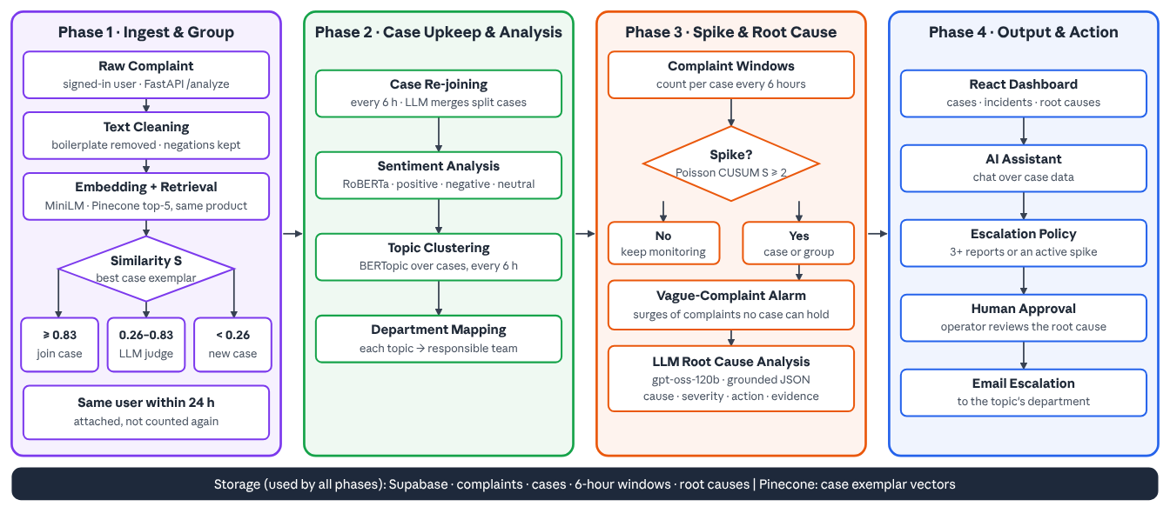
FLOW CHART
26/6/2023

Slide 9
IMPLEMENTATION (1/2)
Running example: a customer writes “Can't log in since the update, the OTP never arrives”.
Intake & Cleaning: the signed-in customer submits through the React app; filler such as “Hi team, please help” is removed, while negations like “can't” are kept.
Embedding & Retrieval: MiniLM turns the text into a vector; Pinecone returns the 5 most similar cases of the same product, e.g. “OTP not received on login” (similarity 0.71).
Decision Band: similarity ≥ 0.8306 joins automatically, < 0.26 opens a new case; our 0.71 falls in between, so the LLM judge decides.
LLM Judge: gpt-oss-120b compares the symptom: “OTP never arrives” = same problem, so the complaint joins that case (count +1); “login is slow” would open a new case.
Same-User Rule: if the same customer repeats this complaint within 24 hours, it is attached to the case but not counted again.
26/6/2023

Slide 10
IMPLEMENTATION (2/2)
Case Re-joining (every 6 h): the LLM merges cases that report one problem, e.g. “no dark mode” and “needs dark mode” become one case.
Sentiment & Topics: RoBERTa labels the case negative; BERTopic places it under an Authentication topic, which carries the responsible department.
Spike Detection: a Poisson CUSUM watches each case and group of similar cases; 5 OTP complaints in 6 hours against a usual 0.1 raises a spike.
Vague-Complaint Alarm: a surge of “app not working” complaints that fit no case still raises a product-level alarm.
Root Cause & Escalation: with 3+ reports or a spike the case is eligible; the LLM writes a grounded root cause (cause, severity, action, evidence) and an operator approves the email to the department.
26/6/2023

Slide 11
MATHEMATICAL FORMULATION
Retrieval: e(x) = MiniLM(x) ∈ ℝ³⁸⁴ with ‖e‖ = 1; S(x, C) = max over exemplars m ∈ E_C of e(x)·e(m); keep the top 5 cases of the same product.
Decision band: join automatically if S* ≥ t_high; open a new case if S* < t_low; otherwise the LLM judge decides.
Upper threshold: t_high = min{ t : Prec(t) ≥ 0.97 }, Prec(t) = share of true duplicates among tuning pairs with similarity ≥ t → 0.8306.
Lower threshold: t_low = 20th percentile of similarities of true duplicate pairs → 0.26 (80% of duplicates stay reachable).
Spike CUSUM: λ = (Σ last 28 windows + 0.5) / (n + 7); k = 1 / ln((λ + 1)/λ); S = max(0, S + c − k); alert when S ≥ 2.
Vague alarm: alert when v ≥ 2 and P(X ≥ v) < 0.001 with X ~ Poisson(λ).
26/6/2023

Slide 12
THRESHOLD CALIBRATION & SENSITIVITY
Setting | t_low | t_high | Precision | Recall | F1 | LLM share
Calibrated on tuning half (deployed) | 20th pct. of duplicates | precision ≥ 0.97 | 0.810 | 0.259 | 0.392 | 86%
t_low raised by 0.04 | + 0.04 | same | 0.803 | 0.256 | 0.388 | 81%
t_low raised by 0.09 | + 0.09 | same | 0.867 | 0.264 | 0.404 | 71%
t_low raised by 0.14 | + 0.14 | same | 0.906 | 0.260 | 0.404 | 61%
t_high lowered by 0.08 | same | − 0.08 | 0.808 | 0.277 | 0.413 | 78%
t_high lowered by 0.13 | same | − 0.13 | 0.722 | 0.246 | 0.367 | 68%
Single cosine threshold, no judge | one cut | one cut | – | – | ≈ 0.10 | 0%
Play Store held-out halves pooled, live judge calls. Recall is stable across settings; a higher t_low raises precision and cuts LLM calls, so the 20th-percentile rule is conservative. Final values (t_low 0.26, t_high 0.8306) transfer unchanged to Firefox, Thunderbird and unseen apps (precision 0.87–0.96).
26/6/2023

Slide 13
SPIKE DETECTOR CALIBRATION
Detector | Setting | Play Store detected | Play Store false / 100 windows | Bug reports detected | Bug reports false / 100 windows
Poisson CUSUM (deployed) | δ = 1, h = 2 | 42% | 0.06 | 76% | 0.38
Poisson CUSUM | δ = 1, h = 1.5 | 56% | 0.78 | 86% | 3.81
Poisson CUSUM | δ = 1, h = 3 | 25% | 0.00 | 50% | 0.01
Poisson CUSUM | δ = 0.5, h = 2 | 45% | 0.22 | 78% | 1.04
Poisson CUSUM | δ = 2, h = 2 | 33% | 0.02 | 67% | 0.10
EWMA | α = 0.2, L = 3 | 55% | 0.67 | 86% | 3.19
Poisson tail test | c ≥ 2, p < 0.001 | 43% | 0.27 | 71% | 1.20
z-score (feedback tools) | z > 2 | 0% | – | 0% | –
300 simulated outbreaks per dataset, case level. h = 2 is the knee: lower h buys little detection for many more false alarms. EWMA reaches CUSUM's detection only at about 9× its false alarms on bug reports.
26/6/2023

Slide 14
TEST DATASETS & LABEL CREDIBILITY
Dataset | Size | Ground truth | Credibility | Used for
Play Store reviews (6 help-desk apps) | 338 labelled of 450 | 2 team annotators, written codebook | κ = 0.74; LLM labellers agree with humans at κ 0.68–0.70 | Tuning and held-out evaluation
Firefox and Thunderbird (Bugzilla) | 437 + 452 reports | Mozilla triagers' duplicate links | Independent of us; some duplicates unlinked, so precision is conservative | Transfer test
BugHub split: Firefox, Thunderbird, Eclipse | 233,521 reports | Public duplicate links | Standard public benchmark | Duplicate retrieval (top-5)
Unseen apps: Intercom, Jira SM, ServiceNow | 588 reviews | Agreed key of 2 LLM labellers | κ 0.38 between LLMs; 50-pair human check pending | Secondary transfer test
Endava IT tickets | 350 of 1,000 | Ticket categories | Partial run, preliminary | Third domain
Synthetic complaints | 488 | Generator ground truth | Sanity check only | Never a headline result
26/6/2023

Slide 15
SENTIMENT & TOPIC CLUSTERING
Sentiment model: RoBERTa (cardiffnlp twitter-roberta-base-sentiment-latest), 3 classes (negative, neutral, positive) with a confidence per case.
How it was evaluated: on real Play Store reviews against star ratings (1–2 negative, 3 neutral, 4–5 positive): accuracy 0.707; negative complaints precision 0.81, recall 0.85.
Why RoBERTa: DistilBERT reached accuracy 0.713 but is binary and cannot say neutral; RoBERTa is more precise on negatives (0.81 vs 0.77).
Topic clustering: BERTopic over case texts: UMAP (12 neighbours, 5 dimensions, cosine), then HDBSCAN (minimum cluster size 3, minimum samples 1), keywords from 1–2-word c-TF-IDF.
Result: 319 staging cases formed 49 topics with 11.9% outliers; each topic's keywords map to a department (Authentication, Engineering, Customer Success) that receives escalations.
Upkeep: re-clustered automatically every 6 hours when cases grow by 20% or outliers exceed 15%.
26/6/2023

Slide 16
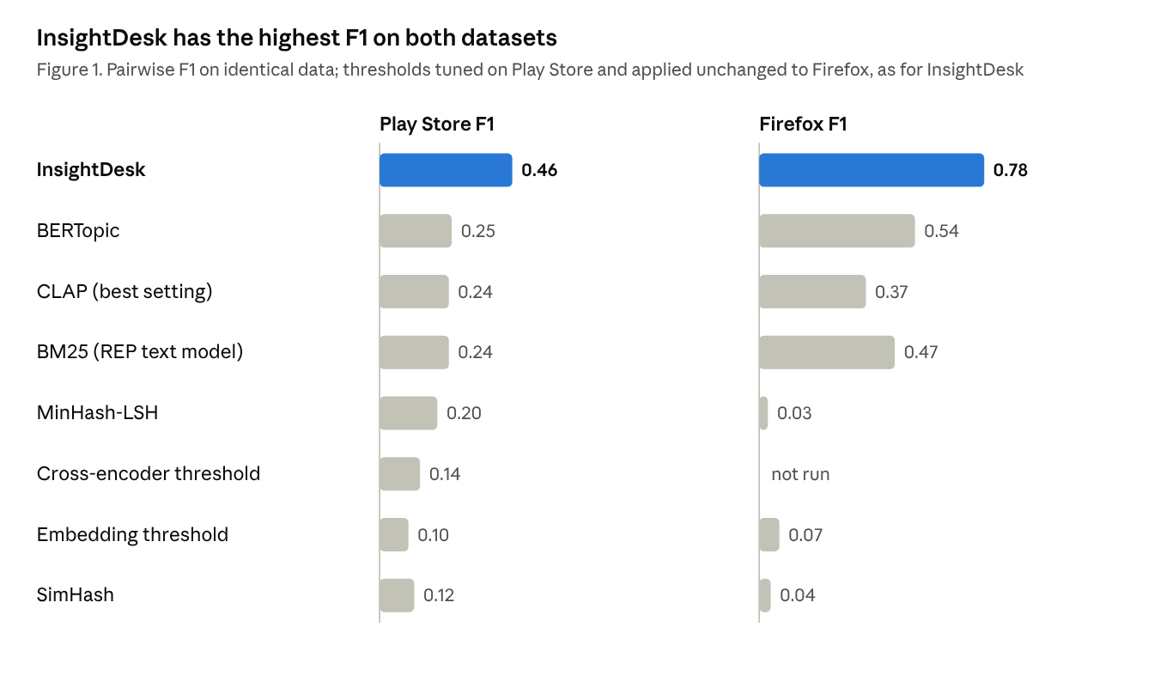
RESULTS: GROUPING QUALITY
Precision 0.80 on human-labelled Play Store reviews.
F1 0.46 vs at most 0.25 for every competitor on the same data.
Firefox bug reports: F1 0.78 with thresholds unchanged.
At equal precision (0.80): 33% of duplicates found vs about 1% for BM25, MinHash and SimHash.
26/6/2023

Slide 17
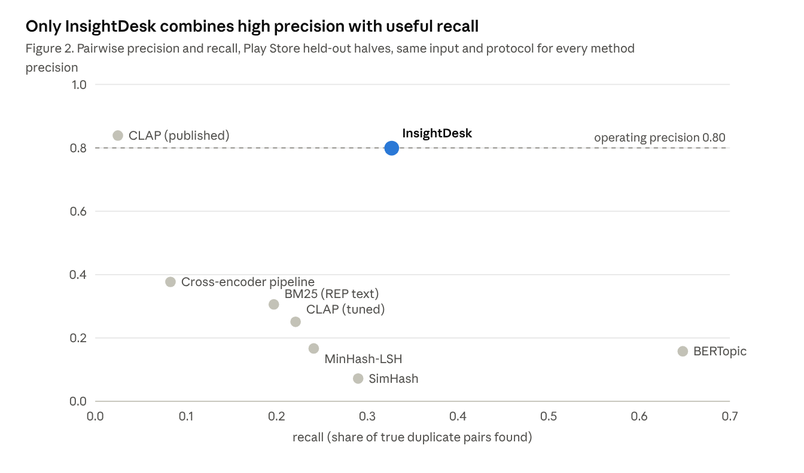
RESULTS: PRECISION VS RECALL
Only InsightDesk keeps precision high while finding useful recall.
Topic models group themes, not problems (BERTopic precision 0.16).
Generalises: unseen apps case precision 0.92, unseen company 0.89.
Duplicate retrieval (top-5): 0.46–0.56 vs REP 0.43–0.44 on 233K bug reports.
26/6/2023

Slide 18
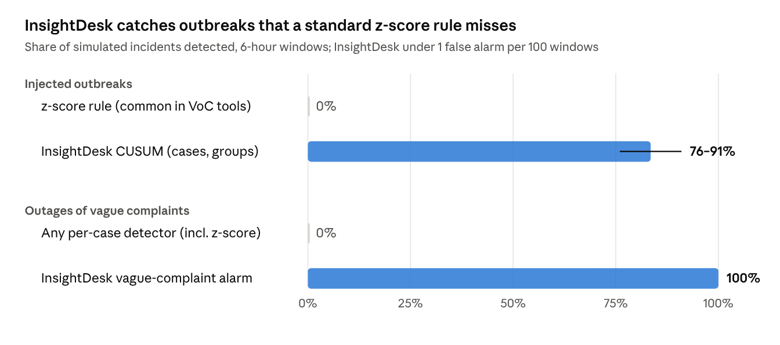
RESULTS: INCIDENT DETECTION
CUSUM: 76–91% of outbreaks detected on bug-report streams, under 1 false alarm per 100 windows.
z-score (used by feedback tools): 0% detected.
Vague alarm: 100% of vague-only outages with 10+ complaints.
End to end: 94% of incidents escalation-eligible within 12 h, 0 false alarms.
26/6/2023

Slide 19
APPLICATIONS
Customer Support Analytics: Detect recurring issues automatically
Mobile App Monitoring: Find crashes and bugs from reviews
Banking / Finance: Detect transaction complaints
E-commerce: Analyze delivery and payment issues
Helpdesk Automation: Generate diagnostics automatically
AI-Powered Monitoring Systems: Real-time complaint analysis
26/6/2023

Slide 20
FUTURE SCOPE
Package the app with Docker and deploy it on GCP or Azure (free tier).
Host the open-weight LLM locally for full data privacy.
Remove personal details from complaints before any LLM call.
Learn from operator corrections to calibrate each company automatically.
Per-user submission limits, multilingual complaints and automatic Jira tickets.
26/6/2023

Slide 21
CONCLUSION
InsightDesk turns raw customer complaints into problem cases as they arrive. Similarity retrieval narrows each complaint to a few candidate cases, calibrated thresholds settle the clear ones, and an LLM judge decides the rest; a re-joining pass merges split cases. On real reviews it reaches precision 0.80 and the highest F1 of every method tested, and it transfers unchanged to bug reports. A Poisson CUSUM and a vague-complaint alarm detect incidents that the usual z-score misses, and every escalation is approved by a person before an email reaches the department.
26/6/2023

Slide 22
REFERENCES
[1] L. Villarroel, G. Bavota, B. Russo, R. Oliveto, M. Di Penta, “Release planning of mobile apps based on user reviews,” ICSE, 2016.
[2] C. Sun, D. Lo, S.-C. Khoo, J. Jiang, “Towards more accurate retrieval of duplicate bug reports,” ASE, 2011.
[3] N. Reimers, I. Gurevych, “Sentence-BERT: Sentence embeddings using Siamese BERT-networks,” EMNLP, 2019.
[4] M. Grootendorst, “BERTopic: Neural topic modeling with a class-based TF-IDF procedure,” arXiv:2203.05794, 2022.
[5] T. Zhang, I. C. Irsan, F. Thung, D. Lo, “Cupid: Leveraging ChatGPT for more accurate duplicate bug report detection,” arXiv:2308.10022, 2023.
[6] R. Peeters, A. Steiner, C. Bizer, “Entity matching using large language models,” EDBT, 2025.
[7] “GPTrace: Effective crash deduplication using LLM embeddings,” ICSE, 2026 (arXiv:2512.01609).
[8] M. Hong et al., “Dial-In LLM: Human-aligned LLM-in-the-loop intent clustering for customer service dialogues,” EMNLP, 2025.
26/6/2023

Slide 23
REFERENCES
[9] P. Pattnayak et al., “LLM-guided lifecycle-aware clustering of multi-turn customer support conversations,” AACL, 2025.
[10] F. Liu et al., “TickIt: Leveraging large language models for automated ticket escalation,” FSE, 2025.
[11] “Incident-aware duplicate ticket aggregation for cloud systems (iPACK),” ICSE, 2023 (arXiv:2302.09520).
[12] SentiSum, “What is anomaly detection?,” product documentation, help.sentisum.com, 2025.
[13] G. S. Manku, A. Jain, A. Das Sarma, “Detecting near-duplicates for web crawling,” WWW, 2007.
[14] A. Z. Broder, “On the resemblance and containment of documents,” Compression and Complexity of Sequences, 1997.
[15] E. S. Page, “Continuous inspection schemes,” Biometrika, vol. 41, 1954 (CUSUM).
26/6/2023

Slide 24
THANK YOU !
26/6/2023

