Slide 1

Eco-Conscious Car Rentals: Classification Strategies for Sustainability and User Engagement
Submitted in the partial fulfillment for the award of the degree of
BACHELOR OF ENGINEERING
IN
AIT - Computer Science and Engineering (AIML)
Submitted by:
Under the Supervision of:
Miss Kirti
SANYA GUPTA 22BAI71049
SUSHIL KUMAR PATRA 22BAI70315
HIMANSHI BHARDWAJ 22BAI70859
KUSHAL YADAV 22BAI50033
Department of AIT-CSE
DISCOVER . LEARN . EMPOWER

Slide 2
Table of Contents
References
Outcome
09
Innovations & Alignment with SDG
Constrain Identification
07
05
Introduction
03
01
08
06
Conclusion
04
Software Specifications
02
Methodology
Problem Defination

Slide 3
INTRODUCTION
CARZ: Eco-Conscious Car Rental Portal
Eco-Conscious Car Rental Portal The Eco-Conscious Car Rental Portal redefines the car rental experience by putting sustainability at the forefront. This innovative platform allows users to select vehicles based on their eco-friendliness, energy efficiency, and minimal environmental impact. By integrating advanced technologies, the portal categorizes and highlights vehicles that meet stringent eco-friendly standards, empowering users to make responsible choices effortlessly.
The portal's primary goal is to reduce carbon emissions and promote greener travel alternatives. By aligning convenience with environmental responsibility, it fosters a culture of sustainability in the car rental industry. Through this initiative, users can contribute to a healthier planet while enjoying the flexibility and convenience of a modern car rental service.

Slide 4
PROBLEM DEFINATION
01
Eco-Friendly Vehicle Options
Offer a wide range of sustainable vehicles to encourage green transportation choices.
The problem statement is to develop an innovative car rental portal that addresses the environmental challenges associated with traditional car rental services, which often overlook sustainability and contribute significantly to carbon emissions.
The limitations of conventional car rental systems drive the need for a platform that prioritizes eco-friendliness by offering vehicles categorized based on energy efficiency, CO₂ emissions, and environmental impact. The solution integrates AI and ML technologies to provide personalized recommendations, track environmental impact, and promote greener travel choices, ultimately reducing carbon footprints and encouraging sustainable practices.
Goals
02
Carbon Emission Reduction
Focus on minimizing emissions through energy-efficient vehicle options and eco-conscious practices.
03
Technology-Driven Personalization
Leverage AI and ML to provide insights, optimize routes, and recommend sustainable travel solutions.

Slide 5


CONSTRAINT IDENTIFICATION
1
High Carbon Emissions in Car Rentals
The traditional car rental industry contributes significantly to
carbon emissions due to the use of non-sustainable vehicle options.
2
Lack of Eco-Friendly Choices
Limited platforms prioritize sustainability or categorize vehicles
based on their environmental impact, leaving users with
few green travel options.
3
Device Compatibility
A responsive platform is essential to ensure seamless usability
across all screen sizes and operating systems.
4
User Accessibility
The platform must offer a simple interface for all users while providing advanced features for detailed insights.

Slide 6
METHODOLOGY
Vehicle Classification: Vehicles are categorized based on their eco-friendliness, energy efficiency ratings, and real-time CO₂ emissions data.
Environmental Impact Tracking: The portal calculates emissions savings for users opting for eco-friendly vehicles and provides detailed insights via dashboards.
AI and ML Integration: These technologies analyze user preferences, predict eco-friendly choices, and recommend optimal routes to minimize emissions.
Carbon Footprint Reduction: Every trip's environmental impact is monitored, with options for users to offset their carbon footprints through supported programs.
Easy-to-Use Responsive Platform: A user-friendly and responsive design ensures seamless access across all devices, providing an intuitive experience for users of all technical expertise levels.
Integrated Feature Set: Combines all essential car rental functionalities, including vehicle selection, emissions tracking, route optimization, and AI-driven recommendations, into a unified platform.

Slide 7
SOFTWARE SPECIFICATIONS
Current OS used
Windows And Linux
Programming Language
Python
Development Environment
Jupyter Notebooks
Machine Learning
scikit-learn for algorithms
Database
SQLite for data management
User Interface
cmd
Real-time Communication
Python features for session communication
Security Measures
Basic security practices in Python code
Version Control
Git for organized collaboration

Slide 8
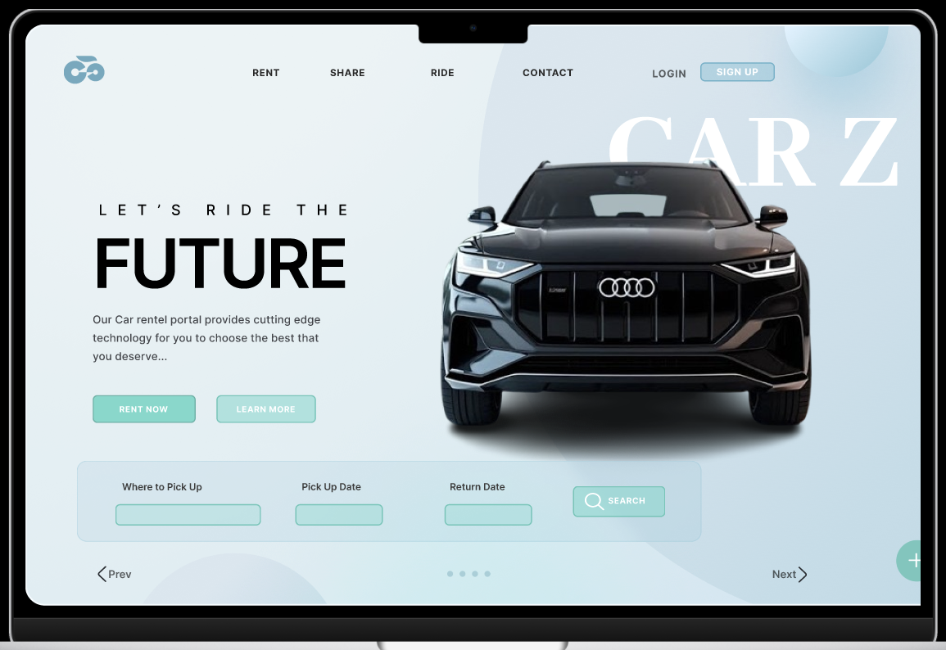
OUTCOME
Figma Design: Home Page

Slide 9

CONCLUSION
Seamless Sustainable Platform: The portal simplifies booking eco-friendly vehicles, making green transportation accessible and convenient for users.
Reduction in Carbon Footprints: By promoting sustainable practices and offering energy-efficient options, the initiative contributes to a significant reduction in greenhouse gas emissions.
Technology-Driven Impact: Leveraging AI and ML, the platform provides data-driven insights and personalized recommendations, encouraging eco-conscious decision-making.
Future-Ready Solution: This project aligns convenience with sustainability, paving the way for greener innovations in the car rental industry and beyond.

Slide 10
REFERENCE
https://www.researchgate.net/publication/261421343_Keystroke_dynamics_for_user_authentication
https://www.semanticscholar.org/paper/User-authentication-through-keystroke-dynamics-Bergadano-Gunetti/6695bd3dc2412b86ffd35d99b46e8bb3b602274b
https://biometrics.cse.msu.edu/Publications/SoftBiometrics/ZhongDengJain_KeystrokeDynamicsUserAuthentication_CVPR12biometricworkshop.pdf
https://www.academia.edu/1433106/User_authentication_through_keystroke_dynamics

Slide 11



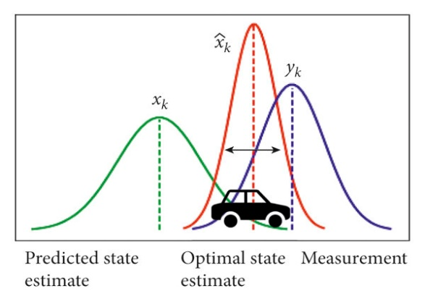
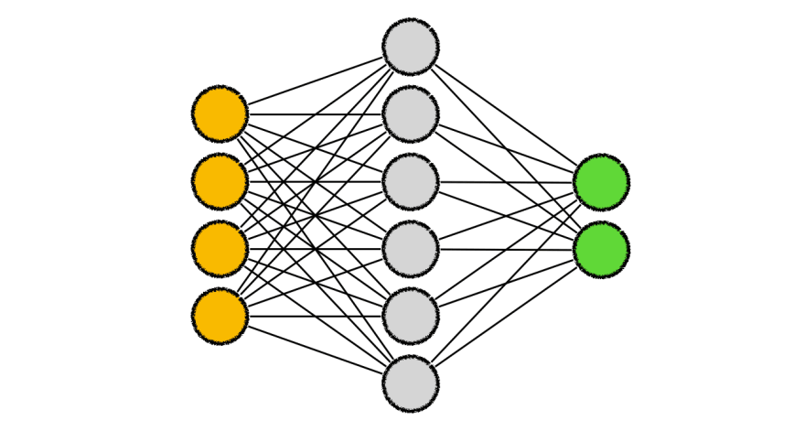


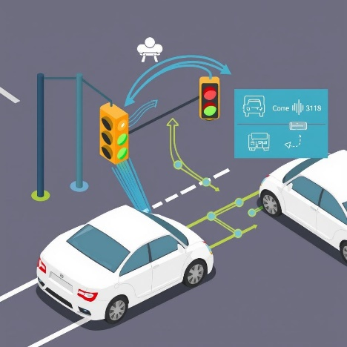
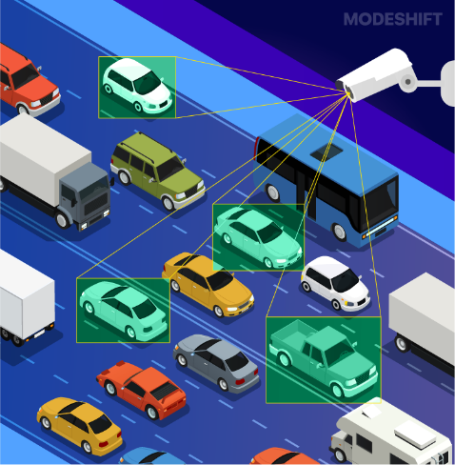

Frameworks and Innovations
Kalman Filter
Predicts and
Refines traffic flow
CNN
Classifies traffic signs and objects
Computer Vision (CV)
Detects and classifies
Vehicles in real time.
V2I Communication
Connects vehicles with
traffic infrastructure
FRAMEWORK
YOLO
Real-time object
detection model.
Feedback Mechanism Continuously improves
using real-time data

Slide 12
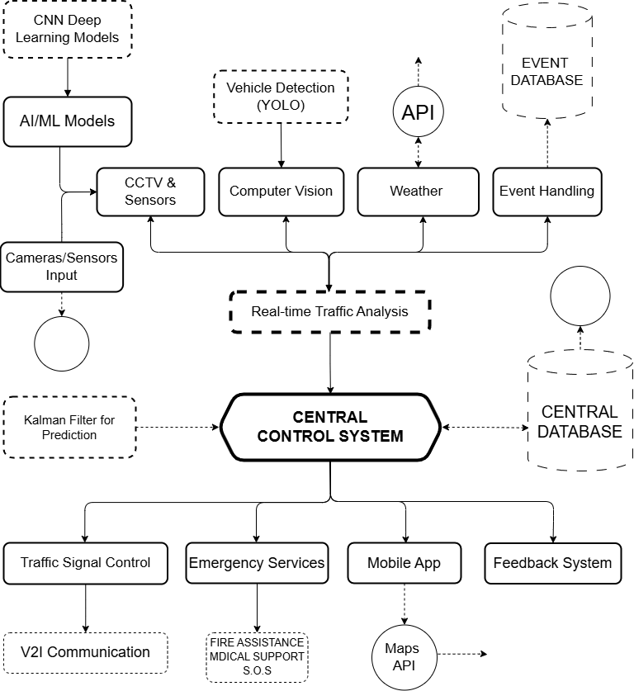




Methodology
Data Collection: Cameras and sensors detect real-time traffic flow, with YOLO for vehicle detection and classification.
Traffic Prediction: Kalman filter and AI/ML models forecast traffic patterns, optimizing flow and reducing congestion.
Event & Weather Handling: The system integrates special events and weather data to adjust traffic control dynamically.
Real-Time Analysis: The Central Control System processes real-time data for traffic optimization.
Signal Control & V2I: Adaptive traffic signals and Vehicle-to-Infrastructure communication streamline traffic and inform drivers.
User Interface: A mobile app provides real-time updates, alternate routes, and gathers user feedback for continuous improvement.

Slide 13






Sustainable Development Goals (SDG)
GOAL 9: Industry, Innovation, and Infrastructure
Long-term Impact: Contribution to the Goals
Enhances Urban Infrastructure
Fosters Technological Innovation
Supports Industrial Growth
Measurability: Can the Impact Be Measured?
SIGNIFICANCE:
Reduced Travel Times: 20-30% faster travel through optimized signals.
Decreased Traffic Congestion: 25-35% less congestion during peak hours.
Enhanced Safety: Fewer weather-related incidents with real-time data.
Improved Emergency Response Times: 15-20% faster response for emergency vehicles.
Environmental Benefits: Lower emissions through reduced idle time.
Infrastructure Efficiency
Technology Adoption
Economic Impact
Infrastructure Resilience

Slide 14
Autonomous Vehicle Integration:
Direct communication with autonomous vehicles for smoother, optimized traffic flow.
Smart City Integration:
FUTURE
SCOPE
Expand into smart city systems for unified urban management.
AI-Predictive Traffic Management:
Anticipate traffic patterns, enabling preemptive signal control and congestion avoidance.
Urban Planning Support:
Use AI-driven traffic data for long-term urban infrastructure planning.
Enhanced Emergency Response:
Create AI-driven "green corridors" for faster emergency vehicle response.
Crowdsourced Data Use:
Incorporate user-reported incidents for real-time traffic optimization.
Sustainability Impact:
Optimize routes to reduce emissions and promote eco-friendly traffic solutions.

Slide 15
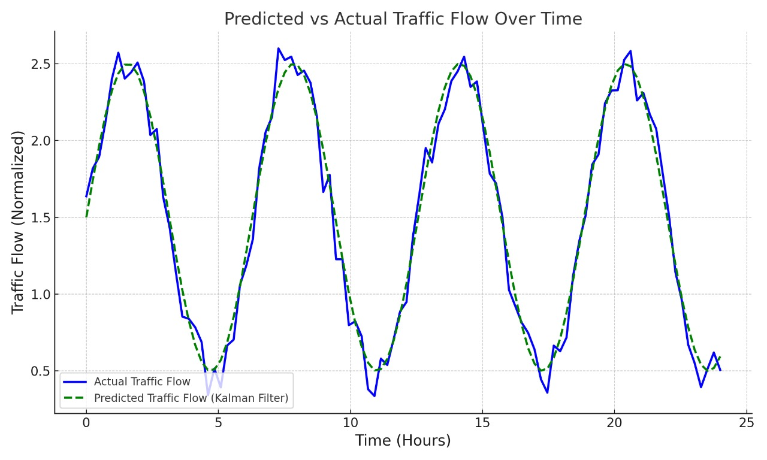

Conclusion
Scalability
City-Wide Traffic Management Expansion
Adaptable to Various Urban Sizes
Integrates with Existing Infrastructure
Supports Future Technology Upgrades
Easily Deployable Across Regions
The Smart Traffic Management System (STMS) leverages AI-driven traffic signal optimization and real-time data integration to enhance urban mobility. By utilizing IoT for traffic monitoring and incorporating weather analytics, it reduces congestion and improves emergency response times. This system facilitates efficient traffic flow, significantly elevating commuter safety and quality of life.

