Slide 1
KnowYourProf Teachers’ Information and Assessment Website

Slide 2
Greetings from all of us!
Saiful Islam 16.01.04.040
Syed Sanzam 16.01.04.042
&
Nusrat Hossain Anika 16.01.04.045
14.02.19

Slide 3
Sampling Decision and Sampling Design
Sample size: Incorporates 60 responses
Parameter of Interest: Mainly students and teachers
Target-oriented Sampling
Includes emails, instant messages and meet-ups
Data collection through google form
14.02.02

Slide 4
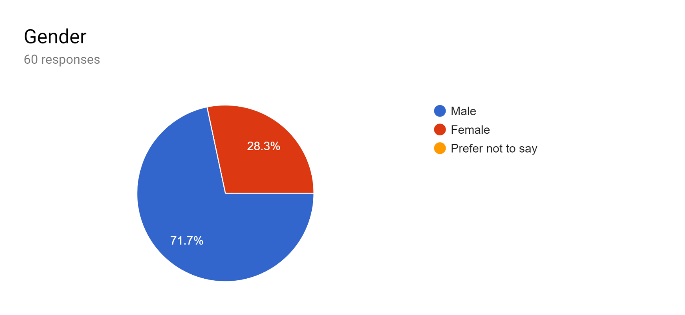
Data Analysis Demographic Information
71.7% of the respondents were male
28.3% of the respondents were female
14.02.19

Slide 5
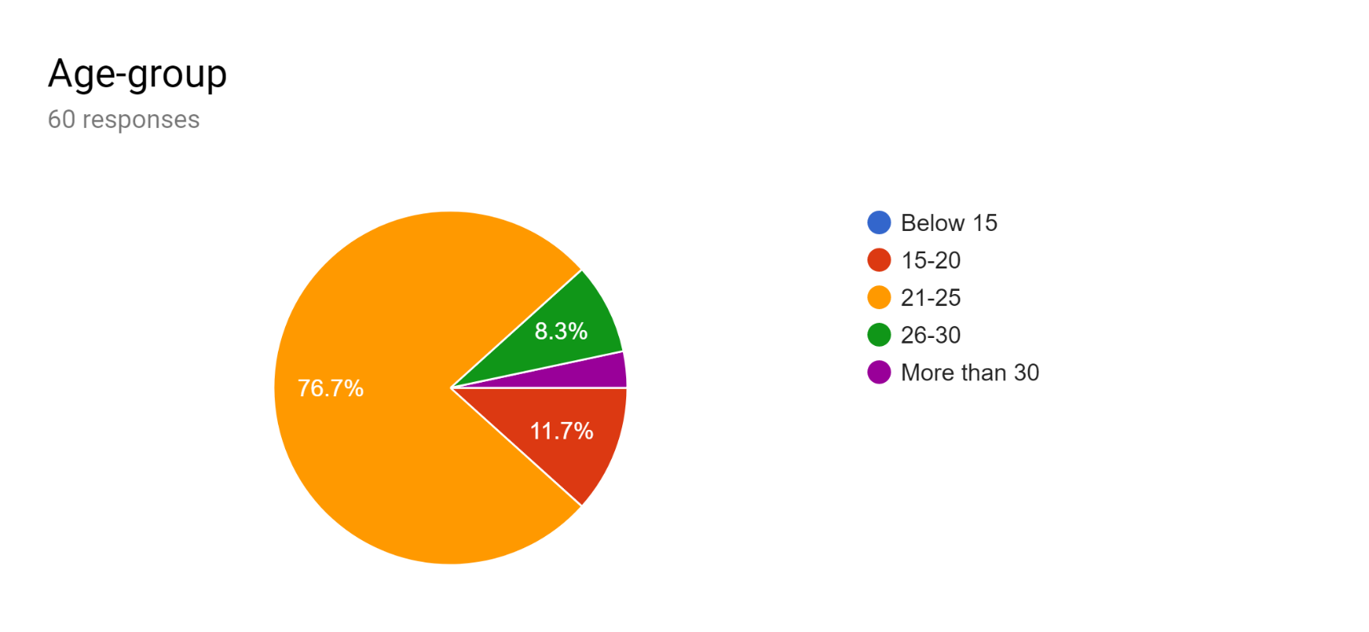
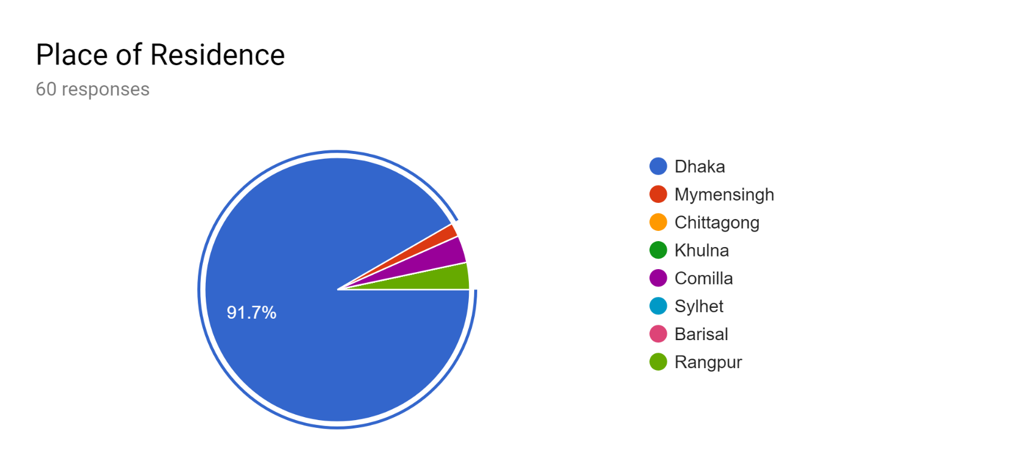
Data Analysis Demographic Information
The majority of the respondents were ranging from 21-25 age and from Dhaka
14.02.19

Slide 6
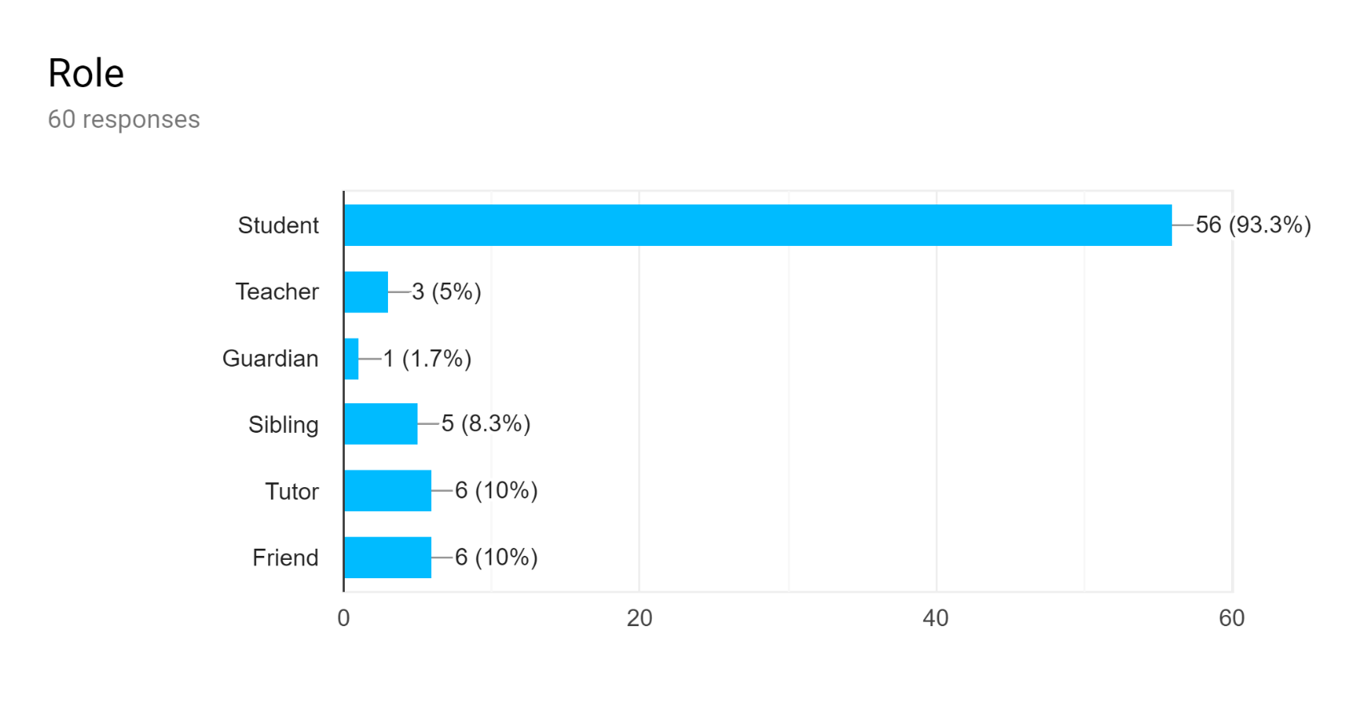
Data Analysis Demographic Information
The majority of the respondents were students.
14.02.19

Slide 7
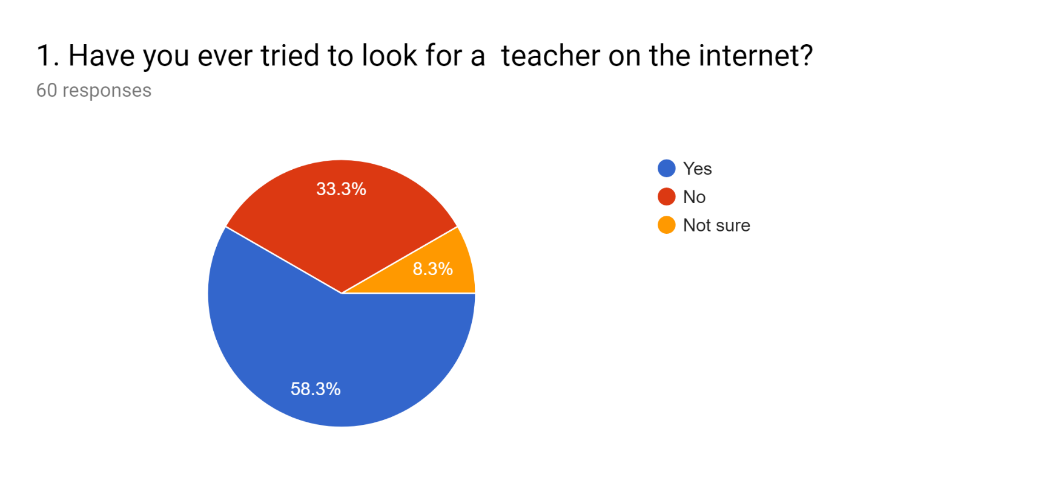
Data Analysis Project Related Information
Most of the respondents agreed that they have tried looking for a teacher on the internet at some point.
14.02.19

Slide 8
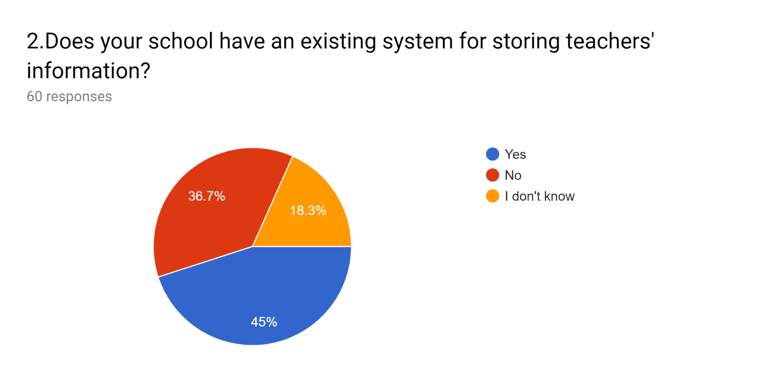
Data Analysis Project Related Information
Apparently, majority said they do have existing system but there is still a large number of participants that said otherwise.
14.02.19

Slide 9
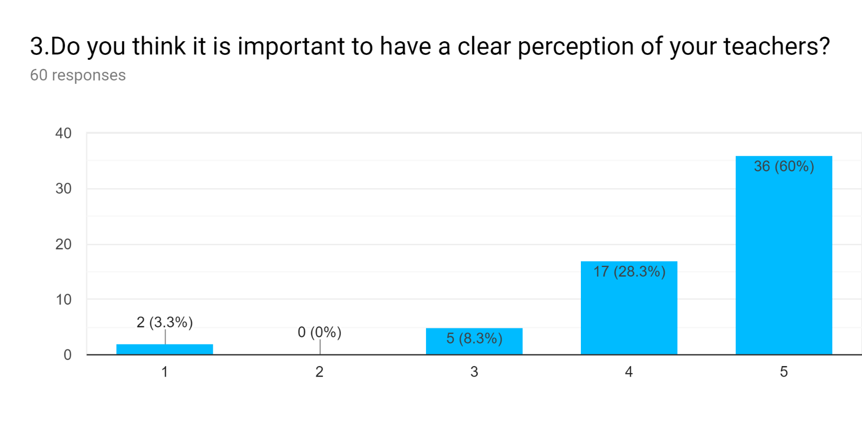
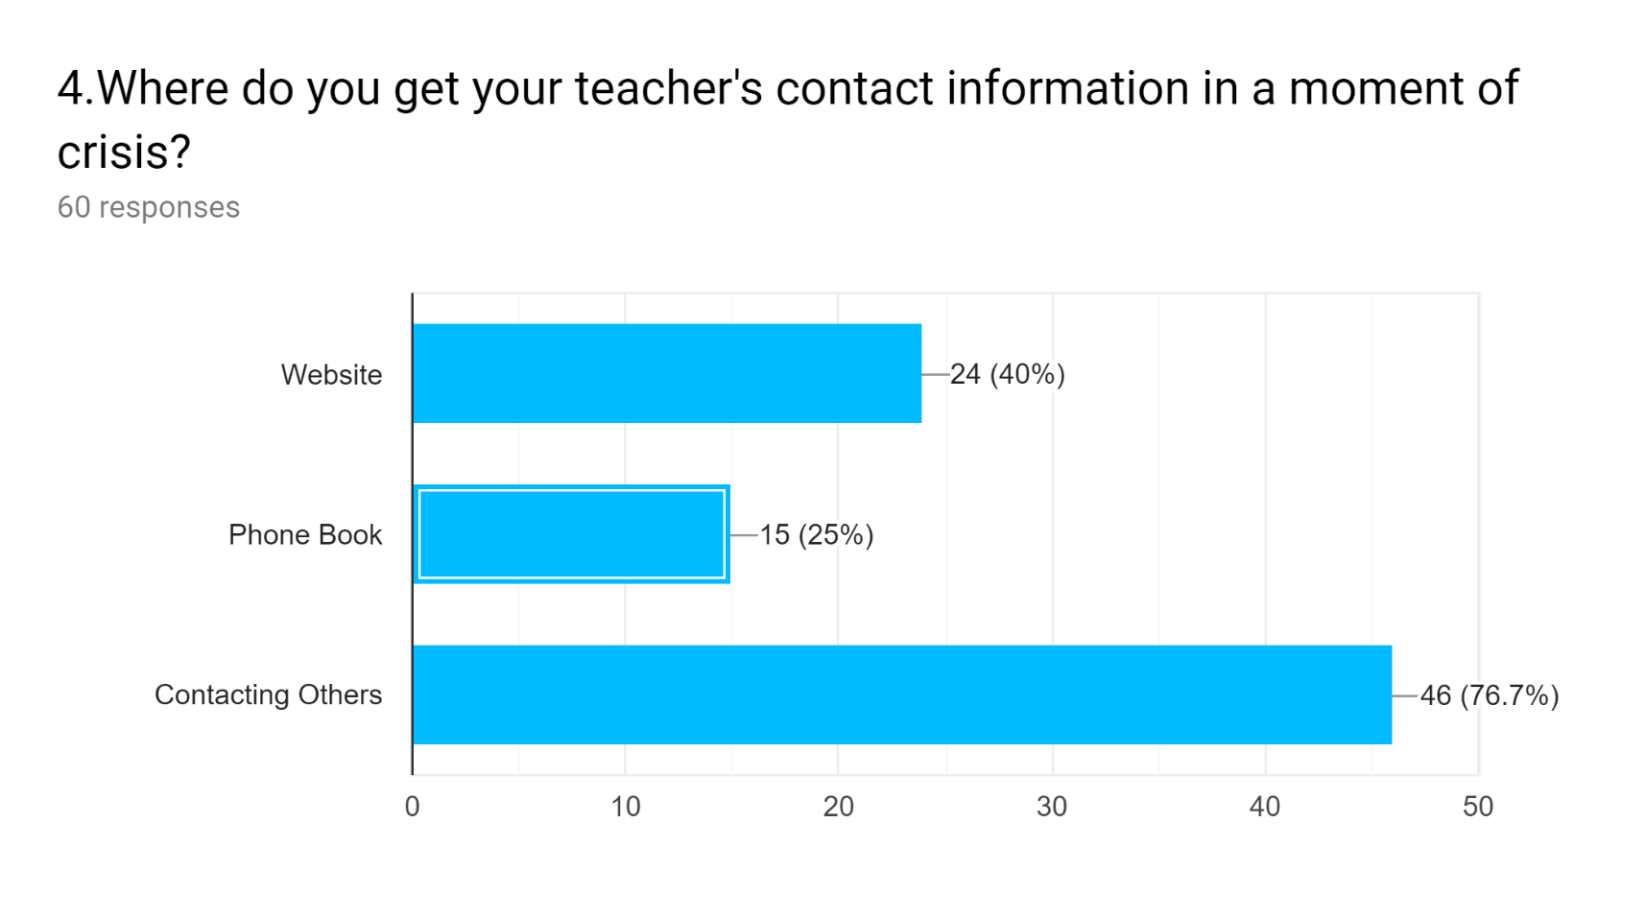
Data Analysis Project Related Information
14.02.19

Slide 10
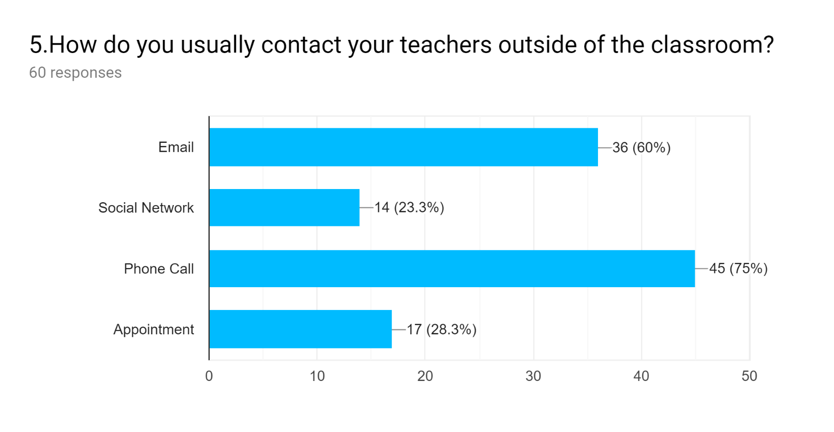
Data Analysis Project Related Information
The majority of the respondents agrees making a phone call is the way to contact their teachers.
14.02.19

Slide 11
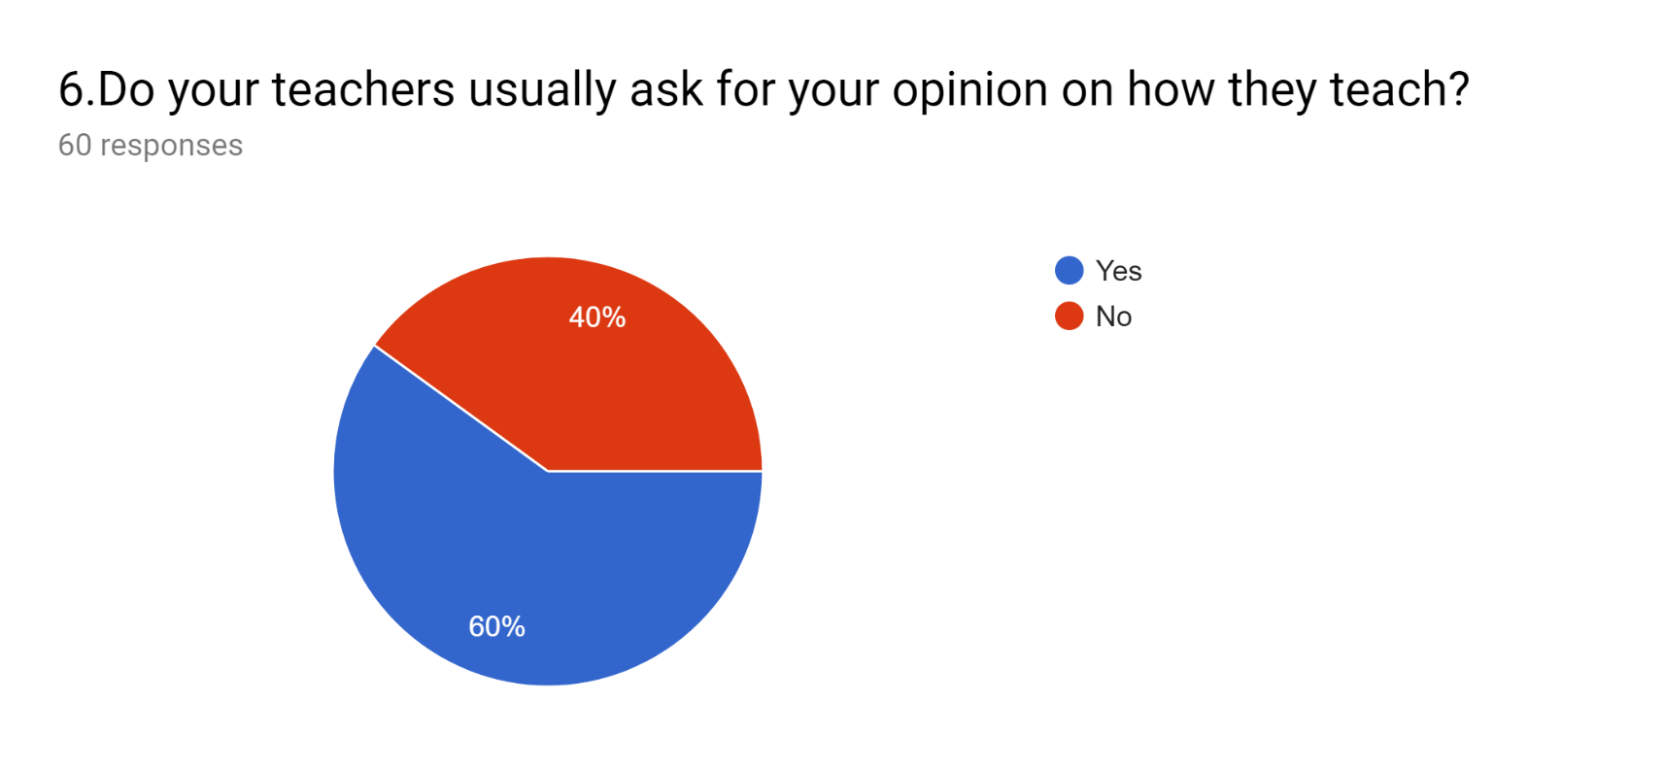
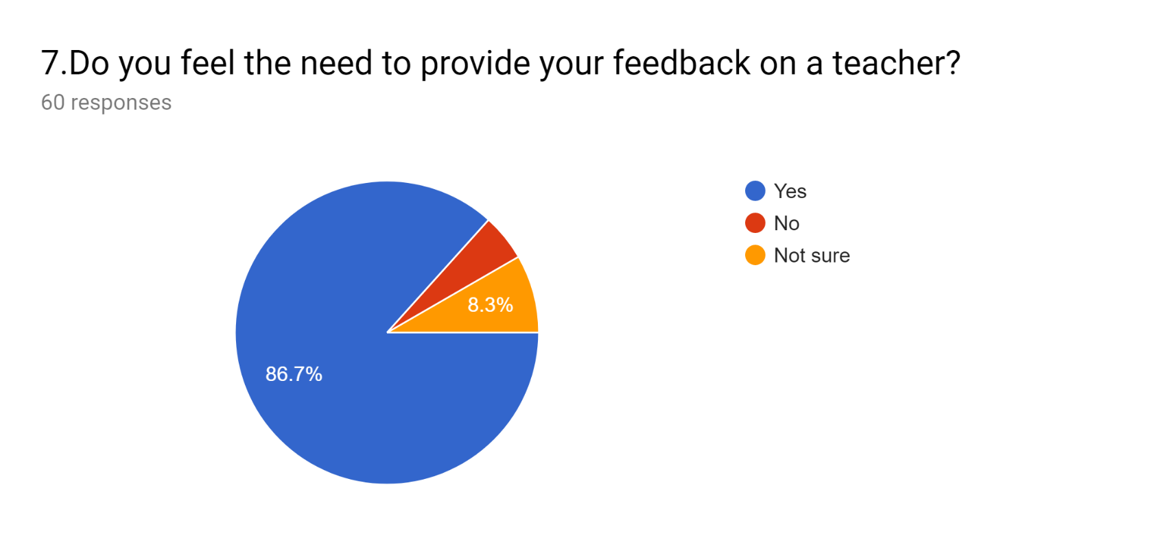
Data Analysis Project Related Information
A large number of teachers believes that it is crucial to connect with the pupils.
Almost all the participants firmly feel the need to provide their feedback on teachers.
14.02.19

Slide 12
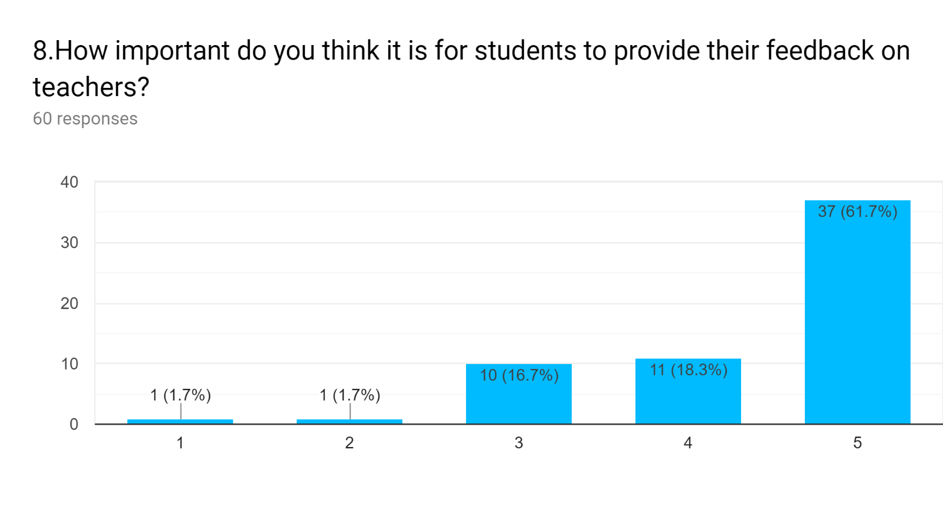
Data Analysis Project Related Information
14.02.19

Slide 13
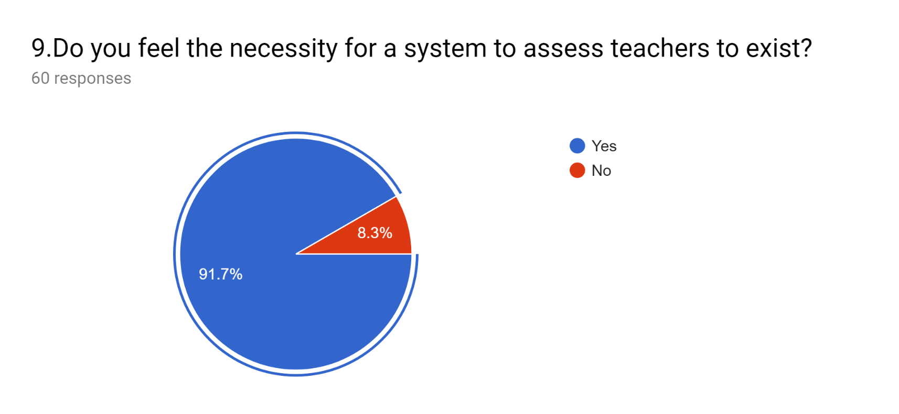
Data Analysis Project Related Information
Indicates people are very much willing to rate and review their teacher if an integrated system is available as it will make the process easier and convenient.
14.02.19

Slide 14
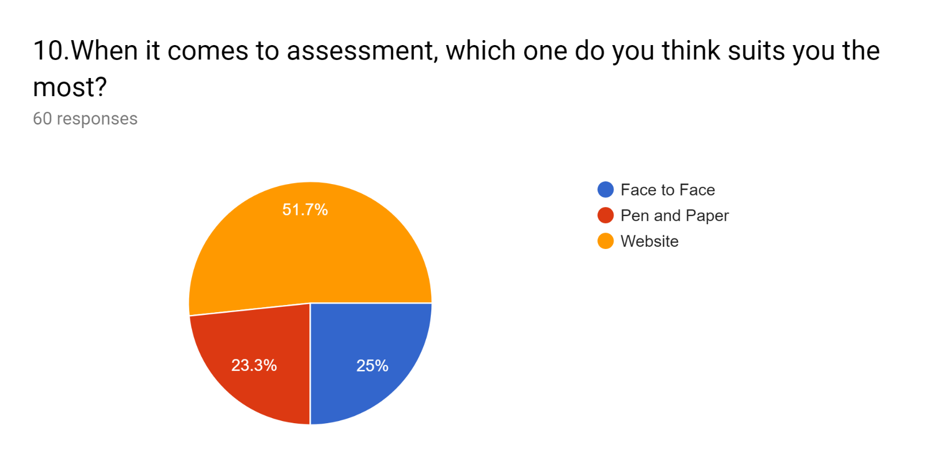
Data Analysis Project Related Information
It can be deducted that many people think a web-based system is a lot more convenient than the other options available when it comes to putting a reviews on teachers.
14.02.19

Slide 15
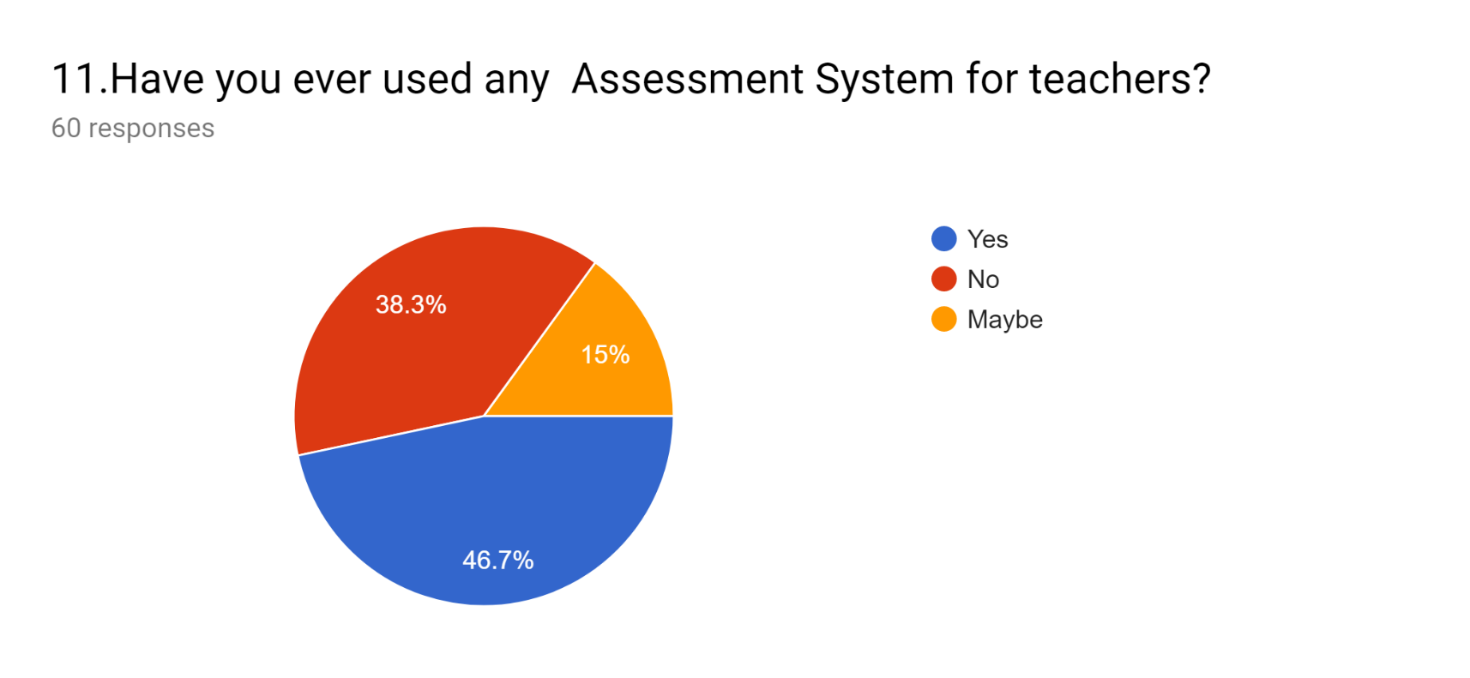
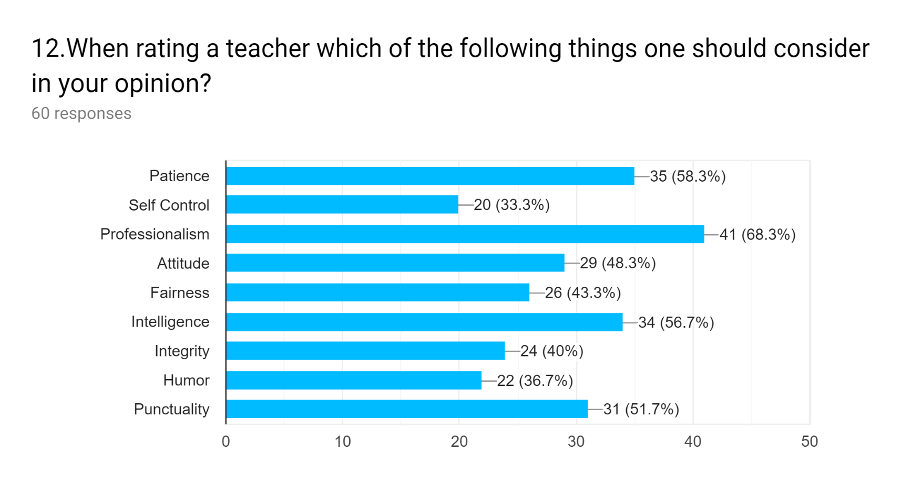
Data Analysis Project Related Information
14.02.19

Slide 16
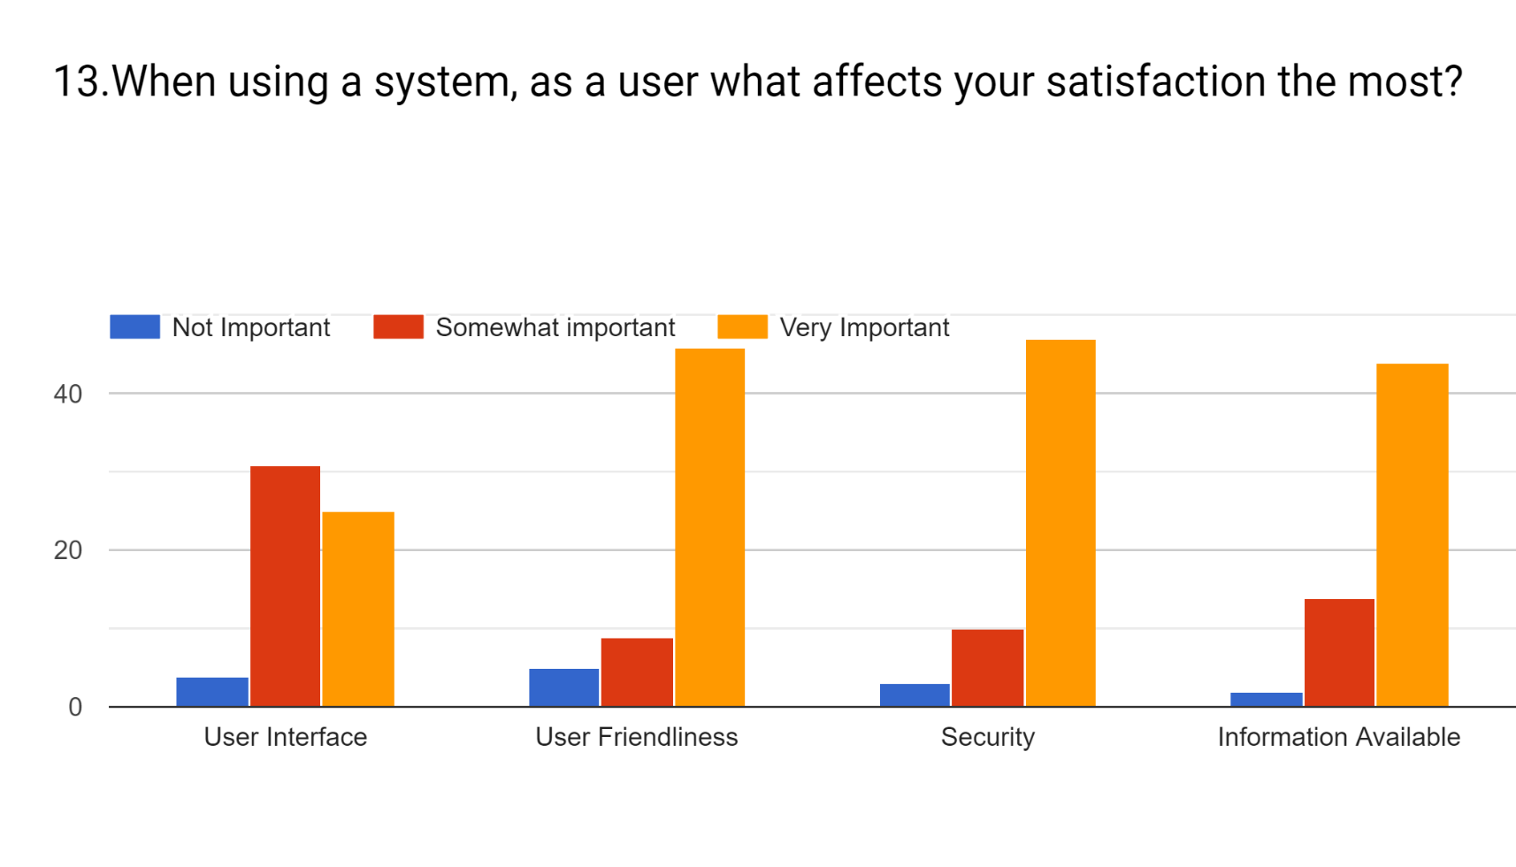
Data Analysis Project Related Information
14.02.19

Slide 17
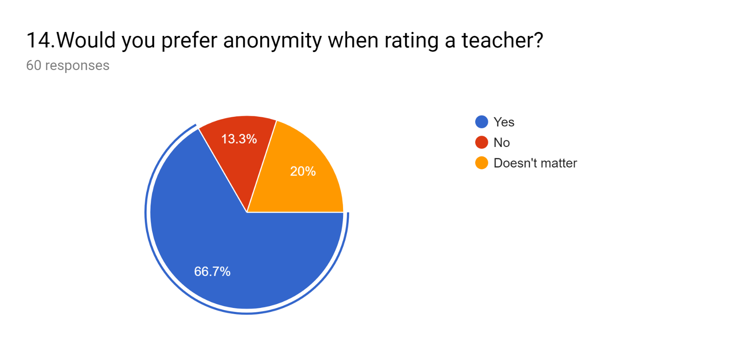
Data Analysis Project Related Information
It is obvious from the data that users will be more comfortable and truthful if the system can guarantee anonymity.
14.02.19

Slide 18
Our Findings
People look for teachers on internet
Lack of an existing system
Clear perception is required
Many teachers ask students for feedback
Getting in touch with a teacher can be clumsy
Students in general are in favor of a review system
Almost everyone believes in this system
14.02.19

Slide 19
Conclusion
Asking questions is crucial for any kind of software development as it opens up a lot of doors. It is a must to learn about the demographic as well as what users specifically expect from the system.A research like this is undoubtedly a salutary experience and will result in a lot of good things.
14.02.19

Slide 20
Thanks!
We’ll be more than happy to answer your questions ☺
14.02.19
20

