Slide 1
eSIM
Presented by : Sanjeev magar
BICT 2nd SEMESTER

Slide 2
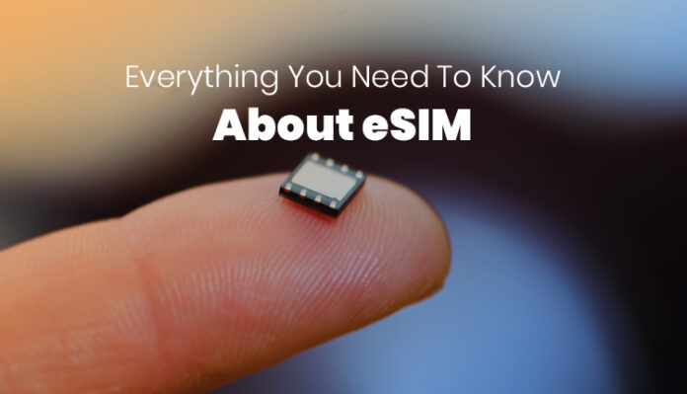
What is eSIM?
The eSIM stands for embedded SIM.
It is build into the mobile set and eliminates the need for physical sim.
It can also be known as virtual SIM.

Slide 3
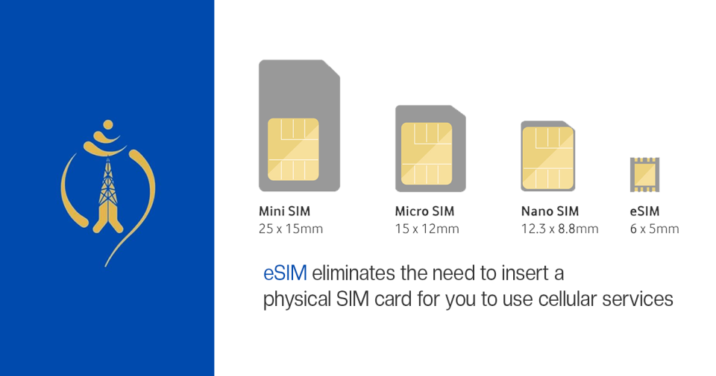
Nepal Telecom eSIM in Nepal

Slide 4
Advatages
The eSIM allows the user to have more than one phone number.
The eSIM also takes significantly less space than a SIM tray.
The eSIM also makes it easier to switch networks as it can be done digitally.

Slide 5
Dis-Advatages
Although users can change the service provider or an eSIM profile (phone number) digitally, the users are not in control of the process.
With a traditional SIM card, users could simply swap the card, but with the eSIM, users need to contact the service provider.
Also, you can no longer save the contact information on the SIM card.

Slide 6
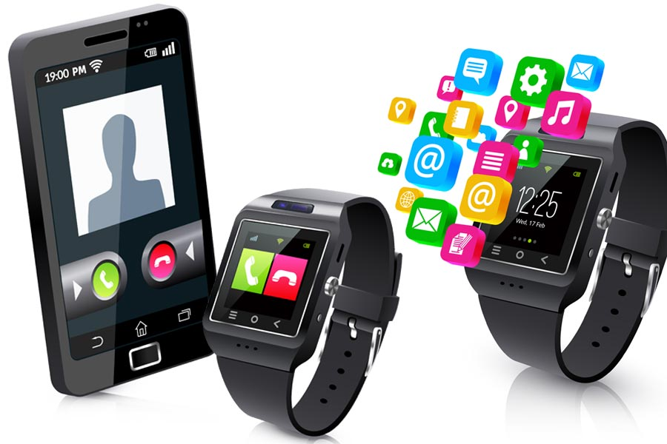
COMPATIBILITY
There are only a handful of smartphones that currently support eSIM, but that number is only going to increase.
The eSIM is not limited to just smartphones, it can also be used on other devices such as wearables — including smartwatches — and IoT devices.

