Slide 1




Slide 2
EDINRPS
To Use Smart Student System
JUST CLICK!
Supervised by/
Dr. Ehab Rushdy
Eng. Ahmed Awad

Slide 3








Our team
Abdul-Hamid Ibrahim
Abdul-Rahman Fawzi
Abdul-Rahman Salah
Hagar Mosleh
Safa Salah
Samar Talat
Soha Talat
Mennatullah Rabie

Slide 4





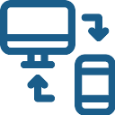
Motivation
Difficult communication between students
and doctors.
Limited accessibility : accessibility might have been restricted to specific physical locations or devices .
Lack of control for professors over
lectures.
Data mismanagement risk
User friendliness : the existing system may have lacked intuitive controls or interfaces , making it difficult for users to navigate .
Lack of file upload and mail features in
classes.

Slide 5
Objectives
Flexible system for Students ,Doctors,AdminsAnd Parent
Building a professional smart student system
Highly efficient system architecture
Availability of system network and components

Slide 6
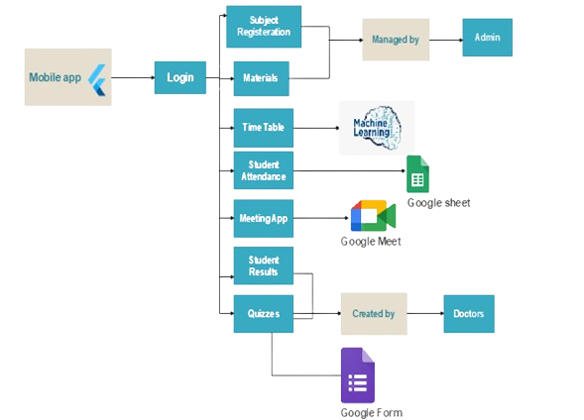
System Architecture
Mobile Application

Slide 7
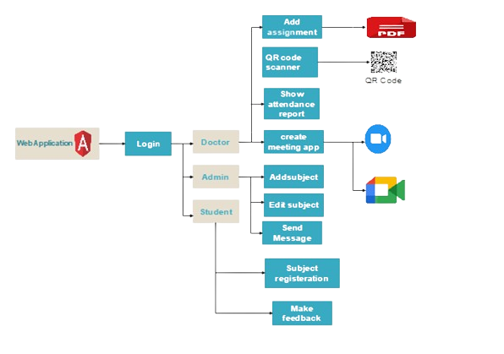
System Architecture
Web Application

Slide 8




Technologies
Flutter
ASP.NET
Visual Studio
Angular
ASP.NET is a web framework designed by Microsoft Inc. that is extensively used to build robust web applications.
Visual Studio is an Integrated Development Environment(IDE) developed by Microsoft to develop Desktop applications, GUI(Graphical User Interface), console, web applications, mobile applications, cloud, and web services, etc
Angular is a popular open-source Typescript framework created by Google for developing web applications.
Flutter is an open-source mobile app development framework created by Google.

Slide 9



Technologies
Android studio
StarUML
Figma
It provides a powerful code editor with features such as auto-completion, and code navigation to write and maintain code.
StarUML is a software engineering tool for system modeling using the Unified Modeling Language, as well as Systems Modeling Language, and classical modeling notations.
Figma is a collaborative browser-based interface design tool, with additional offline features enabled by desktop applications

Slide 10
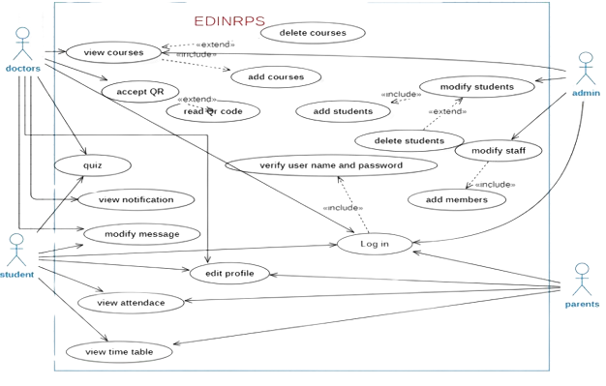
Usecase Diagram

Slide 11
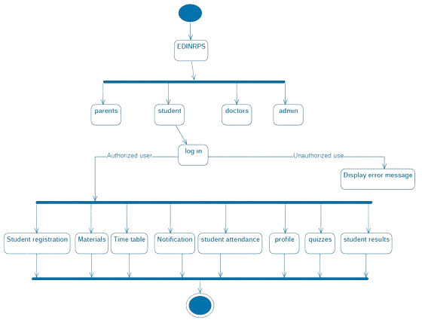
Activity Diagram

Slide 12
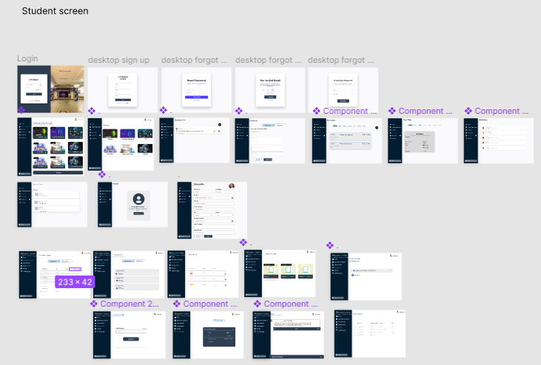
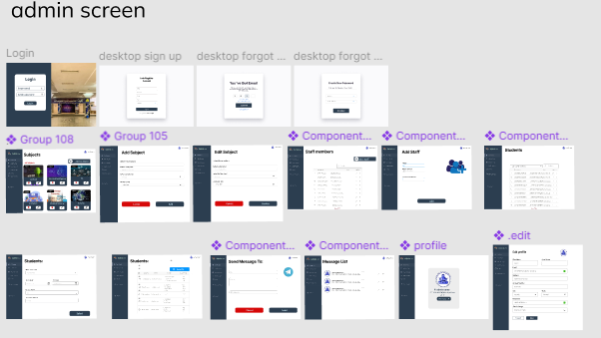
UI/UX for web app
Students can get their lectures, attendance, time table and results .
Admin can add lectures and assignments to students .

Slide 13
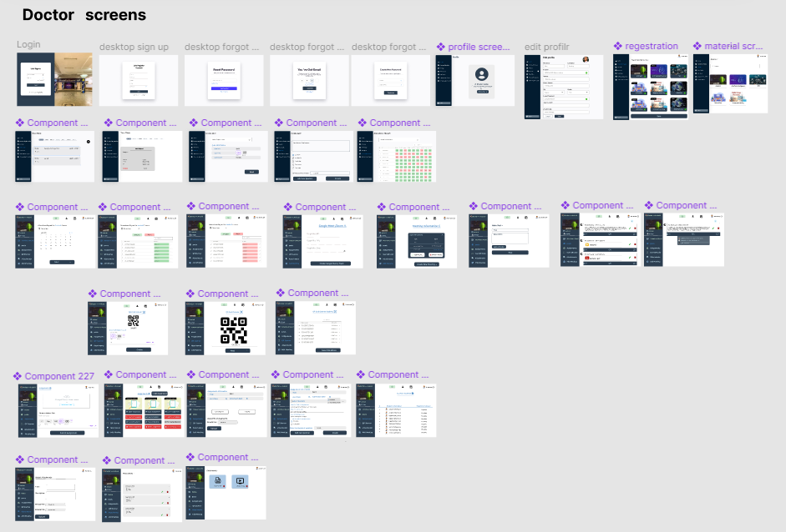
UI/UX for web app
Doctor can log in to his spcific subjects and upload lectures and posts to students .

Slide 14
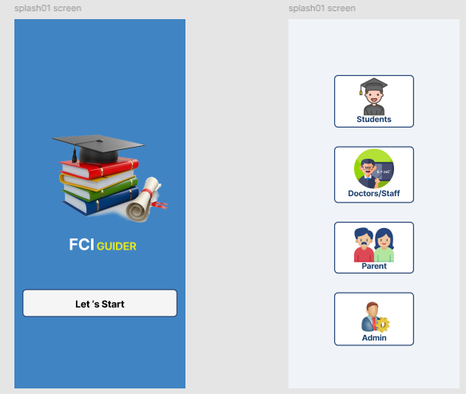
UI/UX For Mobile

Slide 15
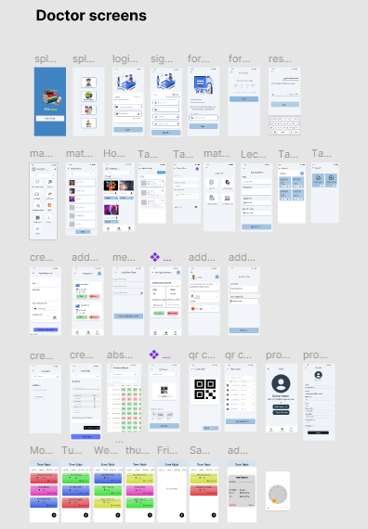
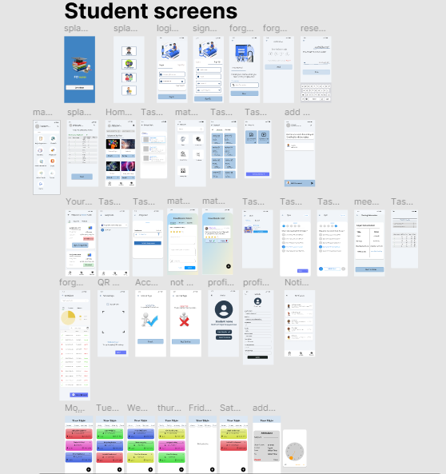
Doctor can log in to his spcific subjects and upload lectures and posts to students .
UI/UX for Mobile app
Students can get their lectures, attendance, timetable and results .

Slide 16
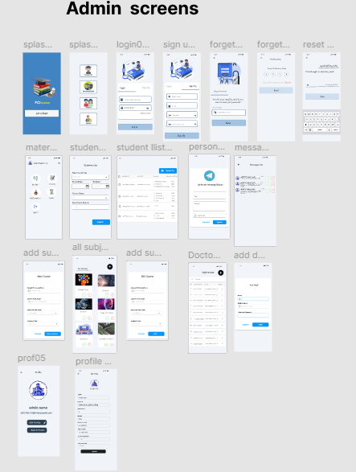
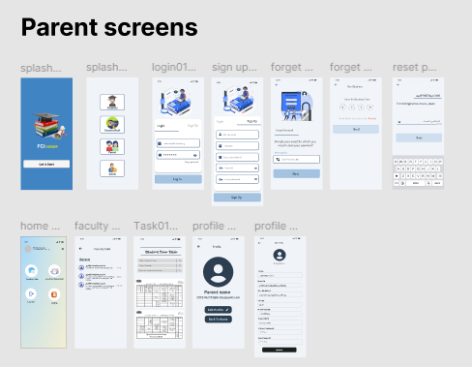
Parents can keep track of their children by pursuse their absents and results .
UI/UX for Mobile app
Admin can add lectures and assignments to students .

Slide 17
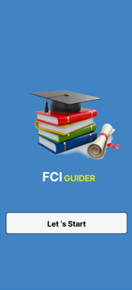
Mobile Application
This is an easy-to-use application designed for Doctors,Students,Admin,and parent which streamlines their daily work in college, particularly in student system, through the use of mobile application and web application.

Slide 18
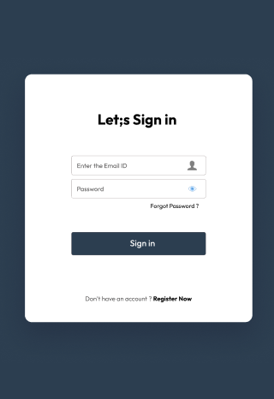
Web Application
This is an easy-to-use web-application designed for Doctors, Students and Admin which streamlines their daily work in college, particularly in student system, through the use of mobile application and web application.

Slide 19
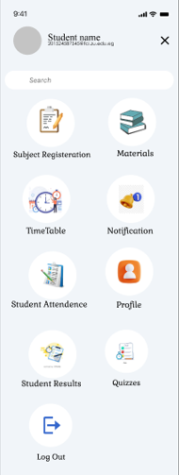
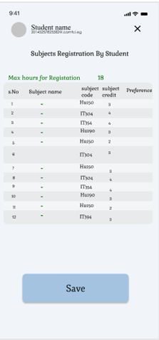
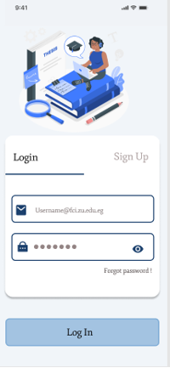
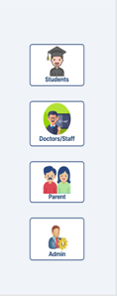
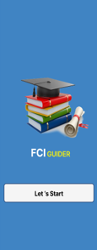
Here comes the … App!

Slide 20
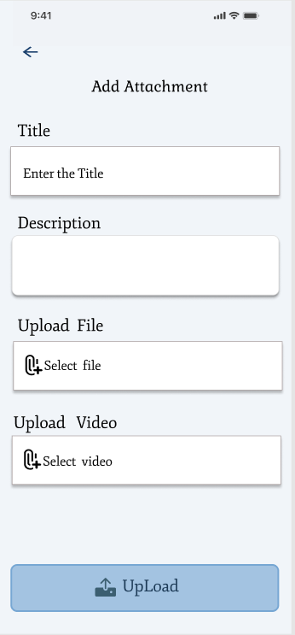
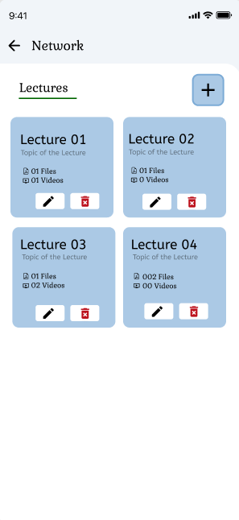
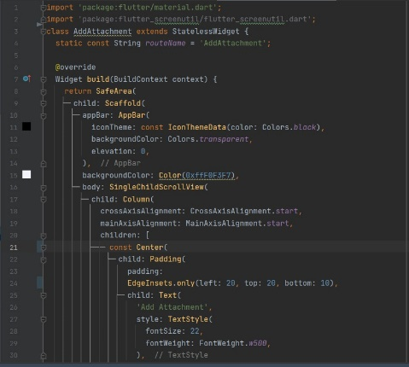
Features : Uploading Files
Instructor Uploads his files from mobile or any device to the app to be sent student to automatically

Slide 21
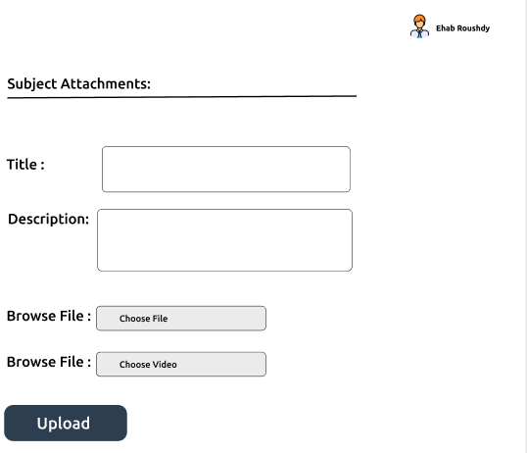
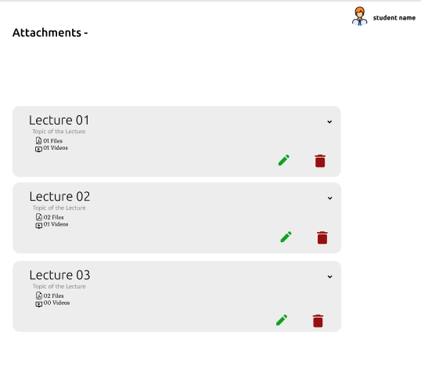
Features : Uploading Files
Instructor Uploads his files from laptop or any device to the website to be sent student to automatically

Slide 22
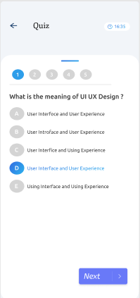
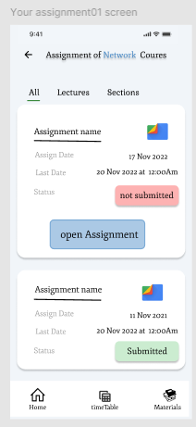



Features : Quizzes and Assignment
Instructor creates a quiz and creates assignment then grades are corrected and send
to students.

Slide 23
Demo for Mobile Application

Slide 24
Conclusion
In Conclusion ...
The learning landscape of colleges and universities worldwide is undergoing rapid and expansive transformations, demanding a persistent awareness of the latest innovations and methodologies that can effectively and efficiently cater to the evolving needs of students. The objective of this project is to provide educators and learners with a comprehensive set of advanced features that can alleviate any obstacles encountered during the learning process.

Slide 25
Thank Listening
Do You have any question?
SmartStudentSystem2025@gmail.com

