Slide 1
Java
Spring Core - Introduction

Slide 2

Module Objectives
After completing this course you will be able to:
Describe the core purpose of Spring
Understand the benefits of Spring
List some of the key Spring modules
Illustrate the purpose of the Spring Core Container
Describe the aspects of the bean lifecycle
Illustrate the differences between Inversion of Control, Dependency Pull and Dependency Injection

Slide 3
Spring Overview
Benefits
Components
Mechanics
Injection Implementation
3

Slide 4
Spring Overview
Perform initial research into what the Spring Framework is, and the benefits of it. (5 mins)

Slide 5
Spring Overview
What is Spring?
Spring is an open source framework that sits on top of Java.
It is made up of a series of JAR files (dependencies to add in Maven).
Provides an abstract layer to some of the more complex parts of Java.
Spring helps structure whole applications in a consistent, productive manner, encouraging SOLID design.

Slide 6
Spring Overview
Benefits
Components
Mechanics
Injection Implementation
6

Slide 7
Spring Benefits
Lightweight
The basic version of spring framework is about 2MB.
Inversion of Control (IoC)
Loose coupling is achieved in Spring using the technique IOC.
Aspect Oriented Programming (AOP)
Spring supports AOP and enables cohesive development by separating business logic from cross-cutting concerns.
Container
Spring contains and manages the lifecycle of objects.
Boilerplate code
Spring provides templates which allow you to reduce the amount of boilerplate code. For example, JDBCTemplate

Slide 8
Spring Overview
Benefits
Components
Mechanics
Injection Implementation
8

Slide 9
Spring Components
Research and find out three core components of the Spring Framework. (5 mins)

Slide 10
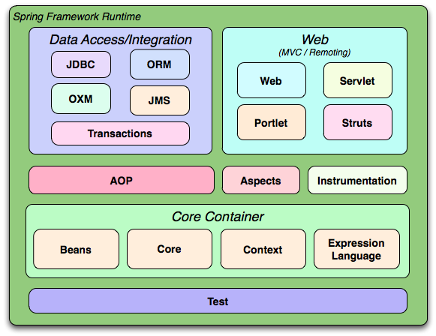
Components
http://static.springsource.org/spring/docs/current/spring-framework-reference/html/overview.html [Accessed 17/07/2012]

Slide 11
Components
The Spring Framework consists of features organised into about 20 modules.
These modules can be used individually or in conjunction with each other.
For example, an application that needs to connect to a database might use the JDBC module. If this application is a web application, it might also use the web module.
This course covers the core container modules, AOP and Web. All other modules are not in the scope of the course.

Slide 12
Spring Overview
Benefits
Components
Mechanics
Injection Implementation
12

Slide 13
Spring Core Container
The Spring Core Container is the heart of Spring
It is configured using an XML file. This file contains bean information and describes how these beans are configured and introduced to each other.
The container then manages the lifecycle of these beans, from creation to destruction.
A bean can simply be thought of as a POJO (Plain Old Java Object).
They are nothing special
They container getters and setters
They are just simple java objects like the ones you have used up until now

Slide 14
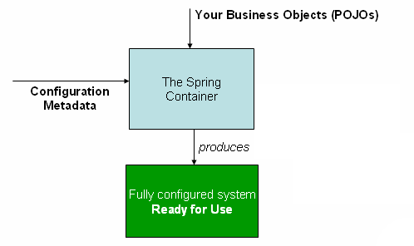
Spring Core Container
Bean descriptions are fed in to the container in XML format. The container then instantiates the beans which can then be used by the application.
http://static.springsource.org/spring/docs/current/spring-framework-reference/html/beans.html#beans-introduction [Accessed 17/07/2012]

Slide 15
Inversion of Control (IoC)
The IoC concept says that you do not create your objects but describe how they should be created
If an object depends on another, you do not connect them together yourself – you merely describe which objects are needed by which.
The container is then responsible for hooking it all up.
This reduces code in the application, eliminating the need for instantiation and factories.
There are two types of IoC container (more on these later):
BeanFactory
ApplicationContext

Slide 16
Bean Lifecycle
Research the bean lifecycle in Spring (5 mins)

Slide 17
Lifecycle of a bean
The Spring Framework is transparent and thereby hides most of the complex communication that happens between the Spring Container and the Spring Beans.
The five main stages of the lifecycle are:
Creation
Injection
Validation
Registration
Destruction
Notes:
Info on the five main stages of the bean lifecycle are below. For more information on each, with code examples, visit: http://www.javabeat.net/life-cycle-management-of-a-spring-bean/
Creation
- The container will look for the configuration metadata of the given bean.
- Once found, the container will create an instance of the object (using Reflection).
2. Injection
- After creation, it’s dependencies will be injected into the bean. If these dependencies are other beans, they are created first.
3. Validation and 4. Registration
- It is possible for your classes to implement certain interfaces which usually have one or two methods to implement. If these interfaces are implemented, these methods are
invoked at this stage of the lifecycle, in this order:
- BeanNameAware (if you want the instance to have a property set: the property being a name of the bean)
- BeanClassLoaderAware (if you want the instance to have a ClassLoader set as a property – the ClassLoader which loaded it)
- BeanFactoryAware (if you want the instance to have a BeanFactory set as a property – the BeanFactory which created it).
- ApplicationContextAware (if you want the instance to have an ApplicationContext set as a property – the ApplicationContext which created it).
- BeanPostProcessor. Contains two methods: postProcessBeforeInitialization() is invoked now, before the properties are set. The other is postProcessAfterInitialization()
- Init-method (Not an interface): It is possible to set one of the bean’s methods as an init-method. If done, this method will be invoked now.
- The other method in BeanPostProcessor is invoked: postProcessAfterInitialization() which is done after the properties are set.
5. Destruction
- If the DisposableBean interface is implemented, the method destroy() is invoked at this stage (may be useful for closing Connection objects).
- It is possible to set one of the bean’s methods as a destroy-method. If done, this method will be invoked now.

Slide 18
Spring Overview
Benefits
Components
Mechanics
Injection Implementation
18

Slide 19
IoC Implementations
There are two key Inversion of Control (IoC) implementations to know about:
Dependency Pull
Dependency Push (AKA Dependency Injection)

Slide 20
Dependency Pull
The objects “asks” for the dependency
By calling a method in a factory class

Slide 21
Dependency Pull - Example
public class PullExample{
public void addStockExchangeToBroker(Broker broker){
SEDaoFactory factory = new SEDaoFactory(); StockExchangeDao dao = factory.getStockExchange();
int id = broker.getId(); StockExchange se = dao.findBrokersStockExchange(id); broker.setStockExchange(se);
}
}

Slide 22
Dependency Push / Injection
Something outside of the object “pushes” its dependencies into it.
The object does not ask for it. It also doesn’t care where it came from. It just assumes it is there.

Slide 23
Dependency Pull - Example
public class PushExample {
private StockExchangeDao dao;
public void setStockExchangeDao(StockExchangeDao dao){
this.dao = dao;
}
public void addStockExchangeToBroker(Broker broker){
int id = broker.getId(); StockExchange se = dao.findBrokersStockExchange(id); broker.setStockExchange(se);
}
}

Slide 24
Dependency Push vs Dependency Pull
Which is better? Discuss (5 mins)

Slide 25
Dependency Push vs Dependency Pull
Dependency Push / Injection is better for two reasons:
The code is more decoupled.
You don’t hard code dependencies between classes. Instead, you configure them outside of the code (in XML in Spring). This makes it easier to inject a different implementation if required.
Testability is improved.
As stated previously, the object doesn’t care where the dependencies come from as long as they are there. So you can easily inject mock objects.

Slide 26
Dependency Push vs Dependency Pull
Inversion of Control (IoC)
A generic term. Rather than the application calling methods in a framework (where the application is in control), the framework calls implementations provided by the application, “reversing” the control.
Dependency Injection (DI)
DI is a form of IoC. Dependencies are passed into an object from the framework, rather than the object having to get the dependencies itself.

Slide 27
Module review
What is Spring?
What are the key modules?
What are some of the benefits of Spring?
What are the main stages in the lifecycle of a bean?
What interfaces are involved during the bean lifecycle?
What is Dependency Pull?
What are some of the issues with Dependency Pull?
What is Dependency Injection?
Why is Dependency Injection better than Dependency Pull?

Slide 28
Questions

Slide 29
Review
You are now able to:
Describe the core purpose of Spring
Understand the benefits of Spring
List some of the key Spring modules
Illustrate the purpose of the Spring Core Container
Describe the aspects of the bean lifecycle
Illustrate the differences between Inversion of Control, Dependency Pull and Dependency Injection
29

