Slide 1
Java
Java EE Web – Tomcat

Slide 2

Module Objectives
After completing this course you will be able to:
Describe Tomcat’s directory structure
Describe a Web application directory structure
Deploy a web app
Describe JNDI

Slide 3
Introduction
Directory Structure & Configuration
Deploying with Tomcat
JNDI & Database Connections
3

Slide 4
Resources
Tomcat documentation in your installation directory:
C:\apache-tomcat-8.0.26\webapps\docs\index.html
Tomcat FAQ as maintained by the developers:
http://wiki.apache.org/tomcat/FAQ
Tomcat Wiki:
http://wiki.apache.org/tomcat
To determine which version of Tomcat to use:
http://tomcat.apache.org/whichversion.html

Slide 5
Introduction
Directory Structure & Configuration
Deploying with Tomcat
JNDI & Database Connections
5

Slide 6
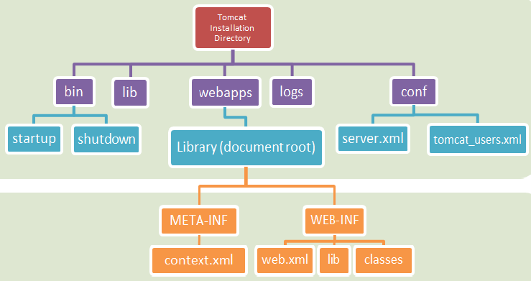
Directory Structure
Notes:
Show the server.xml file – port 8080 is used by Oracle by default, it can be changed to something else 8088
Temp folder is always ok to delete – everything in temp is cached and can be deleted if Tomcat server is behaving in an expected manner. (clean will delete the cached files)
Anything you deploy and run, it will be in the eclipse→.metadata->.plugins→org.eclipse.wst.server.core→tmp0 directory
not in the machine’s tomcat’s temp directory.
So when you clean, it will clean from the workspace, not in the Tomcat folder’s temp folder

Slide 7
Directories
/bin | Contains startup and shutdown scripts, amongst others.
/lib | JAR files that might be used by multiple web apps.
/conf | Stores configuration files and DTDs (Document Type Definition). The most important is server.xml, the main configuration file for Tomcat.
/logs | Default location for log files.
/webapps | Where your web applications go.
Each time you make a change to the configuration of Tomcat, you have to restart the container.

Slide 8
WAR Files
A Java web application is a hierarchy of directories
It can be ‘packed’ into a .war file – usually in order to deploy the app
In its ‘unpacked’ state, the directory structure is convenient for developing
WAR files can be created using:
The command-line jar tool
A build tool such as Ant or Maven
Eclipse (auto-generated)
To deploy an application, place the .war file into the /webapps directory under the Tomcat installation.
Notes:
War – contains all the files
When you put it in webapps, tomcat will automatically deploy it
3 Different ways you can deploy:
1. Show them how to create a .war file from the current project
Open tomcat folder in the system and open webapps and copy paste the .war file → it will automatically extract it within a few seconds
Now if you go to the localhost:8088/manager and your project folder will appear in the browser
2. Browse on the browser, select the .war file and click deploy
Undeploy and you shouldn’t see the project file in the webapps
3. Copy tomcat plugin to the project’s pom file
Change the path to the name of your project /ServletSample
<server>deploymentRepo</server>
- This should match the C:\apache-maven→conf→setting.xml→server→id
Clean –e tomcat7:redeploy
Right-click on the project→Run As→maven build →and type the above in the “Goals” section

Slide 9
Document Root
The top-level directory of your application is the document root.
Contains files that the client’s browser might request
HTML, JSPs, images, JavaScript, CSS etc.
The context path of index.html in your document root is:
/ProjectName/index.html

Slide 10
WEB-INF Directory
/WEB-INF
Not publicly accessible
Best practice is to place JSP files within WEB-INF
Static resources like CSS must remain outside
/WEB-INF/web.xml
Web Application Deployment Descriptor
/WEB-INF/classes
Java class files that are part of the application
/WEB-INF/lib
All .jar files required by this application (Maven dependencies, etc.)
Notes:
/WEB-INF/classes
Java class files that are part of the application
Package structure needs to be reflected inside /WEB-INF/classes
e.g. The ‘com.fdmgroup.User’ class needs to be in this directory structure: /WEB-INF/classes/com/fdmgroup/User.class
- Views should not be accessible to the users – you should always have to request it from the controller.

Slide 11
META-INF Directory
/META-INF/context.xml – Used to define deployment configuration that is specific to Tomcat, such as:
logging
data sources
session manager configuration
etc.

Slide 12
Introduction
Directory Structure & Configuration
Deploying with Tomcat
JNDI & Database Connections
12

Slide 13
Starting Tomcat Manually
In Tomcat’s ‘bin’ directory, run the startup script.
Once started, you will be able to see Tomcat’s home page in a browser by typing: http://localhost:8088.
There are many useful links including Examples and FAQ’s.
To be able to access the management screen (where you can deploy your app) you need to have a username and password.
These can be found/added in the file: conf/tomcat-users.xml

Slide 14
Deployment with Tomcat
Deploying in Eclipse
We can benefit from the speed of using Eclipse’s UI to deploy a modified web app in Tomcat.
Deploying manually (2 methods)
Copy the modified files to Tomcat. You MUST restart Tomcat.
Use an Ant build script or Maven to automate execution of commands.
It is typical to keep separate directories for source code and the deployable application.
Source code is easier to manage when it is in a directory by itself.

Slide 15
Introduction
Directory Structure & Configuration
Deploying with Tomcat
JNDI & Database Connections
15

Slide 16
Naming System
Like a library card system, a Naming System provides computer programs with a single location where they can access the resources they need.
Naming System
We can use JNDI to allow applications to look up resources in an abstract, resource-independent way.
Name
Binding
Name
Binding
Client
Name
Binding

Slide 17
Introduction to JNDI
JNDI – Java Naming and Directory Interface
Clients have the illusion that everything stored in the naming directory is a Java object.
Commonly used to set up a database connection.
An InitialContext gives us an entrance into the naming system. Once we have an initial context we can access an object by name.
JNDI tutorial at Oracle: http://docs.oracle.com/javase/jndi/tutorial/getStarted/overview/naming.html

Slide 18
InitialContext
In JNDI, all naming and directory operations are performed relative to a context (no root).
An InitialContext implementation is provided for each webapp.
All configured entries and resources are placed in the java:comp/env portion of the JNDI namespace.
In META-INF/context.xml:
<Context antiResourceLocking="false" privileged="true" >
<Resource name="jdbc/myoracle" auth="Container"
type="javax.sql.DataSource"
driverClassName="oracle.jdbc.driver.OracleDriver"
url="jdbc:oracle:thin:@oracle.fdmgroup.com:1521:xe"
username="yourUserName" password="YourPassword"
maxActive="20" maxIdle="10“ maxWait="-1"/>
</Context>

Slide 19
Using a JDBC DataSource
// Obtain our environment naming context
Context initCtx = new InitialContext();
Context envCtx = (Context) initCtx.lookup("java:comp/env");
// Look up our data source
DataSource ds = (DataSource)envCtx.lookup("jdbc/myoracle");
// Allocate and use a connection from the pool
Connection conn = ds.getConnection();
// Use this connection to access the database...
conn.close();
See: C:\apache-tomcat-8.0.26\webapps\docs\jndi-resources-howto.html

Slide 20
Module Review
What are the main directories in Tomcat?
Which directories should be in the project document root?
Where are the startup and shutdown commands stored?
In which directory of your web app do you put static content?
In which directory of your web app do you put non-static content?
How do you gain access to Tomcat’s management screen?
How can we use Tomcat to get a DB connection?

Slide 21
Questions

Slide 22
Module Outcomes
You should be able to:
Describe Tomcat’s directory structure
Describe a Web application directory structure
Deploy a web app
Describe JNDI

