Slide 1
Assembly Language for Intel-Based Computers, 4th Edition
Kip R. Irvine
Chapter 8:Advanced Procedures
Slides prepared by Kip R. Irvine
Revision date: 11/01/2003
Chapter corrections (Web) Assembly language sources (Web)
(c) Pearson Education, 2002. All rights reserved. You may modify and copy this slide show for your personal use, or for use in the classroom, as long as this copyright statement, the author's name, and the title are not changed.

Slide 2
Chapter Overview
Local Variables
Stack Parameters
Stack Frames
Recursion
Creating Multimodule Programs
Irvine, Kip R. Assembly Language for Intel-Based Computers, 2003.

Slide 3
Local Directive
A local variable is created, used, and destroyed within a single procedure
The LOCAL directive declares a list of local variables
  immediately follows the PROC directive
  each variable is assigned a type
Syntax:
    LOCAL varlist
Example:
MySub PROC
LOCAL var1:BYTE, var2:WORD, var3:SDWORD
Irvine, Kip R. Assembly Language for Intel-Based Computers, 2003.

Slide 4
Local Variables
Examples:
LOCAL flagVals[20]:BYTE ; array of bytes
LOCAL pArray:PTR WORD ; pointer to an array
myProc PROC, ; procedure
LOCAL t1:BYTE, ; local variables
Irvine, Kip R. Assembly Language for Intel-Based Computers, 2003.

Slide 5
MASM-Generated Code (1 of 2)
BubbleSort PROC
LOCAL temp:DWORD, SwapFlag:BYTE
. . .
ret
BubbleSort ENDP
MASM generates the following code:
BubbleSort PROC
push ebp
mov ebp,esp
add esp,0FFFFFFF8h ; add -8 to ESP
. . .
mov esp,ebp
pop ebp
ret
BubbleSort ENDP
Irvine, Kip R. Assembly Language for Intel-Based Computers, 2003.

Slide 6
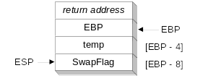
MASM-Generated Code (2 of 2)
Diagram of the stack frame for the BubbleSort procedure:
Irvine, Kip R. Assembly Language for Intel-Based Computers, 2003.

Slide 7
Stack Parameters
Register vs. Stack Parameters
INVOKE Directive
PROC Directive
PROTO Directive
Passing by Value or by Reference
Parameter Classifications
Example: Exchanging Two Integers
Trouble-Shooting Tips
Irvine, Kip R. Assembly Language for Intel-Based Computers, 2003.

Slide 8
Register vs. Stack Parameters
Register parameters require dedicating a register to each parameter. Stack parameters are more convenient
Imagine two possible ways of calling the DumpMem procedure. Clearly the second is easier:
pushad
mov esi,OFFSET array
mov ecx,LENGTHOF array
mov ebx,TYPE array
call DumpMem
popad
push OFFSET array
push LENGTHOF array
push TYPE array
call DumpMem
Irvine, Kip R. Assembly Language for Intel-Based Computers, 2003.

Slide 9
INVOKE Directive
The INVOKE directive is a powerful replacement for Intel’s CALL instruction that lets you pass multiple arguments
Syntax:
    INVOKE procedureName [, argumentList]
ArgumentList is an optional comma-delimited list of procedure arguments
Arguments can be:
  immediate values and integer expressions
  variable names
  address and ADDR expressions
  register names
Irvine, Kip R. Assembly Language for Intel-Based Computers, 2003.

Slide 10
INVOKE Examples
.data
byteVal BYTE 10
wordVal WORD 1000h
.code
; direct operands:
INVOKE Sub1,byteVal,wordVal
; address of variable:
INVOKE Sub2,ADDR byteVal
; register name, integer expression:
INVOKE Sub3,eax,(10 * 20)
; address expression (indirect operand):
INVOKE Sub4,[ebx]
Irvine, Kip R. Assembly Language for Intel-Based Computers, 2003.

Slide 11
ADDR Operator
Returns a near or far pointer to a variable, depending on which memory model your program uses:
  Small model: returns 16-bit offset
  Large model: returns 32-bit segment/offset
  Flat model: returns 32-bit offset
Simple example:
.data
myWord WORD ?
.code
INVOKE mySub,ADDR myWord
Irvine, Kip R. Assembly Language for Intel-Based Computers, 2003.

Slide 12
PROC Directive (1 of 2)
The PROC directive declares a procedure with an optional list of named parameters.
Syntax:
  label PROC paramList
paramList is a list of parameters separated by commas. Each parameter has the following syntax:
  paramName : type
type must either be one of the standard ASM types (BYTE, SBYTE, WORD, etc.), or it can be a pointer to one of these types.
Irvine, Kip R. Assembly Language for Intel-Based Computers, 2003.

Slide 13
PROC Directive (2 of 2)
Alternate format permits parameter list to be on one or more separate lines:
  label PROC,
  paramList
The parameters can be on the same line . . .
  param-1:type-1, param-2:type-2, . . ., param-n:type-n
Or they can be on separate lines:
  param-1:type-1,
  param-2:type-2,
  . . .,
  param-n:type-n
comma required
Irvine, Kip R. Assembly Language for Intel-Based Computers, 2003.

Slide 14
AddTwo Procedure (1 of 2)
The AddTwo procedure receives two integers and returns their sum in EAX.
AddTwo PROC,
val1:DWORD, val2:DWORD
mov eax,val1
add eax,val2
ret
AddTwo ENDP
Irvine, Kip R. Assembly Language for Intel-Based Computers, 2003.

Slide 15
PROC Examples (2 of 3)
FillArray receives a pointer to an array of bytes, a single byte fill value that will be copied to each element of the array, and the size of the array.
FillArray PROC,
pArray:PTR BYTE, fillVal:BYTE
arraySize:DWORD
mov ecx,arraySize
mov esi,pArray
mov al,fillVal
L1: mov [esi],al
inc esi
loop L1
ret
FillArray ENDP
Irvine, Kip R. Assembly Language for Intel-Based Computers, 2003.

Slide 16
PROC Examples (3 of 3)
Swap PROC,
  pValX:PTR DWORD,
  pValY:PTR DWORD
  . . .
Swap ENDP
ReadFile PROC,
pBuffer:PTR BYTE
LOCAL fileHandle:DWORD
. . .
ReadFile ENDP
Irvine, Kip R. Assembly Language for Intel-Based Computers, 2003.

Slide 17
RET Instruction
Pops stack into the instruction pointer (EIP or IP). Control transfers to the target address.
Syntax:
  RET
  RET n
Optional operand n causes n bytes to be added to the stack pointer after EIP (or IP) is assigned a value.
Irvine, Kip R. Assembly Language for Intel-Based Computers, 2003.

Slide 18
PROTO Directive
Creates a procedure prototype
Syntax:
  label PROTO paramList
Every procedure called by the INVOKE directive must have a prototype
A complete procedure definition can also serve as its own prototype
Irvine, Kip R. Assembly Language for Intel-Based Computers, 2003.

Slide 19
PROTO Directive
Standard configuration: PROTO appears at top of the program listing, INVOKE appears in the code segment, and the procedure implementation occurs later in the program:
MySub PROTO ; procedure prototype
.code
INVOKE MySub ; procedure call
MySub PROC ; procedure implementation
.
.
MySub ENDP
Irvine, Kip R. Assembly Language for Intel-Based Computers, 2003.

Slide 20
PROTO Example
Prototype for the ArraySum procedure, showing its parameter list:
ArraySum PROTO,
ptrArray:PTR DWORD, ; points to the array
szArray:DWORD ; array size
Irvine, Kip R. Assembly Language for Intel-Based Computers, 2003.

Slide 21
Passing by Value
When a procedure argument is passed by value, a copy of a 32-bit integer is pushed on the stack. Example:
.data
myData DWORD 10000h
.code
main PROC
INVOKE Sub1, myData
MASM generates the following code:
push myData
call Sub1
Irvine, Kip R. Assembly Language for Intel-Based Computers, 2003.

Slide 22
Passing by Value (16-bit)
In 16-bit mode, you can also push a 16-bit integer on the stack before calling a procedure:
.data
myData WORD 1000h
.code
main PROC
INVOKE Sub1, myData
MASM generates the following code:
push myData
call Sub1
Irvine, Kip R. Assembly Language for Intel-Based Computers, 2003.

Slide 23
Passing by Reference
When an argument is passed by reference, its address is pushed on the stack. Example:
.data
myData WORD 1000h
.code
main PROC
INVOKE Sub1, ADDR myData
MASM generates the following code:
push OFFSET myData
call Sub1
Irvine, Kip R. Assembly Language for Intel-Based Computers, 2003.

Slide 24
Parameter Classifications
An input parameter is data passed by a calling program to a procedure.
  The called procedure is not expected to modify the corresponding parameter variable, and even if it does, the modification is confined to the procedure itself.
An output parameter is created by passing a pointer to a variable when a procedure is called.
  The procedure does not use any existing data from the variable, but it fills in a new value before it returns.
An input-output parameter is a pointer to a variable containing input that will be both used and modified by the procedure.
  The variable passed by the calling program is modified.
Irvine, Kip R. Assembly Language for Intel-Based Computers, 2003.

Slide 25
Example: Exchanging Two Integers
The Swap procedure exchanges the values of two 32-bit integers. pValX and pValY do not change values, but the integers they point to are modified.
Swap PROC USES eax esi edi,
  pValX:PTR DWORD, ; pointer to first integer
  pValY:PTR DWORD ; pointer to second integer
  mov esi,pValX ; get pointers
  mov edi,pValY
  mov eax,[esi] ; get first integer
  xchg eax,[edi] ; exchange with second
  mov [esi],eax ; replace first integer
  ret
Swap ENDP
Irvine, Kip R. Assembly Language for Intel-Based Computers, 2003.

Slide 26
Trouble-Shooting Tips
Save and restore registers when they are modified by a procedure.
  Except a register that returns a function result
When using INVOKE, be careful to pass a pointer to the correct data type.
  For example, MASM cannot distinguish between a DWORD argument and a PTR BYTE argument.
Do not pass an immediate value to a procedure that expects a reference parameter.
  Dereferencing its address will likely cause a general-protection fault.
Irvine, Kip R. Assembly Language for Intel-Based Computers, 2003.

Slide 27
Stack Frames
Memory Models
Language Specifiers
Explicit Access to Stack Parameters
Passing Arguments by Reference
Creating Local Variables
Irvine, Kip R. Assembly Language for Intel-Based Computers, 2003.

Slide 28
Stack Frame
Also known as an activation record
Area of the stack set aside for a procedure's return address, passed parameters, saved registers, and local variables
Created by the following steps:
  Calling program pushes arguments on the stack and calls the procedure.
  The called procedure pushes EBP on the stack, and sets EBP to ESP.
  If local variables are needed, a constant is subtracted from ESP to make room on the stack.
Irvine, Kip R. Assembly Language for Intel-Based Computers, 2003.

Slide 29
Memory Models
A program's memory model determines the number and sizes of code and data segments.
Real-address mode supports tiny, small, medium, compact, large, and huge models.
Protected mode supports only the flat model.
Small model: code < 64 KB, data (including stack) < 64 KB. All offsets are 16 bits.
Flat model: single segment for code and data, up to 4 GB. All offsets are 32 bits.
Irvine, Kip R. Assembly Language for Intel-Based Computers, 2003.

Slide 30
.MODEL Directive
.MODEL directive specifies a program's memory model and model options (language-specifier).
Syntax:
    .MODEL memorymodel [,modeloptions]
memorymodel can be one of the following:
  tiny, small, medium, compact, large, huge, or flat
modeloptions includes the language specifier:
  procedure naming scheme
  parameter passing conventions
Irvine, Kip R. Assembly Language for Intel-Based Computers, 2003.

Slide 31
Language Specifiers
C:
  procedure arguments pushed on stack in reverse order (right to left)
  calling program cleans up the stack
pascal
  procedure arguments pushed in forward order (left to right)
  called procedure cleans up the stack
stdcall
  procedure arguments pushed on stack in reverse order (right to left)
  called procedure cleans up the stack
Irvine, Kip R. Assembly Language for Intel-Based Computers, 2003.

Slide 32
Explicit Access to Stack Parameters
A procedure can explicitly access stack parameters using constant offsets from EBP¹.
  Example: [ebp + 8]
EBP is often called the base pointer or frame pointer because it holds the base address of the stack frame.
EBP does not change value during the procedure.
EBP must be restored to its original value when a procedure returns.
¹ BP in Real-address mode
Irvine, Kip R. Assembly Language for Intel-Based Computers, 2003.

Slide 33
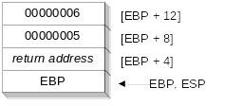
Stack Frame Example (1 of 2)
.data
sum DWORD ?
.code
push 6 ; second argument
push 5 ; first argument
call AddTwo ; EAX = sum
mov sum,eax ; save the sum
AddTwo PROC
push ebp
mov ebp,esp
.
.
Irvine, Kip R. Assembly Language for Intel-Based Computers, 2003.

Slide 34
AddTwo Procedure (1 of 3)
Recall the AddTwo Procedure
AddTwo PROC,
val1:DWORD, val2:DWORD
mov eax,val1
add eax,val2
ret
AddTwo ENDP
Irvine, Kip R. Assembly Language for Intel-Based Computers, 2003.

Slide 35
AddTwo Procedure (2 of 3)
MASM generates the following code when we assemble AddTwo (from the previous panel):
AddTwo PROC,
val1:DWORD, val2:DWORD
push ebp
mov ebp, esp
mov eax,val1
add eax,val2
leave
ret 8
AddTwo ENDP
The LEAVE instruction is shorthand for:
mov esp,ebp
pop ebp
Irvine, Kip R. Assembly Language for Intel-Based Computers, 2003.

Slide 36
AddSub Procedure (3 of 3)
AddTwo PROC
  push ebp
  mov ebp,esp ; base of stack frame
  mov eax,[ebp + 12] ; second argument (6)
  add eax,[ebp + 8] ; first argument (5)
  leave
  ret 8
AddTwo ENDP ; EAX contains the sum
Irvine, Kip R. Assembly Language for Intel-Based Computers, 2003.

Slide 37
Your turn . . .
Create a procedure named Difference that subtracts the first argument from the second one. Following is a sample call:
    push 14 ; first argument
    push 30 ; second argument
    call Difference ; EAX = 16
Difference PROC
  push ebp
  mov ebp,esp
  mov eax,[ebp + 8] ; second argument
  sub eax,[ebp + 12] ; first argument
  pop ebp
  ret 8
Difference ENDP
Irvine, Kip R. Assembly Language for Intel-Based Computers, 2003.

Slide 38
Passing Arguments by Reference (1 of 2)
The ArrayFill procedure fills an array with 16-bit random integers
The calling program passes the address of the array, along with a count of the number of array elements:
.data
count = 100
array WORD count DUP(?)
.code
push OFFSET array
push COUNT
call ArrayFill
Irvine, Kip R. Assembly Language for Intel-Based Computers, 2003.

Slide 39
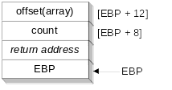
Passing Arguments by Reference (2 of 2)
ArrayFill can reference an array without knowing the array's name:
ArrayFill PROC
push ebp
mov ebp,esp
pushad
mov esi,[ebp+12]
mov ecx,[ebp+8]
.
.
ESI points to the beginning of the array, so it's easy to use a loop to access each array element. View the complete program.
Irvine, Kip R. Assembly Language for Intel-Based Computers, 2003.

Slide 40
LEA Instruction
The LEA instruction returns offsets of both direct and indirect operands.
  OFFSET operator can only return constant offsets.
LEA is required when obtaining the offset of a stack parameter or local variable. For example:
CopyString PROC,
count:DWORD
LOCAL temp[20]:BYTE
mov edi,OFFSET count ; invalid operand
mov esi,OFFSET temp ; invalid operand
lea edi,count ; ok
lea esi,temp ; ok
Irvine, Kip R. Assembly Language for Intel-Based Computers, 2003.

Slide 41
Creating Local Variables
To explicitly create local variables, subtract their total size from ESP.
The following example creates and initializes two 32-bit local variables (we'll call them locA and locB):
MySub PROC
push ebp
mov ebp,esp
sub esp,8
mov [ebp-4],123456h ; locA
mov [ebp-8],0 ; locB
.
.
Irvine, Kip R. Assembly Language for Intel-Based Computers, 2003.

Slide 42
Recursion
What is recursion?
Recursively Calculating a Sum
Calculating a Factorial
Irvine, Kip R. Assembly Language for Intel-Based Computers, 2003.

Slide 43
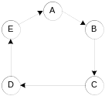
What is Recursion?
The process created when . . .
  A procedure calls itself
  Procedure A calls procedure B, which in turn calls procedure A
Using a graph in which each node is a procedure and each edge is a procedure call, recursion forms a cycle:
Irvine, Kip R. Assembly Language for Intel-Based Computers, 2003.

Slide 44
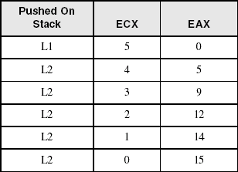
Recursively Calculating a Sum
The CalcSum procedure recursively calculates the sum of an array of integers. Receives: ECX = count. Returns: EAX = sum
CalcSum PROC
cmp ecx,0 ; check counter value
  jz L2 ; quit if zero
  add eax,ecx ; otherwise, add to sum
  dec ecx ; decrement counter
  call CalcSum ; recursive call
L2: ret
CalcSum ENDP
View the complete program
Stack frame:
Irvine, Kip R. Assembly Language for Intel-Based Computers, 2003.

Slide 45
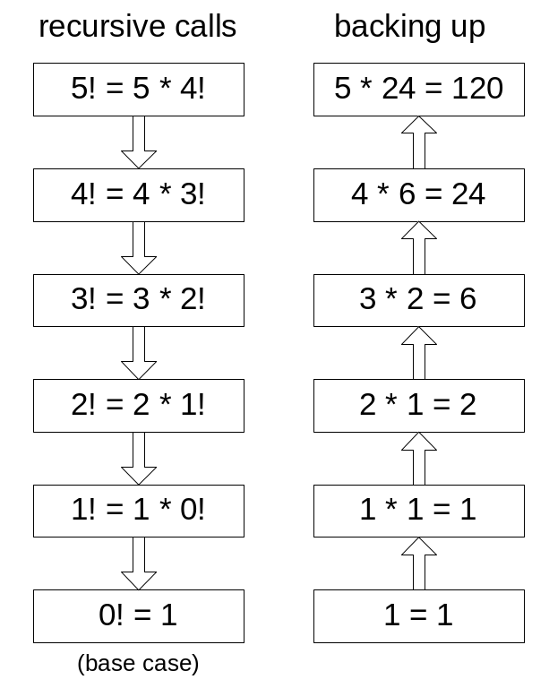
Calculating a Factorial (1 of 3)
This function calculates the factorial of integer n. A new value of n is saved in each stack frame:
int function factorial(int n)
{
if(n == 0)
return 1;
else
return n * factorial(n-1);
}
As each call instance returns, the product it returns is multiplied by the previous value of n.
Irvine, Kip R. Assembly Language for Intel-Based Computers, 2003.

Slide 46
Calculating a Factorial (2 of 3)
Factorial PROC
push ebp
mov ebp,esp
mov eax,[ebp+8] ; get n
cmp eax,0 ; n < 0?
ja L1 ; yes: continue
mov eax,1 ; no: return 1
jmp L2
L1: dec eax
push eax ; Factorial(n-1)
call Factorial
; Instructions from this point on execute when each
; recursive call returns.
ReturnFact:
mov ebx,[ebp+8] ; get n
mul ebx ; eax = eax * ebx
L2: pop ebp ; return EAX
ret 4 ; clean up stack
Factorial ENDP
See the program listing
Irvine, Kip R. Assembly Language for Intel-Based Computers, 2003.

Slide 47
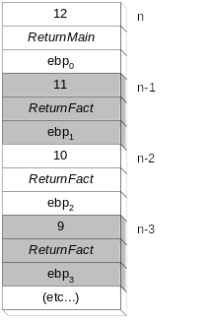
Calculating a Factorial (3 of 3)
Suppose we want to calculate 12!
This diagram shows the first few stack frames created by recursive calls to Factorial
Each recursive call uses 12 bytes of stack space.
Irvine, Kip R. Assembly Language for Intel-Based Computers, 2003.

Slide 48
Multimodule Programs
A multimodule program is a program whose source code has been divided up into separate ASM files.
Each ASM file (module) is assembled into a separate OBJ file.
All OBJ files belonging to the same program are linked using the link utility into a single EXE file.
  This process is called static linking
Irvine, Kip R. Assembly Language for Intel-Based Computers, 2003.

Slide 49
Advantages
Large programs are easier to write, maintain, and debug when divided into separate source code modules.
When changing a line of code, only its enclosing module needs to be assembled again. Linking assembled modules requires little time.
A module can be a container for logically related code and data (think object-oriented here...)
  encapsulation: procedures and variables are automatically hidden in a module unless you declare them public
Irvine, Kip R. Assembly Language for Intel-Based Computers, 2003.

Slide 50
Creating a Multimodule Program
Here are some basic steps to follow when creating a multimodule program:
  Create the main module
  Create a separate source code module for each procedure or set of related procedures
  Create an include file that contains procedure prototypes for external procedures (ones that are called between modules)
  Use the INCLUDE directive to make your procedure prototypes available to each module
Irvine, Kip R. Assembly Language for Intel-Based Computers, 2003.

Slide 51
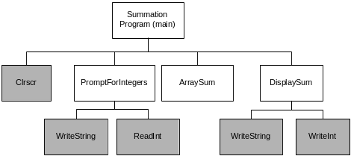
Example: ArraySum Program
Let's review the ArraySum program from Chapter 5.
Each of the four white rectangles will become a module.
Irvine, Kip R. Assembly Language for Intel-Based Computers, 2003.

Slide 52
Sample Program output
Enter a signed integer: -25
Enter a signed integer: 36
Enter a signed integer: 42
The sum of the integers is: +53
Irvine, Kip R. Assembly Language for Intel-Based Computers, 2003.

Slide 53
INCLUDE File
The sum.inc file contains prototypes for external functions that are not in the Irvine32 library:
INCLUDE Irvine32.inc
PromptForIntegers PROTO,
ptrPrompt:PTR BYTE, ; prompt string
ptrArray:PTR DWORD, ; points to the array
arraySize:DWORD ; size of the array
ArraySum PROTO,
ptrArray:PTR DWORD, ; points to the array
count:DWORD ; size of the array
DisplaySum PROTO,
ptrPrompt:PTR BYTE, ; prompt string
theSum:DWORD ; sum of the array
Irvine, Kip R. Assembly Language for Intel-Based Computers, 2003.

Slide 54
Inspect Individual Modules
Main
PromptForIntegers
ArraySum
DisplaySum
Custom batch file for assembling and linking.
Irvine, Kip R. Assembly Language for Intel-Based Computers, 2003.

Slide 55

The End
Irvine, Kip R. Assembly Language for Intel-Based Computers, 2003.

