Slide 1

Two sample transactions. (a) Transaction T₁.
(b) Transaction T₂.

Slide 2
Why Concurrency Control is needed?
The Lost Update Problem.
This occurs when two transactions that access the same database items have their operations interleaved in a way that makes the value of some database item incorrect.
The Temporary Update (or Dirty Read) Problem.
This occurs when one transaction updates a database item and then the transaction fails for some reason. The updated item is accessed by another transaction before it is changed back to its original value.

Slide 3
Why Concurrency Control is needed?
The Incorrect Summary Problem .
If one transaction is calculating an aggregate summary function on a number of records while other transactions are updating some of these records, the aggregate function may calculate some values before they are updated and others after they are updated.

Slide 4
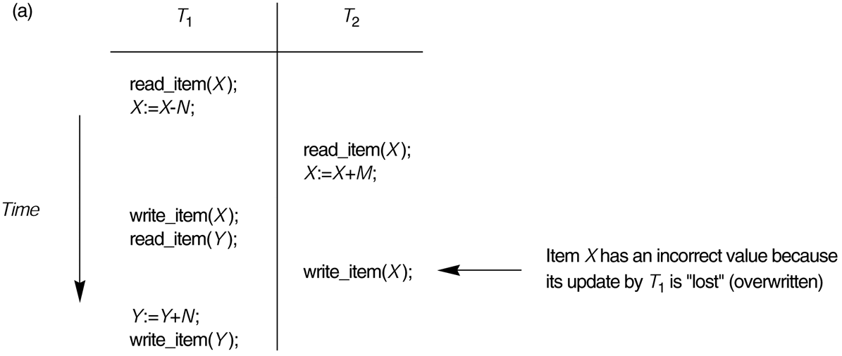
Some problems that occur when concurrent execution is uncontrolled. (a) The lost update problem.

Slide 5
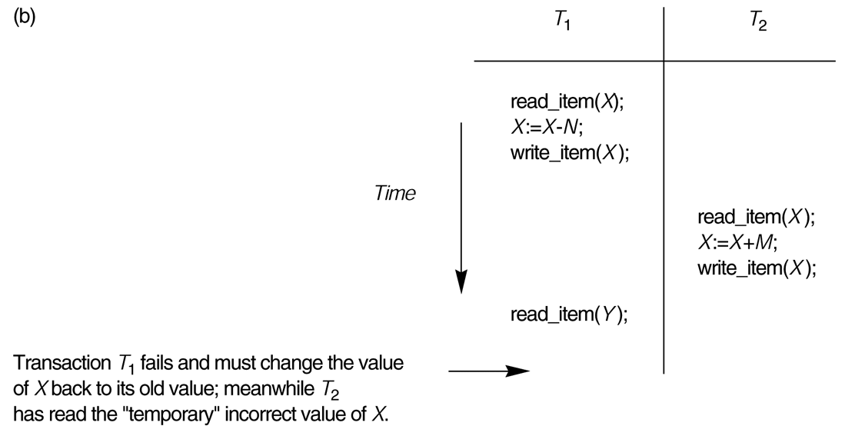
Some problems that occur when concurrent execution is uncontrolled. (b) The temporary update problem.

Slide 6
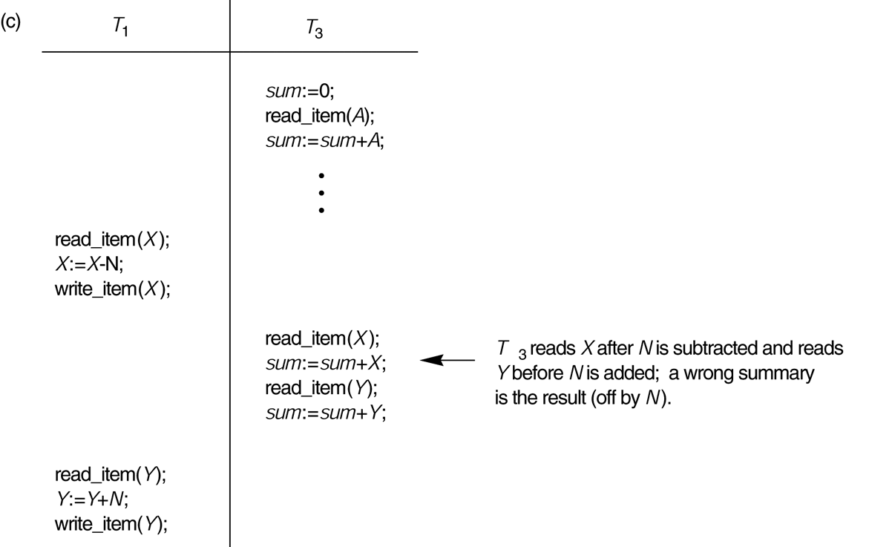
Some problems that occur when concurrent execution is uncontrolled. (c) The incorrect summary problem.

Slide 7
Why recovery is needed?
(What causes a Transaction to fail)
1. A computer failure (system crash): A hardware or software error occurs in the computer system during transaction execution. If the hardware crashes, the contents of the computer’s internal memory may be lost.
2. A transaction or system error : Some operation in the transaction may cause it to fail, such as integer overflow or division by zero. Transaction failure may also occur because of erroneous parameter values or because of a logical programming error. In addition, the user may interrupt the transaction during its execution.

Slide 8
Why recovery is needed?
3. Local errors or exception conditions detected by the transaction:
- certain conditions necessitate cancellation of the transaction. For example, data for the transaction may not be found. A condition, such as insufficient account balance in a banking database, may cause a transaction, such as a fund withdrawal from that account, to be canceled.
- a programmed abort in the transaction causes it to fail.
4. Concurrency control enforcement: The concurrency control method may decide to abort the transaction, to be restarted later, because it violates serializability or because several transactions are in a state of deadlock

Slide 9
Why recovery is needed?
5. Disk failure: Some disk blocks may lose their data because of a read or write malfunction or because of a disk read/write head crash. This may happen during a read or a write operation of the transaction.
6. Physical problems and catastrophes: This refers to an endless list of problems that includes power or air-conditioning failure, fire, theft, sabotage, overwriting disks or tapes by mistake, and mounting of a wrong tape by the operator.

Slide 10
Transaction and System Concepts
A transaction is an atomic unit of work that is either completed in its entirety or not done at all. For recovery purposes, the system needs to keep track of when the transaction starts, terminates, and commits or aborts.
Transaction states:
Active state
Partially committed state
Committed state
Failed state
Terminated State

Slide 11
Transaction and System Concepts
Recovery manager keeps track of the following operations:
begin_transaction: This marks the beginning of transaction execution.
read or write: These specify read or write operations on the database items that are executed as part of a transaction.
end_transaction: This specifies that read and write transaction operations have ended and marks the end limit of transaction execution. At this point it may be necessary to check whether the changes introduced by the transaction can be permanently applied to the database or whether the transaction has to be aborted because it violates concurrency control or for some other reason.

Slide 12
Transaction and System Concepts
Recovery manager keeps track of the following operations (cont):
commit_transaction: This signals a successful end of the transaction so that any changes (updates) executed by the transaction can be safely committed to the database and will not be undone.
rollback (or abort): This signals that the transaction has ended unsuccessfully, so that any changes or effects that the transaction may have applied to the database must be undone.

Slide 13
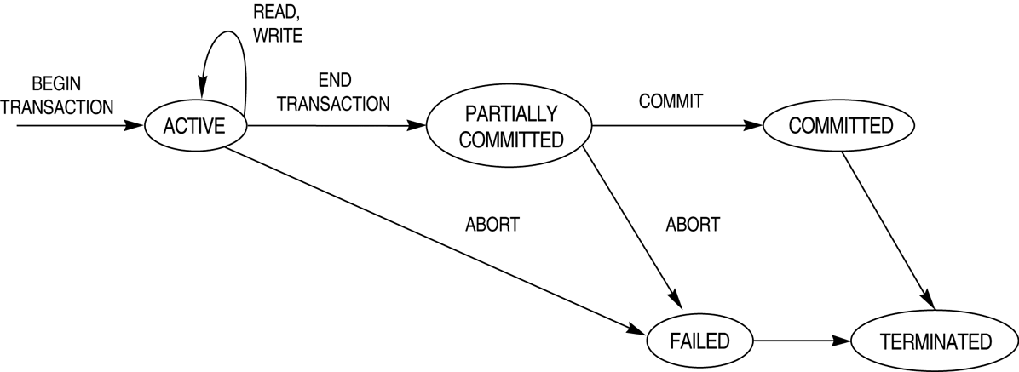
State transition diagram illustrating the states for transaction execution.

Slide 14
The System Log
Log or Journal : The log keeps track of all transaction operations that affect the values of database items. This information may be needed to permit recovery from transaction failures. The log is kept on disk, so it is not affected by any type of failure except for disk or catastrophic failure. In addition, the log is periodically backed up to archival storage (tape) to guard against such catastrophic failures.
T in the following discussion refers to a unique transaction-id that is generated automatically by the system and is used to identify each transaction:

Slide 15
The System Log (cont)
Types of log record:
[start_transaction,T]: Records that transaction T has started execution.
[write_item,T,X,old_value,new_value]: Records that transaction T has changed the value of database item X from old_value to new_value.
[read_item,T,X]: Records that transaction T has read the value of database item X.
[commit,T]: Records that transaction T has completed successfully, and affirms that its effect can be committed (recorded permanently) to the database.
[abort,T]: Records that transaction T has been aborted.

Slide 16
Recovery using log records
If the system crashes, we can recover to a consistent database state by examining the log and using one of the techniques described in Chapter 19.
Because the log contains a record of every write operation that changes the value of some database item, it is possible to undo the effect of these write operations of a transaction T by tracing backward through the log and resetting all items changed by a write operation of T to their old_values.
We can also redo the effect of the write operations of a transaction T by tracing forward through the log and setting all items changed by a write operation of T (that did not get done permanently) to their new_values.

Slide 17
Commit Point of a Transaction
Definition: A transaction T reaches its commit point when all its operations that access the database have been executed successfully and the effect of all the transaction operations on the database has been recorded in the log. Beyond the commit point, the transaction is said to be committed, and its effect is assumed to be permanently recorded in the database. The transaction then writes an entry [commit,T] into the log.
Roll Back of transactions: Needed for transactions that have a [start_transaction,T] entry into the log but no commit entry [commit,T] into the log.

Slide 18
Commit Point of a Transaction (cont)
Redoing transactions: Transactions that have written their commit entry in the log must also have recorded all their write operations in the log; otherwise they would not be committed, so their effect on the database can be redone from the log entries. (Notice that the log file must be kept on disk. At the time of a system crash, only the log entries that have been written back to disk are considered in the recovery process because the contents of main memory may be lost.)
Force writing a log: before a transaction reaches its commit point, any portion of the log that has not been written to the disk yet must now be written to the disk. This process is called force-writing the log file before committing a transaction.

Slide 19
ACID properties
Atomicity: A transaction is an atomic unit of processing; it is either performed in its entirety or not performed at all.
Consistency preservation: A correct execution of the transaction must take the database from one consistent state to another.

Slide 20
ACID properties (cont.)
Isolation: A transaction should not make its updates visible to other transactions until it is committed; this property, when enforced strictly, solves the temporary update problem .
Durability or permanency: Once a transaction changes the database and the changes are committed, these changes must never be lost because of subsequent failure.

