Slide 1
Process Creation

Slide 2
Process Creation
Includes
  Build kernel data structures
  Allocate memory
Reasons to create a process
    Submit a new batch job/Start program
    User logs on to the system
    OS creates on behalf of a user (printing)
    Spawned by existing process
Feb 16, 2016
Operating Systems

Slide 3
Process Termination
Batch job issues Halt instruction
User logs off
Process executes a service request to terminate
Parent terminates so child processes terminate
Operating system intervention
  such as when deadlock occurs
Error and fault conditions
  E.g. memory unavailable, protection error, arithmetic error, I/O failure, invalid instruction
Feb 16, 2016
Operating Systems

Slide 4
Unix Process Creation
When the system starts up it is running in kernel mode
There is only one process, the initial process.
At the end of system initialization, the initial process starts up another kernel process.
The init kernel process has a process identifier of 1.
Feb 16, 2016
Operating Systems

Slide 5
Process Creation
These new processes may themselves go on to create new processes.
All of the processes in the system are descended from the init kernel thread.
You can see the family relationship between the running processes in a Linux system using the pstree command
A new process is created by a fork() system call
Feb 16, 2016
Operating Systems

Slide 6
Compiling C++ code
g++ test.cpp –o Output
Running the code:
./Output
Feb 16, 2016
Operating Systems

Slide 7
The fork() system call
At the end of the system call there is a new process waiting to run once the scheduler chooses it
A new data structure is allocated
The new process is called the child process.
The existing process is called the parent process.
The parent gets the child’s pid returned to it.
The child gets 0 returned to it.
Both parent and child execute at the same point after fork() returns
Feb 16, 2016
Operating Systems

Slide 8
Unix Process Control
int main()
{
int pid;
int x = 0;
x = x + 1;
fork();
x = 3;
printf(“%d”,x);
}
Feb 16, 2016
Operating Systems

Slide 9
But we want the child process to do something else…
The fork syscall returns a zero to the child and the child process ID to the parent
int pid;
int status = 0;
if (pid = fork()) {
/* parent */
……
pid = wait(&status);
} else {
/* child */
……
exit(status);
}
Parent uses wait to sleep until the child exits; wait returns child pid and status.
Wait variants allow wait on a specific child, or notification of stops and other signals
Fork creates an exact copy of the parent process
Child process passes status back to parent on exit, to report success/failure
Feb 16, 2016
Operating Systems

Slide 10
Child Process Inherits
Stack
Memory
Environment
Open file descriptors.
Current working directory
Resource limits
Root directory
Feb 16, 2016
Operating Systems

Slide 11
Child process DOESNOT Inherit
Process ID
Different parent process ID
Process times
Own copy of file descriptors
Resource utilization (initialized to zero)
Feb 16, 2016
Operating Systems

Slide 12
How can a parent and child process communicate?
Through any of the normal IPC mechanism schemes.
But have special ways to communicate
  For example
    The variables are replicas
    The parent receives the exit status of the child
Feb 16, 2016
Operating Systems

Slide 13
The wait() System Call
A child program returns a value to the parent, so the parent must arrange to receive that value
The wait() system call serves this purpose
  pid_t wait(int *status)
  it puts the parent to sleep waiting for a child’s result
  when a child calls exit(), the OS unblocks the parent and returns the value passed by exit() as a result of the wait call (along with the pid of the child)
  if there are no children alive, wait() returns immediately
  also, if there are zombies, wait() returns one of the values immediately (and deallocates the zombie)
Feb 16, 2016
Operating Systems

Slide 14
What is a zombie?
In the interval between the child terminating and the parent calling wait(), the child is said to be a ‘zombie’.
Even though its not running its taking up an entry in the process table.
The process table has a limited number of entries.
Feb 16, 2016
Operating Systems

Slide 15
What is a zombie?
If the parent terminates without calling wait(), the child is adopted by init.
The solution is:
Ensure that your parent process calls wait() or waitpid or etc, for every child process that terminates.
Feb 16, 2016
Operating Systems

Slide 16
exit()
void exit(int status);
After the program finishes execution, it calls exit()
This system call:
  takes the “result” of the program as an argument
  closes all open files, connections, etc.
  deallocates memory
  deallocates most of the OS structures supporting the process
  checks if parent is alive:
    If so, it holds the result value until parent requests it, process does not really die, but it enters the zombie/defunct state
    If not, it deallocates all data structures, the process is dead
Feb 16, 2016
Operating Systems

Slide 17
execv()
We usually want the child process to run some other executable
For Example, ls
Feb 16, 2016
Operating Systems

Slide 18
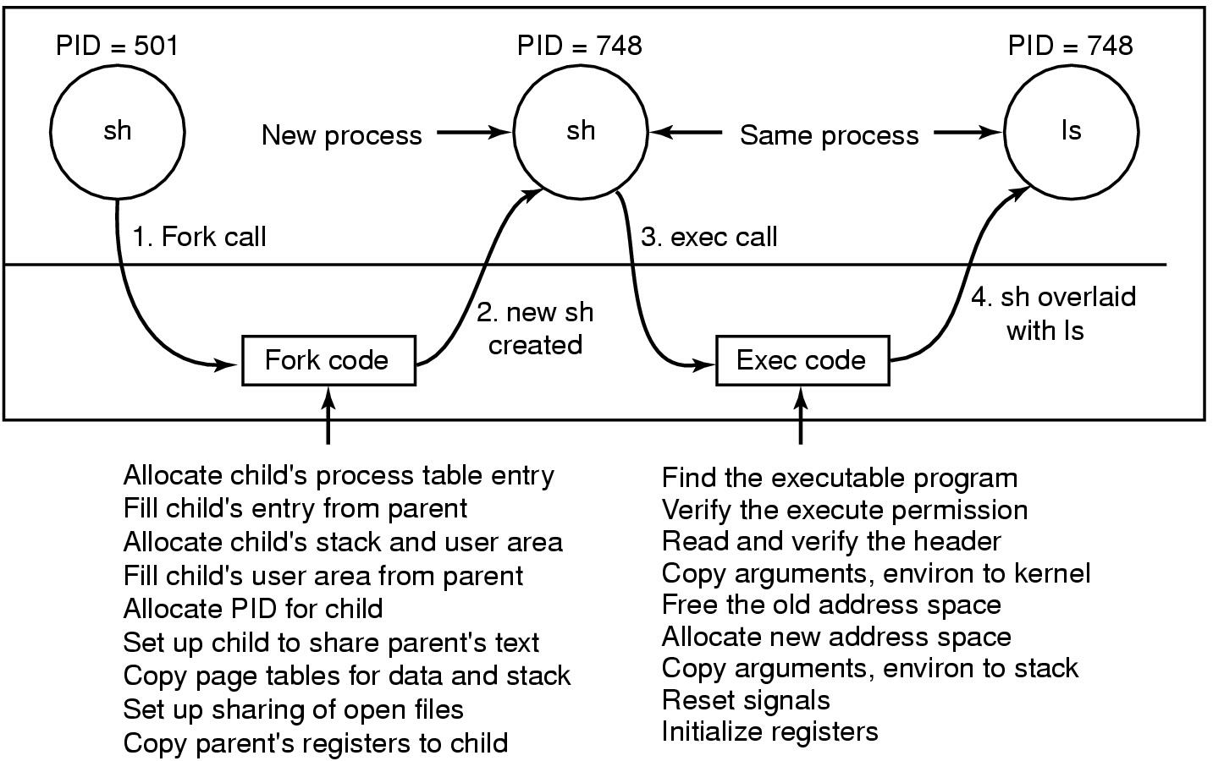
The ls Command
Steps in executing the command ls type to the shell
Feb 16, 2016
Operating Systems

Slide 19
execv
int execv(const char *path, char *const argv[]);
the current process image with a new process image.
path is the filename to be executed by the child process
When a C-language program is executed as a result of this call, it is entered as a C-language function call as follows:
  int main (int argc, char *argv[]);
The argv array is terminated by a null pointer.
The null pointer terminating the argv array is not counted in argc.
Feb 16, 2016
Operating Systems

