Slide 1
Chapter 6
Iterative, Evolutionary and Agile

Slide 2
Iteration
The most import aspect of OOA/D
An agile practice
vs waterfall – early and repeated programming, feedback, adaptation
waterfall is the opposite – big up front requirements investment
http://en.wikipedia.org/wiki/Agile_software_development

Slide 3
What is UP?
development organized is a series of short, fixed-length mini-projects called iterations.
each mini-project results in tested, integrated, executable partial programs
each mini-project has its own requirements analysis and design, implementation and testing phases
complete project implemented by successive enlargement and refinement
feedback and adaptation at the end of a mini-project is crucial.
both iterative and incremental as well as iterative and evolutionary

Slide 4
Example (three week iteration):
Monday AM, kick-off meeting, clarify tasks and goals
meanwhile reverse engineer last iteration’s code into UML diagrams
Monday PM, whiteboard work in pairs, UML diagrams captured with digital camera, some pseudocode, notes
next three weeks – coding, testing, design, integration, daily builds
NOTES:
  requirements/design part of each iteration
  after three weeks, something should execute
  output is NOT experimental or throw-away, this is not prototyping

Slide 5
Handling Change
Embrace it
Don’t try to avoid change by being “complete” up front
adaptation drives success
should not be uncontrolled (feature creep), must be disciplined
keep to small subset of requirements, quick coding, early feedback, be ready for change
I have always found that plans are useless, but planning is indispensable.
- Dwight Eisenhower

Slide 6
Value of Feedback
Can’t be underestimated. Yes, some new features will be added but mostly it will clarify requirements
Example, load testing could show fundamental approach is not scalable.
Early on, you see more deviation caused by feedback, later on, less

Slide 7

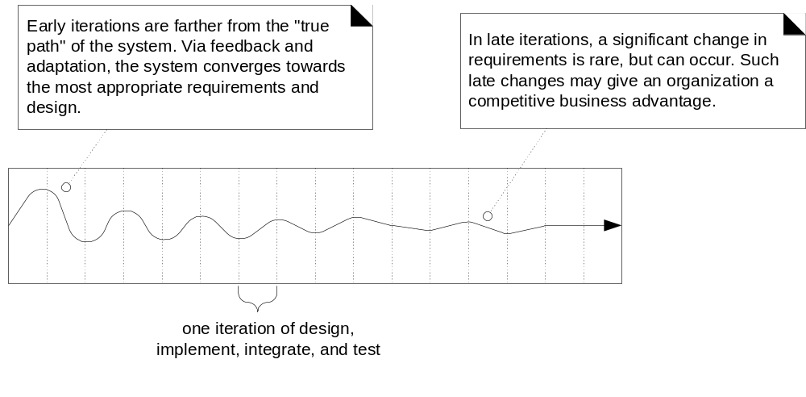
Fig. 2.2

Slide 8
Benefits:
less project failure, better productivity, fewer defects
early mitigation of high risks
early visible progress
early feedback
managed complexity (bite-sized chunks)
learned in one iteration, used in next

Slide 9
How long should an Iteration be?
usually two to six weeks
regardless, fix the time (timeboxed)

Slide 10
What about Waterfall?
decidedly sequential
requirements before programming
too much time invested in UML diagrams that change
high failure rates, defect rates
45% of requirements never used
schedule varies up to 400%
need to avoid “waterfall” thinking in our project (let’s write all the use cases first) or (let’s design all our classes with UML before we code)

Slide 11
Why Waterfall Fails:
false assumption: specifications are predictable and stable and can be correctly defined at the start
typical is 25% change in requirements, more in big projects
change is the only constant so feedback and adaptation are essential

Slide 12
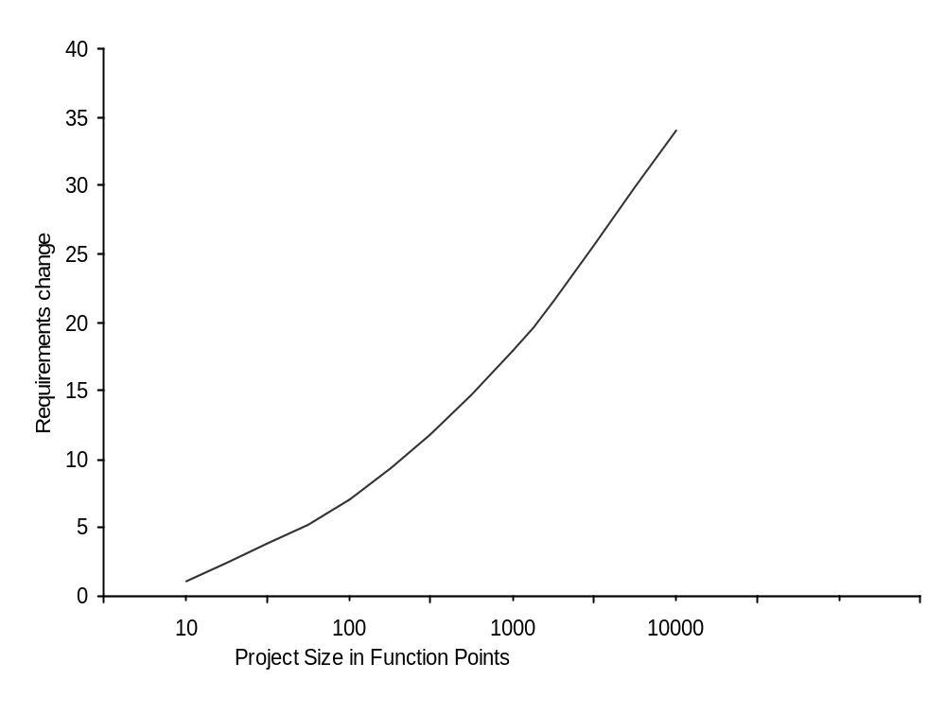
Fig. 2.3

Slide 13
How to do Iterative:
Analysis and design are essential starting points, just don’t try to be complete
A recipe:
  before 1st iteration meet with business people and decide list of use-case names, non-functional features
  pick 10% of use-cases with these qualities
    significant, high business value, high risk
  do detailed analysis on these 10%
  select a subset of the 10% for design and implementation (3-week timebox)
  list the tasks of this iteration

Slide 14
How to do Iterative (2):
Iteration 1:
  days 1 & 2: modeling and design work in pairs, whiteboarding, UMP, use a war room
  after day 2: put on your programming hat – program, test, integrate
  various levels of testing – unit, acceptance, load, usability, …
  1 week to go: check if iteration goals met; if not, scale down expectations (create “to do” list). NOTE: You will almost certainly only have a fraction of coding done.
  4 days to go: freeze code,
  3 days to go: demo
  rest: get ready for next iteration (next slide)

Slide 15
How to do Iterative (3):
After Iteration 1:
  do second requirements workshop; review results of last iteration, identify another 10% of the requirements that you will work on (most significant, etc) and analyze them in detail
  at this point up to 25% of requirements are detailed
  last day: planning day for next iteration
Iteration 2:
  do it as before
Repeat for a couple more iterations
  we now have 80% of detailed requirements but only 10% of code

Slide 16
How to do Iterative (4):
After 4 Iterations:
  20% of iterations done
  in UP this is called the end of the elaboration phase.
  time to estimate what is needed to complete detailed requirements (should be good estimates)
  no more requirements; 3-week iterations until you are done.

Slide 17
What is Risk-Driven and Client-Driven Planning?
Risk-Driven: early iterations driven by high risk requirements
Client-Driven: early iterations driven by what client cares most about

Slide 18
What are Agile Methods and Attitudes?
Agile development uses timeboxed, iterative and evolutionary approaches.
Use adaptive approaches, incremental delivery, encourage speed and flexibility
Some practices:
  common project workroom,
  self-organizing teams

Slide 19
What is Agile Modeling?
Secret of Modeling: to understand not to document
The purpose of UML is to give you well-defined language in which to develop your understanding
together these make up “agile modeling”

Slide 20
Consequences:
not about avoiding modeling
modeling to support understanding
don’t use UML everywhere; too time consuming
follow the “simplest tool” approach
work in pairs; switch roles
create models in parallel (use case || sequence diagram)
use “good enough” notation; reduce UML
realize your understanding will be imperfect; fill in the details later
developers should do their own design; letting others design for you is “waterfall”

Slide 21
What is Agile UP?
UP is big; pick a small subset of activities you like best
UP is iterative and evolutionary so agile by nature
follow agile modeling practices
not a detailed plan for entire project; Iteration Planning is done one iteration at a time

Slide 22
Other UP Practices:
essential idea: short timeboxed iterative, evolutionary and adaptive programming
Also:
  tackle high-risk, high-value issues first
  engage users at feedback time
  build the core early
  continuous verify; test early and often
  use use-cases
  use visual modeling
  manage requirements (no feature creep)
  create a change request mechanism

Slide 23
What are the UP Phases?
Inception:
  approximate vision, business case, scope, estimates
Elaboration:
  refined vision, core implemented iteratively, attack high risks, most requirements identified
Construction:
  fill in the details through iteration
Transition:
  beta tests and deployment

Slide 24
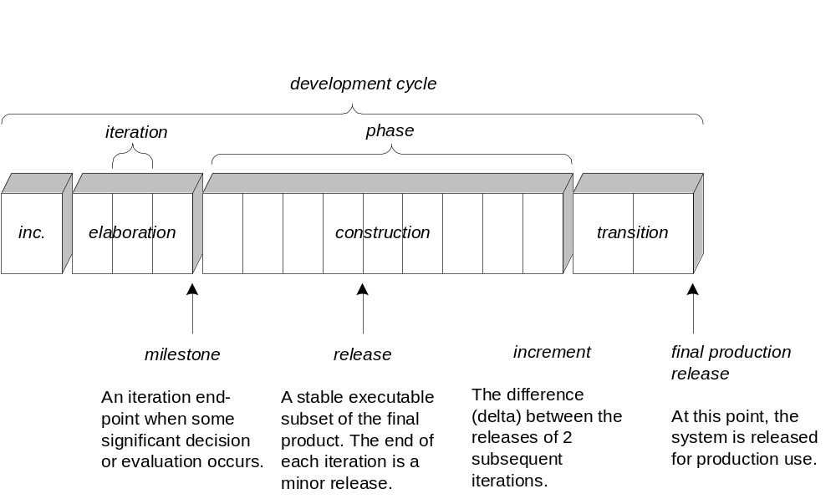
Fig. 2.6

Slide 25
What are the UP Disciplines?
In UP, a type of activity is a discipline; an artifact is a work product
Business Modeling:
  The Domain Model artifact
Requirements:
  Use-Case Model, Supplementary Specifications
Design:
  Design Model
Disciplines and Artifacts

Slide 26
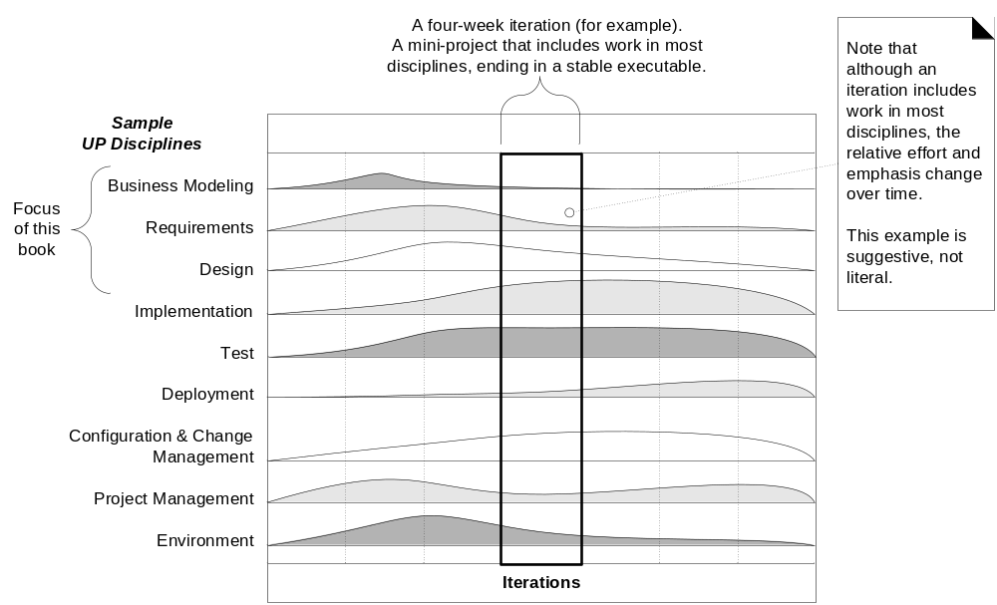
UP Disciplines (Fig. 2.7)

Slide 27
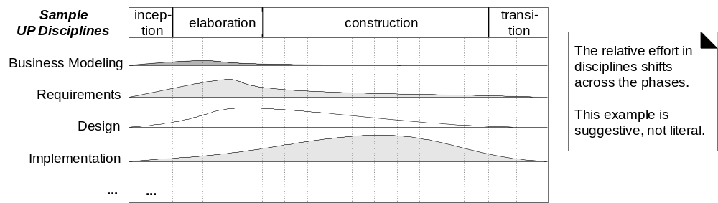
Fig. 2.8

Slide 28
How to Customize the Process?
Almost everything is optional (not the code)
The GOAL is to have a good understanding of the system being developed.

