Slide 1
AI-POWERED CAR RECOMMENDATION SYSTEM
Matching User Preferences to Vehicle Specifications Using NLP
[Your Name] | [Course Name / Code] | [Institution] | [Date]

Slide 2
MOTIVATION
Choosing a car means navigating thousands of specs
Buyers are not domain experts
Filters force premature precision
Reviews help, but don't scale
Most people can't translate "engine displacement" or "torque" into what they actually need.
Dropdown-based recommenders demand exact numeric ranges before a user even knows what's realistic.
Peer advice is trusted but slow to gather and hard to search systematically.
This project asks: can a system accept a plain-English description of what a buyer wants, and still return accurate, explainable recommendations?
2

Slide 3
RESEARCH QUESTION
To what extent can a hybrid NLP recommendation system — combining rule-based constraint extraction with Sentence-BERT semantic matching — accurately and transparently recommend cars from free-text descriptions, when applied to a real, imperfect, publicly sourced dataset?
RQ-a
RQ-b
Can hard constraints (budget, seats, fuel type) be reliably extracted from free text?
Does semantic similarity produce a ranking a human would consider relevant?

Slide 4
LITERATURE
Building on prior NLP-based recommenders
Singh et al. (2022)
Topic modelling (NMF + LDA) over Edmunds customer reviews to support free-text car queries.
Boteju & Munasinghe (2020)
Hybrid collaborative/knowledge-based recommender + Naïve Bayes sentiment NLP; 96% accuracy.
Aliberti, D'Aniello & Gaeta (2026)
PRISMA systematic review: hybrid architectures + explainability are the dominant trend.
Gap this project addresses: match structured specifications directly to free text via semantic embeddings — not third-party reviews or social sentiment — tested on real, imperfect data.
4

Slide 5
DATA
504 real car listings, not synthetic data
504
10
2025
Car listings scraped from
Indian automotive portals
Raw fields per listing
(price, fuel, mileage, cc, power...)
Comprehensive Vehicle
Specifications Dataset (Kaggle)
Deliberate choice: a real, publicly scraped dataset rather than an idealised synthetic one — so the system is tested against the same messiness a production system would face.
5

Slide 6
DISCOVERY
DISCOVERY
A real bug: column-shifted rows
A real bug: column-shifted rows
Aston Martin Vantage — raw record
Why it happens
price:
"Rs.3.99 Cr"
A scraper assumes a fixed number of columns per listing page. When one field is missing (e.g. no listed transmission), every value after it silently shifts one position left.
fuel:
"7 kmpl" ← actually mileage
mileage:
"3998 cc" ← actually cc
The fix
transmission:
"656 bhp" ← actually power
Extract every value by content pattern (units like cc, bhp, kmpl, Star Safety) from the whole record's text — not by trusting which key it landed under.
cc:
"2 Seats" ← actually seats

Slide 7
METHODOLOGY
Cleaning: extraction, then honest imputation
Dropped
Imputed (median)
Labelled “Unknown”
2 of 504 rows
Numeric fields
Categorical fields
No recoverable price — too important to guess.
Engine cc, power, mileage, seats, safety rating.
Fuel type & transmission — never guessed, to avoid misleading matches.
Field completeness after extraction: price 99.6% · fuel type 66.5% · transmission 35.5% · safety rating 22.2%
7

Slide 8
ARCHITECTURE
Four-stage recommendation pipeline
1
2
3
4
NL Profile
Generation
Preference
Parsing
Semantic
Embedding + Rank
NL
Explanation
Each car → a descriptive sentence
Regex extracts budget, seats, fuel
Sentence-BERT cosine similarity
+ constraint penalties
Why each car was recommended
Offline fallback: automatically switches to TF-IDF if Sentence-BERT can't be downloaded.
8

Slide 9
NLP
Rule-based constraint extraction
“I need a fuel-efficient family car under $15,000 with good safety”
max_budget
min_seats
fuel_type
$15,000
5 (from “family”)
None
Handles varied phrasing discovered through testing: “no more than $90,000”, “up to”, “two-seater” (word-numbers), “budget of” — each required a targeted regex fix.
9

Slide 10
NLP
Semantic matching + hybrid ranking score
Sentence-BERT (all-MiniLM-L6-v2)
Final Score
Embeds both the user query and every auto-generated car-profile sentence into 384-dimension vectors, then ranks by cosine similarity — capturing meaning, not just keyword overlap.
0.7 × Semantic + 0.3 × BudgetFit − Penalties
• −0.5 if over budget
• −0.3 if under min seats
Offline fallback: TF-IDF keyword vectors (weaker on descriptive words like “sporty”)
• −0.2 if wrong fuel type
10

Slide 11
LIVE DEMO
Streamlit app: type it, get an explained answer
🔍 “fuel-efficient family car under $15,000 with good safety”
AI response
Based on your request, here's what I'd recommend:
1. Daewoo Matiz — $5,000, Petrol, 18.5 km/l, 5 seats (5★). Fits your budget, strong fuel efficiency, 5-star safety.
2. Chevrolet Aveo U-VA — $6,000, Petrol, 15.3 km/l, 5 seats (5★). Fits your budget, 5-star safety.
3. Fiat Palio — $4,325, Petrol, 15.5 km/l, 5 seats (5★). Fits your budget, 5-star safety.
11

Slide 12
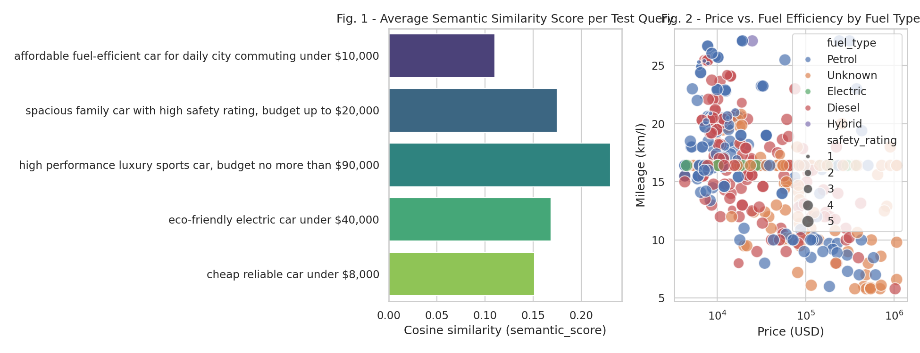
EVALUATION
Results across 5 representative queries
Fig. 1. Semantic similarity by query (left); price vs. fuel efficiency by fuel type (right).
100% of top-5 results respected the stated budget constraint across all 5 test queries.
12

Slide 13
HONEST ASSESSMENT
Limitations
No body-type field:
SUV/sedan/hatchback isn't in the source data — usage-style queries rely on semantic similarity only, not a hard filter.
Median imputation:
22–64% missing rates on some fields create ties between dissimilar cars sharing an imputed value.
Heuristic evaluation:
No human relevance labels — evaluation is constraint-satisfaction + similarity-score based, not ground-truth accuracy.
Fixed exchange rate:
INR→USD conversion uses one approximate rate, not live rates.
13

Slide 14
CONCLUSION
Hybrid NLP recommendation works — on real, messy data
Rule-based constraint extraction reliably enforces hard requirements; Sentence-BERT semantic matching ranks by descriptive relevance — and both survived contact with a real, imperfect, publicly scraped dataset once its data-quality defects were diagnosed and repaired.
Next steps
→ Collect real user-relevance ratings via the accompanying questionnaire
→ Enrich data with a body-type/segment label (classifier or external taxonomy)
→ Replace median imputation with make/segment-conditioned estimates

Slide 15
Thank you
Questions & discussion
Code: github.com/[your-username]/car-recommendation-nlp
Demo notebook, Streamlit app, dataset, and references all included in the repository.

