Slide 1
RedTo AI Agentic Penetration Testing

Slide 2
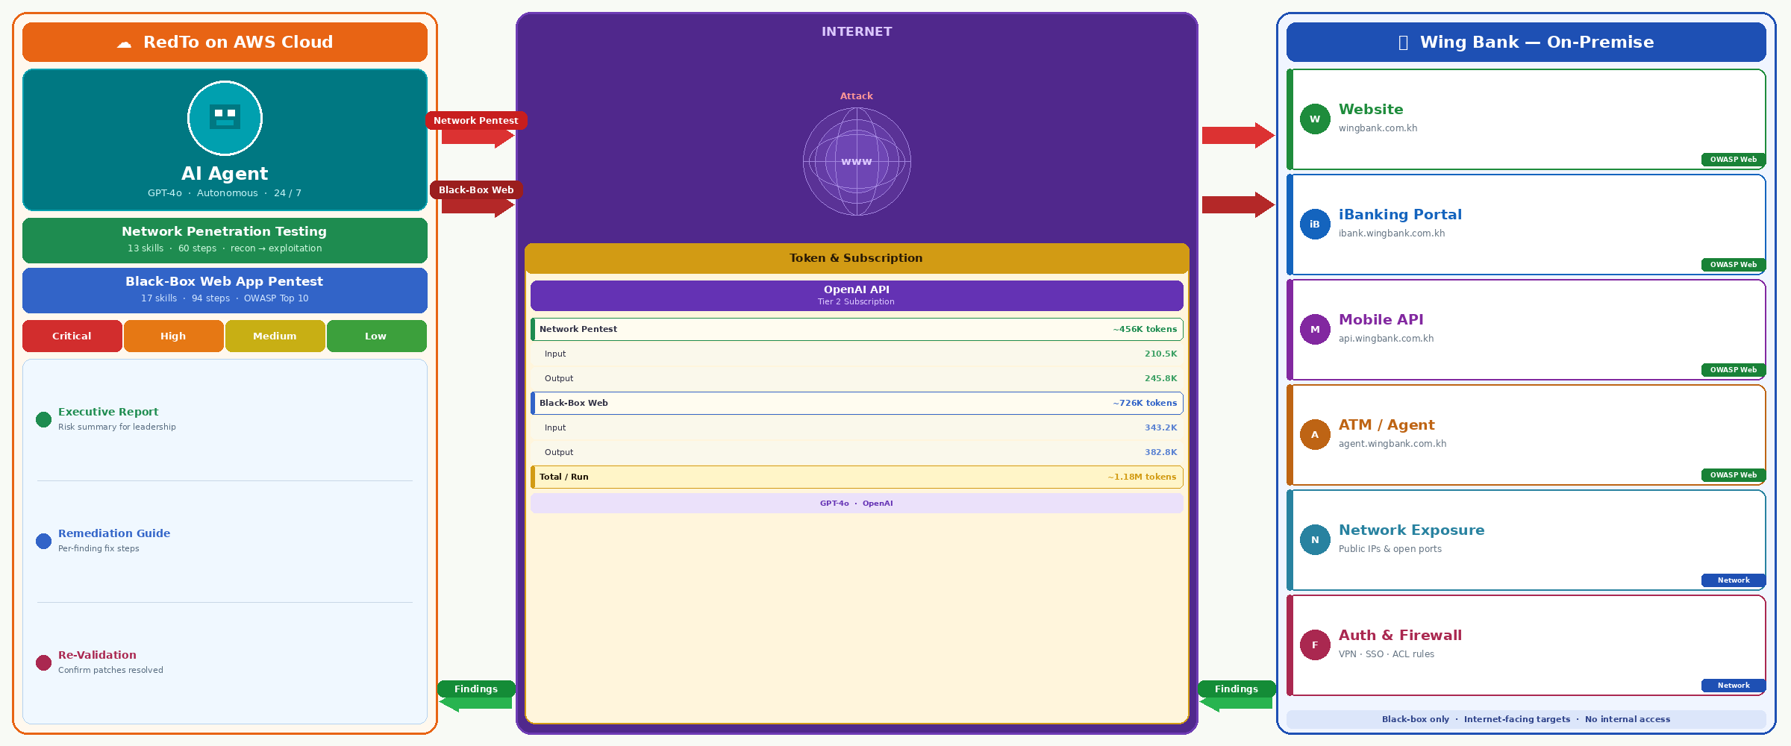
RedTo — Project Overview
RedTo deployed on AWS Cloud → attacks Wing Bank On-Premise internet-facing services (Website, iBanking, Mobile API, Network) via Internet

Slide 3
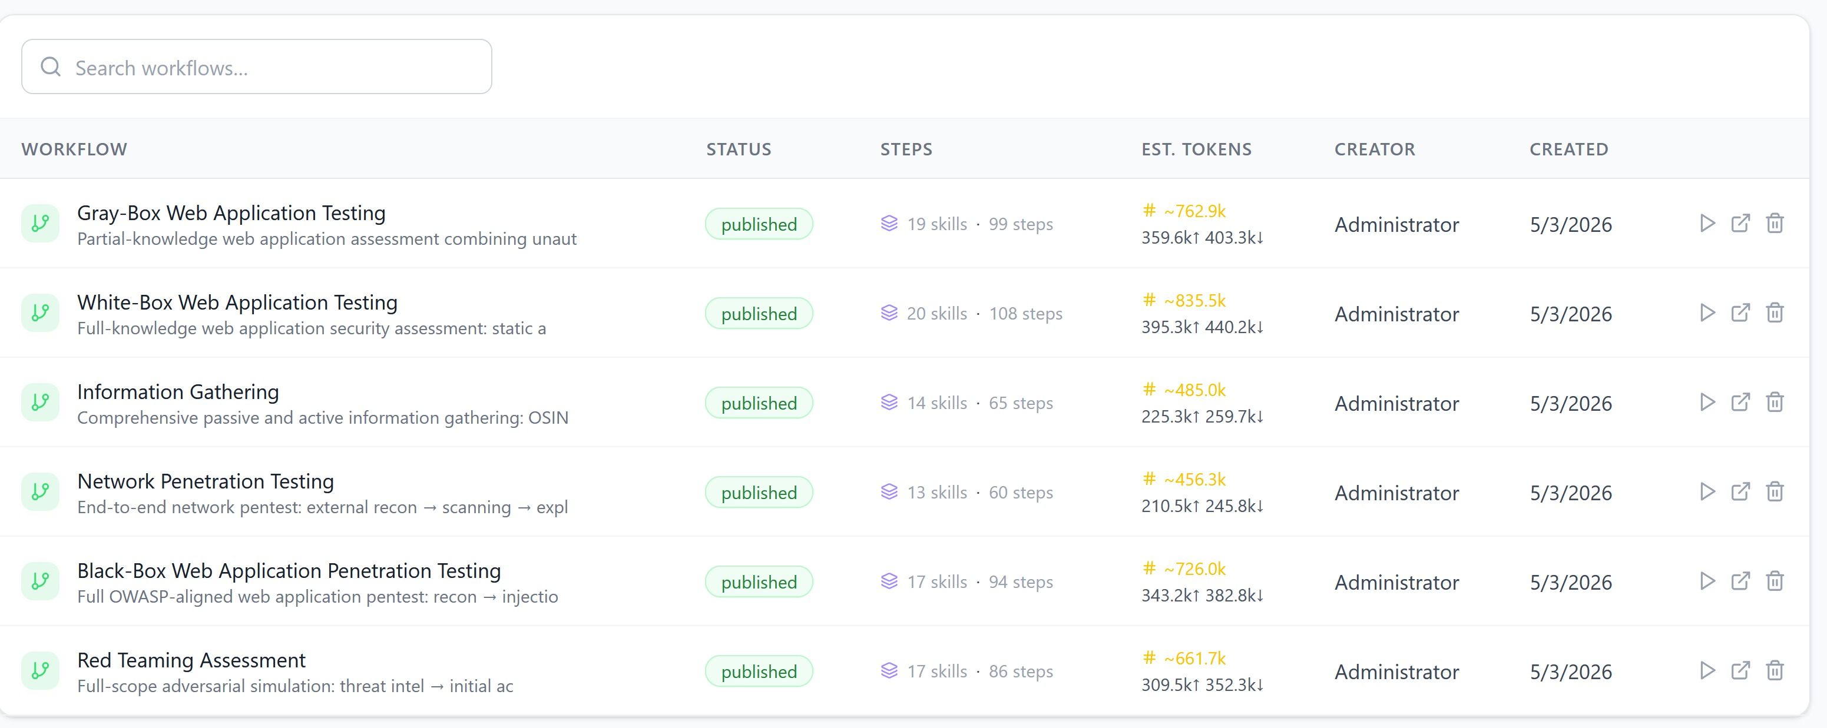
AI Agentic Workflows Platform
Published workflows powering RedTo — Network Pentest (13 skills · 60 steps) and Black-Box Web Testing (17 skills · 94 steps) selected for Phase 1

Slide 4
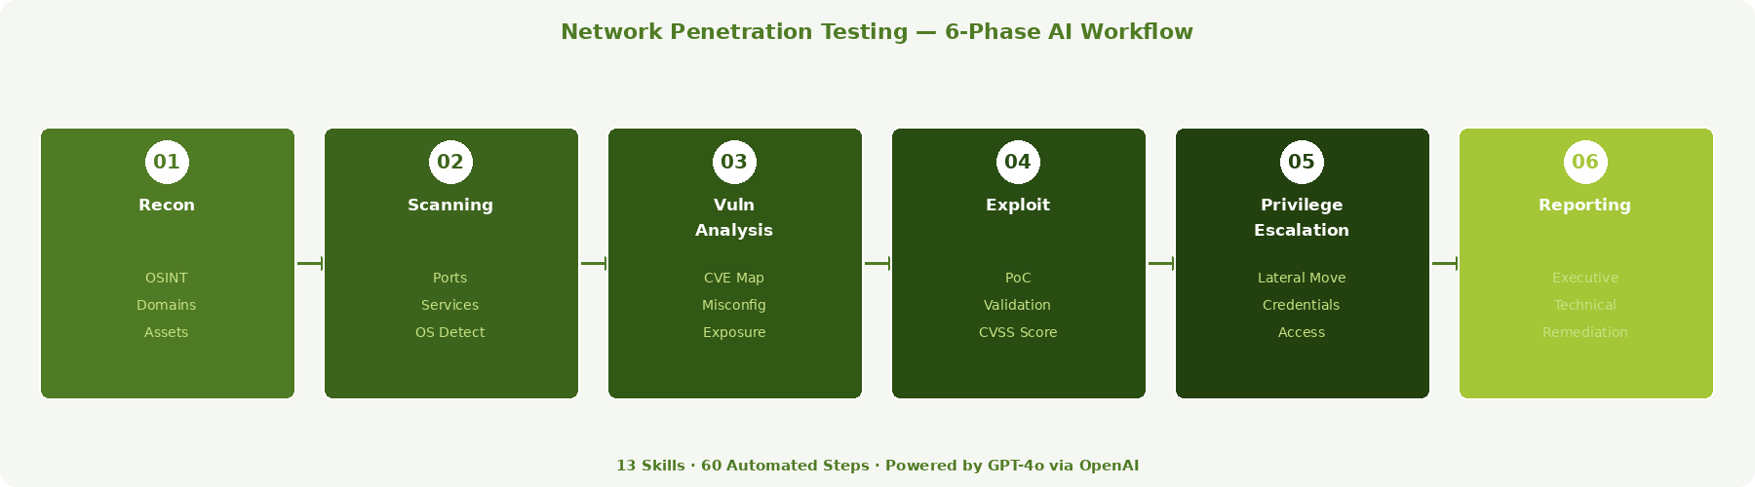
Network Penetration Testing Workflow
13 Skills · 60 Steps — End-to-End Network Attack Simulation
Phase 1 — External Reconnaissance: domain enumeration, OSINT, asset discovery
Phase 2 — Scanning & Fingerprinting: port scanning, service detection, OS fingerprinting
Phase 3 — Vulnerability Analysis: CVE mapping, misconfiguration detection, exposure analysis
Phase 4 — Exploitation: safe proof-of-concept exploit validation with CVSS scoring
Phase 5 — Privilege Escalation: lateral movement simulation and credential access testing
Phase 6 — Reporting: executive summary + technical findings with remediation guidance
Covers: firewall rules, open ports, protocol weaknesses, VPN exposure, DNS/subdomain leaks

Slide 5
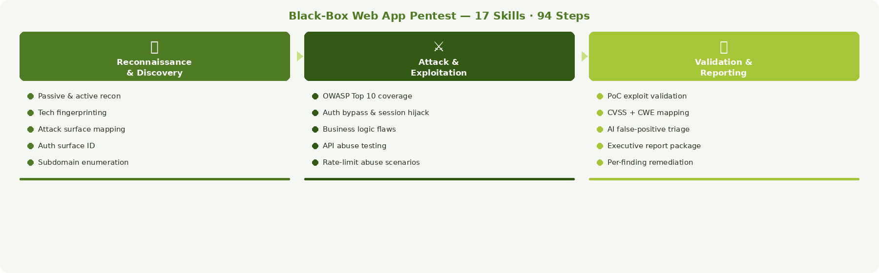



Black-Box Web Application Penetration Testing
Reconnaissance & Discovery
Attack & Exploitation
Validation & Reporting
Passive & active recon — target profiling
Technology fingerprinting and version detection
Attack surface mapping — endpoints, forms, APIs
Authentication surface identification
Subdomain and directory enumeration
OWASP Top 10 — injection, XSS, SSRF, IDOR
Authentication bypass and session hijacking
Business logic flaw testing
API abuse — broken auth, mass assignment
Rate limiting and abuse scenario testing
Proof-of-concept exploit validation
CVSS-scored findings with CWE mapping
False-positive elimination via AI triage
Executive report + technical evidence package
Remediation recommendations per finding

Slide 6
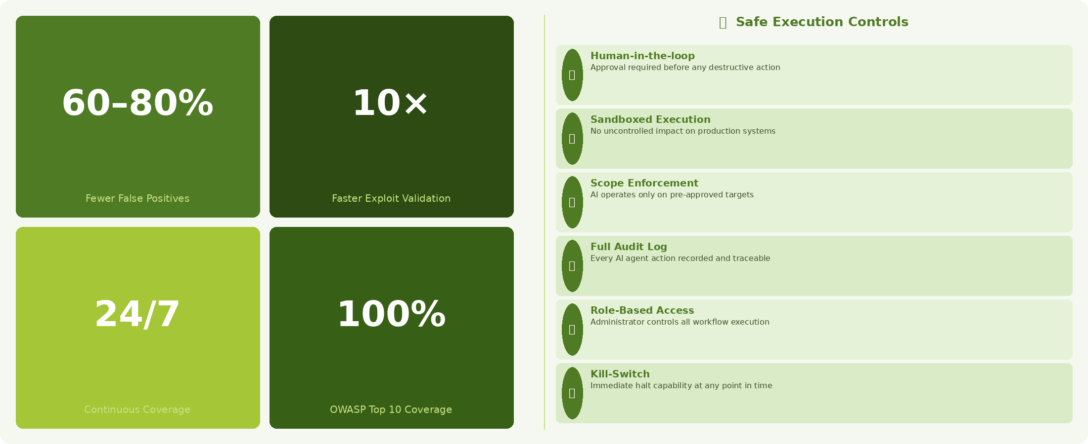
Key Benefits & Execution Governance

Slide 7
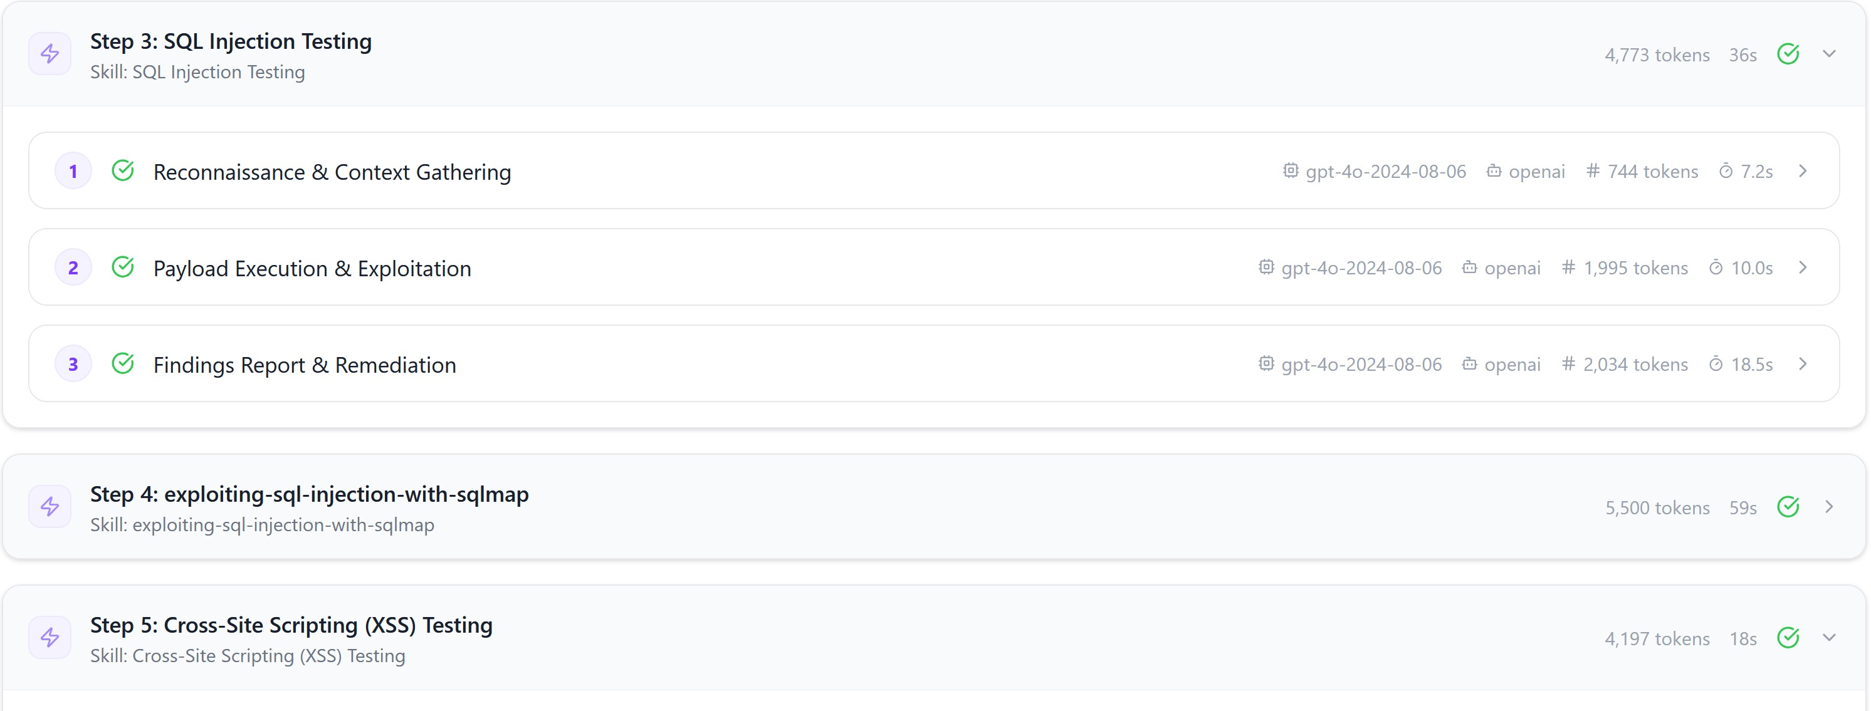
Sample Activity — Black-Box Web Pentest in Action
Step 3: SQL Injection Testing
Step 4: SQLMap Exploitation
Step 5: XSS Testing

Slide 8
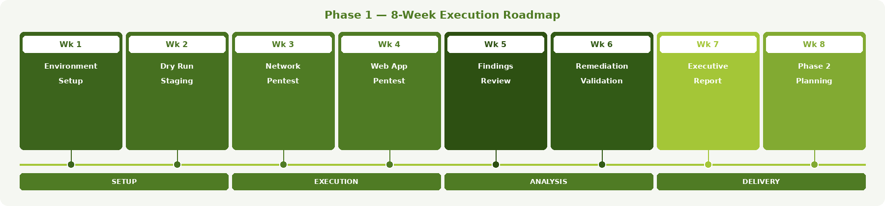
Implementation Roadmap & Next Steps
Phase 1 Execution Plan — RedTo AI Agentic Pentest
Week 1 — Environment Setup: configure target scope, whitelist IPs, set execution permissions
Week 2 — Dry Run: execute Network Pentest workflow against staging environment
Week 3 — Production Run 1: Network Penetration Testing — review and triage findings
Week 4 — Production Run 2: Black-Box Web Application Pentest — full OWASP coverage
Week 5 — Findings Review: joint session with security and dev teams on remediation priorities
Week 6 — Remediation Validation: re-run targeted skills against patched vulnerabilities
Week 7 — Executive Report: deliver final report with CVSS scores, risk ratings, and roadmap
Week 8 — Phase 2 Planning: scope IAM assessment and Gray-Box web testing for next cycle

Slide 9
Thank You!

