Slide 1
Miroservice using Spring Cloud
Sao Thien Hat - saothienhat@gmail.com

Slide 2
Agenda
What I have learned
Assignment Overview
API Gateway concept
Demo

Slide 3
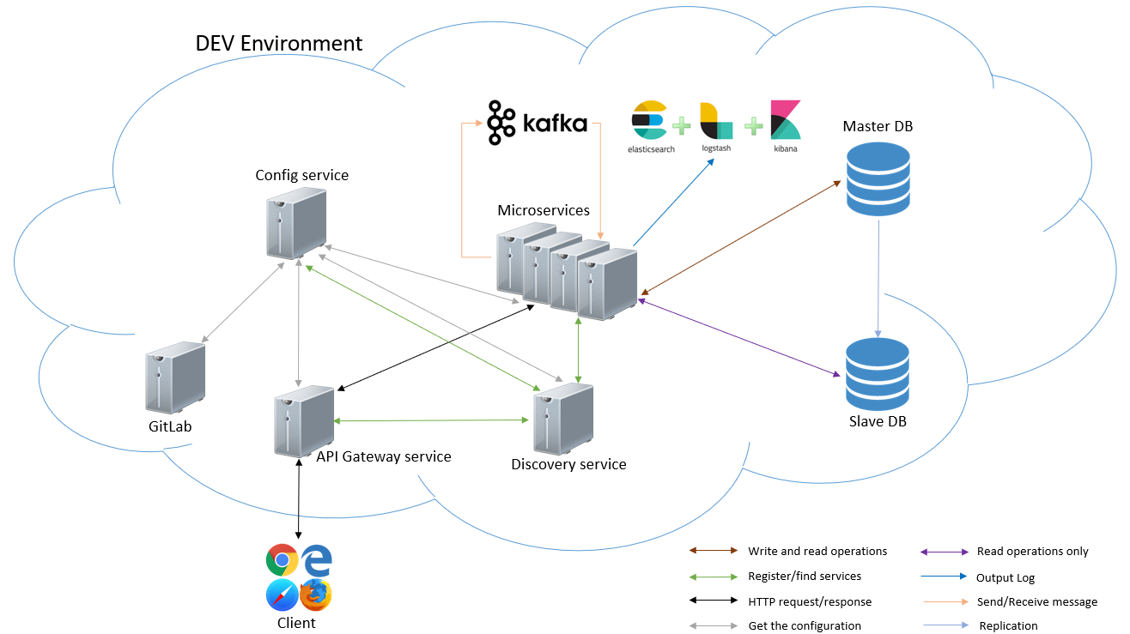
What I have learned – General Architecture

Slide 4
What I have learned – General Architecture
Item | Content | Status
Config server | Automatically load the configuration from GitLab | Done
API gateway | Allow client-side can access to microservices via gateway | Done
Discovery server | Allow microservices find with each other without hard-code hostname and port | Done
Microservice Communication | Communicate between microservices using RestTemplate and Kafka server | Done
API Gateway with Authentication | Access to Microservices via API Gateway Support Login API Generate & validate JWT acess_token for each API | Done
Deploy | Deploy Demo to dev environment | Not Started
Others | Feign client, Cloud Stream, Circuit Broker, etc | Not Started

Slide 5


Assignment Overview
config.properties
Config Server
Gitlab
get config data
API Gateway
Bank Service
(RestTemplate.java)
/user/status
User Service
Simple Kafka Service
Cart Service
data
receive
message
send message
Kafka Server
register service
Eureka Discovery Server

Slide 6
API Gateway (Normal case)
API
/cart/products
Cart Service
API Gateway
data

Slide 7



API Gateway (Authentication)
API
/cart/products
token
Cart Service
1
API Gateway
validate Token = false
API
/login
2
Cart Service
API Gateway
token: JWT
API
/cart/products
3
token
JWT
Cart Service
API Gateway
data
validate Token = true

Slide 8
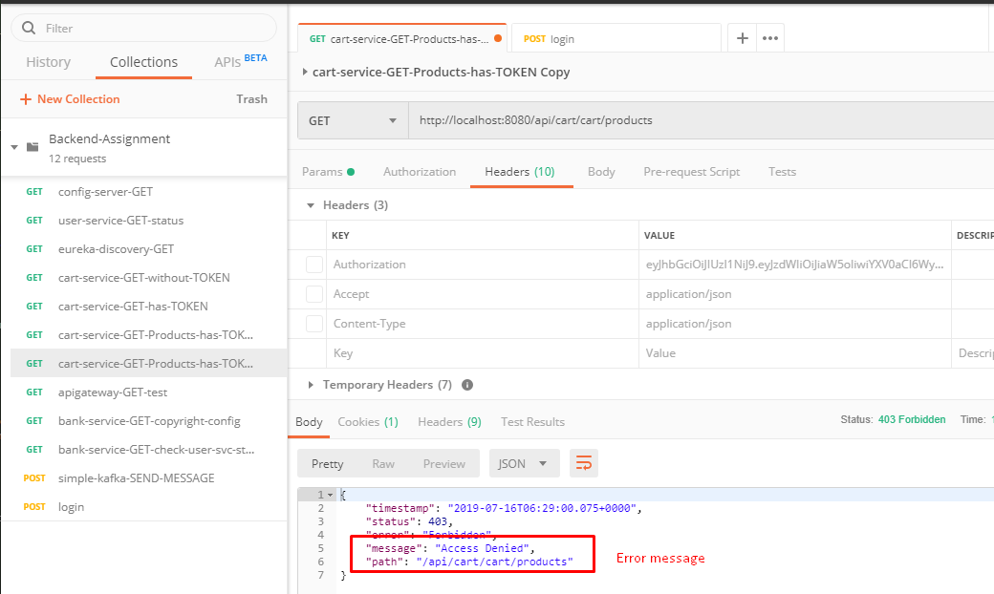
API Gateway (Authentication) (cont)

Slide 9
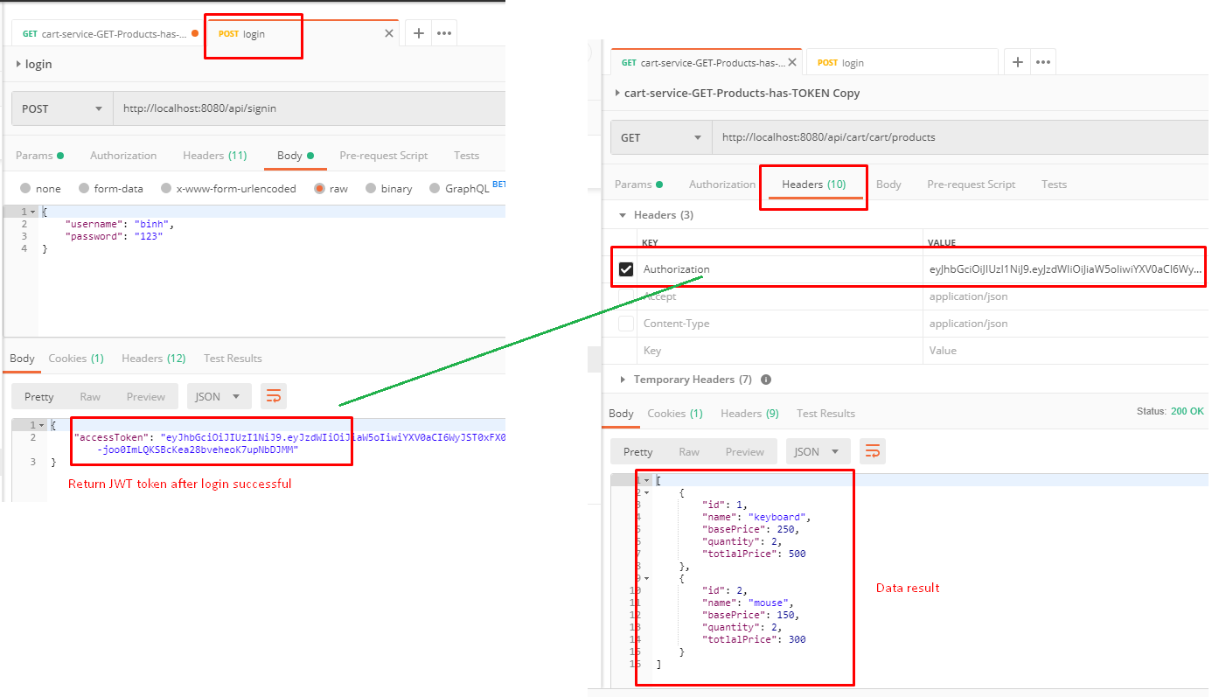
API Gateway (Authentication) (cont)

Slide 10
Reference

Slide 11
END

