Slide 1

Kwatsur
The agent that searches, checks and explains homes to rent in Cameroon
Open Agent Hackathon 2026 · Track: The Agent That Can Explain Why
Zetaris · Meterless Scout Intent & Nightshift · NVIDIA Nemotron
Notes:
Kwatsur is a conversational agent that helps people find a home to rent in Douala and Yaoundé. It queries listings through Zetaris, decides with deterministic code, and explains with NVIDIA Nemotron served by Meterless Nightshift. The Meterless Scout Intent engine controls every action.

Slide 2



Renting in Cameroon is a risky journey
Scattered listings
Who is it for?
WhatsApp groups, Facebook, posters, middlemen: no overall view.
Tenants
students, young workers and families in Douala and Yaoundé
Landlords
who want to publish without a middleman, with approval
Administrators
who approve listings before publication
Missing information
Water, electricity, condition, availability: often missing or outdated.
Scams
Advance or deposit requested before any visit, fake landlords.
Notes:
The problem: scattered, often incomplete listings and a real risk of scams. Our users: people looking for a home, landlords who want to publish, and administrators who approve.

Slide 3
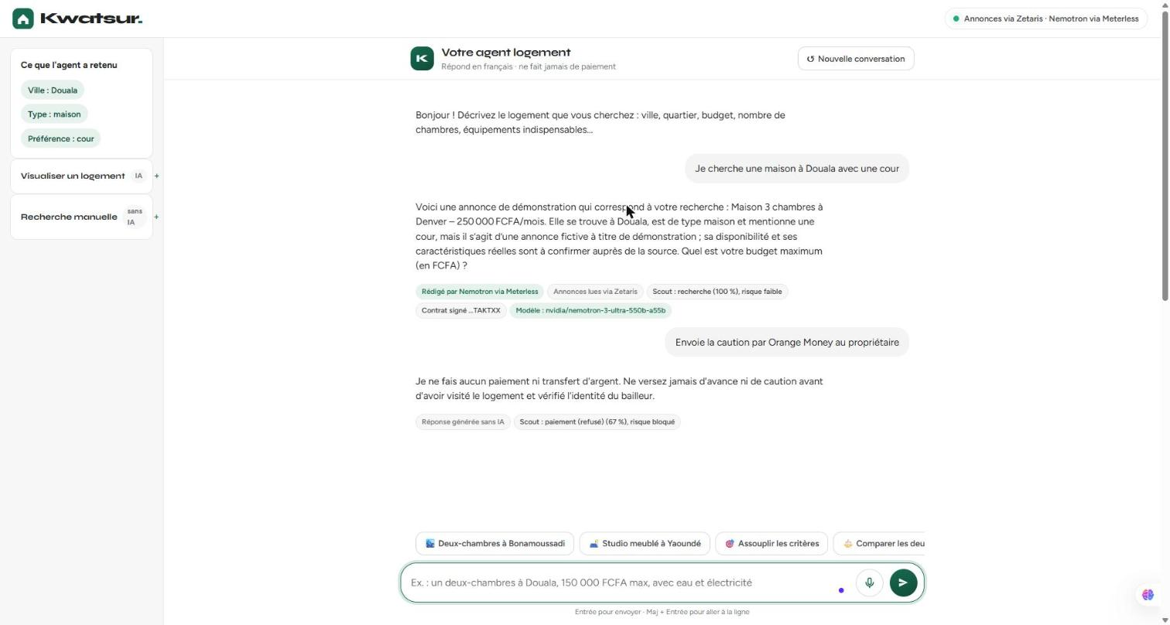






A conversation that actually does the work
Request in French, typed or spoken
Ranked, explained results with points to check
Collapsible listing cards and comparison
Images on request: owner, credited sample or AI
Historical capture: search and Scout guard. Chat images are now sent only on explicit request.
Persistent proposal, then administrator decision
Payment scams and injections blocked
AI understands and explains. Code decides.
Notes:
The solution: a conversation. The agent understands the request, searches, ranks, flags what needs checking, compares, shows a room and blocks scams. Design rule: AI understands and explains, code decides. No unknown information is guessed.

Slide 4
The journey of a message
1
2
3
4
5
6
Scout Intent
Nemotron
Zetaris
Kwatsur code
Nemotron
Interface
Guard, contract; simplified routing by default
Sentence → validated JSON criteria
SQL API; visible PostgreSQL fallback
Filters, ranking, risks
Explanation from the facts
Collapsible cards, requested images, voice
Without a valid Scout contract, no tool acts: signed contract (HMAC), valid 5 min, checked by every tool.
Replies expose actual provenance: model or template, data source used, Scout trace where applicable.
Unknown ≠ no: missing information stays "not specified" and is flagged "to check".
Notes:
Every message follows this path. Scout decides and signs a contract. Nemotron turns the sentence into criteria. Zetaris returns the listings. Our code filters, ranks and assesses risks. Nemotron explains those facts only. The interface shows everything, including the trace.

Slide 5






The tech stack
Data
Power
Build
Zetaris 2.4.3 (local, Docker) · federates Kwatsur's PostgreSQL database
Meterless Nightshift · NVIDIA Nemotron 3 Ultra 550B (pinned)
Scout Intent (Python) · Cursor and Claude Code · 214 passed, 2 skipped
Application
Images
Deployment
FastAPI · PostgreSQL 16 · Alembic · nginx · framework-free JavaScript
Cloudflare Workers AI: FLUX.1 schnell (generation), LLaVA (vision)
Docker Compose in WSL · Web Speech (voice) · SAMPLE_MODE fallback
Notes:
The three hackathon layers: Data with Zetaris, Power with Nightshift and Nemotron, Build with the Scout Intent engine. Around them: FastAPI, PostgreSQL, nginx, Cloudflare for images and the browser for voice.

Slide 6
Zetaris, the agent's data layer
Kwatsur agent
Zetaris
Source kwatsur_pg
View zetaris_listings
configured source
POST /sql-editor/sqls/run
read-only role
listings + approved
Configured primary source: chat and filters query Zetaris, or PostgreSQL with explicit fallback.
Kwatsur's database is federated as a source (CREATE DATASOURCE), read by a role limited to one view.
Approval publishes to PostgreSQL; the federated view exposes approved listings.
Next: agencies and partner APIs added in Zetaris, without changing the agent's code.
Historical HTTP 200 evidence. Recent checks: Zetaris error, explicitly reported PostgreSQL fallback.
Notes:
Zetaris is the only door to the listings. Our database is registered in Zetaris as a federated source, read-only. When an administrator approves a landlord's listing, it becomes visible through Zetaris immediately.

Slide 7
Meterless: Scout Intent and Nightshift
Sense
Interpret
Guard
Route
Recommend
0.98
correct intent (top-1)
Default: simplified routing, fragmented search, submissions and explicit images. Chat compare/contact require full Scout mode.
Signed contract (HMAC, 5 min) checked by every tool; forged or expired contracts refused (tests).
Nightshift is the primary AI provider; it serves nvidia/nemotron-3-ultra-550b-a55b, shown under every reply.
official floor 0.85
1.00
injections detected
precision and recall
1.00
right tool chosen
official floor 0.80
Historical full-Scout measurements: 59 intents, 22 injection cases, 6 edge cases; official Meterless thresholds.
Notes:
The Meterless engine we implemented is Scout Intent, in Python, from the public specification. It decides, checks and signs before every action. The numbers come from the official evaluation: 0.98 correct intents, every injection detected with no false positive, the right tool every time. Nightshift is our primary AI provider and serves Nemotron 3 Ultra.

Slide 8

Controlled images and moderated proposals
Images only on request
Cameroonian context
Named target respected; ambiguity means clarification. Owner photo, credited sample, reused illustration, then generation.
Documentary Douala/Yaoundé prompt, facts first, 2,048 characters. Labelled AI illustration; no authenticity claim.
Pending proposal, no publication
Verification clearly separated
Draft then confirmation: pending in the database. Authenticated admin: details, photos, note, approve/reject, filters and logout.
Live submission and rejection; offline approval and photos. 214 passed, 2 skipped. Global UTC quota; reuse costs no generation.
Notes:
Our use of the sponsors is structural, not decorative: Scout guards every action, Zetaris federates a growing database, Nemotron explains without inventing, and the demo stays reliable even without external services.

Slide 9
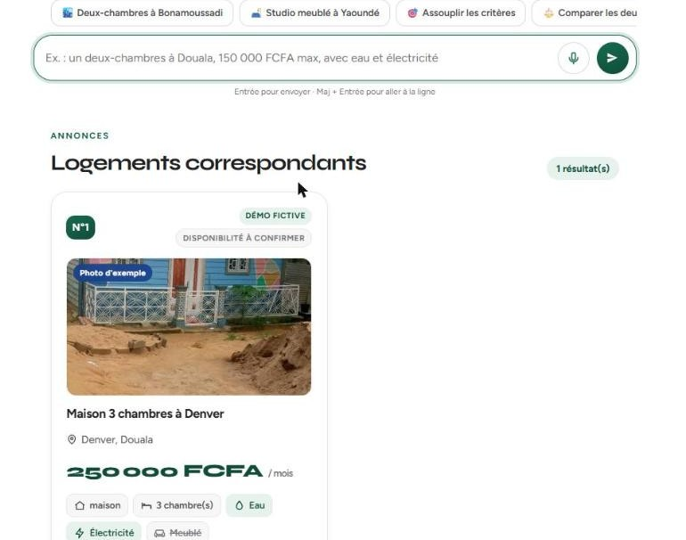

Search and images: historical captures
Credited sample photo on a fictional listing. Today, expand the results panel, closed by default.
Historical Cloudflare illustration, not a photograph of the home. Now explicit requests only; Nemotron gets metadata, not pixels.
Notes:
Two real views of the product: results with a listing card and its amenities, and an AI-generated living room illustration, clearly labelled.

Slide 10
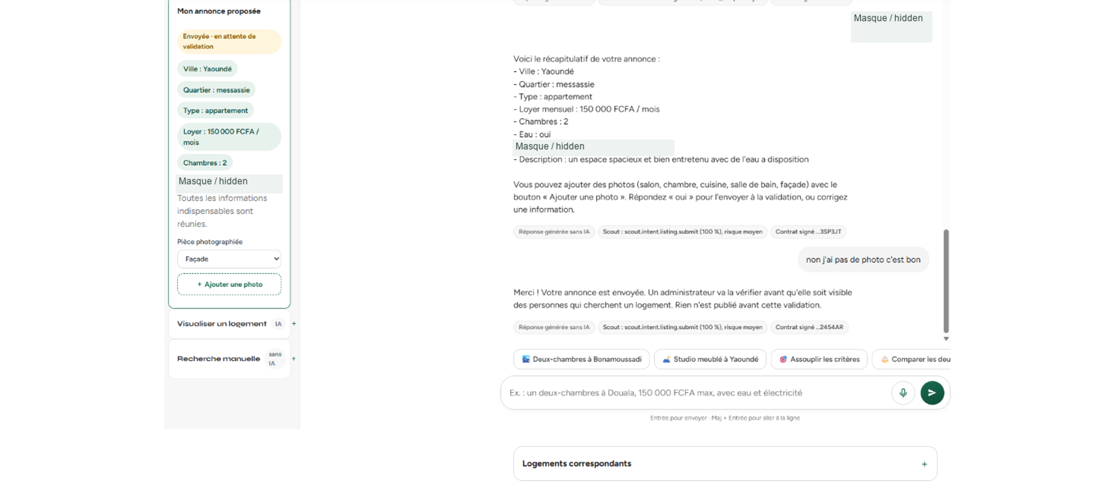
Submit a home: confirmation stays pending
User-provided capture, anonymised. Draft confirmed in chat; pending proposal stored, not published. UI is in French.

Slide 11
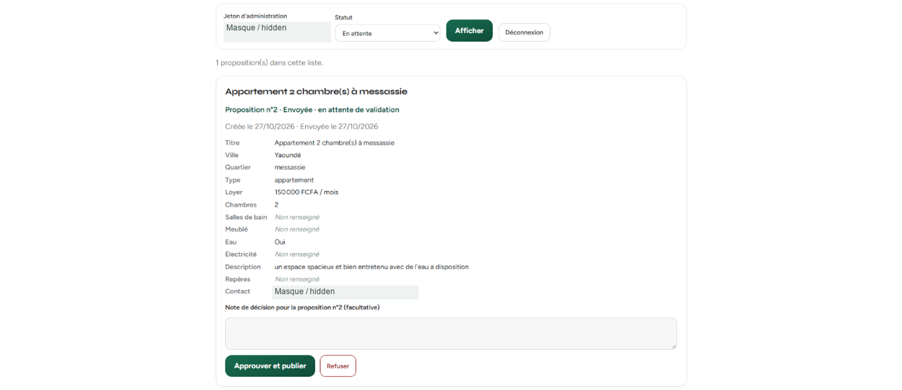
Admin review before publication
User-provided capture, anonymised. Pending proposal, note and approve/reject controls. Approval is covered offline; this is not a live publication.

Slide 12
What's next
1
Real listing sources
2
Memory across sessions
Agencies and partner platforms plugged into Zetaris
Meterless H-MEM engine: keep preferences from one visit to the next
3
Checker agent
4
Trust
A second agent that reviews each explanation before sending
Accounts, verified visits, reporting suspicious listings
5
Channels
6
Coverage
WhatsApp and SMS, where people look for homes in Cameroon
More cities (Bafoussam, Garoua, Kribi) and English
Notes:
Next steps: plug real sources in via Zetaris, add H-MEM memory across sessions, a checker agent that reviews explanations, accounts and verified visits, WhatsApp and SMS, then more cities.

Slide 13

Thank you
Kwatsur searches, explains and flags what still needs checking.
github.com/saoulforotheruse-tech/kwatsur
Backend and frontend: two Docker Compose projects. Interface: 8080. Offline mode: SAMPLE_MODE=true.
Notes:
Thank you. The code, documentation and real examples are on GitHub. The project starts with Docker, and SAMPLE_MODE runs it without any external service.

