Slide 1

Project Presentation: Smart Mug
1. Idea
2. Main Functions
3. Components
4. Techniques Used
5. Future Improvements

Slide 2
PART1
Idea

Slide 3

Idea
Water is very important to health.
Average men : 3.7 litres
Average women : 2.7 litres
Who is going to keep the track of water consumption ?
The Smart Mug

Slide 4
PART2
Main Functions

Slide 5

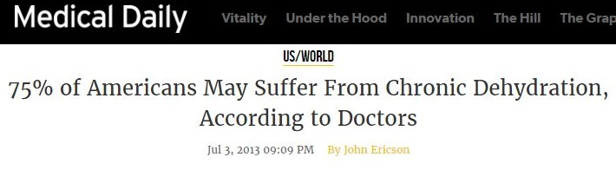

Main Functions
Detects the water consumption.
Keeps track of water consumption on hourly basis.
Adds up the to give the total consumption daily.
Alerts the user if enough water is not consumed.
Stirring the coffee

Slide 6
PART3
Components

Slide 7
Components
Arduino Controller (UNO)
Load Cell
Amplifier (HX711)
Accelerometer
WiFi module (ESP8233)
LCD Display
Text-to-Speech Module (Emic2)
Speaker
Servo motor (Continuous)
Mechanical Components

Slide 8
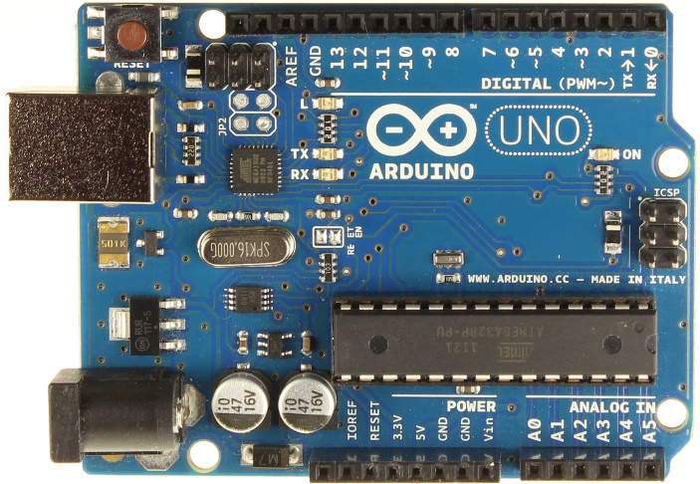
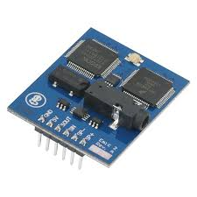
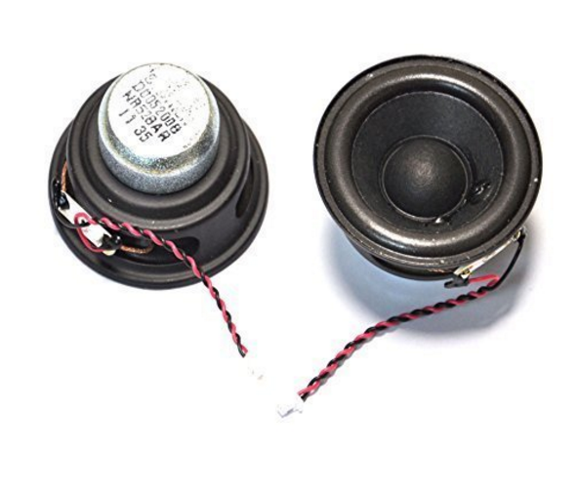
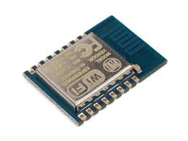



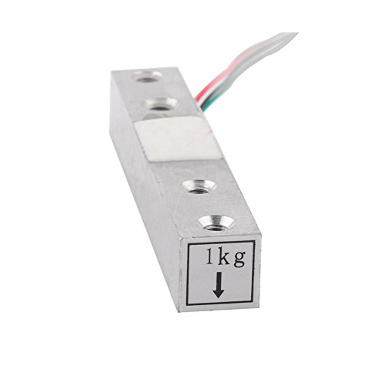
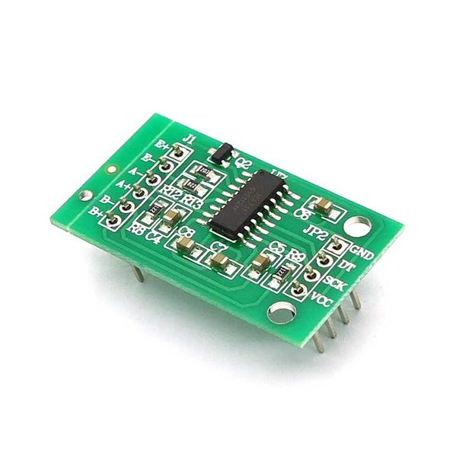
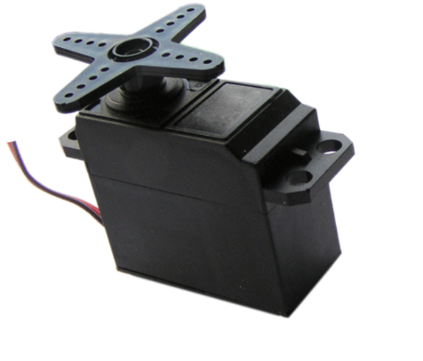
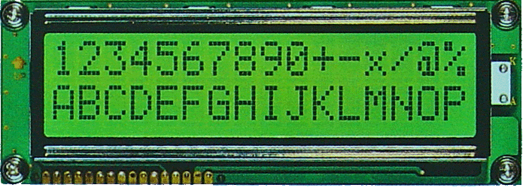

Slide 9
PART4
Techniques Used

Slide 10
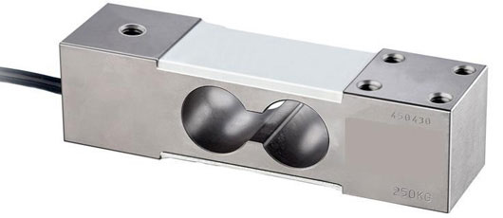

Techniques Used
Load Cell is used to measure the weight of the Mug.
Accelerometer is used for proper measurement.
Sending message to phone over WiFi network
Reminding user by Text-to-Speech Module

Slide 11
Details
Accelerometer: Only measure the weight when the mug is put flat
Sending message every hour (every 30 sec for demonstration)
When user does not drink enough water in the past hour (30 sec), the speaker will remind user

Slide 12
PART5
Future Improvements

Slide 13
Future Improvements
Using multiple Load Cells.
Other options like capacitive plates or ultrasonic sensor for measuring amount of water.
Implementing Keypad for manual entry.
Desired messages, alerts, greetings, etc.
Personal Mug, Personal Hydration Level.

Slide 14
Thank You

