Slide 1
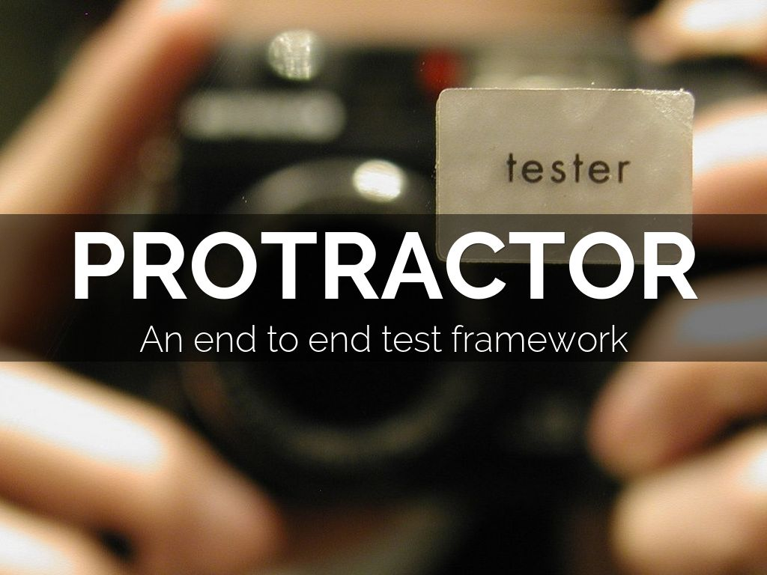
Photo by [phil h] - Creative Commons Attribution-NonCommercial-ShareAlike License https://www.flickr.com/photos/14318462@N00
Created with Haiku Deck

Slide 2
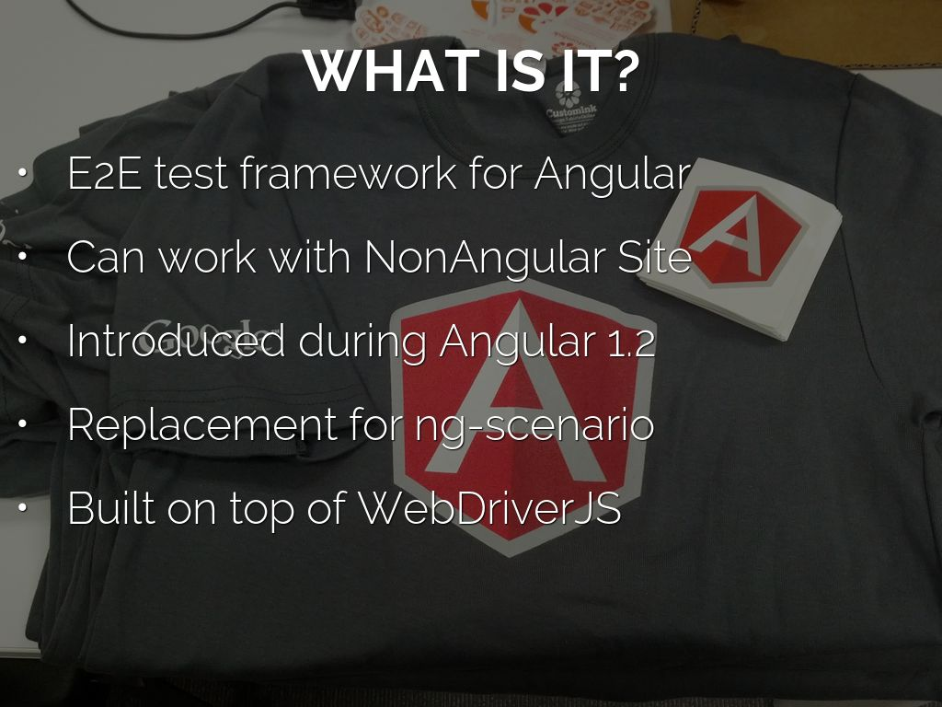
Photo by fumi - Creative Commons Attribution-NonCommercial-ShareAlike License https://www.flickr.com/photos/35237097961@N01
Created with Haiku Deck

Slide 3
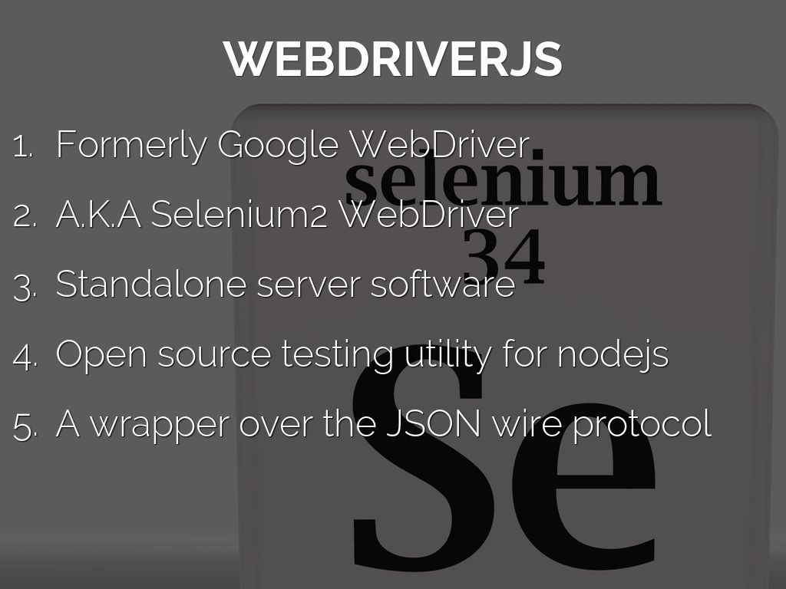
Photo by fdecomite - Creative Commons Attribution License https://www.flickr.com/photos/21649179@N00
Created with Haiku Deck

Slide 4
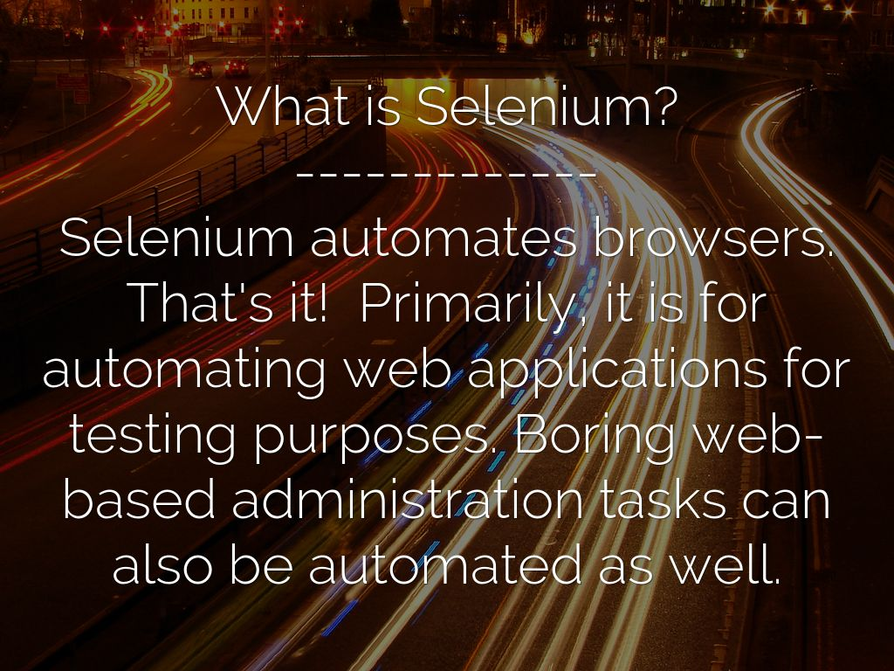
Photo by Greg Marshall - Creative Commons Attribution-NonCommercial-ShareAlike License https://www.flickr.com/photos/86874036@N00
Created with Haiku Deck

Slide 5
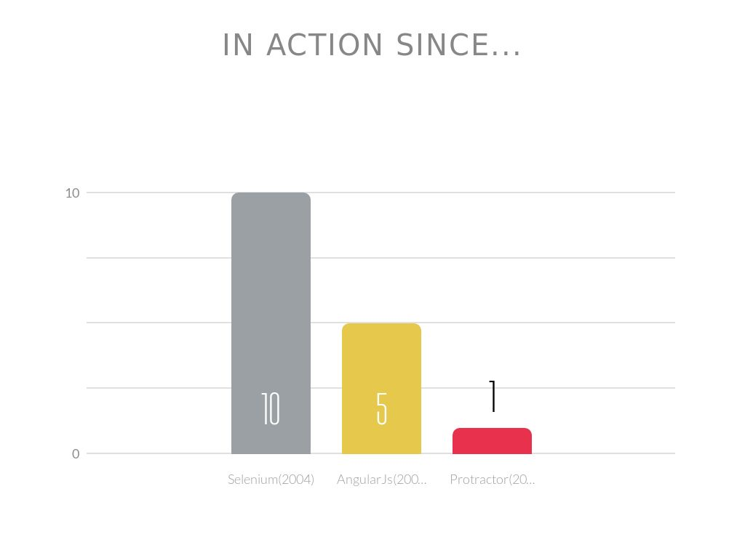

Slide 6

Photo by Peppe702 - Creative Commons Attribution License https://www.flickr.com/photos/81812830@N03
Created with Haiku Deck

Slide 7

Photo by anarchosyn - Creative Commons Attribution-ShareAlike License https://www.flickr.com/photos/24293932@N00
Created with Haiku Deck

Slide 8
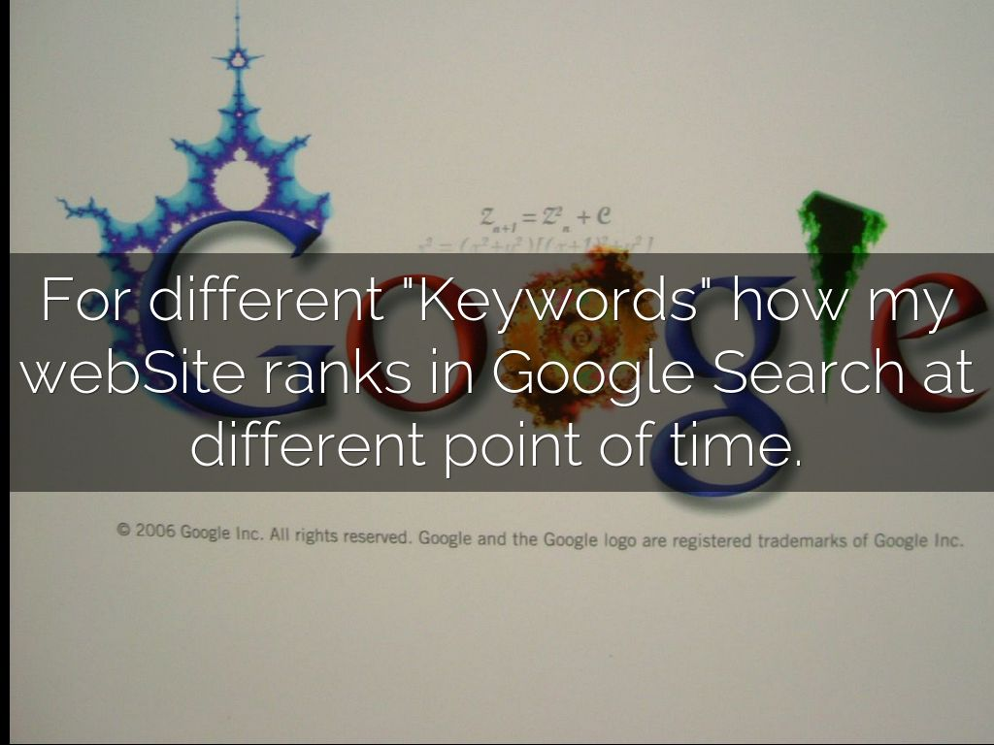
Photo by Junyu Wang | 王俊煜 - Creative Commons Attribution-NonCommercial-ShareAlike License https://www.flickr.com/photos/29381470@N00
Created with Haiku Deck

Slide 9

Photo by stefanweihs - Creative Commons Attribution License https://www.flickr.com/photos/23132637@N08
Created with Haiku Deck

Slide 10


Slide 11
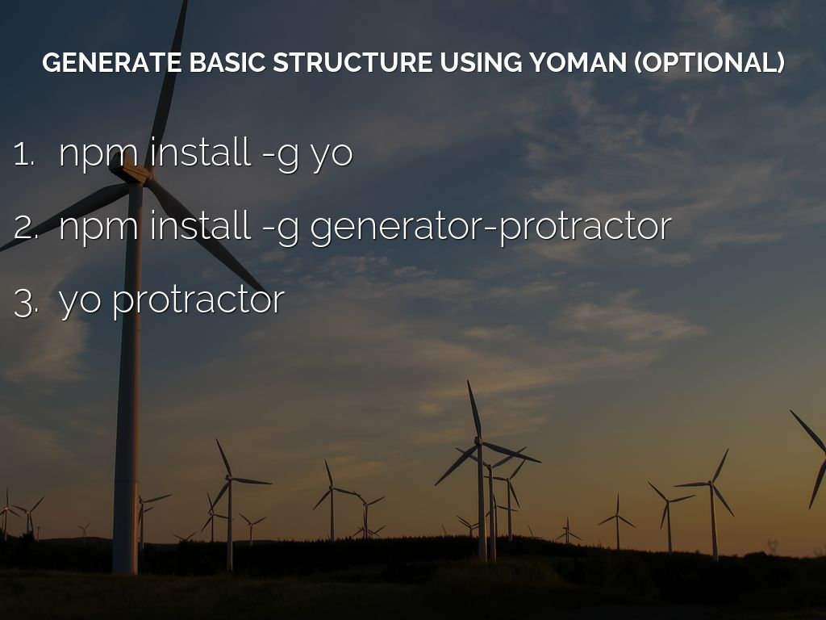
Photo by Mohammad Afshar - HideInColors.com - Creative Commons Attribution-NonCommercial License https://www.flickr.com/photos/98686233@N07
Created with Haiku Deck

Slide 12
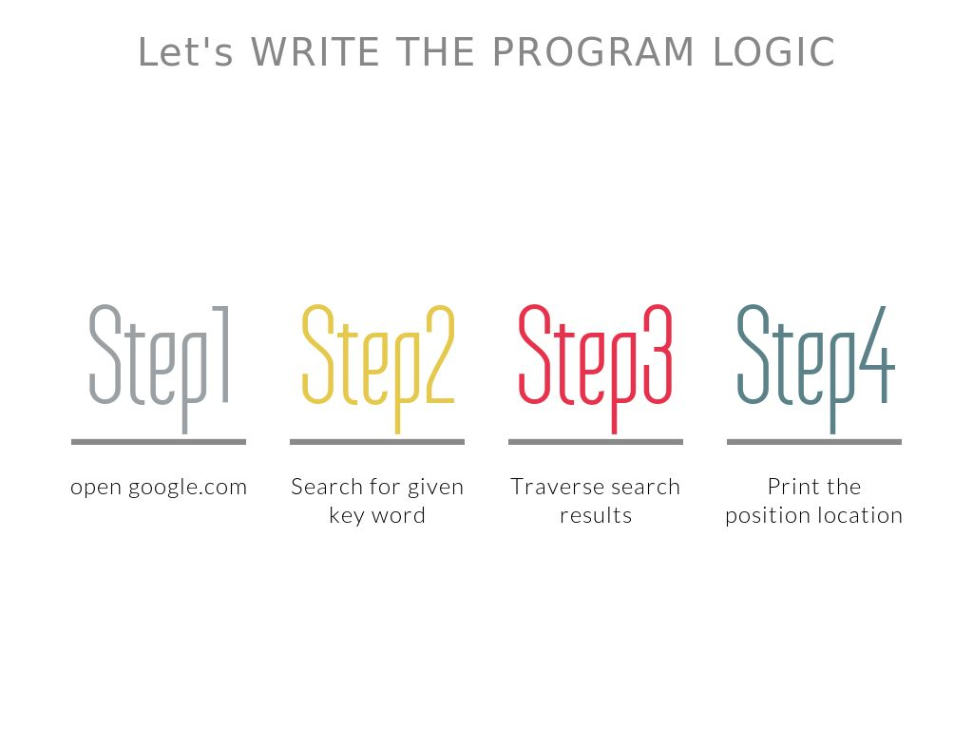
Photo by Sean MacEntee - Creative Commons Attribution License https://www.flickr.com/photos/18090920@N07
Created with Haiku Deck

Slide 13
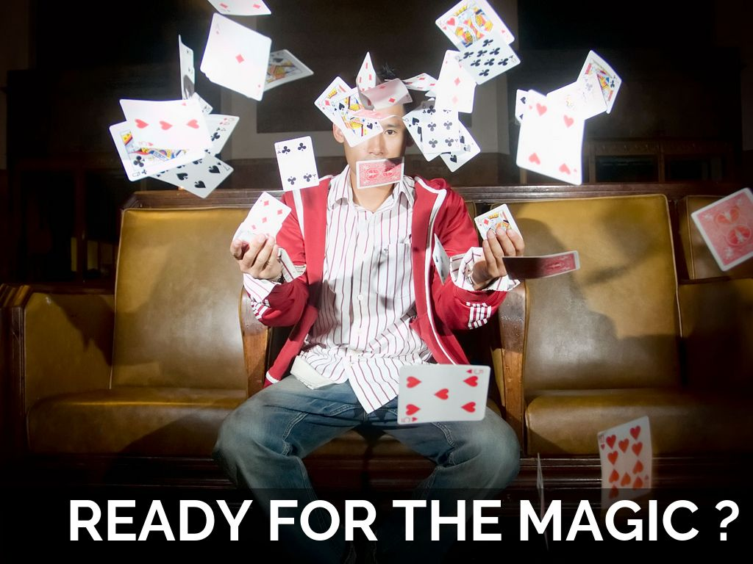
Photo by photomassacre - Creative Commons Attribution License https://www.flickr.com/photos/37719169@N00
Created with Haiku Deck

Slide 14

Photo by SurfaceWarriors - Creative Commons Attribution-ShareAlike License https://www.flickr.com/photos/55244200@N05
Created with Haiku Deck

Slide 15

Photo by isafmedia - Creative Commons Attribution License https://www.flickr.com/photos/29456680@N06
Created with Haiku Deck

Slide 16

Photo by ernest figueras - Creative Commons Attribution-NonCommercial-ShareAlike License https://www.flickr.com/photos/32316075@N00
Created with Haiku Deck

