Slide 1
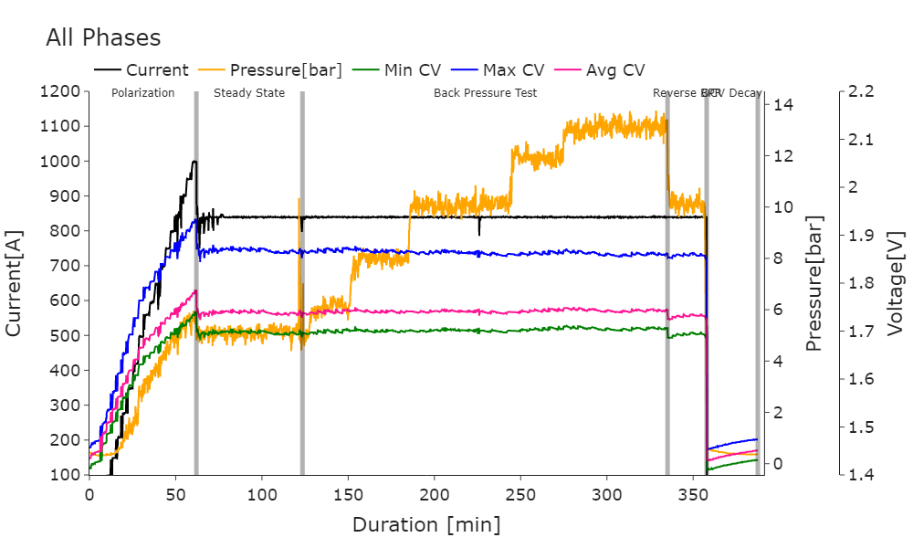
Stack ID | U260-112
Completed Duration | 409.17 mins | Start Date | 22-02-2025 15:59 | End Date | 22-02-2025 23:30
 | Pol Curve | Steady State | Back Pressure @10bar | Back Pressure @13bar | Reverse BPR @10bar
Max Current | 1000 A | 840 A | 840 A | 840 A | 840 A
Max CV | 1.931 V | 1.868 V | 1.863 V | 1.861 V | 1.858 V
Max Cell | Cell 17 | Cell 17 | Cell 17 | Cell 17 | Cell 17
Min CV | 1.737 V | 1.697 V | 1.701 V | 1.705 V | 1.693 V
Min Cell | Cell 31 | Cell 31 | Cell 31 | Cell 31 | Cell 48
Average CV | 1.783 V | 1.738 V | 1.74 V | 1.743 V | 1.731 V
Water Temp | 74.3 °C | 74.5 °C | 74.2 °C | 74.3 °C | 74.6 °C
Inlet Water Pressure | 1.45 bar | 1.41 bar | 1.43 bar | 1.43 bar | 1.43 bar
COS | 0.4 µS/cm | 0.4 µS/cm | 0.4 µS/cm | 0.4 µS/cm | 0.5 µS/cm
Inherent Pressure | 5.45 bar | 5.12 bar | 10.0 bar | 13.0 bar | 10.0 bar
HYS 102 Max | 0.0 % | 7.9 % | 12.0 % | 16.0 % | 12.0 %
HYS 102 End Avg | 0.0 % | 5.72 % | 11.07 % | 15.34 % | 11.0 %
HYS 501 Max | 0.2 % | 0.3 % | 0.2 % | 0.4 % | 0.4 %

Slide 2
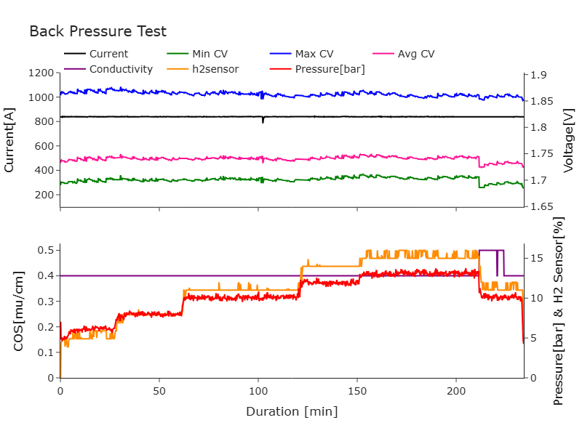

Slide 3
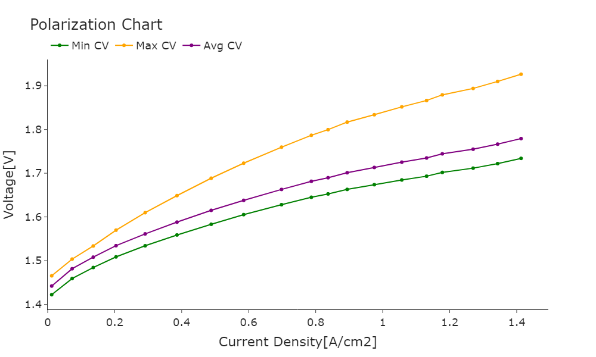

Slide 4
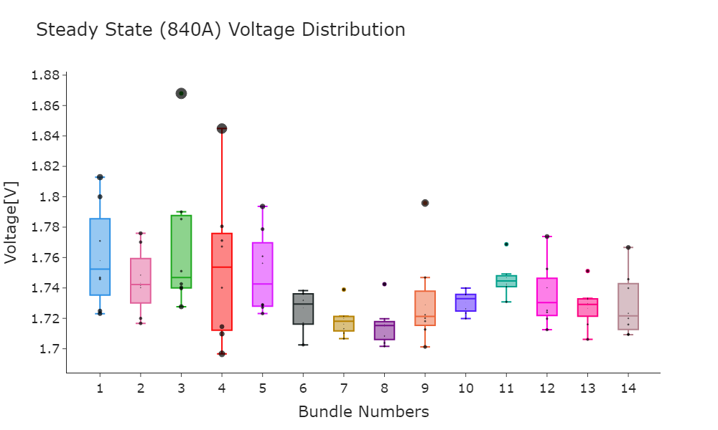

Slide 5
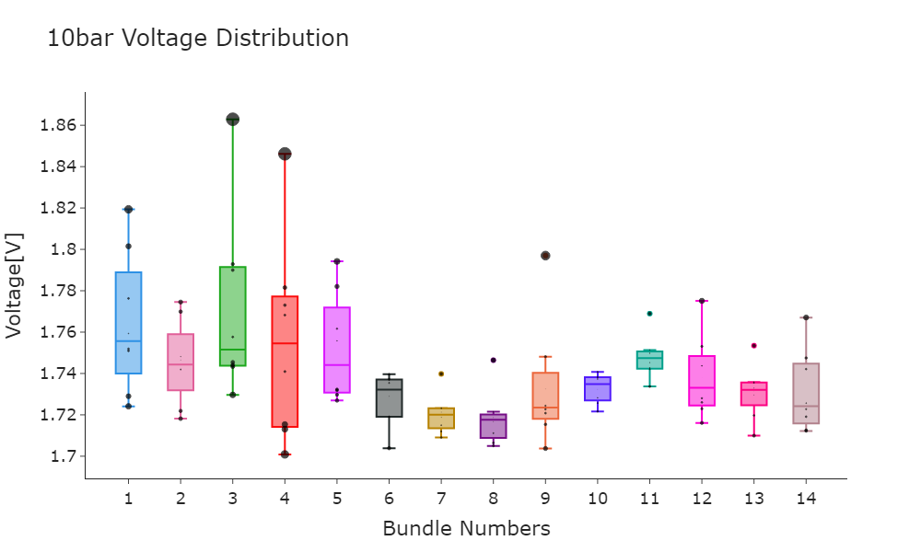

Slide 6


Slide 7
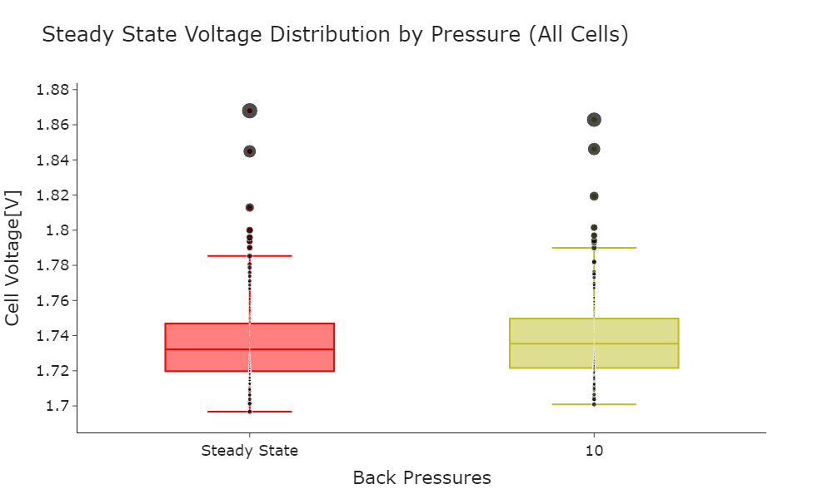

Slide 8
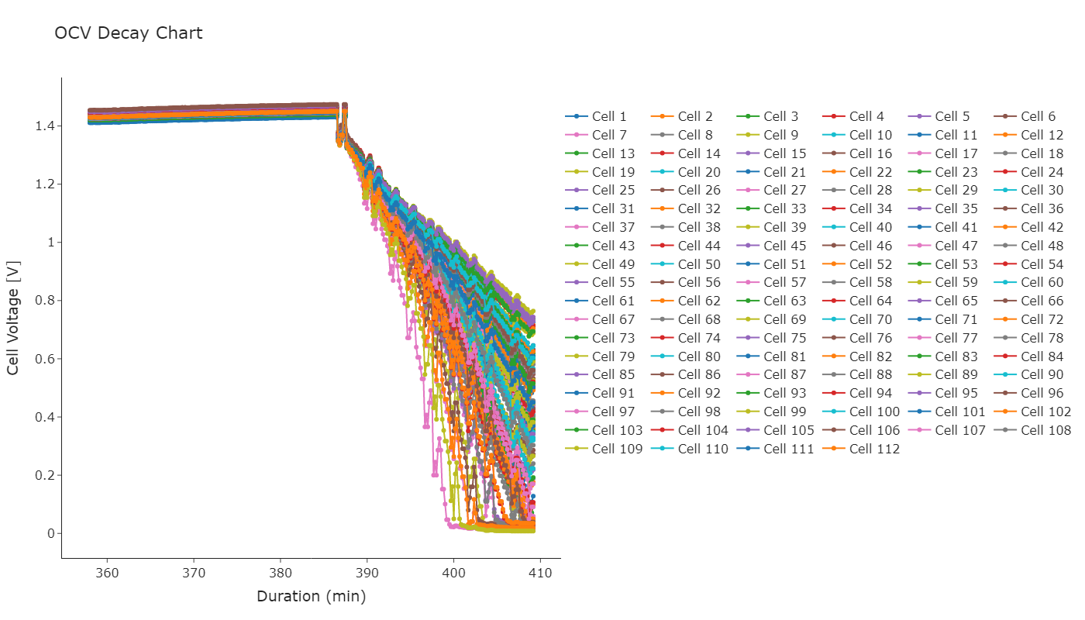

Slide 9
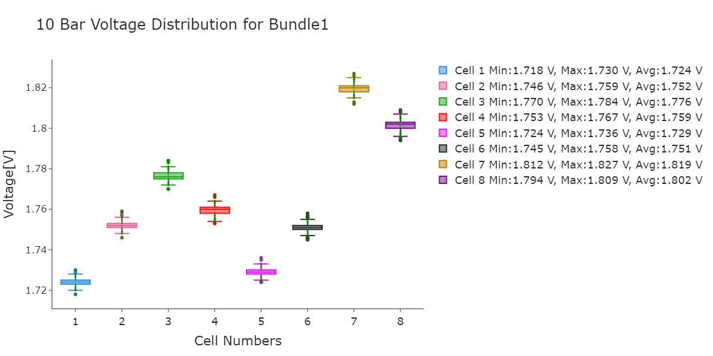

Slide 10
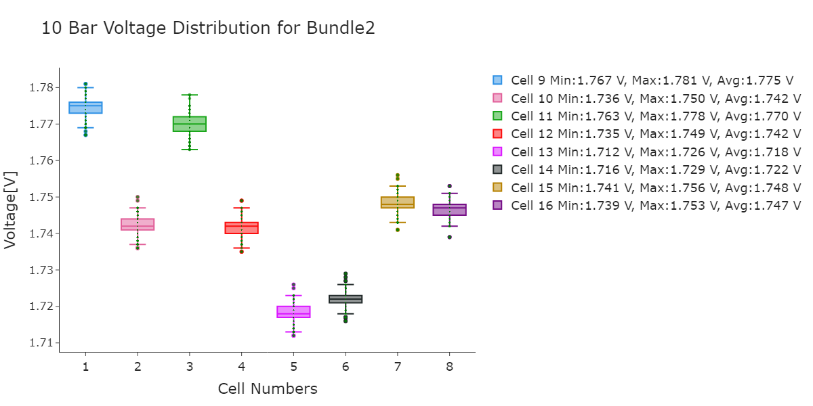

Slide 11
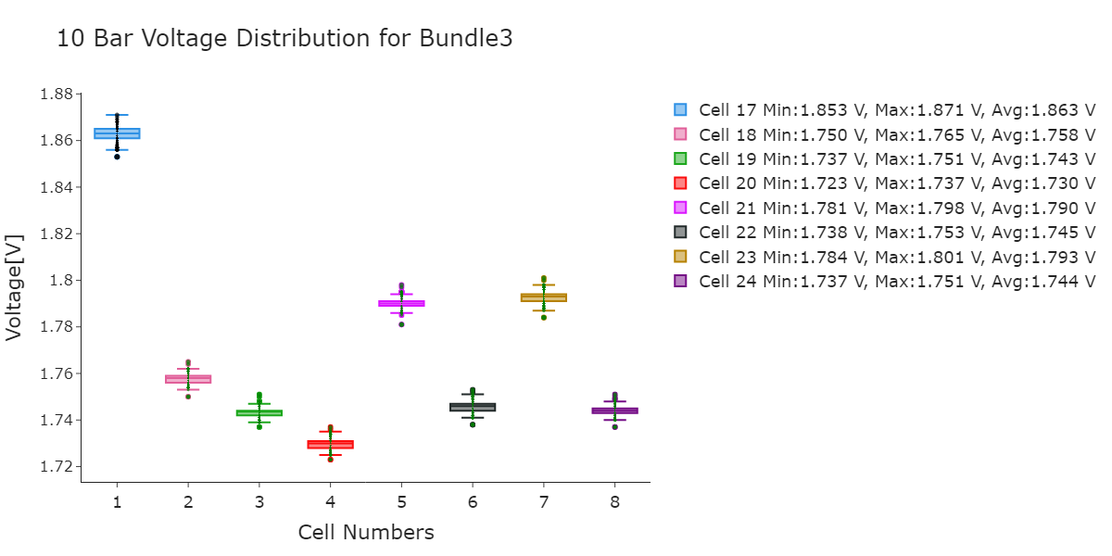

Slide 12
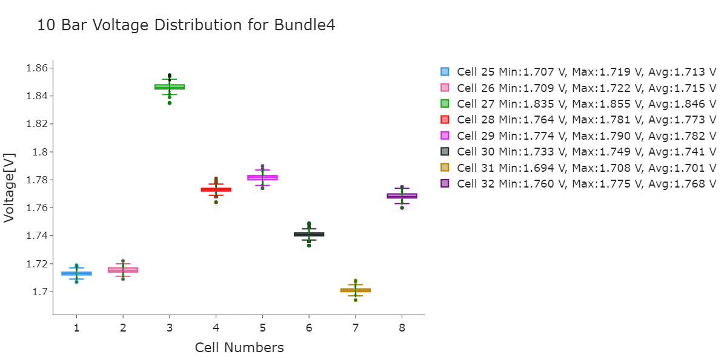

Slide 13
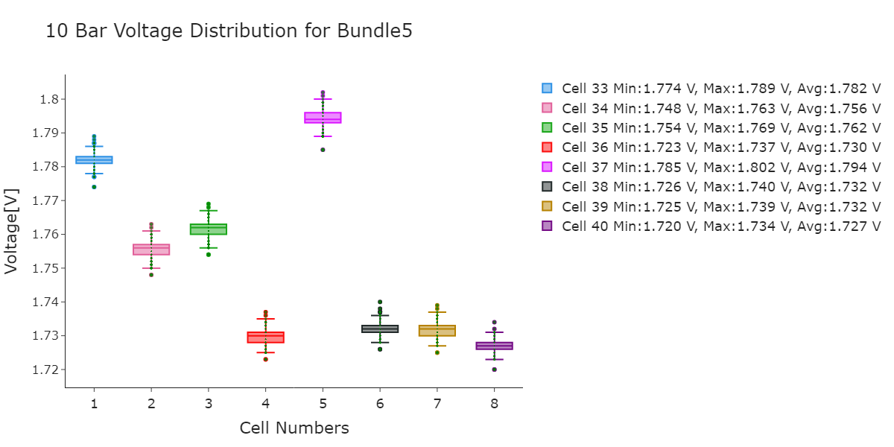

Slide 14
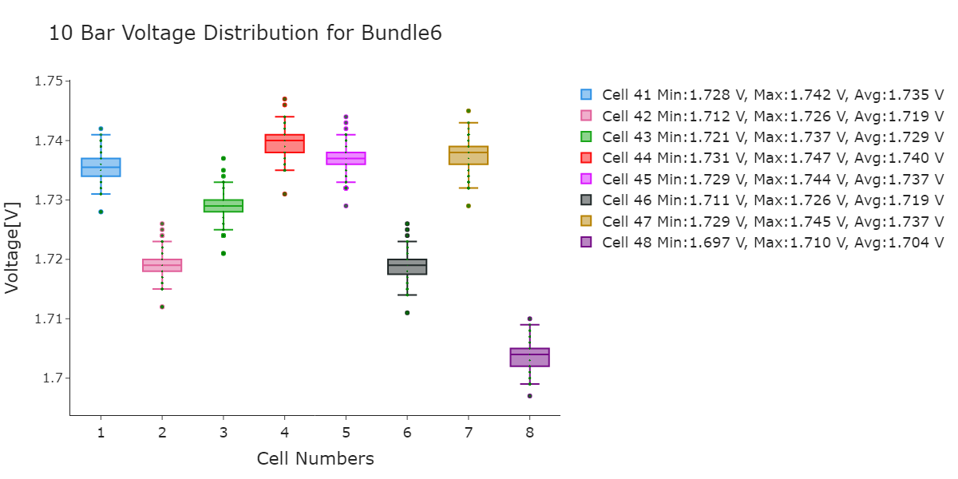

Slide 15
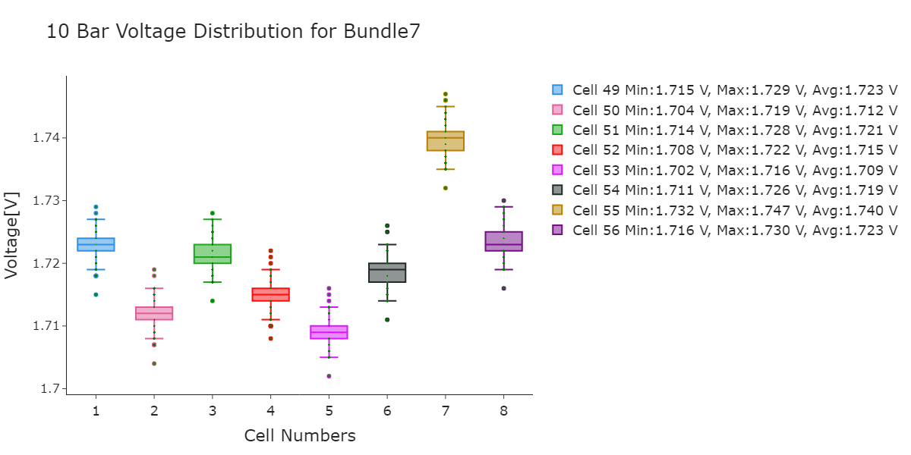

Slide 16
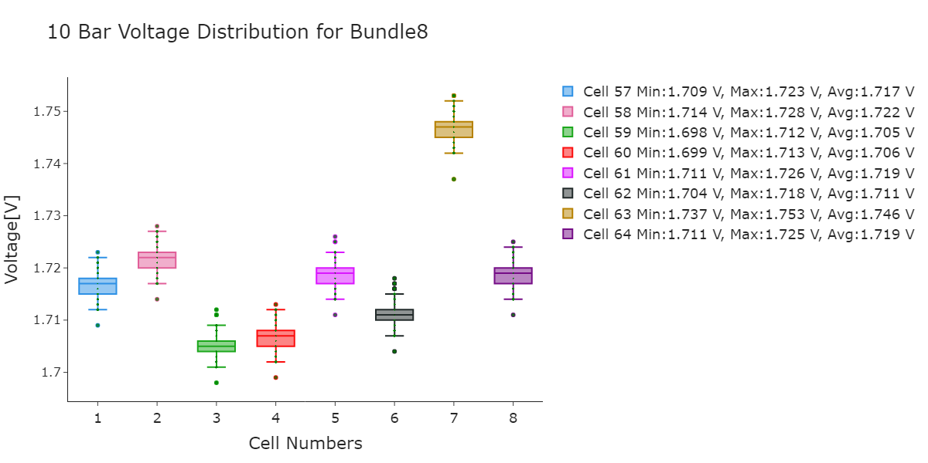

Slide 17
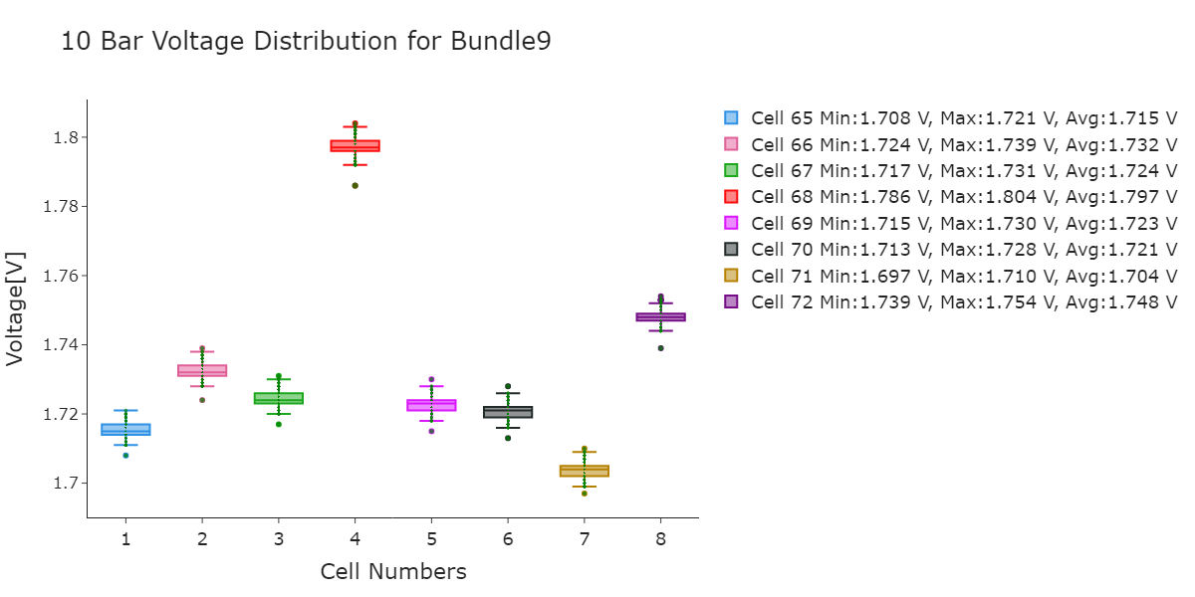

Slide 18
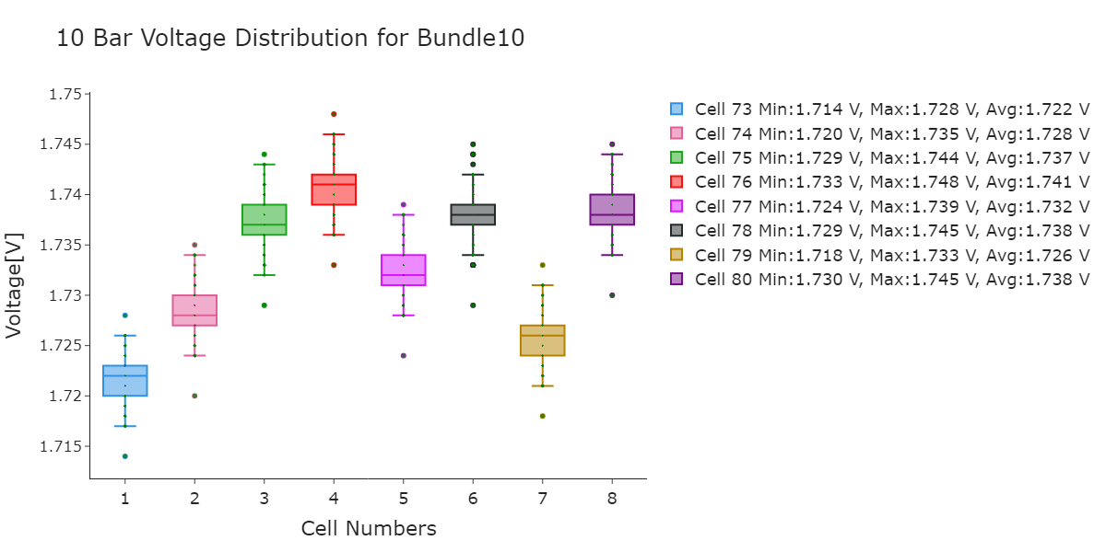

Slide 19
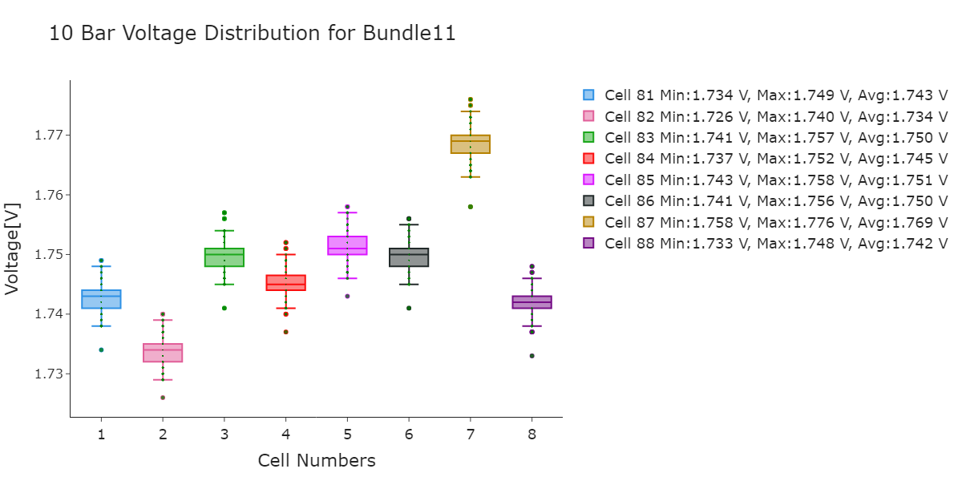

Slide 20
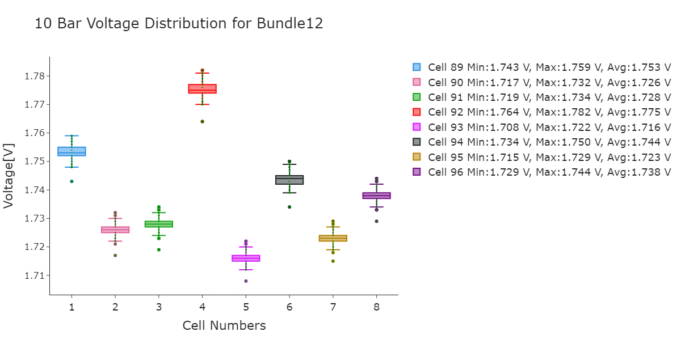

Slide 21
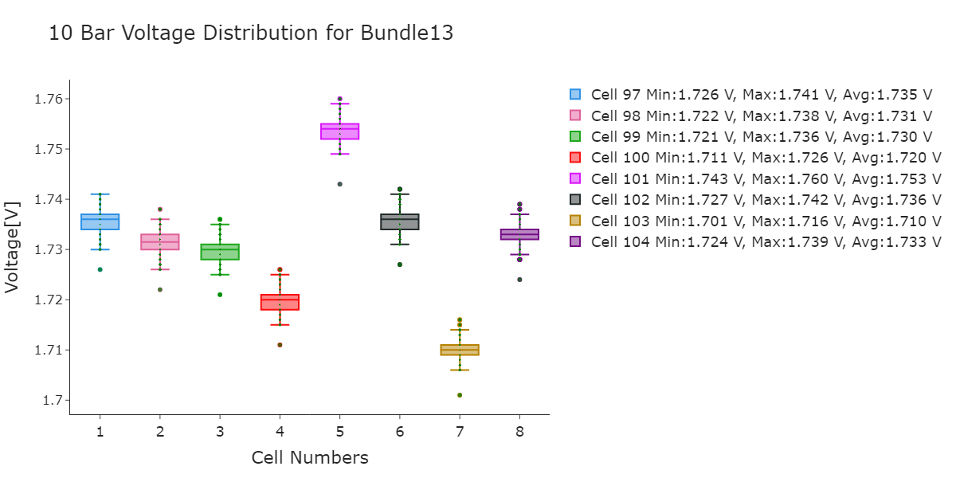

Slide 22
