Slide 1

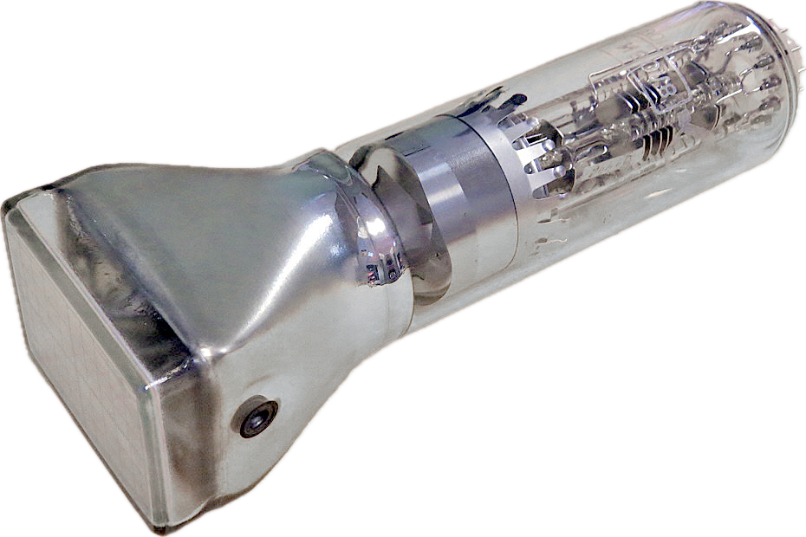

Computer Graphics
Sapandeep Singh Sandhu

Slide 2
Agenda
1. Introduction
Overview of computer graphics applications
2. Graphics Overview
Applications, Systems, Inputs
3. Techniques & Algorithms
Line Drawing, Polygon Filling, Clipping
4. Transformations & Viewing
2D/3D Transformations, Viewing Techniques
5. Advanced Topics
Surface Detection, Animation
6. Applications
Real-Time Graphics, Visualization

Slide 3
Computer Graphics Overview
Application Areas: Used in design, virtual reality, entertainment, and simulation.
Graphics Systems: Includes video-display devices, raster-scan systems, and graphics monitors.
Input Devices: Details various devices used for input in graphics system

Slide 4
Application Areas
Design: Computer-Aided Design (CAD) for engineering and architectural systems.
Virtual Reality: Creating immersive environments for simulation and training.
Entertainment: Used in the production of movies, video games, and visual effects.
Simulation: For training and educational purposes, e.g., simulating natural phenomena.

Slide 5
Graphics Systems
Video-Display Devices: Cathode-Ray Tubes (CRTs), modern LCDs, and projection systems.
Raster-Scan Systems: How the raster display processes images using pixel grids.
Graphics Monitors: Differentiating features like resolution, color depth, and refresh rate.
Work Stations: High-performance computers designed for complex graphics tasks.

Slide 6
Input Devices
Pointing Devices: Mice, graphic tablets with styluses, and touch screens.
Keyboards: Standard and specialized keyboards for input.
Scanners: For digitizing images and documents.
Motion Sensors: Used in virtual reality systems to track user movements.

Slide 7
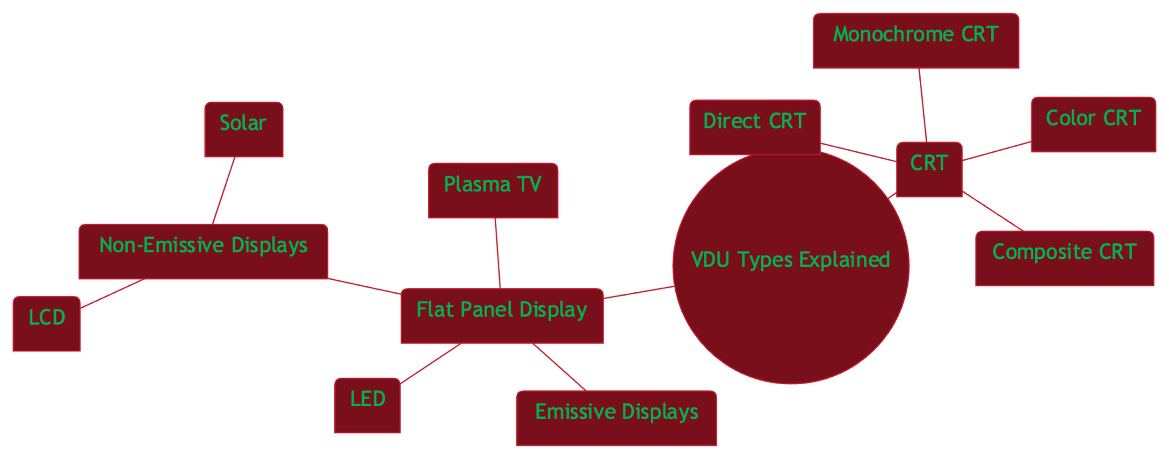

Slide 8
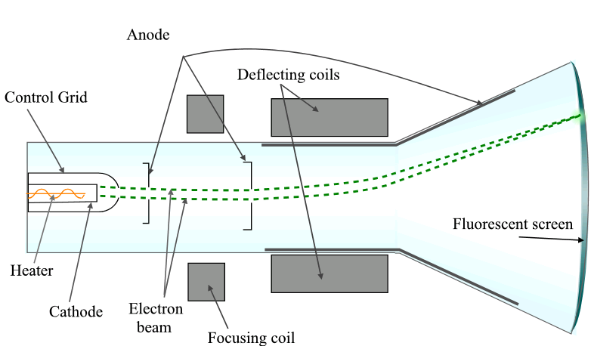
CRT

Slide 9
CRT Monitor Basics
Phosphor Dots: Emit light when electrons hit; in red, green, and blue for color representation.
Electron Beam: Generated by the electron gun, this stream of electrons is the "paintbrush" of the CRT display.

Slide 10
Electron Gun Assembly
Cathode: A heated filament emitting a stream of electrons within the vacuum tube.
Anode: The positive terminal that attracts the negative electrons towards the screen.

Slide 11
Deflection Plates
Horizontal Deflection Plate: Controls the left-right movement of the electron beam across the screen.
Determines the horizontal position of the electron impact on the phosphor screen.
Vertical Deflection Plate: Controls the up-down movement of the electron beam.
Determines the vertical position of the electron impact on the phosphor screen.

Slide 12
Image Creation Process
Raster Scanning: The electron beam moves left to right, top to bottom, illuminating phosphor dots to form an image.
Refresh Rate: The frequency at which the screen is redrawn; critical for image stability.

Slide 13
Beam Filtering Technologies
Shadow Mask: Precisely directs electrons through a perforated metal sheet to hit specific phosphor dots.
Aperture Grill: Utilizes vertical wires allowing more electron flow for a brighter image.
Slot Mask: Combines elements of both shadow mask and aperture grill for a unique display quality.

Slide 14
Impact on Display Quality
Deflection System: Determines the precision and accuracy of the electron beam placement, affecting image resolution and clarity.
Filtering Technology: Shapes the electron beam to enhance color purity and sharpness of the display.

Slide 15
Energy Conversion and Pixel Information in Frame Buffers
Gaussian Distribution Law:
Describes how electron beam energy is distributed across the screen.
The peak of the Gaussian curve represents the point of highest energy concentration where the beam strikes.

Slide 16
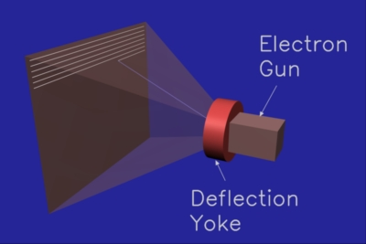

Slide 17
Understanding the Deflection Yoke in CRT Monitors
Primary Function: Directs the electron beam across the monitor's screen in a controlled and systematic manner.

Slide 18
Components and Operation
Composition: Consists of coils of wire, typically arranged horizontally and vertically around the neck of the CRT.
Magnetic Fields: When current passes through these coils, magnetic fields are created that deflect the electron beam.
Raster Scanning: The yoke adjusts the magnetic field to move the beam in a raster scan pattern, which is essential for forming images on the CRT display.

Slide 19
Deflection Yoke vs. Deflection Plates
Deflection Plates: Used in oscilloscopes and older CRT designs for beam steering.
Deflection Yoke: More common in modern CRTs for television and computer monitors, offering finer control and durability.

Slide 20
Implications on Image Quality
Precision: The accuracy of the deflection yoke determines the crispness and geometry of the displayed image.
Refresh Rate: The speed at which the yoke operates influences the monitor’s refresh rate and overall stability of the image.

Slide 21
Real-Life Example
CRT Television: Uses a deflection yoke to ensure that the electron beams for red, green, and blue phosphors align correctly to produce a clear color image.
Arcade Gaming Monitors: High precision yokes are used for the fast and accurate rendering required by arcade games.

Slide 22
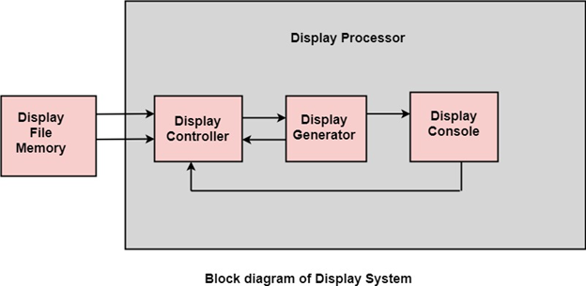
Block Diagram of Display System
Display File Memory
Display Controller
Display Generator
Display Console

Slide 23
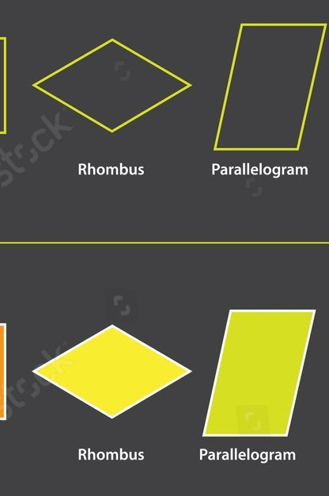
Display File Memory
Holds the frame buffer and the display list of output primitives.
Purpose: Generates the picture.
Function: Identifies and stores graphic entities.
Example: Holds vector lists for shapes to be drawn.
Numerical Data: Memory capacity often measured in kilobytes or megabytes.

Slide 24
Frame buffer
Q What is a Frame Buffer?
A memory area where pixel data for each frame is stored.
Directly correlates to the resolution and color depth of the display

Slide 25
Color Depth and Pixel Data:
Color Depth: Determines how many colors can be displayed.
Example: 24-bit color depth allows for 16,777,216 colors per pixel.
Calculation: Color Depth = Number of Bits per Pixel

Slide 26
Calculating Frame Buffer Size
Frame Buffer Size: Total memory needed to store a single frame.
Formula: Frame Buffer Size = Resolution x Color Depth per Pixel
Example: For a resolution of 1920x1080 (Full HD) and a 24-bit color depth:
Resolution: 1920 pixels (width) x 1080 pixels (height) = 2,073,600 pixels
Color Depth: 24 bits/pixel or 3 bytes/pixel
Frame Buffer Size: 2,073,600 pixels x 3 bytes/pixel = 6,220,800 bytes

Slide 27
Converting to Megabytes:
Since 1 MB = 220220 bytes = 1,048,576 bytes,
Frame Buffer Size in MB: 6,220,800 bytes / 1,048,576 bytes/MB ≈ 5.93 MB

Slide 28
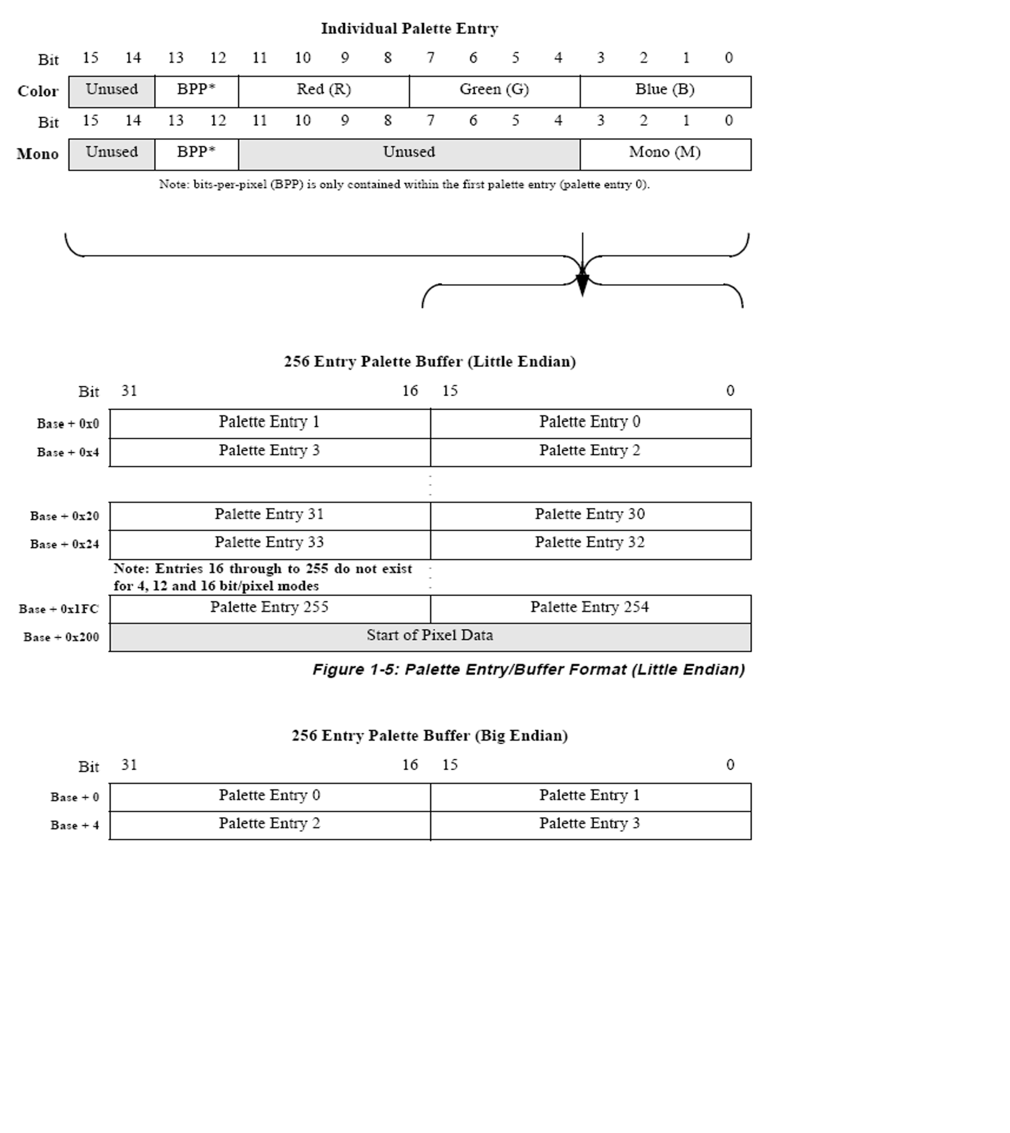

Slide 29
Real-Life Example
Scenario: A gaming console outputs to a Full HD TV with a 24-bit color depth.
For smooth gameplay, the console needs a frame buffer to handle the rapid refresh of images.
Required Memory: At least 5.93 MB per frame. For a double buffer (to prevent flicker), double this amount.

Slide 30
Relationship
The frame buffer needs to be large enough to hold the complete pixel data for the entire screen at the resolution and color depth specified.
For example, if a system has a color depth of 24 bits per pixel (standard for true color), it can display 16,777,216 different colors (2^24 color variations).
Each pixel's color is stored as a combination of red, green, and blue values, with 8 bits (or 1 byte) for each color in a 24-bit color depth system.

Slide 31
Relationship
The size of the frame buffer is directly proportional to both the resolution (the number of pixels) and the color depth (bits per pixel).
To calculate the frame buffer size, you multiply the total number of pixels (resolution) by the color depth (bits per pixel) and then convert bits to bytes (since memory is typically measured in bytes).
For instance:

Slide 32
Relationship
Resolution: 800 x 600 pixels
Color Depth: 24-bit (3 bytes per pixel)
Calculation:
Total pixels = 800 x 600 = 480,000 pixels
Total color information (in bytes) = 480,000 pixels x 3 bytes/pixel = 1,440,000 bytes
Frame Buffer Size = 1,440,000 bytes or approximately 1.37 megabytes

Slide 33
Frame buffer
The size of the frame buffer determines how much memory is required to display a single frame.
As the resolution or color depth increases, more memory is needed to store the pixel data.
This relationship is key for designing systems with sufficient memory for graphics-intensive applications.

Slide 34
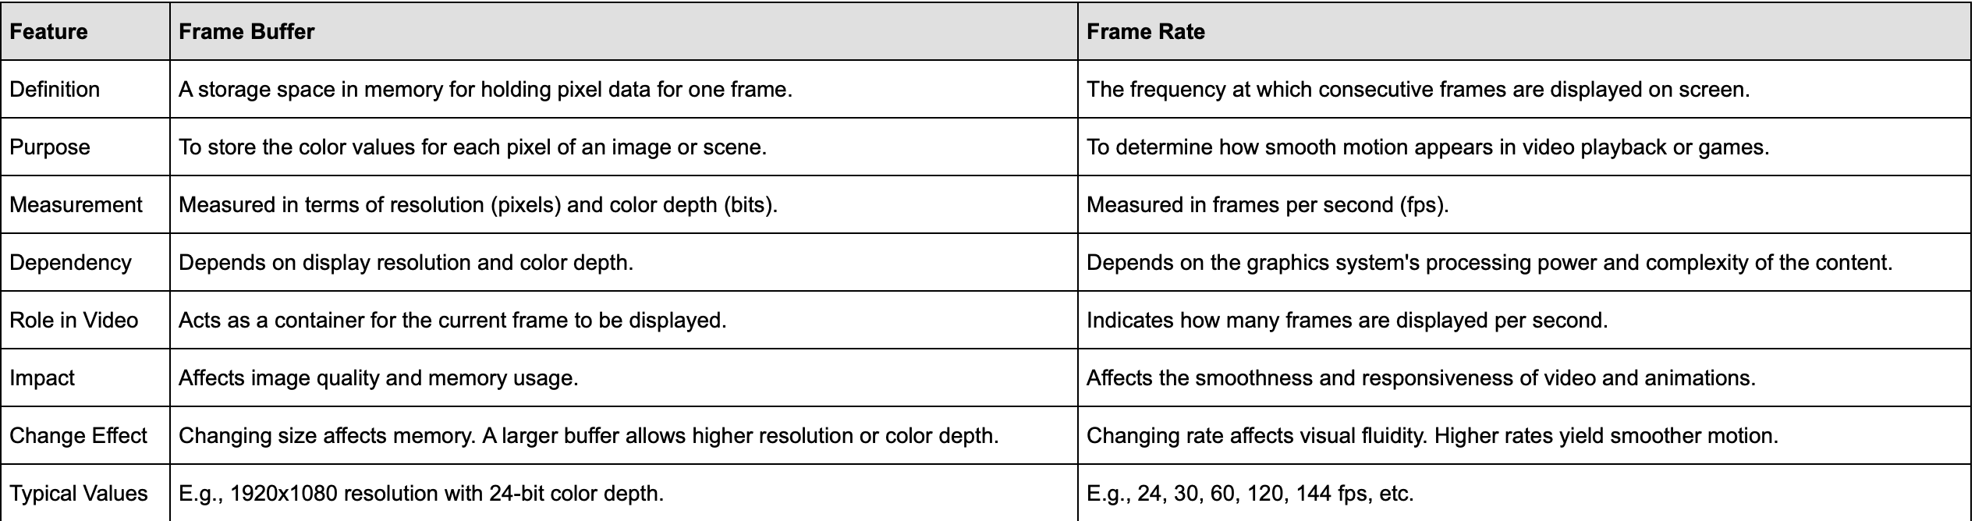

Slide 35
Display Controller
Manages the flow of data from the display file memory to the display generator.
Handles synchronization and refresh operations.
Responsibilities:
Handles interrupts and maintains precise timing.
Interprets instructions for display operations.

Slide 36
Display Generator
Converts digital data from the display file memory into an analog signal.
Responsible for creating the visual representation on the screen.
Uses:
Character generation.
Curve rendering for smooth graphics.

Slide 37
Display Console
The user interface for interacting with the display system.
Includes tools for viewing and manipulating the display output.
Composition: Contains CRT, Light Pen, Keyboard, and the deflection system.
Interactivity: Enables user interaction with the graphical display.

Slide 38
Central Processing
Display Processor
Processes instructions from the display file memory.
Orchestrates the overall functioning of the display system components.
Flow of Information
Data flows from the display file memory through the display controller and generator before being output on the display console.
The display processor guides this flow and ensures proper rendering and display updates.

Slide 39
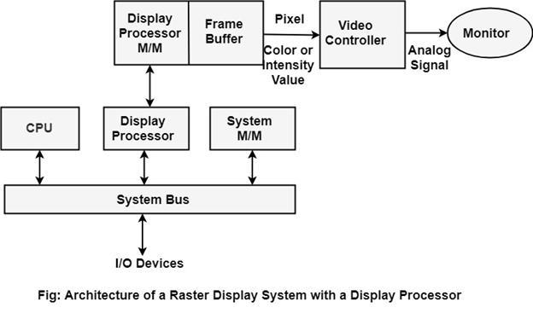
Architecture of a Raster Display System

Slide 40
Architecture of a Raster Display System
1. Central Processing Unit (CPU)
Heart of the system, processes user commands and performs operations.
2. System Bus
Facilitates data transfer between the CPU, display processor, system memory, and I/O devices.
3. Display Processor
Dedicated processor for graphics operations, relieving the CPU of these tasks.
Interprets display commands and processes graphical data.
4. System Memory (M/M)
Stores active programs, including the display processor's instructions.

Slide 41
Architecture of a Raster Display System
5. Display Processor Memory (M/M)
Dedicated memory for the display processor to store graphics instructions and attributes.
6. Frame Buffer
Memory space where pixel values are stored.
Each location corresponds to a pixel's color or intensity value on the screen.
7. Video Controller
Reads pixel values from the frame buffer.
Converts digital values into an analog signal suitable for the monitor.

Slide 42
Architecture of a Raster Display System
8. Monitor
Displays the final output image based on the analog signals received from the video controller.
9. I/O Devices
Input and Output devices that allow user interaction with the system.

Slide 43
Key Techniques and Algorithms
Line Drawing Algorithms: Bresenham’s line algorithm and DDA algorithm for raster devices.
Polygon Filling: Scan-line polygon fill algorithm, boundary-fill, and flood-fill algorithms.
Clipping Algorithms: Cohen-Sutherland and Liang-Barsky line clipping algorithms, Sutherland-Hodgman polygon clipping.

Slide 44
Line Drawing Algorithms:
Bresenham’s Line Algorithm: Efficient method using integer arithmetic for line drawing.
DDA (Digital Differential Analyzer): Interpolates variables between start and end points

Slide 45
Polygon Filling
Scan-line Polygon Fill Algorithm: Determines intersections of scan lines with polygon edges.
Boundary-Fill Algorithm: Fills bounded areas recursively, suitable for simple shapes.
Flood-Fill Algorithm: Similar to boundary-fill but used for filling areas with specified colors.

Slide 46
Clipping Algorithms
Cohen-Sutherland Algorithm: Optimized for line clipping using region codes.
Liang-Barsky Algorithm: More efficient using parameterized line clipping.
Sutherland-Hodgman Algorithm: Clipping polygon edges against a clipping window.

Slide 47
Transformations and Viewing
2D Transformations: Translation, scaling, rotation, reflection, and shear transformations.
3D Transformations: Detailed methods for translating, rotating, and scaling in three dimensions.
Viewing Coordinates: Explains the viewing pipeline and coordinate transformations.

Slide 48
2D Transformations
Translation, Scaling, Rotation: Basic transformations applied to objects in 2D space.
Reflection and Shear Transformations: Less common but useful for specific graphical effects.

Slide 49
3D Transformations
Extending 2D Transformations: Including z-coordinates for spatial transformations.
Complex Rotations and Scalings: Applying transformations around any axis in 3D space

Slide 50
Viewing Coordinates
Viewing Pipeline: How graphics systems convert world coordinates to device coordinates.
Projection Techniques: Parallel and perspective projection methods for rendering 3D objects on 2D screens.

Slide 51
Advanced Topics
Surface Detection: Methods for visible surface detection including depth-buffer, scan-line, and depth sorting.
Computer Animation: Techniques for designing animation sequences and motion specifications.

Slide 52
Surface Detection:
Visible Surface Detection: Algorithms to determine which surfaces are visible to the viewer.
Methods: Depth-buffer, scan-line, and depth sorting techniques.

Slide 53
Computer Animation
Keyframe Systems: Define key points of motion which are then automatically interpolated.
Motion Specifications: Detailed scripting of animation sequences for characters and objects.

Slide 54
Practical Applications
Real-Time Graphics: Used in simulations and training environments like those for pilots and ship captains.
Visualization: Helps in understanding complex data through visual representation

Slide 55
R and v
Real-Time Graphics:
Simulations for Training: E.g., flight simulators and military training.
Interactive Applications: Video games and real-time data visualization.
Visualization:
Scientific and Medical: Complex data rendered for easier analysis and understanding.
Business Analytics: Visualizing large datasets to discern patterns and trends.

