Slide 1
Epsilon-greedy → Boltzmann
Clean summary of the reinforcement-learning project
Filip Baciak, Stanisław Pańkowski
01

Slide 2
Project in one sentence
Train DQN agents with different exploration strategies.
Compare simple epsilon-greedy exploration against Boltzmann-based variants.
Use CartPole, LunarLander, and Breakout as increasingly harder benchmarks.
02

Slide 3
Core idea
Early training: Q-values are noisy, so random exploration is safer.
Later training: Q-values are more meaningful, so softmax sampling can be more selective.
The project tests whether a gradual transition improves learning.
03

Slide 4
How the exploration approaches differ
All methods choose actions from Q-values, but they differ in how much they trust those Q-values during training.
Approach
Early training
Later training
Main idea
epsilon-greedy
mostly random / robust
mostly greedy
Simple baseline: ignores Q-value scale, but exploration is coarse.
Boltzmann
softmax over noisy Q-values
softmax over learned Q-values
Samples better actions more often, but depends strongly on temperature.
annealed ε → B
starts like ε-greedy
gradually becomes Boltzmann
Project’s core idea: random first, value-aware later.
top-k Boltzmann
ε-style exploration
softmax only among top actions
Avoids spending probability on clearly bad actions.
uncertainty switch
waits for clearer preferences
switches when Q entropy drops
Uses confidence-like signal instead of only a fixed schedule.
Takeaway: the hybrid methods try to delay Q-value-based exploration until Q-values are more meaningful.

Slide 5
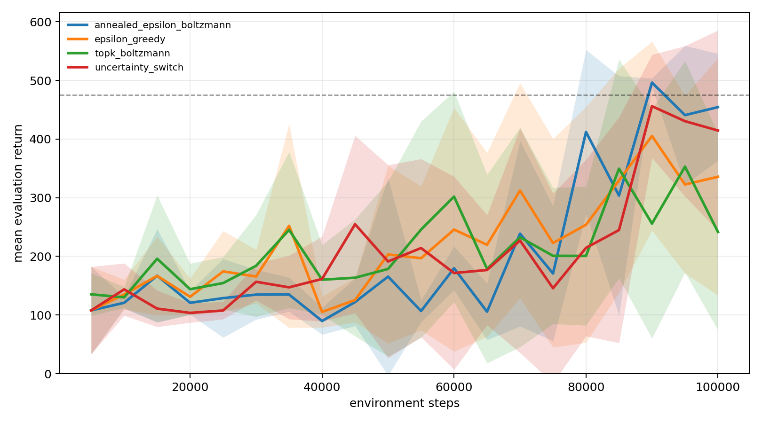
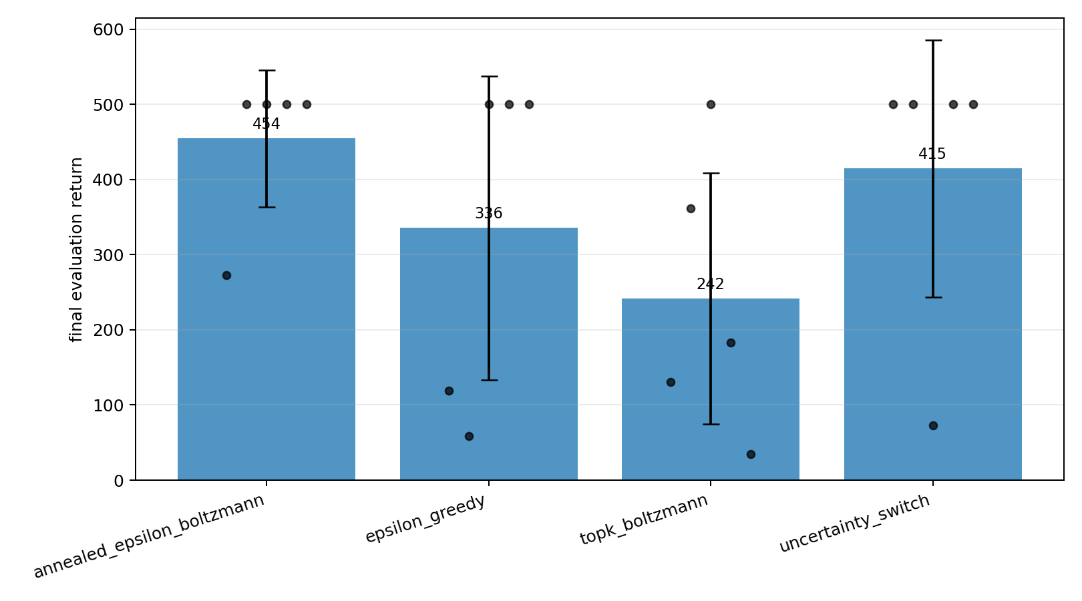
CartPole results
Learning curve
Final return
Mean learning curves on the left; final returns on the right.
04

Slide 6
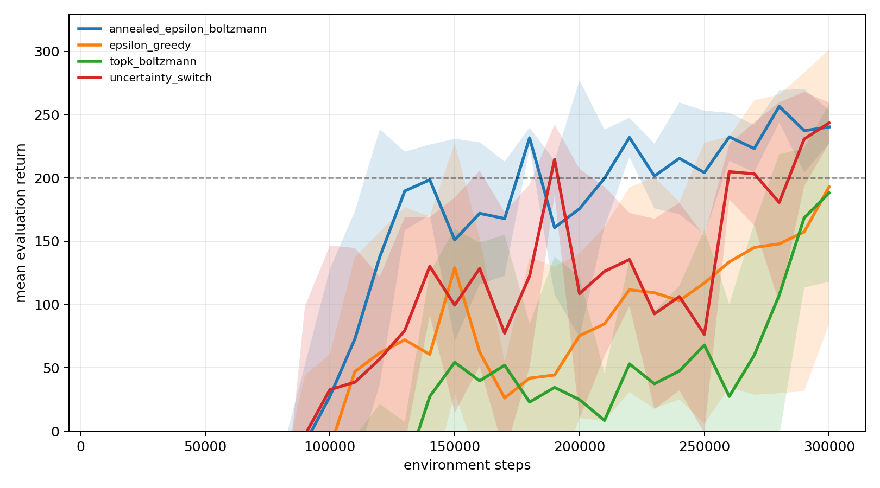
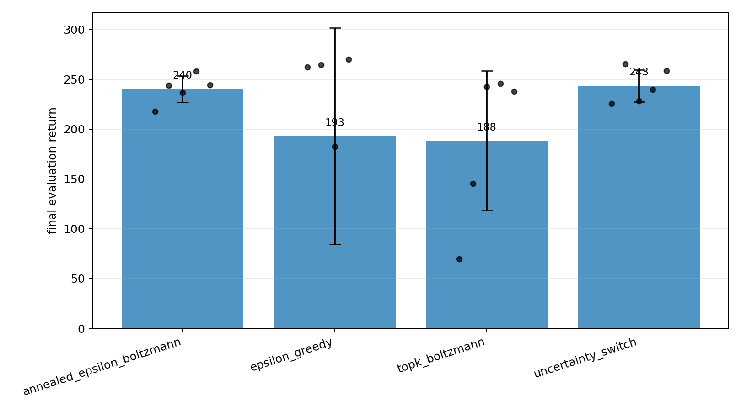
LunarLander results
Learning curve
Final return
Mean learning curves on the left; final returns on the right.
05

Slide 7
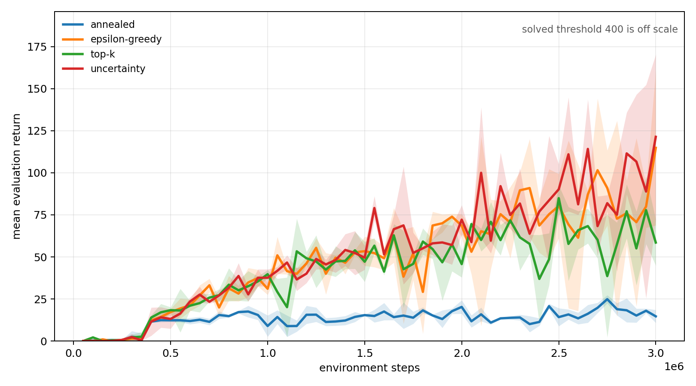
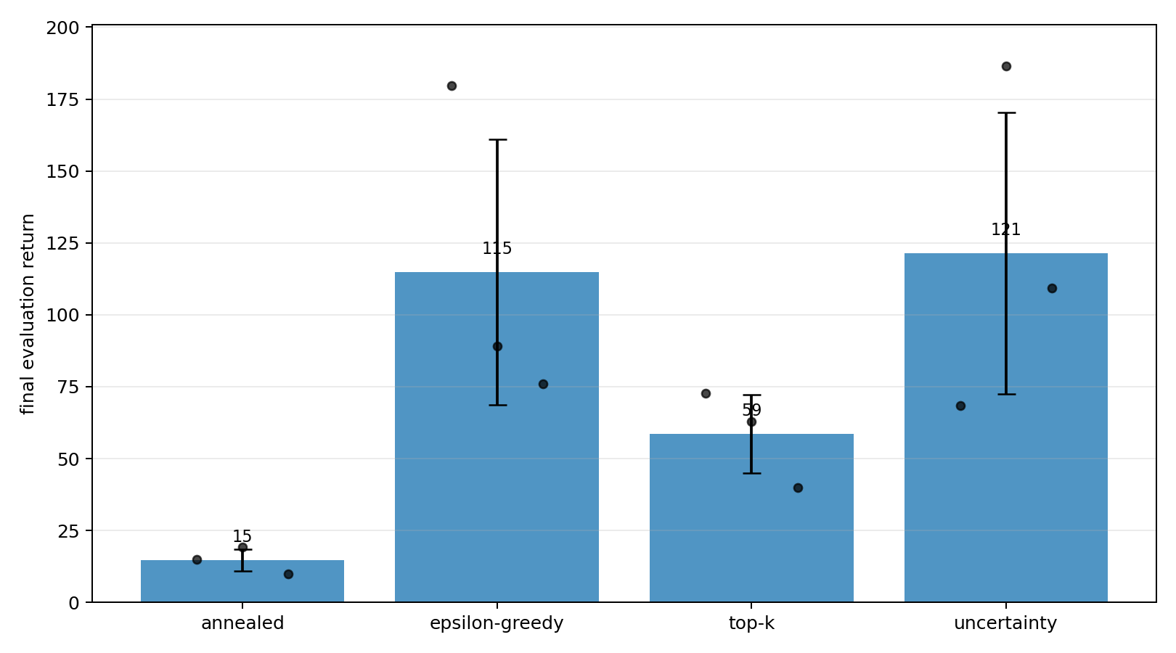
Breakout results
Learning curve
Final return
Mean learning curves on the left; final returns on the right.
06

Slide 8
Takeaway
Hybrid exploration is a reasonable idea, but sensitivity to schedules remains important.
CartPole and LunarLander show the framework works on small control tasks.
Breakout needs longer runs and more seeds before strong conclusions.
07

