Slide 1


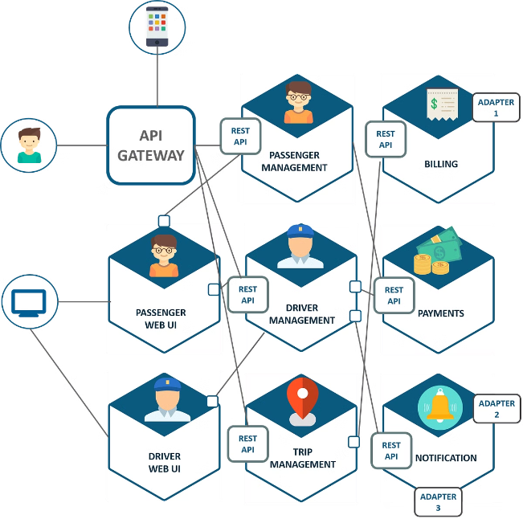
Introduction to Microservices Architecture
Microservices architecture has emerged as a popular approach to building complex, scalable, and resilient software systems. By breaking down monolithic applications into smaller, independent services, organizations can benefit from increased agility, improved scalability, and better fault isolation. In this presentation, we will explore the key characteristics of microservices, the supporting infrastructure, communication patterns, common challenges and solutions, as well as real-world case studies. Whether you're a software developer, architect, or IT professional, understanding the fundamentals of microservices can help you navigate the evolving landscape of modern application development.
by Mani Chandra Saparay

Slide 2
Key Characteristics of Microservices
Independent Deployment
Scalability
Decentralized Data Management
Microservices can be scaled individually based on demand, enabling organizations to allocate resources more efficiently and handle high-traffic scenarios more effectively.
Microservices are designed to be independently deployable, allowing teams to update and release individual services without affecting the entire application. This promotes faster delivery, reduced risk, and better scalability.
Each microservice is responsible for its own data storage and management, promoting data autonomy and avoiding the complexities of a shared database.

Slide 3

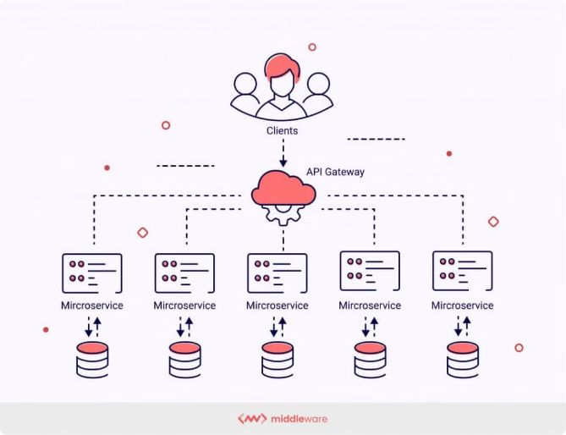
Microservices Infrastructure
Containers and Orchestration
Microservices are often deployed using containerization technologies like Docker, which provide a consistent and portable runtime environment. Container orchestration platforms, such as Kubernetes, help manage the deployment, scaling, and networking of these containers.
Load Balancing
To handle increased traffic and provide high availability, microservices architectures often incorporate load balancing solutions. These distribute incoming requests across multiple instances of a service, ensuring efficient resource utilization and enhanced resilience.
1
2
3
Service Discovery
Microservices need a way to find and communicate with each other, which is achieved through service discovery mechanisms. These allow services to register their location and availability, enabling other services to locate and interact with them.

Slide 4
Communication between Microservices
Synchronous Communication
Asynchronous Communication
Polyglot Programming
Microservices enable the use of different programming languages and technologies for each service, allowing teams to choose the best-fit tool for the job and promoting technological diversity within the architecture.
Microservices can communicate synchronously using protocols like REST. This approach is suitable for request-response interactions, where one service calls another and waits for a response before proceeding.
Alternatively, microservices can communicate asynchronously using message queues or event-driven architectures. This decouples the services, allowing them to work independently and handle heavy workloads more efficiently.

Slide 5
Challenges and Solutions in Microservices
1
Data Consistency and Management
2
Monitoring and Logging
3
Security Concerns
Microservices architectures introduce new security considerations, such as authentication, authorization, and encryption. Techniques like OAuth, JWT, and secure communication protocols can help address these challenges.
Maintaining data consistency across distributed microservices can be challenging. Solutions include using eventual consistency and implementing patterns like the Saga pattern to ensure data integrity.
With multiple independent services, effective monitoring and logging become crucial. Centralized tools like the ELK stack (Elasticsearch, Logstash, Kibana) and Prometheus can help provide visibility into the overall system health.

Slide 6
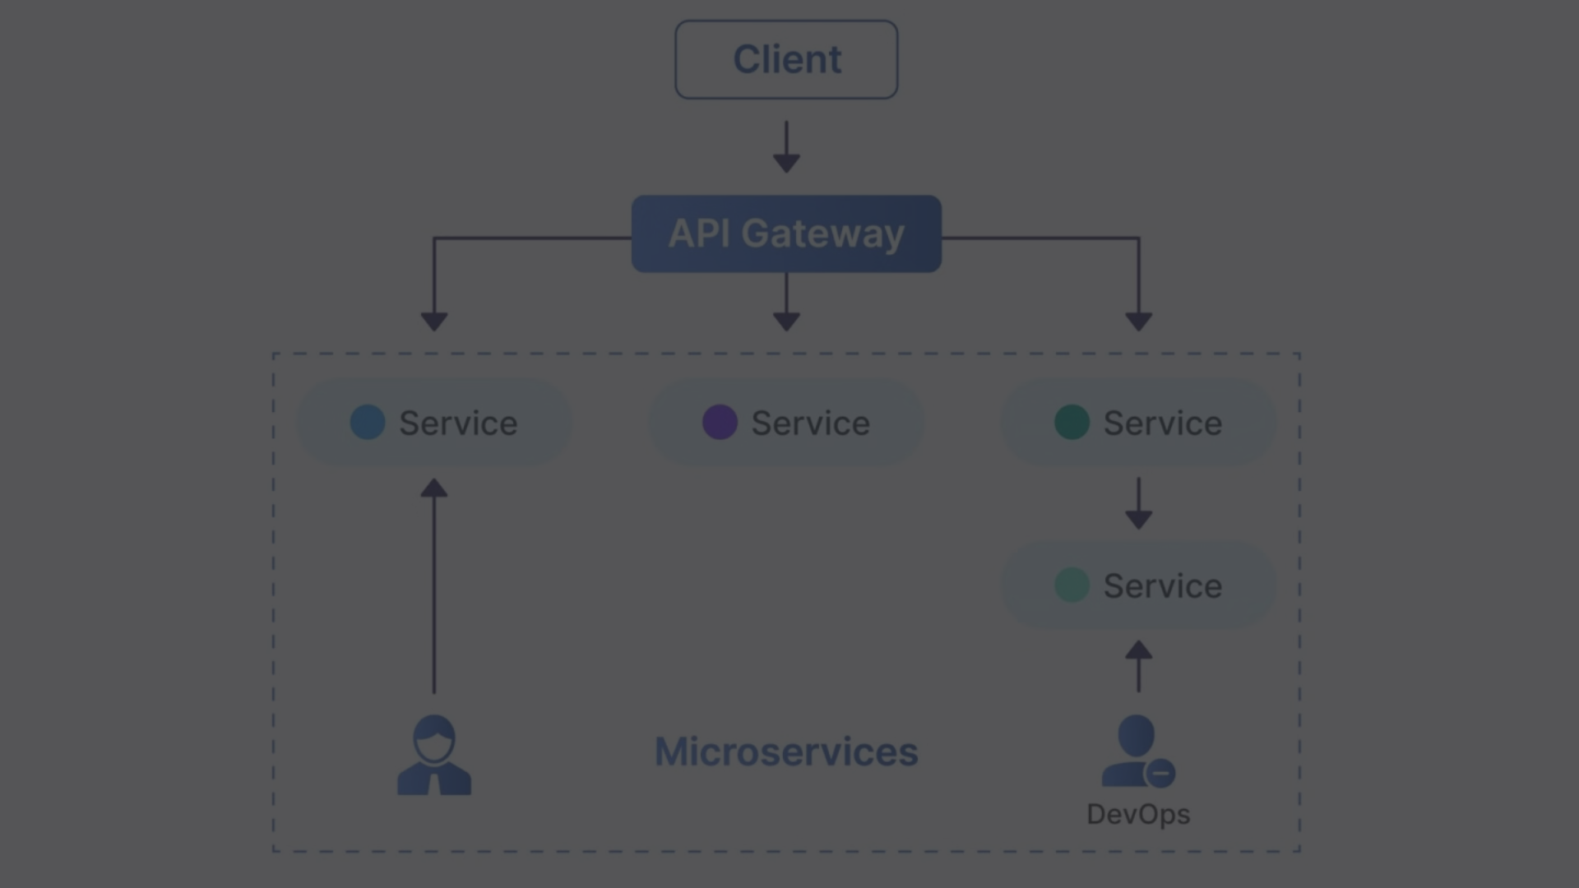
Case Studies and Real-World Examples
Netflix
Amazon
Uber
Netflix has been a pioneer in the adoption of microservices, breaking down its monolithic architecture into hundreds of independent services. This allowed Netflix to scale its platform, improve fault tolerance, and release new features rapidly.
Amazon's transition to a microservices-based architecture enabled it to handle the enormous scale of its e-commerce platform, allowing the company to quickly adapt to changing customer needs and business requirements.
Uber, the ride-sharing platform, leveraged microservices to build a highly scalable and resilient architecture that could handle surges in demand, especially during peak hours and major events.

Slide 7


Future Trends in Microservices
Serverless Architectures
Service Meshes
The rise of serverless computing, where infrastructure management is abstracted away, is expected to further enhance the development and deployment of microservices, enabling more efficient scaling and reduced operational overhead.
Service meshes, like Istio and Linkerd, are emerging as a way to manage the complexity of microservices communication, providing features like service discovery, load balancing, and advanced traffic management.

Slide 8


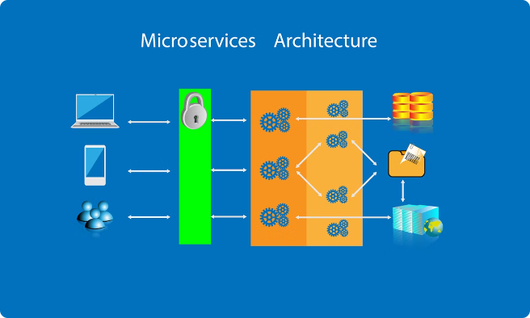


Microservices: The Future of Application Architecture
Agility
Microservices enable teams to develop, deploy, and scale individual services independently, fostering faster innovation and more responsive application development.
Resilience
By isolating failures within individual services, microservices architectures promote overall system resilience, reducing the impact of failures and improving availability.
Scalability
Microservices can be scaled independently, allowing organizations to allocate resources more efficiently and handle increased traffic or user demands without impacting the entire application.

Slide 9
Benefits of Adopting Microservices
Adaptability
Polyglot Development
Reduced Complexity
Microservices enable organizations to quickly adapt to changing business requirements, market conditions, and technological advancements, providing a more agile and responsive application architecture.
Microservices allow developers to choose the most appropriate programming language, framework, or technology for each service, promoting innovation and leveraging the strengths of different tools and techniques.
By breaking down monolithic applications into smaller, independent services, microservices architectures help manage complexity, making it easier to understand, maintain, and evolve the overall system.

Slide 10


Conclusion: The Rise of Microservices
In conclusion, microservices architecture has emerged as a powerful approach to building modern, scalable, and resilient software systems. By emphasizing independent deployment, scalability, and decentralized data management, microservices offer organizations a range of benefits, including increased agility, improved fault tolerance, and better technology diversity. As the industry continues to evolve, the adoption of microservices is expected to grow, with emerging trends like serverless computing and service meshes further enhancing the capabilities of this architectural style. Whether you're a software developer, architect, or IT professional, understanding the fundamentals of microservices can help you navigate the future of application development and stay ahead of the curve.

