Slide 1
Hepa-Twin
A digital twin for early warning of decompensation in liver cirrhosis
Digital Twin Challenge 2026 | Happiest Health
Saparya Jagannath | Bharati Vidyapeeth’s College of Engineering | Solo participant
All data synthetic. Decision support only. Not for clinical use.

Slide 2
The problem: patients get worse between visits
Three challenges
Why it is dangerous
Cirrhosis is common in India: alcohol, fatty liver (MASLD), hepatitis B and C
Many patients are diagnosed late
Many live far from a liver specialist and visit only every month or two
Between visits, the doctor knows nothing
A stable patient can suddenly decompensate:
confusion, fluid in the belly, bleeding, serious infection, emergency admission
Our question: can we spot warning signs days earlier, using data a phone or fitness band already records?

Slide 3
Warning signs a wearable can see
1. Flipped sleep cycle
2. Falling activity
Awake at night, sleepy by day: early hepatic encephalopathy
Fewer steps as the patient gets weaker
3. Rising resting heart rate
4. Falling HRV
Infection, bleeding or dehydration
Body's stress control weakening
Beta-blockers keep the heart rate low and hide signal 3, so the model must know who takes them.

Slide 4
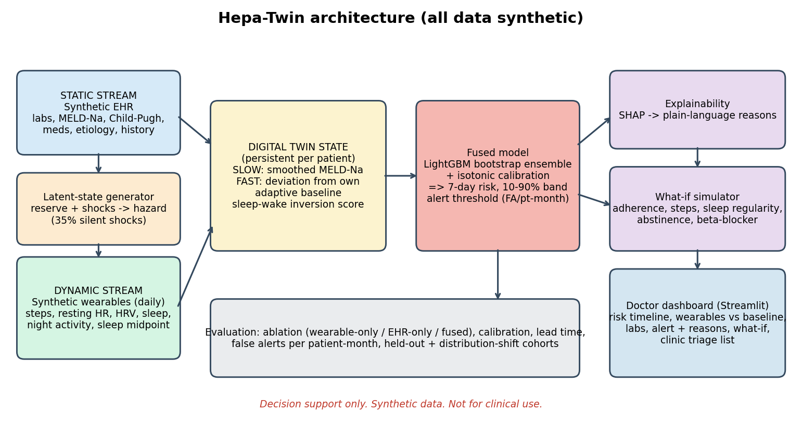
The idea: a digital twin of the patient
Slow data: medical record, labs, medicines, genetic marker
Fast data: daily steps, heart rate, HRV, sleep
Twin: slow severity plus fast deviation from the patient's OWN normal
Output: 7-day risk, reasons, what-if, dashboard

Slide 5
The data: all synthetic, built honestly
What I generated
How events happen
Realistic mess
1,200 patients, 150 days each
700 train, 250 test, 250 harder shift group
No Synthea cirrhosis module and no open cirrhosis + wearable dataset, so a custom generator
Hidden liver reserve declines slowly
Random shocks build over 3-10 days
Events are drawn by chance from hidden state, not copied from wearables
35% of shocks are silent
Days the band is not worn
Weekend dips, hospital gaps
Beta-blocker effect
Shift group: more noise, 50% silent shocks
No real patient data is used anywhere (DPDP Act and HIPAA aware).

Slide 6
How the twin and features work
Twin state
87 features, one question
Learns each patient's normal in the first 7 days
Updates that normal slowly, and only on normal days, so a decline is not absorbed
Fast part: smoothed deviation from own normal
Slow part: smoothed MELD-Na severity
59 wearable features: averages, trends, deviation, sleep-wake inversion score
28 record features: labs, medicines, history, genetic marker
Question: will an event happen in the next 7 days?
The 7 days after an event are excluded (hospital stay)

Slide 7
The model: fused, calibrated, explainable
Prediction
Explain and simulate
LightGBM, team of 6 models
Split by patient, never by row
Calibrated: 30% risk means about 30%
Disagreement between models gives the uncertainty band
Alerts tuned for at most 1 false alert per patient-month
SHAP converted to plain-language reasons
What-if: medicine adherence, steps, sleep regularity, alcohol, beta-blocker
What-if shows learned patterns, not proof of cause

Slide 8
Results
Model | AUROC test | AUPRC test | AUROC shift
Wearable-only | 0.724 | 0.205 | 0.657
EHR-only | 0.746 | 0.206 | 0.717
Fused (EHR + wearable) | 0.776 | 0.263 | 0.717
0.78
64%
AUROC, final model
events caught in advance
4 days
0.65
median warning
false alerts per patient-month
Fusing both streams beats either alone on the main test.
Harder shift group: fused only ties EHR-only (0.717); false alerts rise to 1.83 per patient-month
About a third of events missed, partly by design (silent shocks)
Plain accuracy not reported: events are rare (about 7% of days)

Slide 9
Live demo: what the doctor sees
1. Clinic overview
2. Patient twin
3. What-if and triage
Alerts today, highest risk, average risk
Needs-attention cards: red, amber, green
30-day trend and new alerts
Day slider moves time
Risk timeline with uncertainty band
Wearables vs own baseline
Alert with plain-language reasons
Reveal ground truth toggle
Sliders re-score the patient instantly
Triage list sorted by risk: who to call first
About page lists limitations

Slide 10
Limitations, next steps
Limitations
Next steps
All data synthetic: method shown, not clinically validated
Circularity risk reduced, not removed
Medical constants are assumptions
What-if is association; real-time is a replay
Test on real anonymised data
Re-tune alerts per population
Review with liver specialists
Live wearable feeds, sleep stages
Hepa-Twin: slow hospital data + fast wearable data = a personal twin that warns a week ahead, explains why, and lets the doctor test what-ifs.

Slide 11
Thank You

