Slide 1



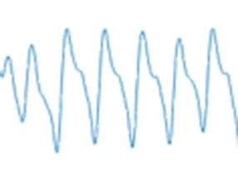

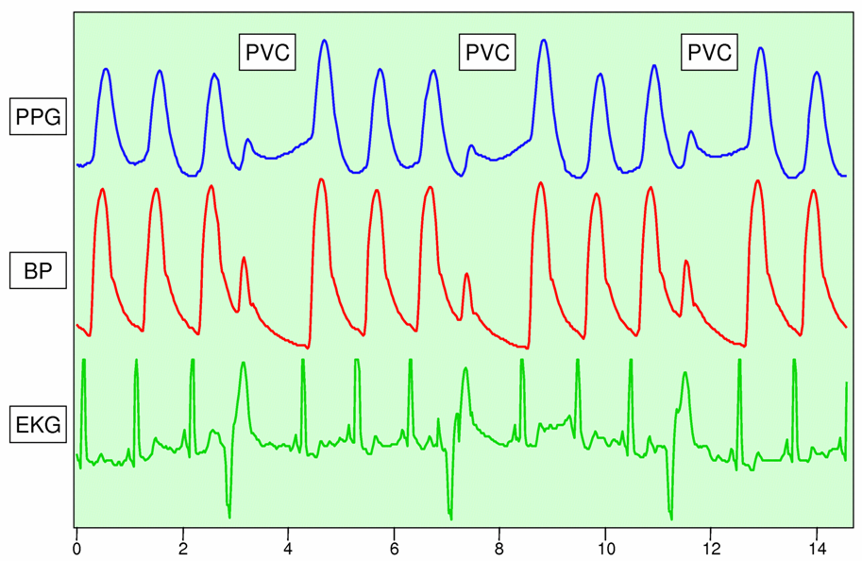
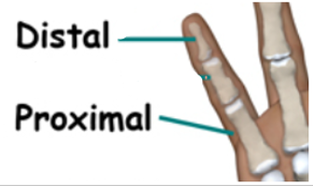
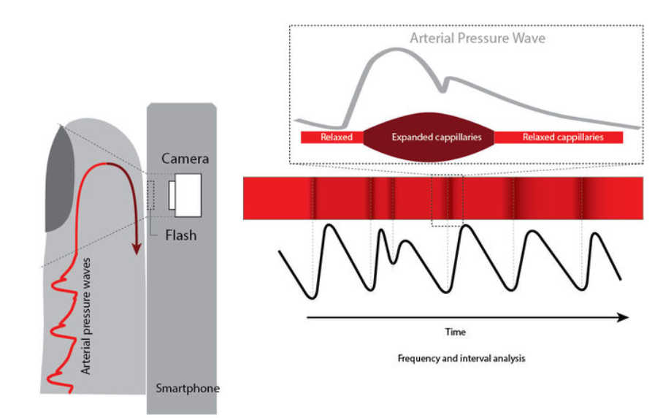
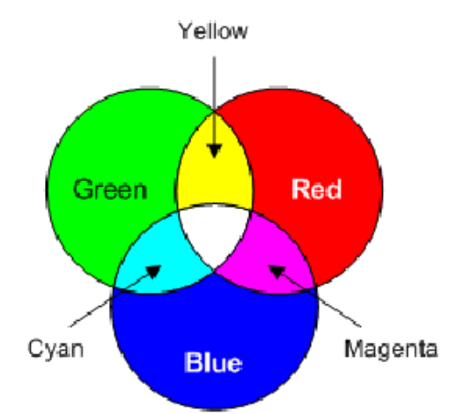
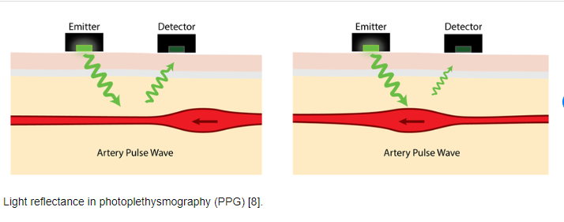
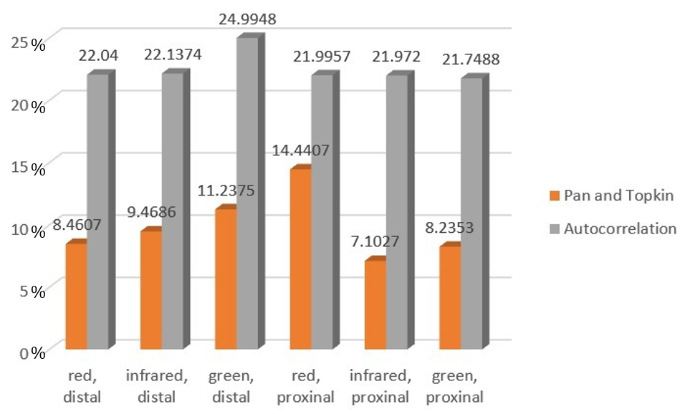
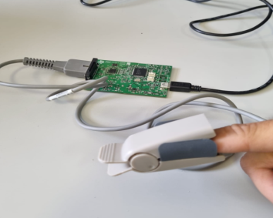
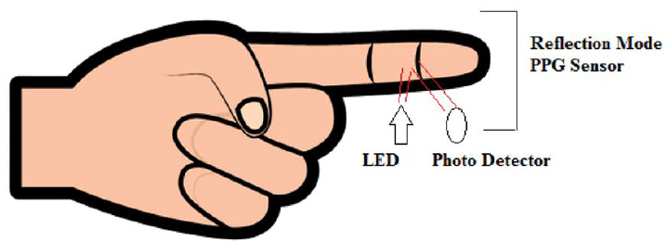
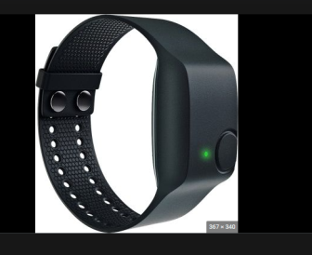
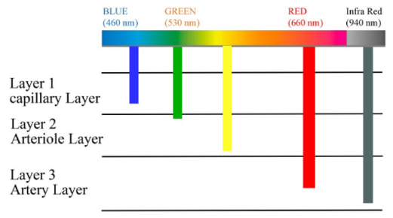
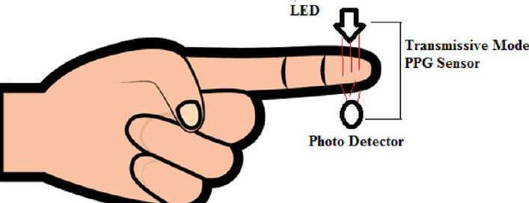
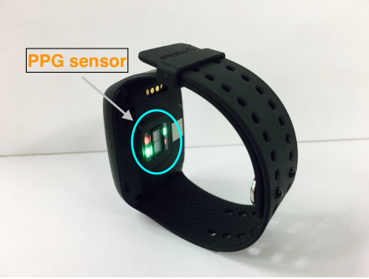
PPG Signal Acquisition and Analysis
Hassan Khalil and Sapir Avidan, Supervised by Hadas Ofir
Introduction
Algorithms for heartbeat extraction
Databases
The PPG signal (PhotoPlethysmoGram) is a sample of the change in blood volume for a certain time.
The technology for acquiring a PPG signal is relatively cheap, non-intrusive, which can be extracted from many parameters on the state of the body
We focused on extracting a heartbeat from the signal
Algorithm Pan and Tompkins
Troika database
Resample
BPF
abs
A database gives us two PPG signals and a reference signal for 8 participants
Each participant performs a variable sports activity (rest, walking and running) at fixed intervals
Additional information we receive an ECG signal and three accelerometers
Window integration
LPF
Peak Detection
Algorithm Autocorrelation
HR
Pulse Transit Time PPG Dataset
The database from the physionet website
The database has samples from 22 different people
Each person has 3 data files for different physical activity (rest, walking and running)
Each file has 3 signals in different colors measured from the proximal finger
And each file has 3 signals in different colors measured from distal finger
and three accelerometers for each finger
BPF
Autocorrelation
Select first peak
Algorithm Flip
HR
PPG signal compared to blood pressure and ECG
BPF
Rotates X axis
Goals
Results
study the PPG signals
find different methods for acquiring
find different ways to extract information
Find existing databases and create our own in addition
for the purpose of building a lab experiment
Rotates X axis
Find peak
Average peak diff
Phone: the signals with high background noise, although in red color we can see a success in reaching the expected heart rate
Analog Evaluation module: We get a clean signal through we were able to extract the expected pulse, although we do not have a reference signal
E4 wristband: We received a clean signal which we were able to extract the expected pulse, in addition to a reference signal
Troika database: the algorithms fail when there is a large change in heart rate, and only the Autocorrelation algorithm succeeds in extracting a heart rate when the heart rate is high
Pulse Transit Time PPG Dataset: the distal part gives a cleaner signal, in addition it gives us a conclusion that Pan and Tompkins is more effective, and does not give us a conclusion regarding the measured color
External Algorithm
HR
External algorithm
Peak for HR
Challenges
HR
Purchase methods
There are many methods and different ways to perform the required action
The heart rate is not really cyclic
The frequency of the heartbeat is in the frequency range of the acceleration noises
Phone
The acquisition method is with the phone camera and the phone flashlight
The acquisition method is by a Reflection mode
The data is a video that consists of frames each frame consists of tree primary colors
We analyze each color by average each color frame to a single number to get a vector of ppg in any color
Signal acquisition
The hemoglobin in the blood absorbs the light projected on it, therefore the change in blood volume creates a change in the light absorbed by the receiver
Analog Evaluation module
The acquisition method is by a Transmissive mode
This method is preferred in hospitals
We get two PPG signals one in red and the other in infrared
Reflection mode: sensor and LED are both placed on the same side of the finger to detect the transmitted light
Conclusions
Using the TROIKA database, we concluded that our algorithms are ineffective when there are many measurement errors
The cheapest option is the use of Analog Evaluation Module; however, it doesn’t give us reference signal.
the use of red and infrared light is more effective for extracting a pulse
We found that Pan and Tompkins and Autocorrelation algorithms are more efficient, moreover Pan and Tompkins algorithm has smaller measurement errors
E4 wristband
Transmissive mode: sensor and LED face each other with a layer of tissues between them
The acquisition method is by a Reflection mode
This method is generally preferred for sporting activities
We get one PPG signal and reference signal
.
October 2022

