Slide 1
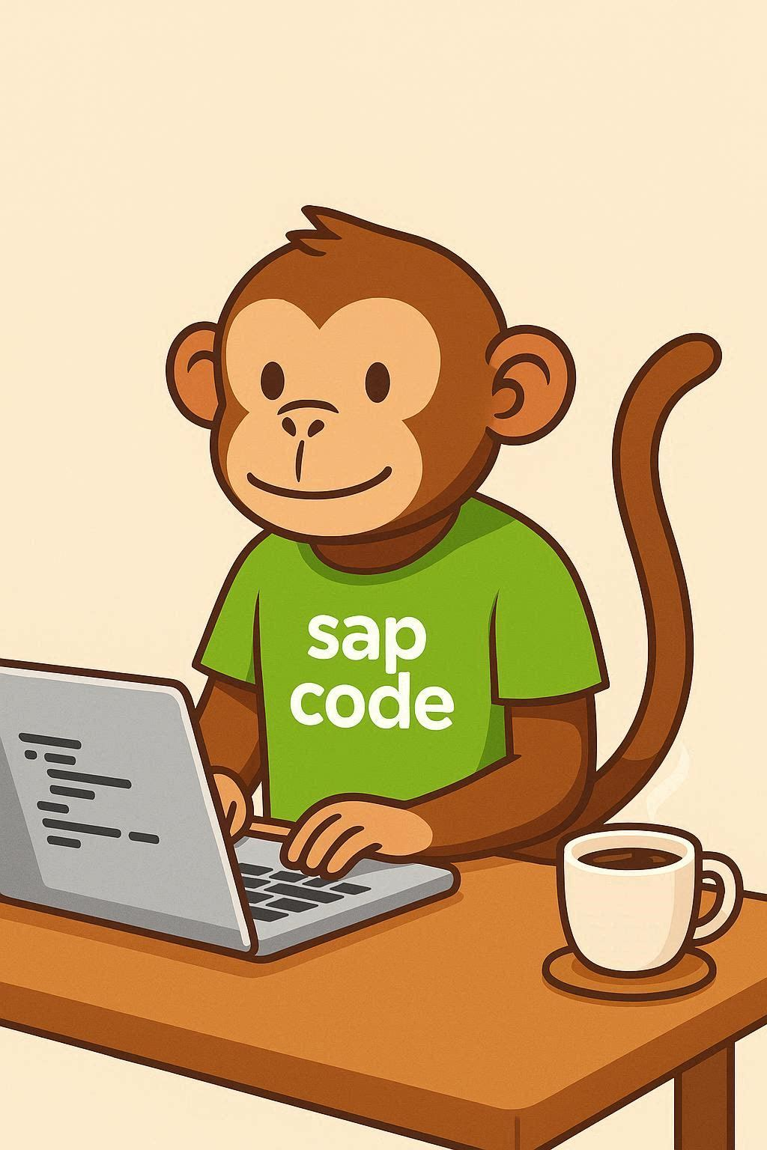
COMPANION DECK
Next-Generation
ABAP Development
More change in two years than the prior twenty
The new toolchain · Agentic AI · The migration agent · What it means for developers
sapcodemonkey.com · Verify roadmap dates against SAP before planning
Notes:
The honest through-line: separate what shipped from what's roadmap, and be straight about what changes for developers.

Slide 2
Assistance → agency
AI in ABAP is crossing from helping you code to owning a task.
2025 — Assistance
2026 — Agency
Explain legacy code
Generate RAP / CDS
Write unit tests
Context-aware suggestions
Autonomous collaborator
Owns a whole task
Runs multi-step flows
Human owns sign-off
2

Slide 3
The foundation ABAP never had
Two components separate development capability from the IDE.
YOUR CHOICE OF IDE + AGENT
Eclipse
VS Code
Copilot
Amazon Q
ABAP MCP Server
opens ABAP to the AI-agent ecosystem
ABAP Language Server
IDE-independent abstraction layer
ABAP backend (S/4HANA)
3
Notes:
This architecture is standard elsewhere. The news is it's arriving for ABAP — and it unlocks IDE and agent choice.

Slide 4
VS Code joins Eclipse
A widening of choice — not a wholesale switch, yet.
Eclipse (ADT)
VS Code
The environment for full-fledged ABAP development, today. Remains the recommended IDE until VS Code reaches feature parity.
GA planned Q2 2026. Initial scope is Fiori app development, more object types to follow. Direct access to modern coding agents.
Both share the same Language Server and MCP Server underneath — one foundation, two front doors.
4

Slide 5
The killer application: custom-code migration
Migrations don't fail on infrastructure — they bog down in custom code.
1
2
3
4
Understand
Analyze
Transform
Review
Read & explain the legacy code first
Run ATC readiness checks, categorize by complexity
Deterministic quick fixes, then AI fixes
Human signs off — governance & edge cases
The agent runs the routine loop; the developer owns review and the cases it shouldn't decide alone.
5
Notes:
SAP's stated principle: understand and explain before proposing changes. Hold them to it.

Slide 6
SAP'S TARGET
40%
targeted efficiency gain in
custom-code transformation work
Even discounted, that's the difference between a migration that drags and one that moves. Treat it as a target, not a guarantee — and verify against your own landscape.
6

Slide 7
What has shipped, what is roadmap
Marketing and reality are close but not identical — and dates slip.
SHIPPING (since 2025)
ROADMAP (2026, several mid-year)
Explain legacy ABAP & CDS
Generate RAP / CDS objects
Unit-test generation
Context-aware suggestions
ABAP-specific language model (analysis)
ABAP MCP Server — agentic layer
ADT for VS Code (GA)
Custom Code Migration agent
ABAP AI for Private Edition (2021+)
Consumption pricing on AI units
Check the current roadmap and your own licensing before you build a business case on any single date.
7

Slide 8
What it means if you write ABAP
It doesn't automate the developer away — but it moves the job.
WHAT SHRINKS
WHAT GROWS
Manual readiness-check remediation
Boilerplate generation
Line-by-line code adaptation
Reverse-engineering undocumented code
Reviewing generated code for correctness
Governing what an agent may change
Owning edge cases & accountability
Knowing when the agent is confidently wrong
8

Slide 9
THE THROUGH-LINE
The agent runs the loop.
Someone owns the sign-off.
Value moves from producing the work to judging it. In ABAP, that shift now has a name, a toolchain, and a shipping date. The developer who learns the agentic toolchain early becomes the person who supervises it — rather than the person it outpaces.
More at sapcodemonkey.com · Independent commentary, not affiliated with SAP.

